Slide 1
Welcome

Slide 2
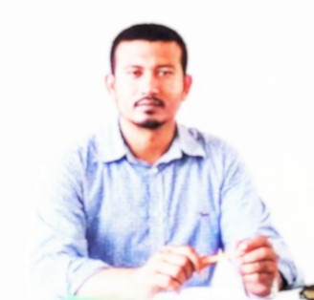
Introduction
Class:One
Subject:English
Unit: 2
Lesson: 4-6
Time: 40 mins
Md.Firoz
Assistant Teacher
Sagla Govt. Primary School
Borhanuddin, Bhola.

Slide 3
Learning Outcomes.
Students will be able to…..
Listening
1.1.1: Become familiar with English sounds by listening to common English words.
Speaking
1.1.1: Repeat after the teacher simple words and phrases.
1.1.2: Say simple words and phrases.
Reading
1.2.1: Recognize and read the alphabet both small and capital (Non-cursive)
Writing
1.2.1: To practice letter shapes/simple writing patterns etc.
1.2.1: Write non-cursive capital letters and small letters.

Slide 4
Now we’ll watch a video.

Slide 5
What can you see in these pictures?
apple
ant

Slide 6
Look, listen and say.
apple
ant

Slide 7
Look and say.
apple

Slide 8
Look and say.
ant

Slide 9
Look and say.
ant
apple
Click on

Slide 10
Look and say.

Slide 11
Listen and say.
apple
arm
ant
Click on

Slide 12
Say with me.
apple
a-p-p-l-e
a
ant
a-n-t
a
arm
a-r-m
a

Slide 13
Do lessons 4-6 from your textbook.

Slide 14
Individual work.
Say a word for “A”

Slide 15
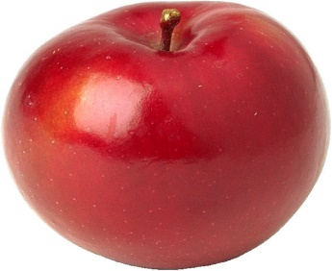
Pair work.
Matching the word with picture.
arm
apple
ant

Slide 16
Evaluation.
Say the word and underlined letter.
pple
A
a
nt

Slide 17
Home work.
Practise two new words for “A”

Slide 18
Thank You

