Slide 3
Presented by
SIMTA RANI SUTRA DHAR
ASSISTANT TEACHER
KALAMBARPUR G. P.S.
JAGANNATHPUR ,SUNAMGONJ.

Slide 4
warmup activities
review session

Slide 5
Introduce Of The Lesson
ENGLISH FOR TODAY
CLASS: THREE
UNIT: 02 LESSON:1-3
LESSON TITLE: introducing a teacher
TIME: 40 MINUTE
Date: 28-03-2020

Slide 6
learning outcomes
student will be able to learn--------
understand simple questions about students, family and friend.
Talk about people and objects.
Write word, phrases and sentence from the text.

Slide 7
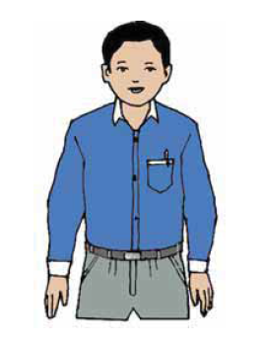
Look at the picture
W
C
W
what is the person’s name?
Mahbub Alam

Slide 8
Ss 30 years old
Mahbub alam
Teacher
Ss Primary School In Narail

Slide 9
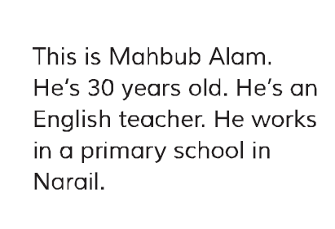
now open your book page no:04
Read

Slide 10
B
complete the table with Mahbub’s information.

Slide 11
pair work
What is the person’s name?
How old is he?
What dose he do?
Where dose he work?

Slide 12
Assessment
Read The Following Sentences . Write True Or False In Your Answers Script.
The parson’s name is Shamsul Alam.
He is 50 years old.
He is an English teacher.
He works in raj Shahi.
He works in a primary school.

Slide 13
HOMEWORK
Write Three Sentence About Mahbub Alam?

Slide 14
Thank you.

