Slide 1
Good morning
Welcome
today’s English class

Slide 2
Mst. Mursheda Begum
Assistant Teacher
Niz Baurbagh Wesr GPS
Kanaight,Sylhet

Slide 3
Class - One
Unit - 5
Lesson - 5
Kring kring telephone
Time- 40 minutes.
26.03.2020

Slide 4
Students will be able to…
4.1.1. Enjoy the rhythm
and music of simple rhymes.

Slide 5
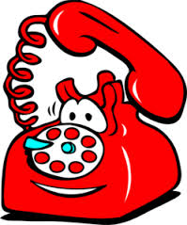
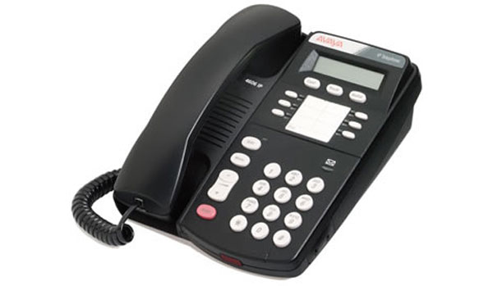
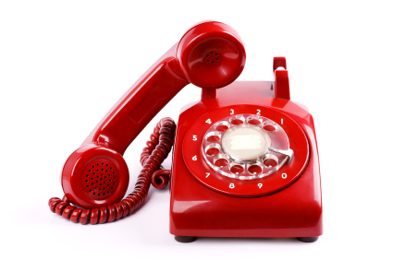
Do you like to See
some picture?
Let’s see.

Slide 6
Ring… ring…It’s the phone!

Slide 7
Hello hello!
I am a rat on a mat.

Slide 8
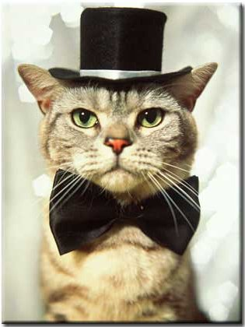
Is this the cat?
I am a cat in a hat.

Slide 9
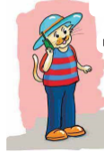
But I’m not at home !

Slide 10
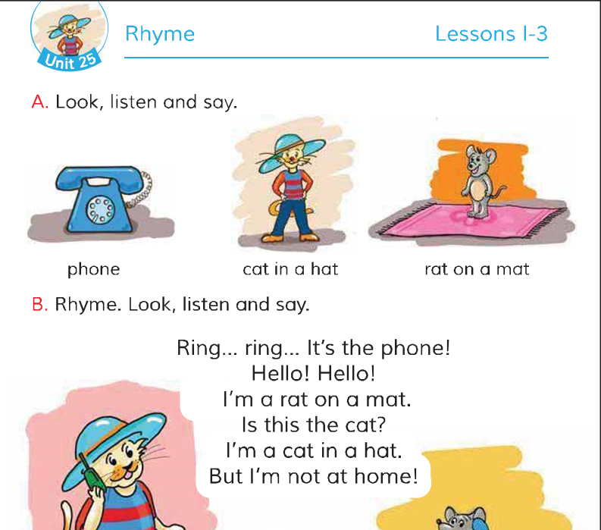
Open your book and look at the lesson
Page no-50 ,Lesson-1-3

Slide 11
New word
Mat
Phone
Rat
Hat
Ring
Cat

Slide 12
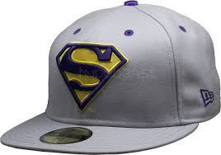
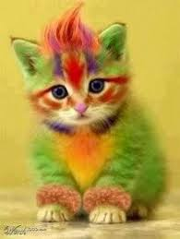
Group work
Think about the picture and tell the names of the word.
Group-B
Group-A

Slide 13
Are you want to listen the rhyme?
Keep quite and listen the rhyme.
Ring ring It’s the phone
Hello hello!
I am a rat on a mat.

Slide 14
Checking learning
Recite the rhyme with correct pronunciation
Ring… ring…It’s the phone!
Hello hello!
I am a rat on a mat.

Slide 15
Task
You Says the next line?
Ring ring It’s the phone
…………..
I am a rat on a mat.
…………………

Slide 16
Thanks to all

