Slide 1
Hide Slide
This is the 3rd multimedia content
on Prefixes & Suffixes series.
So, I would like you to watch out
the whole series and suggest for
creating better contents for all.
Notes:
(Only for teachers) after reading this slide, please hide this.

Slide 2
Notes:
Welcome to the students.

Slide 3
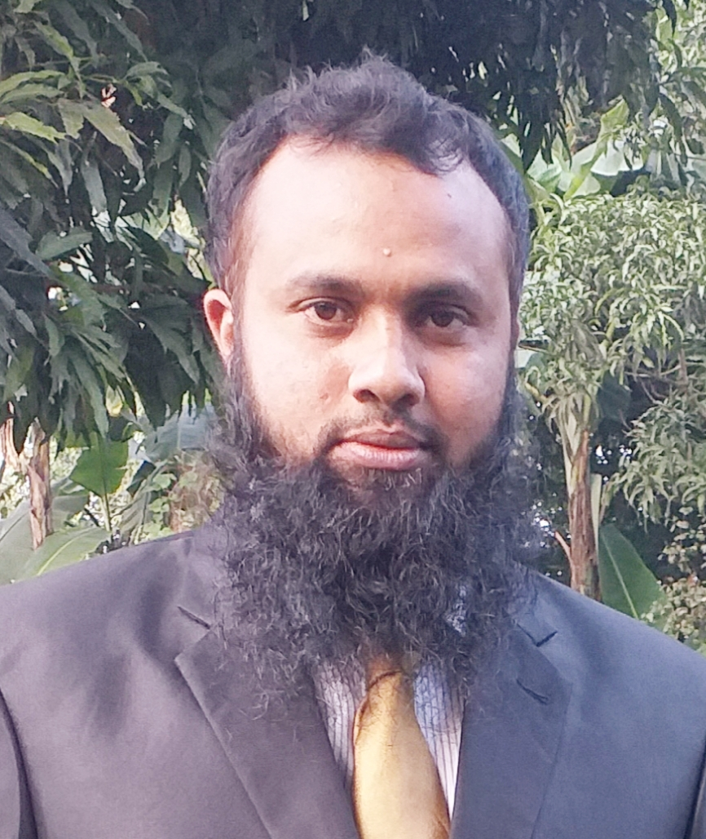
Introduction
Md. Jakirul Islam
BA (Hons’), MA in English, B.Ed, LL.B
Assistant Teacher of English
Shaitshala Adardha High School
& College
Brahmanpara, Cumilla
Subject: English 2nd Paper
Grammar (Time- 45 min)
Notes:
Introducing the teacher & the subject of the class to the students.

Slide 4
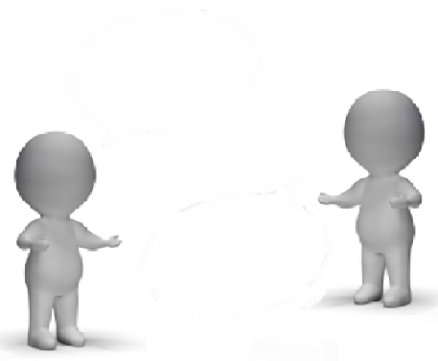
In the dialogue, Which words seem incorrect?
The story is interest .
interesting
Yes, it is
an attract story.
Now, these are Ok
attractive
Notes:
Preparation for declaring the lesson.

Slide 5
interest
ing
interesting
+
=
attract
+
ive
=
attractive
Today’s lesson is
What might be today’s lesson?
Suffixes (Part-3)
Notes:
Ask about today’s lesson & declaration fo the lesson.

Slide 6
Learning Outcomes
By the end of the lesson, students will be able
To identify prefixes of Adjective.
To add suffixes to make new words.
To make various Adjectives using suffixes.
Notes:
Clarification of the learning outcomes of this lesson.

Slide 7
Noun Phrase
academic
His (academy) result is good.
Adjective
+
Noun
In a Noun Phrase, an Adjective may sit before the Noun.
Suffix ‘ic’ has been used to make Adjective.
Notes:
Description of the use of Adjective adding suffix.

Slide 8
Noun Phrase
greedy
They are (greed) persons.
Adjective
+
Noun
In a Noun Phrase, an Adjective may sit before the Noun.
Suffix ‘y’ has been used to make Adjective.
Notes:
Description of the use of Adjective adding suffix.

Slide 9
We make environment danger .
dangerous
‘Make’ Verb
+
Object
+
Adjective
After ‘make’ Verb & Object, there will be an Adjective.
Suffix ‘ous’ has been added to make Adjective .
Notes:
Description of the use of Adjective adding suffix.

Slide 10
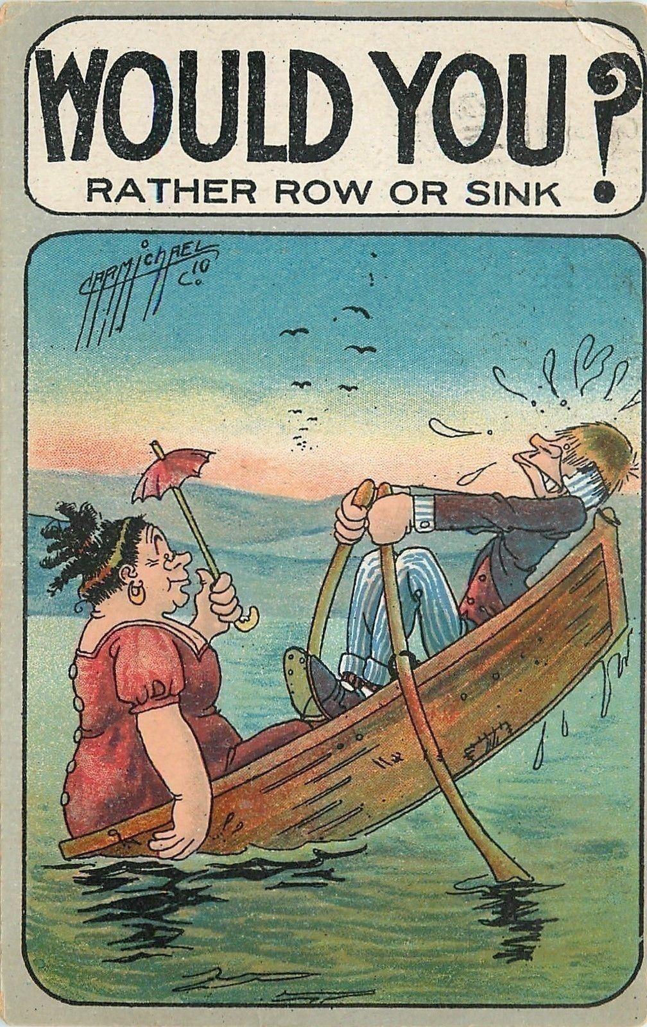
The boy is (tall) than the girl.
taller
Comparative
Degree
Wife is (large) than husband.
larger
In the comparative Degree of Adjective,
The suffix is ‘er’ ‘r’.
Notes:
Description of the use of Adjective adding suffix.

Slide 11
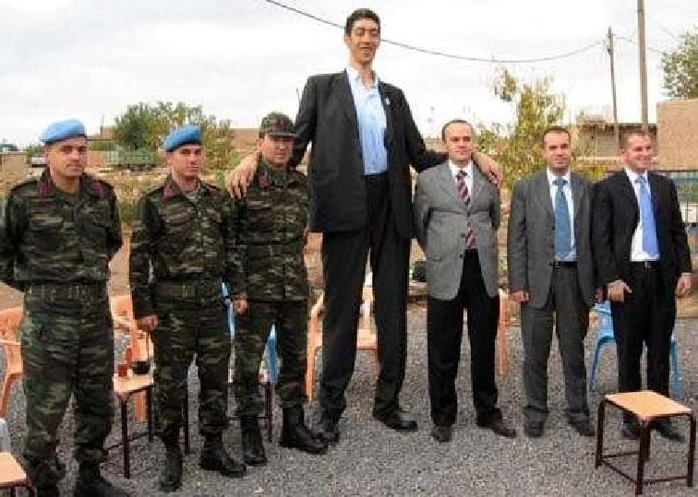
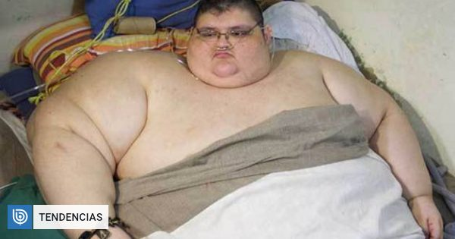
He is the (tall) man in the world.
tallest
Superlative
Degree
He is the (large)man in the world.
largest
In the superlative Degree of Adjective,
The suffix is ‘est’ ‘st’.
Notes:
Description of the use of Adjective adding suffix.

Slide 12
Pair Work
Time- 5 min
Make various Nouns
adding suffixes from below
ful
less
ed
ing
ive
ic
ous
y
al
ish
able
ant
pomp
beauty
+
+
beautiful
pompous
=
=
enjoy
rest
restless
+
enjoyable
+
=
=
reject
rejected
addition
additional
+
=
+
=
amuse
amusing
impress
+
=
+
impressive
=
tasty
+
=
child
childish
taste
+
=
import
important
+
=
hero
+
heroic
=
Notes:
Arrangement of a Pair Work. Monitor the work & give feedback.

Slide 13
Let’s see more Adjectives & Suffixes in Noun Phrase.
Adjective
Noun
Suffix of Adjective
significant
point
ant
dependent
men
ent
Article
Adjective
Noun
the
able
dependable
player
a
responsible
student
ible
Notes:
Description of the position of Adjective in the Noun Phrases.

Slide 14
Let us see more Adjectives in Noun Phrase.
possessive
Adjective
Noun
Suffix of Adjective
our
friendly
match
ly
his
childlike
attitude
like
Demostrative
Adjective
Noun
this
skillful
work
ful
these
restless
fighters
less
Notes:
Description ofe the position of Adjective in the Noun Phrases.

Slide 15
Evaluation (Flash Back) (The Use of Adjective)
‘Be Verb’
+
Adjective
‘become’ Verb
+
Adjective
‘remain’ Verb
+
Adjective
‘feel’ Verb
+
Adjective
‘make’ Verb
+
Object
+
Adjective
Notes:
Evaluation through the Flash Back of the use of Adjective in various positions of sentences to add suffixes of Adjective.

Slide 16
Evaluation (Flash Back) (The Use of Adjective)
Adjective
+
Noun
Article
+
Adjective
+
Noun
possessive
+
Adjective
+
Noun
Demonstrative
+
Adjective
+
Noun
Quantifier
+
Adjective
+
Noun
Notes:
Evaluation through the Flash Back of the use of Adjective in Noun Phrases to add suffixes of Adjective.

Slide 17
Group Work
Time- 8 min
Write down a list of suffixes which are used to make Adjectives.
al / ial / ical
ic
ish
able / ible
ing
like
ant / ent
ed
ly
ous
ful
y
ive
less
Notes:
Arrange a Group Work. Monitor & feedback.

Slide 18
Write down 3 Adjectives for each suffix.
Notes:
Giving Home Work.

Slide 19
for attending my class
Notes:
End of the class with greeting.

