Slide 1
Welcome to HHR PowerPoint presentation.
Notes:
Welcome slide.

Slide 2
Introduction
Hare krisna singha Assistant Teacher Nowdabash KMSC High school Hatibandha-Lalmonirhat. | Lesson Description Class-VIII English 2nd Paper
Notes:
Introduction of teacher and class.

Slide 3
Let us enjoy some image and texts to guess something.
Notes:
Leading to the lesson.

Slide 4
He said, “ Kick the ball.”
He ordered to kick the ball.
Notes:
Suspension of imperative order.

Slide 5
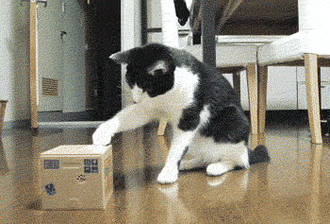
One said to another, “Don’t disturb me.”
One requested another not to disturb him.
Notes:
Suspension of ‘don’t’ sentence.

Slide 6
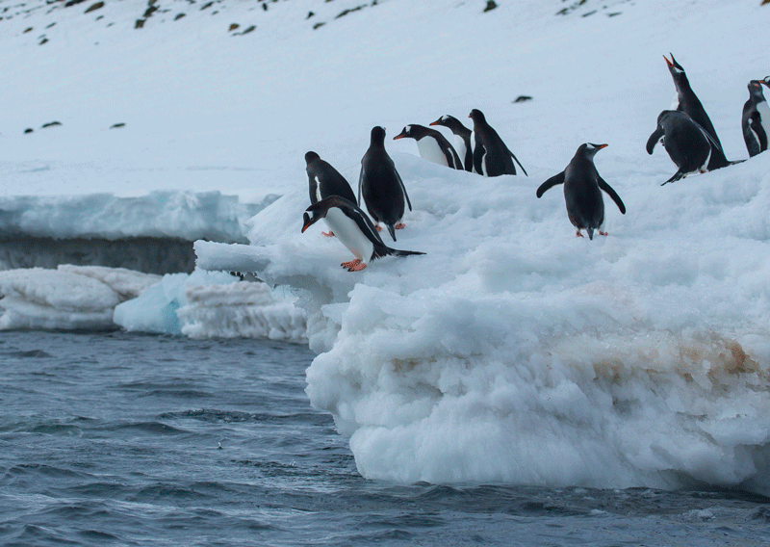
The penguin said,” Let’s jump into the sea.”
The penguin proposed that they should jump into the sea.
Notes:
Suspension of let sentence.

Slide 7
Tell me what are
we going to discuss today?
Direct and indirect speech of Imperative sentence.
Notes:
Taking out the lesson from the students.

Slide 8
Our today's lesson is---
Converting imperative sentence from direct to indirect speech.
Notes:
Lesson declaration.

Slide 9
Learning outcomes
After we have studied this lesson, we will be able to--
define imperative sentence
identify the patterns of imperative sentence
convert imperative sentence into indirect speech.
Notes:
Target to achieve from this class.

Slide 10
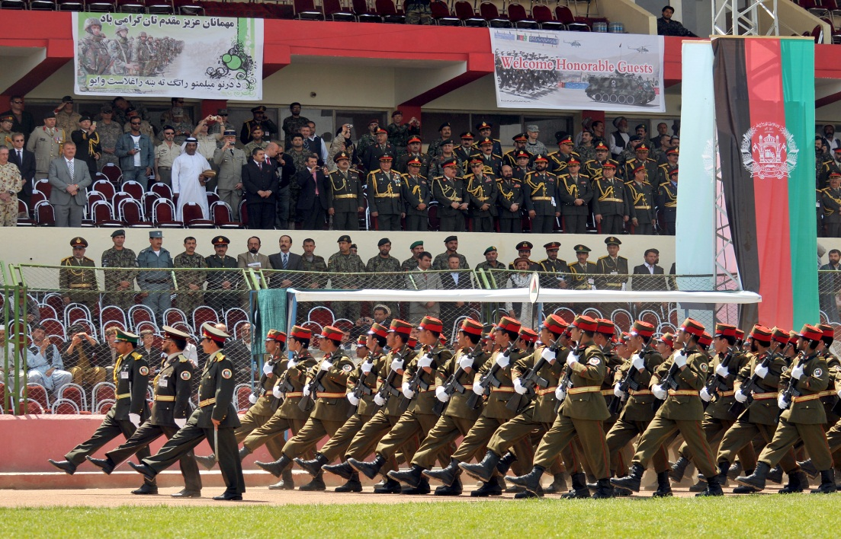
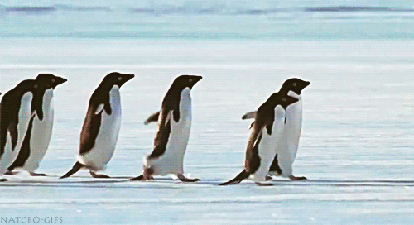
March on
Let’s go
What is Imperative Sentence?
Take it plz
Imperative sentence we mean order, request, advice and command.
Notes:
Definition of imperative sentence.

Slide 11
How is an imperative sentence formed?
Do it at once.
Pattern-1
1. Verb + object + Extension
Let me do this.
Pattern-2
2. Let + object + verb + Extension
Notes:
Formation & pattern of imperative sentence.

Slide 12
Basic in indirect
How reporting verb changes in pattern -1
To mean | Direct | Indirect
order | said to | ordered + object + to + reported speech
command | said to | commanded + object + to + reported speech
request | said to | requested +object + to + reported speech
advice | said to | advised +object + to + reported speech
Notes:
Structures of converting imperative from direct to indirect.

Slide 13
He said to me, “Do your duty.”
He ordered me to do my duty.
The commander said to
the soldiers , “March on.”
Direct speech
Indirect speech
The commander commanded
the soldiers to march on.
Notes:
Use of order and command.

Slide 14
He said to me, “Please help me.”
He requested me to help him.
Notes:
Where requested is used seen here.

Slide 15
Direct speech
He said to me, “Obey your parents.”
He advised me to obey my parents.
Indirect speech
Notes:
Class activities on imperative sentence.

Slide 16
How reporting verb changes in pattern -2
He said to me, “Let me drop the matter.”
Begins with | Direct | Indirect
Let | said to | requested+ object +that + subject + might +V₁ +Extension
He requested me that he might drop the matter.
He said to me, “Let us play the match.”
Let us/Let’s | said to | proposed to +object+ that we/they should + verb + extension
He proposed to me that we should play the match.
Notes:
Structure & examples of let/Let’s sentence.

Slide 17
Convert into indirect
He said to me ,” Let him go.”
My friend said to me,” Let us settle the dispute.”
The teacher said to the student, “ Follow elders.”
Rahim said, “ Let us swim in the pond.”
The man said to the boys,” Let them enjoy the game.”
Notes:
Class activities.

Slide 18
Notes:
Attracting the attention of the learners to the next.

Slide 19
He said to me, “Don’t disobey your parents.”
He advised me not to disobey my parents.
Mother said, “Don’t follow the bad.”
Mother advised not to follow the bad.
Notes
If the reported speech begins with imperative ‘Don’t’, you have to write ‘not to’ before reported speech while changing a direct speech into indirect speech.
Notes:
Use of don’t.

Slide 20
Pair Work
Group-1& 3
Write the structure of imperative sentence, pattern-1 and how the reporting verb changes. Write two examples.
Group-2 & 4
Write the structure of imperative sentence, pattern-2 and how the reporting verb changes. Write two examples.
Notes:
Revision of structure & example.

Slide 21
Home
Task
Change the following speech from direct to indirect—
The teacher said to me, “ Never tell a lie.”
Father said to his son, ”Go to school regularly.”
He said to me,” Please give me a hundred taka.”
“Get out,” said he.
“Let’s enjoy the match.”
Notes:
Assignment at home.

