Slide 1
Welcome to our English class

Slide 2
Identity
Manik Chandra Majumder
Senior Teacher (English)
Gazirhat High School
Senbag, Noakhali
Mobile No: 01717155169
Class : Nine-Ten
Subject : English 1st paper
Time : 50 Minutes
Date : 00/00/2019

Slide 3
Observe the following Pie Chart
A pie chart is used to show relationships between groups.
The two items being compared do not need to affect each other.
It's an easy way to show big differences.
Notice how easy it is to read a pie chart.

Slide 4
So, Dear Learners, Our Today’s Lesson is------
Describing Pie Chart

Slide 5
Learning outcomes
By the end of the lesson, students will be able to------
a) compare the information
b) tell and write what the chart and time period show,
c) describe the changes easily using data and number
from the chart,
d) talk about similarities and differences between the
groups shown.

Slide 6
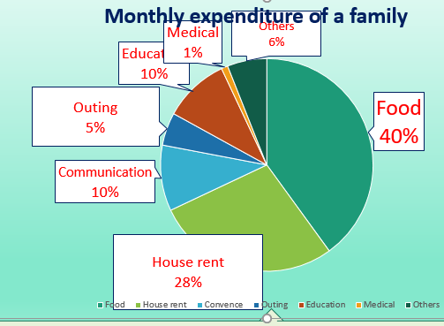
Let’s observe the pie chart
Discus in a group about the percentage of expenditure spent for seven sectors.

Slide 7
Observe the data
Others covers 6% area
Medical covers 1% area
Education covers 10% area
Outing covers 5% area.
Food covers 40% area of the circle.
Communication covers 10% area
House rent covers another 28% area.

Slide 8
Let’s Analyzing the verb formation for describing the graph.
Describe/illustrate/ show : (verb formation)
Present Tense
I describe/illustrate/show/reveal
You describe/illustrate/show/reveal
He/she/it describes/illustrates/shows/reveals
We describe /illustrate/show/reveal
They describe/ illustrate/show /reveal
-ing form :describing illustrating/showing
past simple : described/illustrated/showed/revealed
past participle : described/illustrated/showed/revealed

Slide 9
Compare and contrast the expenditures with each other.
House rent sector is less than food sector but greater than education, communication and outing sector.
The pie chart reveals food sector is greater than house rent sector.
Communication and education is in same position but less than food and house rent sector
Outing is less than education and communication but greater than medical sector

Slide 10
Observe the data and compare the activities with other.
For medical purpose the family spends1% of it’s total expenditure.
Family goes for outing in each month and for this it spends 5% of its total expenditure.
Highest portion of family expenditure goes for food and it is 40% of the total expenditure and shown in the first position in the chart.
10% expenditure goes for communication and same portion is spent for education. These two sectors are in the third position and 30 % less than food and 18% less than house rent.
Apart from these specific expenses the family has some other expenditure that has been shown as ‘others’. For ‘others’ the family spends 6% of its total monthly expenditure.
The family spends 28% for house rent. It is in the second position in the chart which is (40-28)= 12% less than food sector.

Slide 11
Let’s observe the chart and make a summary
Summary: The Pie chart shows the monthly expenditure of a family. From the chart it is clear that the family’s highest portion of monthly expenditure goes for food and it is 40% of the total expenditure. The family spends 28% for house rent. It is in the second position in the chart which is (40-28)= 12% less than food sector.

Slide 12
-------10% expenditure goes for communication and same portion is spent for education. These two sectors are in the third position and 30 % less than food and 18% less than house rent. Family goes for outing in each month and for this it spends 5% of its total expenditure.

Slide 13
--------For medical purpose the family spends1% of it’s total expenditure. Apart from these specific expenses the family has some other expenditure that has been shown as ‘others’. For ‘others’ the family spends 6% of its total monthly expenditure.

Slide 14
------------However, the pie chart reveals that the family is very conscious and well planned family. It is also understood that the family realizes the importance of education and recreation.

Slide 15
Summary of the chart at a glance :
The Pie chart shows the monthly expenditure of a family. From the chart it is clear that the family’s highest portion of monthly expenditure goes for food and it is 40% of the total expenditure. The family spends 28% for house rent. It is in the second position in the chart which is (40-28)= 12% less than food sector. 10% expenditure goes for communication and same portion is spent for education. These two sectors are in the third position and 30 % less than food and 18% less than house rent. Family goes for outing in each month and for this it spends 5% of its total expenditure. For medical purpose the family spends1% of it’s total expenditure. Apart from these specific expenses the family has some other expenditure that has been shown as ‘others’. For ‘others’ the family spends 6% of its total monthly expenditure. However, the pie chart reveals that the family is very conscious and well planned family. It is also understood that the family realizes the importance of education and recreation.

Slide 16
Evaluation
Complete the sentences with appropriate words.
realizes
shown
expenses
expenditure
position
highest
total
than
spends
shows
The Pie chart a)--------- the monthly expenditure of a family. From the chart it is clear that the family’s b) ---------- portion of monthly expenditure goes for food and it is 40% of the total expenditure. The family c) -------- 28% for house rent. It is in the second position in the chart which is (40-28)= 12% less d) ------- food sector. 10% expenditure goes for communication and same portion is spent for education. These two sectors are in the third e) -------- and 30 % less than food and 18% less than house rent. Family goes for outing in each month and for this it spends 5% of its total f) ---------------. For medical purpose the family spends1% of it’s g) -------- expenditure. Apart from these specific h)-------- the family has some other expenditure that has been i) ----------- as ‘others’. For ‘others’ the family spends 6% of its total monthly expenditure. However, the pie chart reveals that the family is very conscious and well planned family. It is also understood that the family j) --------- the importance of education and recreation

Slide 17
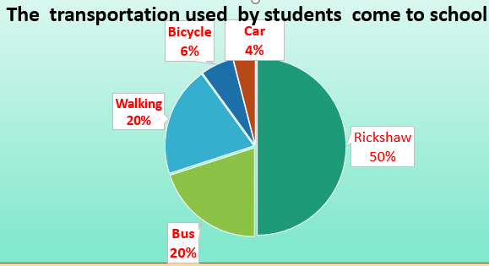
Home work
The pie chart shows the percentage of transportation used by students to come to school. Now write a description of the chart in your exercise book.

Slide 18
Thank you all

