Slide 1
Welcome

Slide 2
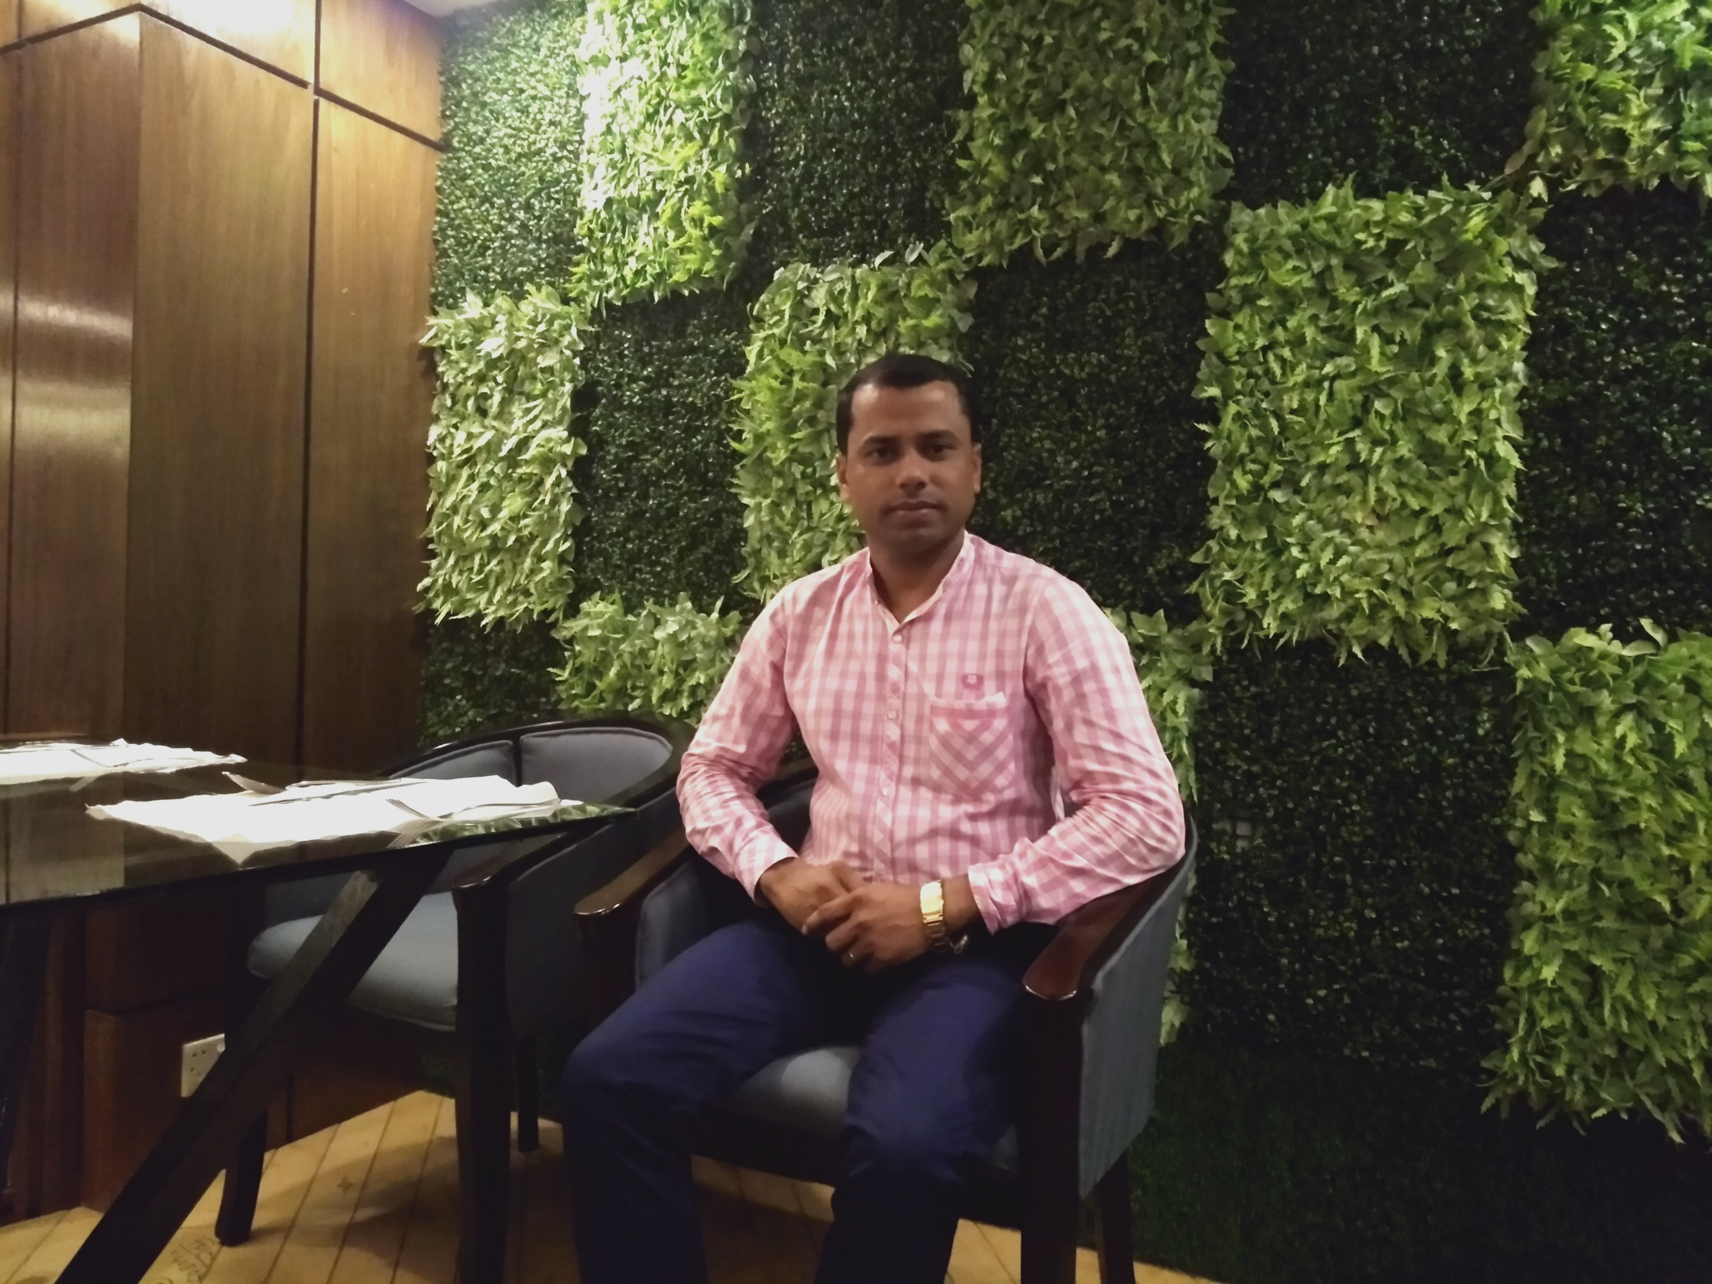
M.K.R. Manik
Khasgaon GPS
Chhatak
Sunamganj
01712-114197
Unit: 23
Lesson: 1-3 (B)
29032020
Time: 40 Mnts

Slide 3
Good morning students.
How are you today?
Let’s sing the good morning song.

Slide 4
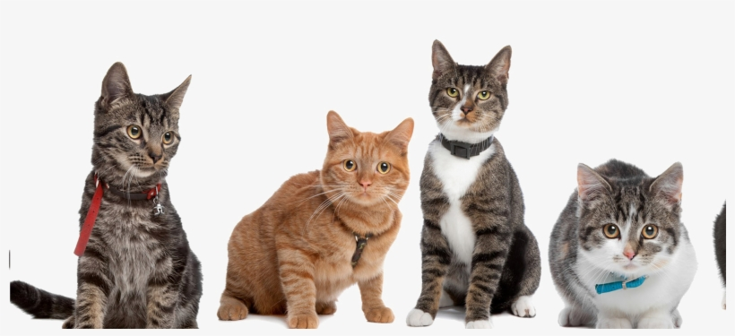
Look at the picture
What do you see in the picture?
Can you guess what’s our today’s lesson?
Ans: Some cats.

Slide 5
Our today’s lesson is…
What do they do?

Slide 6
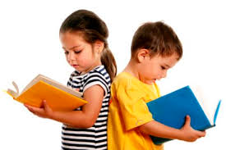
Students will be able to…
1.5.1 read simple sentences with proper
pronunciation and stress;
5.1.3 read text.

Slide 7
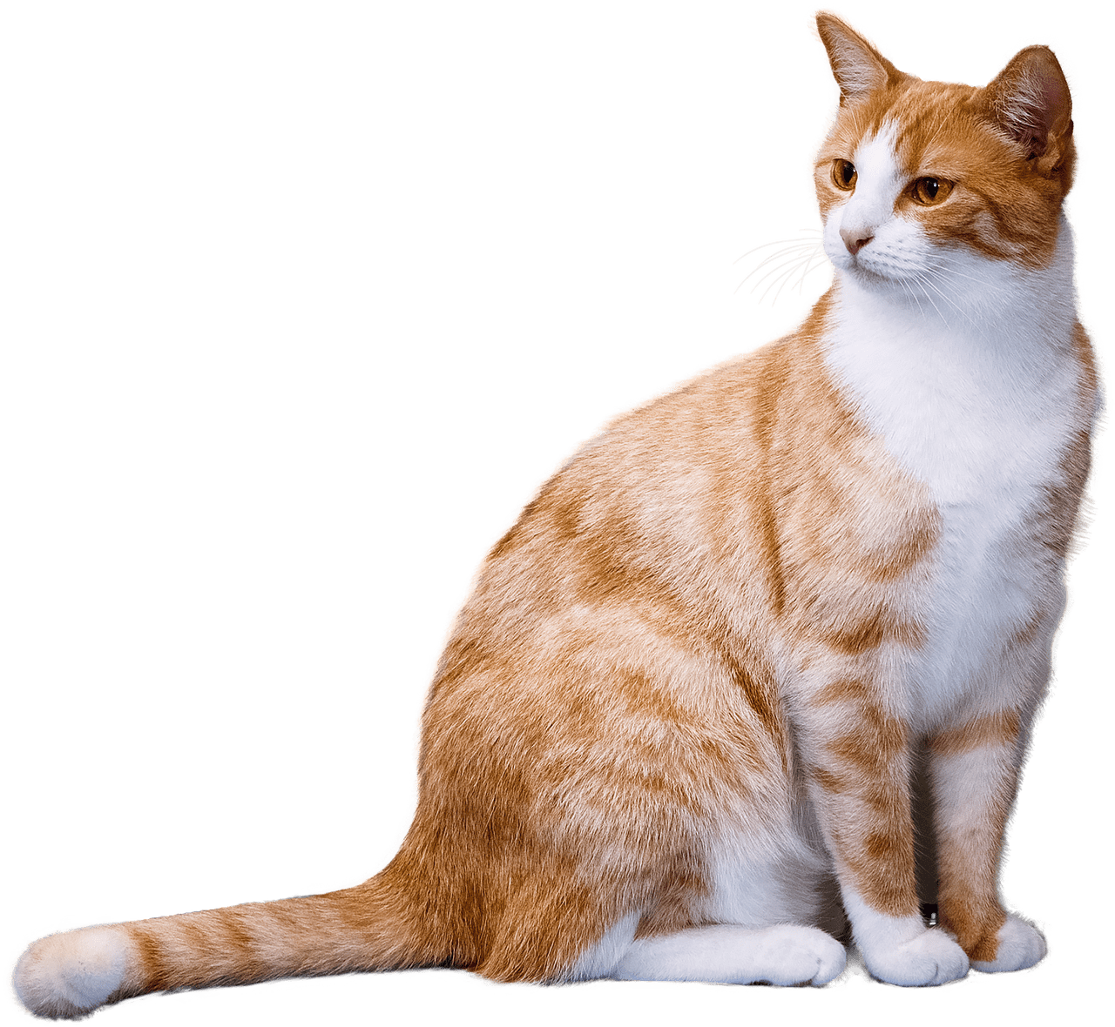
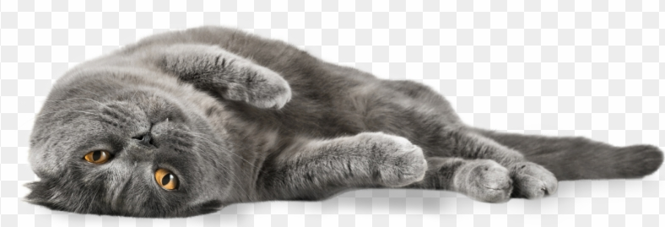
Look and Read.
I am a cat.
In the morning, I’m lazy and slow.
I get up late.

Slide 8
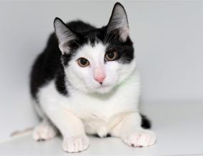
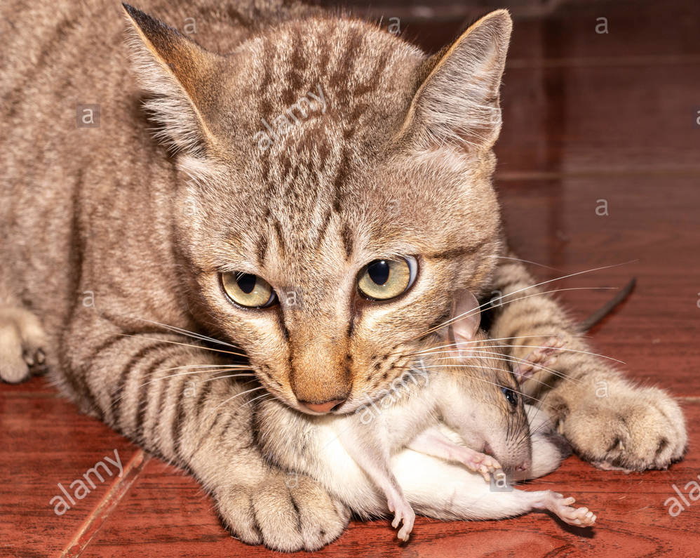
Look and Read.
In the afternoon, I’m active.
I catch rats. I’m quick.

Slide 9
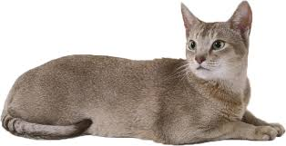
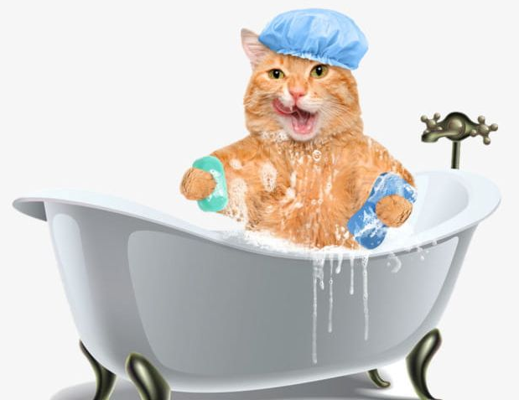
Look and Read.
I’m a clean animal.
I wash myself everyday.

Slide 10
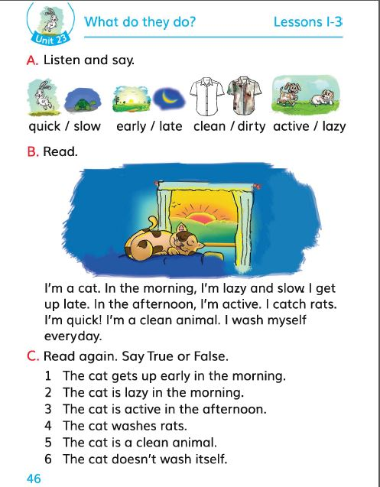
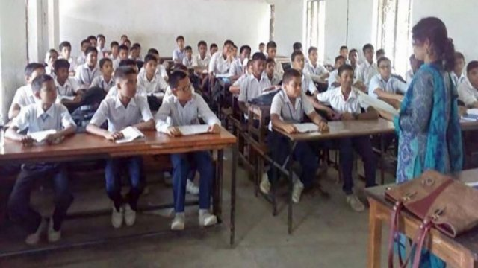
Now, open at page 46 of your textbook.

Slide 11
Now, listen to the Audio of the text.
Listen to the Audio again and repeat after it.

Slide 12
Students’ silent reading.
Students will read the text silently.

Slide 13
Individual Work.
Let’s learn new words from the text.
New Words
Lazy
Catch
Clean
Wash

Slide 14
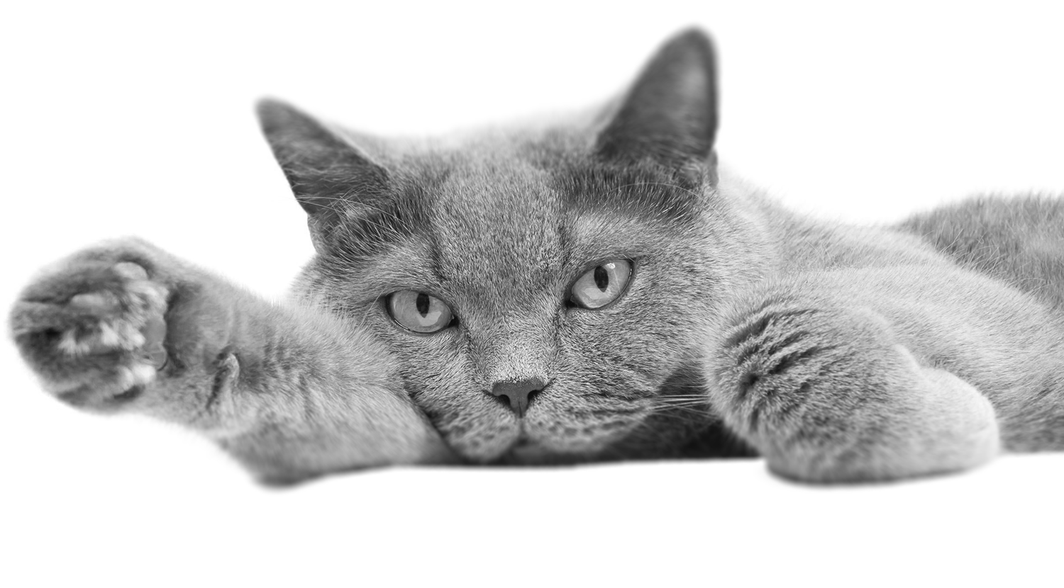
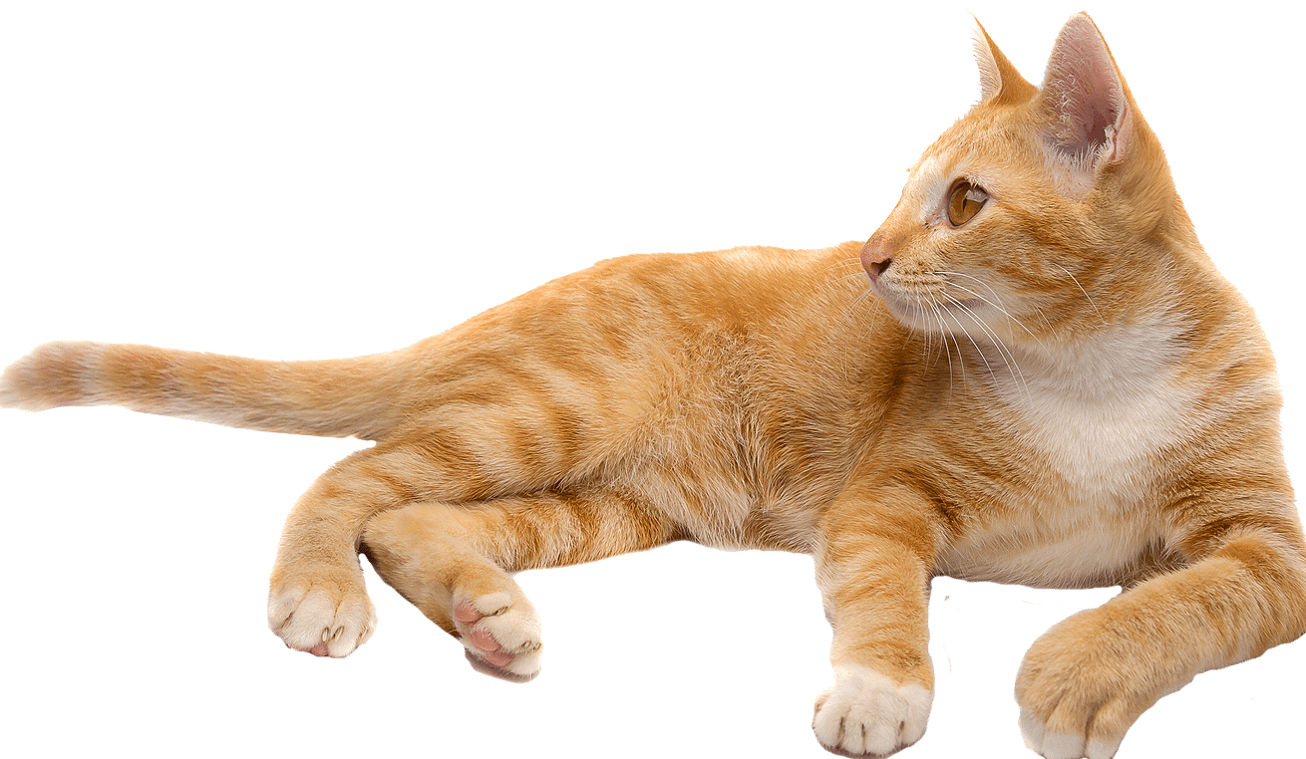
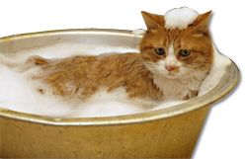
New words with meanings.
Lazy
Idle
Catch
Hold
Clean
Tidy
Wash
Bathe

Slide 15
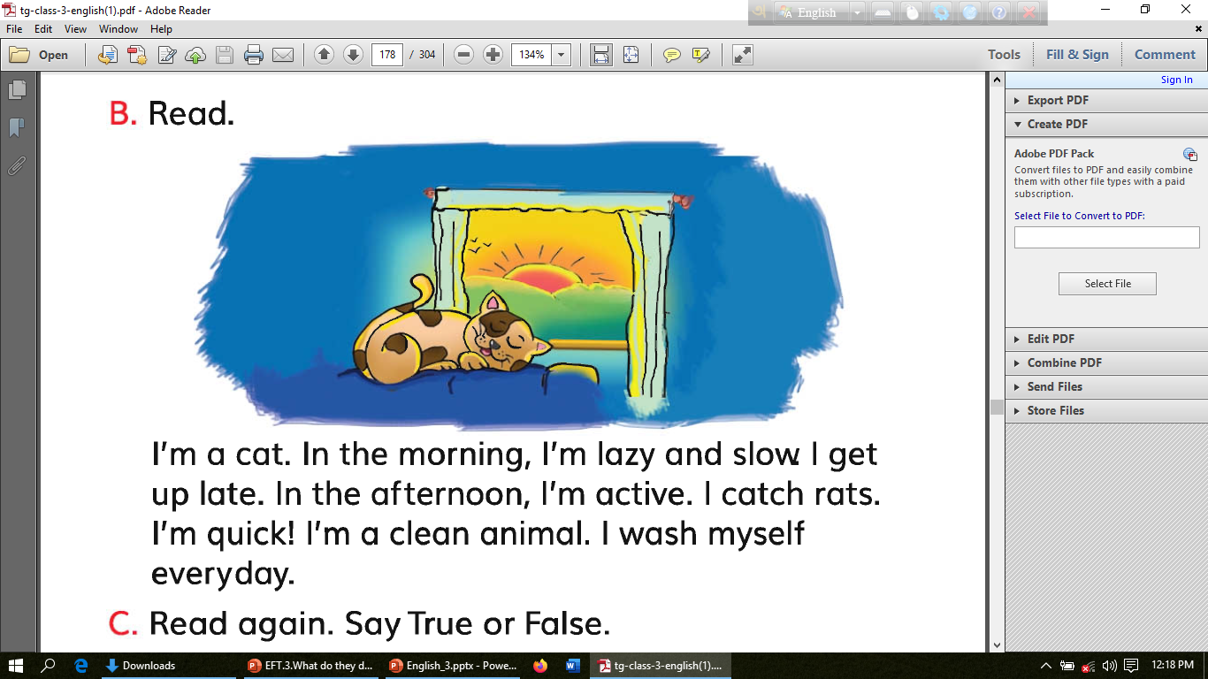
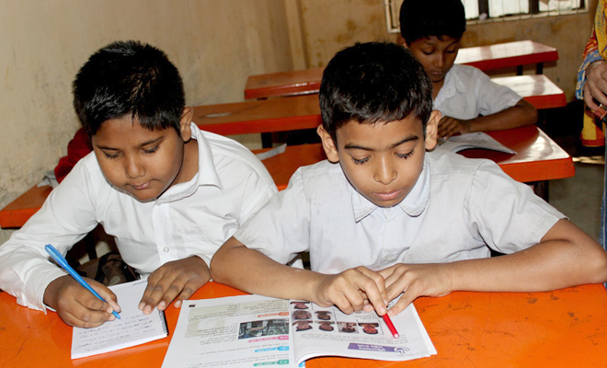
Let’s work in pairs.
Everyone will read out the text to other in pairs.

Slide 16
Group Work
Write three activities of the cat in
poster papers discussing in groups.

Slide 17
Evaluation
Write the answers of the following questions in your own notebooks.
When the cat is lazy and slow?
What does the cat catch?
Answers:
In the morning the cat is lazy and slow.
The cat catches rats.

Slide 18
Home Task
You will write 5 sentences
about your Pet Cat.

