Slide 1
Welcome to our English class

Slide 2
Identity
Manik Chandra Majumder
Senior Teacher (English)
Gazirhat High School
Senbag, Noakhali
Mobile No: 01717155169
Email:manikmajumder01@gmail.com
Class : Nine-Ten
Subject : English 1st paper
Time : 50 Minutes
Date : 00/00/2020

Slide 3
Dear students, observe the following sentences.
In spite of my going his house, he did not meet me.
I went to his house but he did not meet me.
Though/Although I went to his house, he did not meet me.
What kind of changes do you observe in the sentences ?
Transformation of Simple to Compound & Complex

Slide 4
Our Today’s topic is-----
Simple
Compound

Slide 5
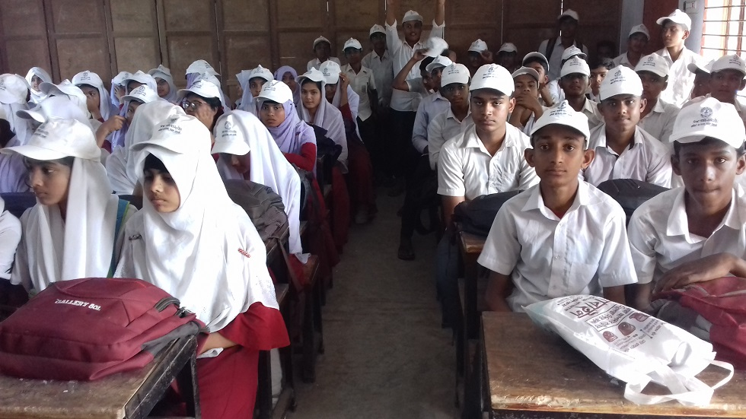
Learning Outcomes
At the end of the lesson the students will be able to
identify simple, compound & complex sentences,
make structures of each form of sentences,
change the simple form into compound.

Slide 6
The simple sentence to compound.
Simple sentence start with In spite of ----------to compound
Structure: Compound: 1st clause possessive turn into sub +being turn into be verb/having turn into have/ main verb with ing takes verb according to 2nd clause + rest of 1st clause +but + 2nd clause.
Simple: In spite of my going to his house, he did not meet me.
Comp'd: I went to his house but he did not meet me
Sim: In spite of going there, I could not meet him.
Comp'd : I went there but I could not meet him.

Slide 7
Simple sentence start with Because of -----------to compound.
Structure: Compound: 1st clause possessive turn into sub +being turn into be verb/having turn into have/ main verb with ing takes verb according to 2nd clause + rest of 1st clause +and/and so + 2nd clause.
Simple: Because of (his) being ill, he could not attend meeting.
Comp’d : He was ill and he could not attend meeting.
Simple: Because of his illness, he could not attend meeting.
Comp’d : He was ill and he could not attend meeting.
Simple: Because of (his) studying hard, he made a good result.
Comp’d : He studied hard and he made a good result.

Slide 8
Sim. Sent. start with pre. participle (v+ing /being/ having) ---to comp’d.
Structure: Compound: 2nd clause sub +being turn into be verb/having turn into have/ main verb with ing takes verb according to 2nd clause + rest of 1st clause +and + 2nd clause.
Simple : Waking up , I received the phone call.
Comp’d : I woke up and I received the phone call.
Simple : Being disappointed, he resigned from the post.
Comp’d : He was disappointed and he resigned from the post.
Simple : Having forgotten him, I went to work.
Comp’d : I had forgotten him and I went to work.

Slide 9
Simple sentence start with By+ gerund (v+ ing ) ----to compound
Structure: Verb + Extension and + 2nd clause.
Sim: By drinking milk, you will get vitamin.
Comp'd : Drink milk and you will get vitamin.
Sim: By working hard, you will be successful.
Comp'd : Work hard and you will be successful.

Slide 10
Simple sentence start with Without+ gerund (v+ ing ) ----to compound
Structure: Verb + Extension + or + 2nd clause.
Simple : Without working hard, you will fail.
Comp'd : Work hard or you will fail.
Simple : Without working hard, you will be failure.
Comp'd : Work hard or you will be failure.

Slide 11
Simple sentence with Infinitive (to +v)----to compound
Structure: Sub +verb + Extension + and +Sub+ suitable V + ------.
Simple : He reads attentively to pass.
Comp’d : He reads attentively and he wants to pass
Simple : He worked hard to succeed.
Comp'd : He worked hard and he wanted to succeed.

Slide 12
Simple sentence with Adjective --------to compound
Structure: Sub +verb + Adj. + Noun +and +Sub+ suitable V + ----.
Simple : Tareq is a meritorious student.
Comp’d :Tareq is a student and he is meritorious.
Simple :Runa is an intelligent girl.
Comp'd : Runa is a girl and she is intelligent.

Slide 13
Simple Sentence with too + Adjective +to +V-------to compound
Structure: Sub+ V +very + Adj. +and +Sub+cannot/ couldnot +v---.
Simple : He is too weak to walk
Comp’d : He is very weak and he cannot walk
Simple: The boy was too short to touch the roof.
Comp'd: The boy was very short and he could not touch the roof.

Slide 14
Some other simple sentences for practising .
Simple: Health is wealth.
Comp’d : It is health and it is wealth
Comp’d: She bought a television.
Comp’d : It is television and she bought it

Slide 15
Some other simple sentences for practising .
Simple: He lives at Cumilla
Comp’d: It is Cumilla and he lives here.
Simple: We went to Dhaka on Friday.
Comp’d: It was Friday and we went to Dhaka.

Slide 16
Some other simple sentences for practising .
Simple: I saw a bird flying in the sky.
Comp’d: I saw a bird and it was flying in the sky.
Simple: I saw a boy running.
Comp’d: I saw a boy and he was running.

Slide 17
Some other simple sentences for practising.
Simple: At the time of his going to school, I saw the boy.
Comp’d: The boy was going to school and I saw him.
Simple: At the time of my taking breakfast, he came to my house.
Comp’d: I was taking my breakfast and he came to my house.

Slide 18
Evaluation
Transform the following simple sentences to compound.
She reads attentively to pass.
The beggar was too ill to beg.
They work hard to earn money.
Health is wealth.
Sitting on chair, the girl was reading on a book.
Finding me, she acted madly.
The tea being hot, I could not drink it.

Slide 19
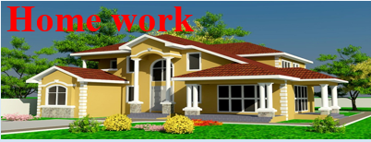
Make the simple sentences into compound.
He works hard to shine in life.
The boy is too small to carry the lo
At the time of their playing, it began to rain.
The writer took a small cabin.
By running fast, you can get the train.
Without giving up smoking, your health will be deteriorated.
The sun having set, they stopped playing.

Slide 20
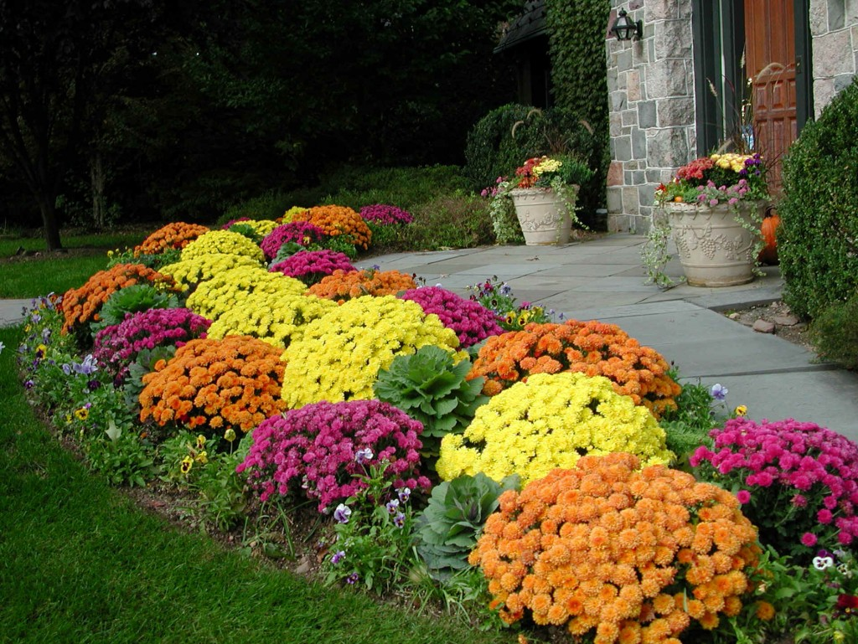
Thank you all
Good bye

