Slide 1
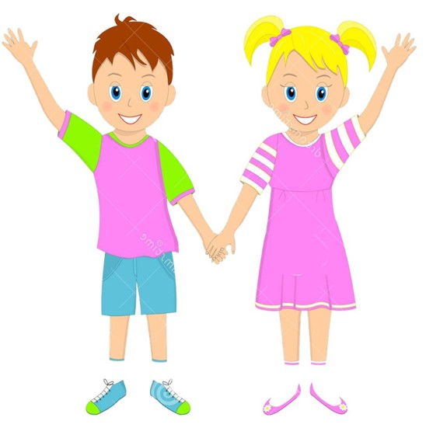

Slide 2
Sub: English
Class: Two
Md. Mushfikur Rahman
ASISSTANT TEACHER
PARGOBINDOPUR GOVT. PRIMARY SCHOOL
BIRAMPUR,DINAJPUR.
Lesson : Alphabet
Parts of the lesson: K-O(Activity-A)
Page No-7

Slide 3
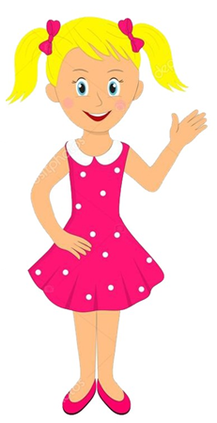
Safety environment by greetings song.
Hello! Hello! How are you?
I’m well, I’m good.
I’m great, I’m wonderful.
Hello! Hello! How are you?
I’m fine! I’m great today.

Slide 4
What’s the name of the letter?
Aa
Hh
Cc
Ff
Ee
Dd
Gg
Bb
Jj
Ii
Now try to say-
What can be the topic of our today’s lesson?

Slide 5
Our today’s lesson is--
Alphabet (K-O)
Activity-A

Slide 6
LEARNING OUTCOMES
By end of the lesson students will be able to-------
Listening:1.1.1 become familiar with English sounds by listening to common
English words.
Speaking: 1.1.1 repeat after the teacher simple words and phrases with proper sounds
and stress.
1.1.2 say simple words and phrases with proper sounds and stress.
Reading: 1.2.1 recognize and read the alphabet both small and
capital (non-cursive)
1.3.1 recognize and read the names of objects having the same initial and
final sounds

Slide 7
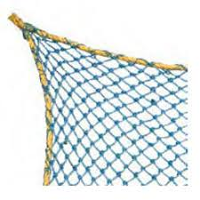
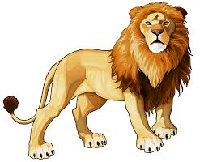
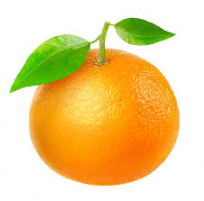
What is this?

Slide 8
K k
L l
M m
N n
O o
Kite
Lion
Mango
Net
Orange
Now repeat after me.

Slide 9
Capital letters
L
O
o
l
M
m
N
K
k
n
Small letters

Slide 10
What is this?
kite
What is the letter’s name?
What is the letter’s sound?

Slide 11
What is this?
lion
What is the letter’s name?
What is the letter’s sound?

Slide 12
What is this?
mango
What is the letter’s name?
What is the letter’s sound?

Slide 13
What is this?
net
What is the letter’s name?
What is the letter’s sound?

Slide 14
What is this?
orange
What is the letter’s name?
What is the letter’s sound?

Slide 15
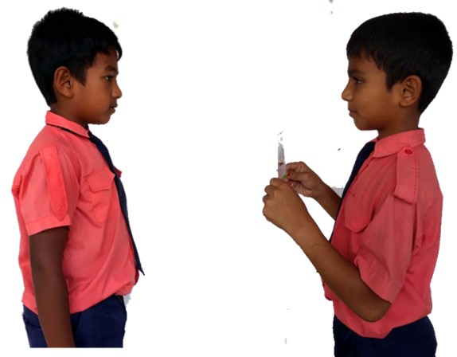
Pair work
m
What’s the letter’s name/sound?
One more

Slide 16
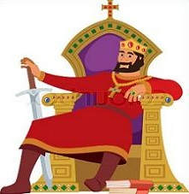
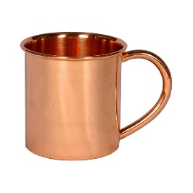
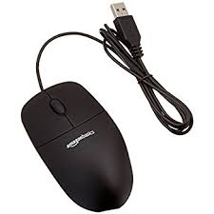
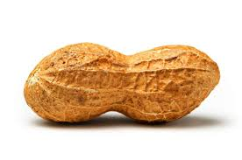
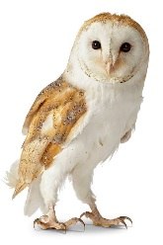
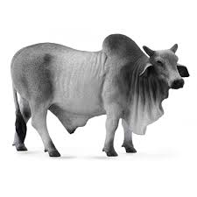
key
king
k
leaf
l
ladder
mug
m
mouse
nut
n
nest
owl
o
ox

Slide 17
Read and say.
lion
net
mango
orange
kite
orange
kite
net
lion
mango
lion
net
mango
orange
kite
orange
kite
net
lion
mango

Slide 18
One day one word
What is this?
lion
সিংহ
Spell out the word - SGW

Slide 19
Find out the letters that are made by the word lion.
h
i
d
a
o
t
l
k
c
n
Find out the correct word.
loin
lion
lione
lino
loni

Slide 20
Say the missing letter.
li--n
l--on
--ion
lio--
Write the word to your notebook.
Date-
/ /20
lion
লায়ন
সিংহ

Slide 21
Home work
Page 7 will be well read and written.

Slide 22
That’s all for today. Goodbye. See you tomorrow.

