Slide 1
WELCOME

Slide 2
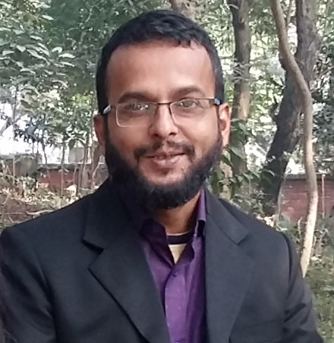
MD.MAIDUL ISLAM
Assistant Teacher
26 Akalom gps
Nesarabad,Pirojpur

Slide 3
Class : 2
Sub : English
Unit : 19
Lesson : 4-6
Lesson Title : Shapes and Numbers
Time : 45 minutes
Date : 02.03.2020

Slide 4
Enjoy a video

Slide 5
Learning Outcomes
Speaking :
1.1.1 Repeat after the teaches simple words and phrases with proper
sounds and stress. Sounds and stress.
1.1.2 Say simple words and phrases with proper sounds and stress.
Writing :
2.1.1 Write cardinal numbers up to 30.

Slide 6
Shapes And Numbers

Slide 7
What is This?

Slide 8
How many squares?
30

Slide 9
How many circles?
10

Slide 10
How many triangles?
23

Slide 11
How many rectangles?
10

Slide 12
GROUP WORK
GROUP- SHAPE
Draw a Square, a Rectangle, a Circle and a Triangle
GROUP -CIRCLE
Write cardinal numbers 1 to 15

Slide 13
EVALUATION
1.Read & say.
Circle , rectangle, square, triangle
2.Count & write the numbers.

Slide 14
HOME TASK
Make a triangle with paper

Slide 15
THANKS
THANKS
THANKS

