Slide 2
IDENTITY OF TEACHER
Masuma begum
Assistant teacher
Mohishkher GPS
Companigonj, Sylhet

Slide 3
Identity of lesson
Class: Five
Subject: English

Slide 4
Now we’ll watch a video

Slide 5
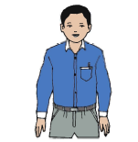
Look at the picture
Saikat’s father
Saikat’ mother
Saikat

Slide 6
Todays lesson is
Saikat’s family
Saikat Islam lives……………and neighbours.

Slide 7
Learning Outcomes
By the end of the lesson the students will be able to
3.2 to undersstand questions about family and friends
1.1 to say words,phrases and sentences with proper sounds stress and intonation.
1.7 to read paragraph and other texts.
8 to make sentences using words and phrases, following instructions.

Slide 8
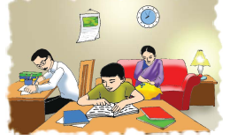
Look at the picture
Think about it and discuss with your partners.

Slide 9
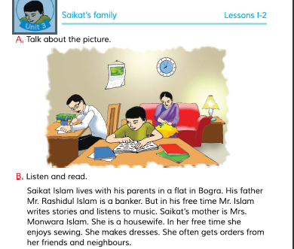
Open your book and read the text

Slide 10
New words identify
flat
banker
Free time
listen
sewing
neighbours

Slide 11
Answer the questions
What is Saikat’father ?
What does Saikat’s mother do ?

Slide 12
Pair work
Read the text in pairs

Slide 13
Write True or False
Saikat is a student of class 5.
Saikat’s father is a teacher.
In her free time Mr Islam writes poem.
Saikat’s mother is a banker.
Saikat lives in Dhaka.

Slide 14
Evaluation
Write 5 sentences about Saikat’s family.

Slide 15
Homework
Write 5 sentences about your family

