Slide 1
WELCOME

Slide 2
IDENTITY
MD.MUKUL MIA Assistant teacher( English) M.A Sattar Adarsha high school Kurigram. Email:mukulict30@gmail.com mobil: 01717171741.
CLASS:TEN
SUBJECT:ENGLISH(2ND)
TOPIC: TENSE (future TENSE)
DATE:06/02/2016

Slide 3
LEARNING OUTCOMES
At the end of the lesson, students will be able to use…
01. Definition of tense
02 Kinds of future Tense
03. Sentence making and sentence transferring
04. Tense practice with structure

Slide 4
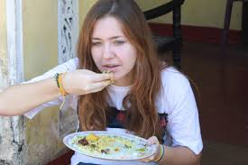
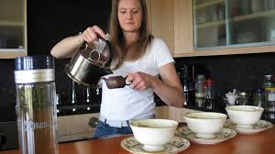
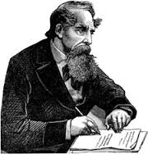
The baby will look very cute
She will be eating rice
A woman will have making tea.
The writer will have been writing a poem.

Slide 5
HERE
Look, eating, making, writing
Indicates
Time
Tense

Slide 6
What is the definition of Tense?
The time of the action of verb is called “Tense’’
What does future tense means?
When something is done in future time is called future tense
future Tense(kinds of future Tense)
future Indefinite
future continuous
future Perfect
future Perfect continuous

Slide 7
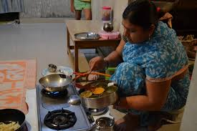
Subject-Verb agreement
Subject(he/she/It/any singular name) takes helping verb
shall/will/shall be/will be/shall have/shall have/shall have been/shall have been.
She will cook rice.
future Indefinite Tense
The structure of future Indefinite tense
Sub+ (shall/will+(main)v1+ob/exten.

Slide 8
The girl will be drawing the picture.
Future continuous tense
Structure:
Sub+ shall be/will be +v1+ing+ob/exten.

Slide 9
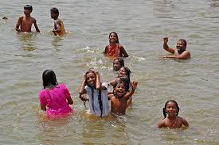
He will have writen a letter.
Fure Perfect Tense
Struct:Sub+shall have/will have+main v3+ob/exten

Slide 10
Pair work
Make some sentences in future tense using the words
Write ,Eat, Draw ,Go, Buy
Group Work:
Change the following sentences into future continuous
01.She writes a letter
02.Nahid does the work
03.She goes to school.
04. The girl eats a mango.
01. She will be writing a letter
02. Nahid will be doing the work
03.She will be going to school
04.The girl will be eating a mango.

Slide 11
Evaluation
01.What do You mean by Tense?
Ans: The time of action of verb is called Tense
02. How many kinds of futureTense?
Ans: Four kinds
03 .What is the structure of Indefinite Tense?
Ans: Sub+shall/will+verb1+obj/Exten.
. 04.Make two sentence in past Indefinite Tense
a)The girl learned English
(b) The woman went to market

Slide 12
Home Work
Write a paragraph within ten sentences using the four structures of past tense

Slide 13
THANKS TO ALL

