Slide 1
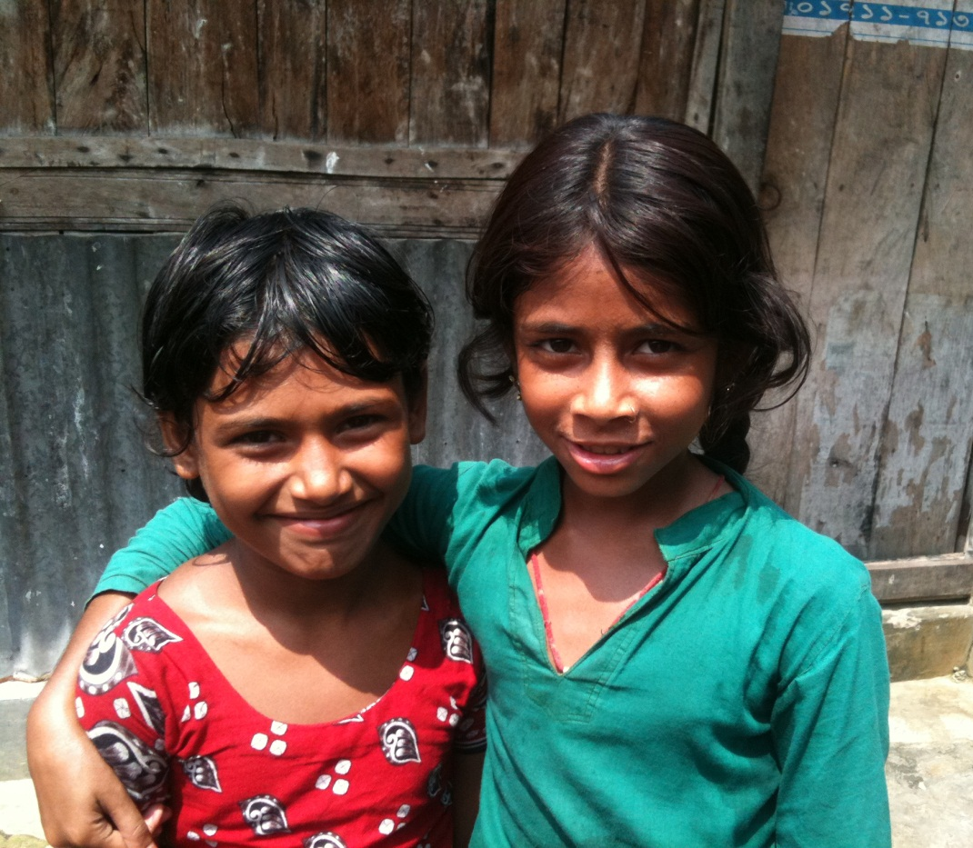
Welcome

Slide 2

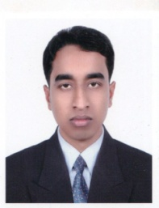
Sukesh Sutradhar,
Assistant Teacher,
Gokarna East Government Primary School,
Mobile: 01722269461,
Email- sukeshbd@gmail.com.
Class- Three,
Subject-English.

Slide 3
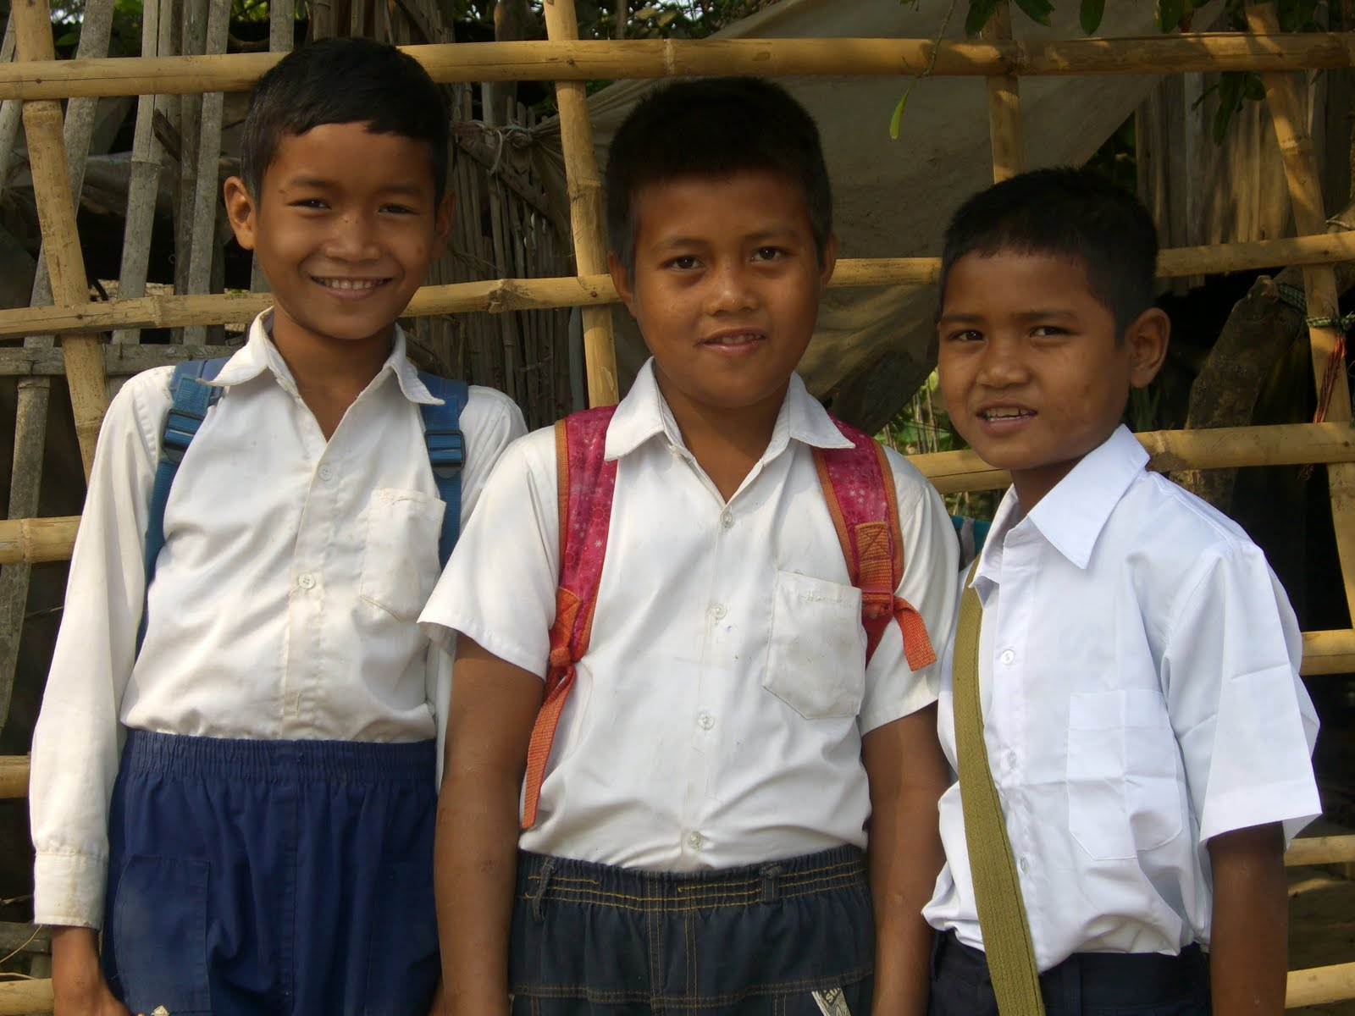
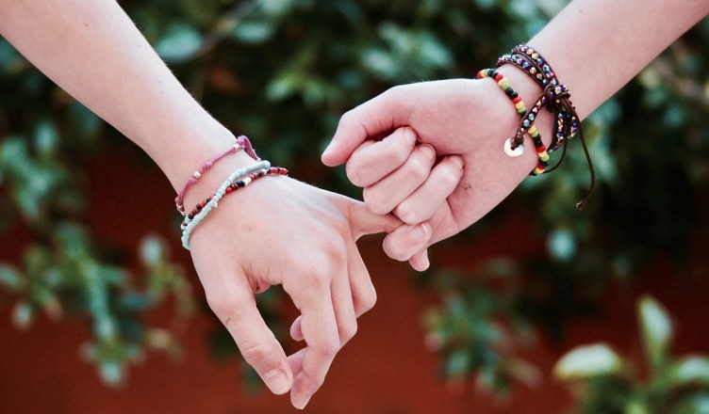
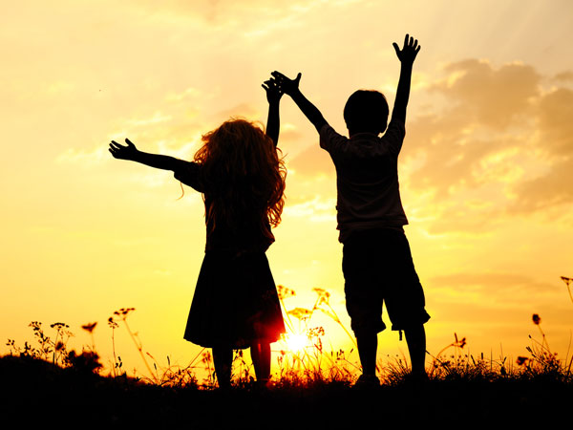
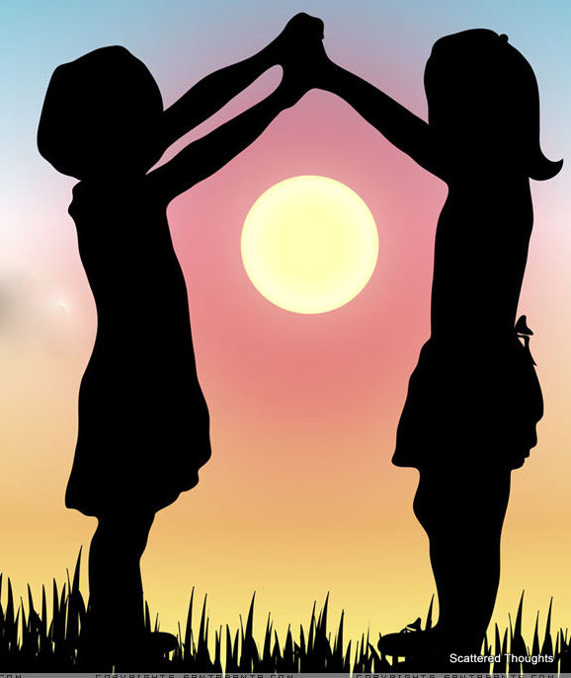
Can you guess what is our today’s lesson?
What is the relationship between them?

Slide 4
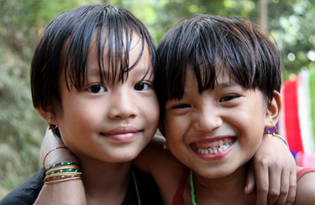
Today's Our Lesson
My friend
Unit- 35.
Lessons- 1-3.

Slide 5
Learning Outcomes
Students will be able to:
Listening:
4.3.1- enjoy and understand simple stories.
Speaking:
3.1.1- ask and answer Wh questions.
Reading:
5.1.1- read simple paragraphs.
Writing:
8.1.3- write sentence from the text book or model.
10.1.1- write short and simple paragraphs answering a
set of questions.

Slide 6
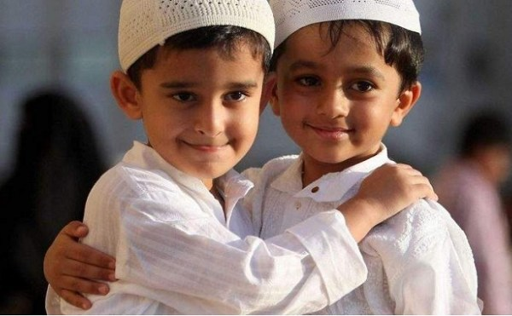

New Words
What can you see in the picture?
Friend
A person with whom one has a bond of mutual affection.
My friend name is Tusher.

Slide 7

New Words
What can you see in the picture?
The period of 365 days (or 366 days in leap years) starting from the first of January.
Year
I’m 10 years old.

Slide 8
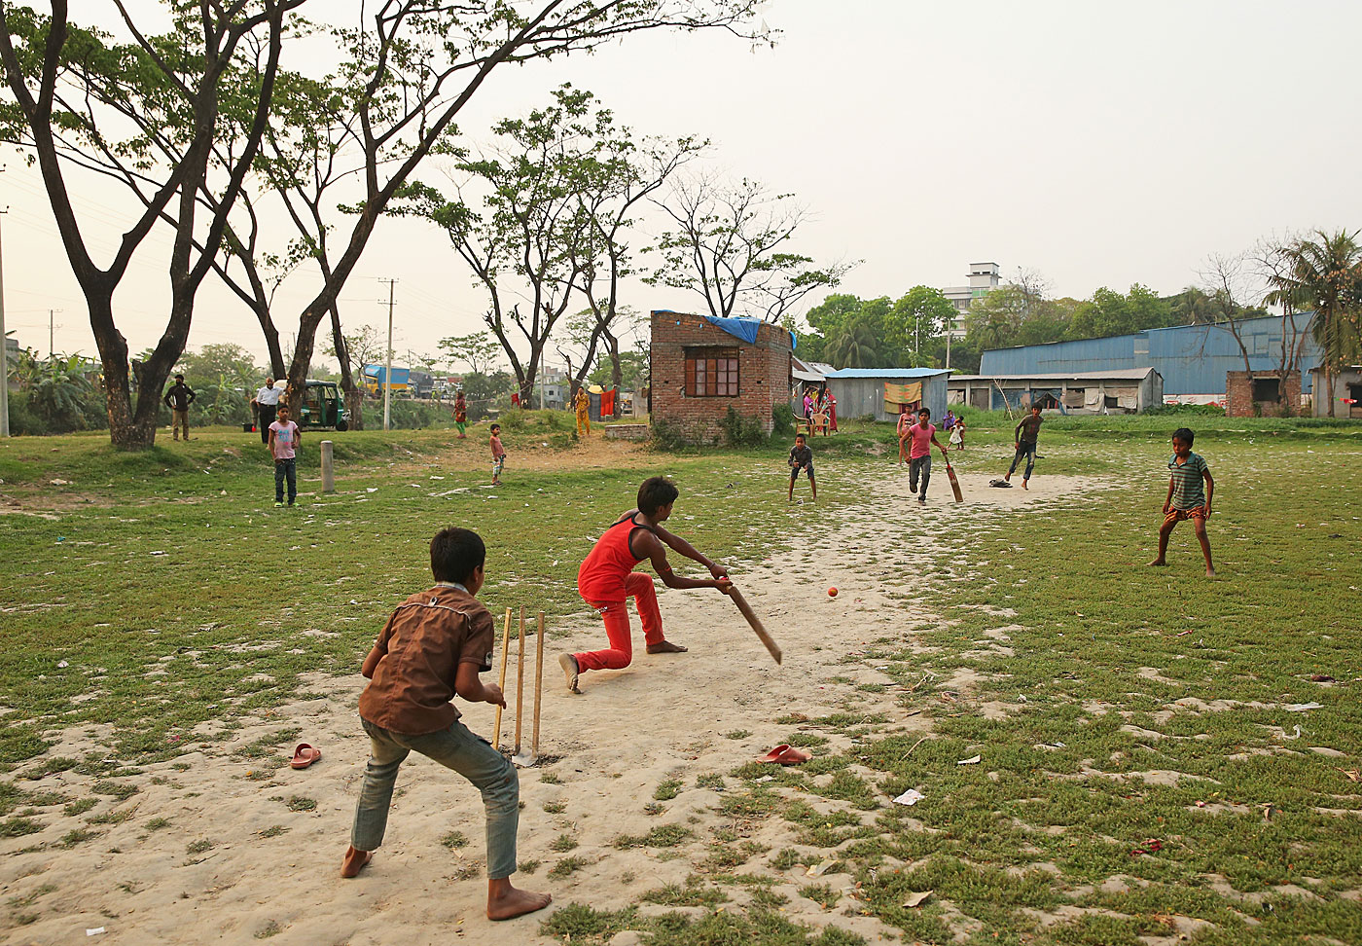
New Words
What can you see in the picture?
Activity engaged in for enjoyment and recreation, especially by children.
Play
My favourite game is cricket.

Slide 9
Time: 5 minute's
Individual Work
Make sentence by the words:
Friend
Year
Play

Slide 10
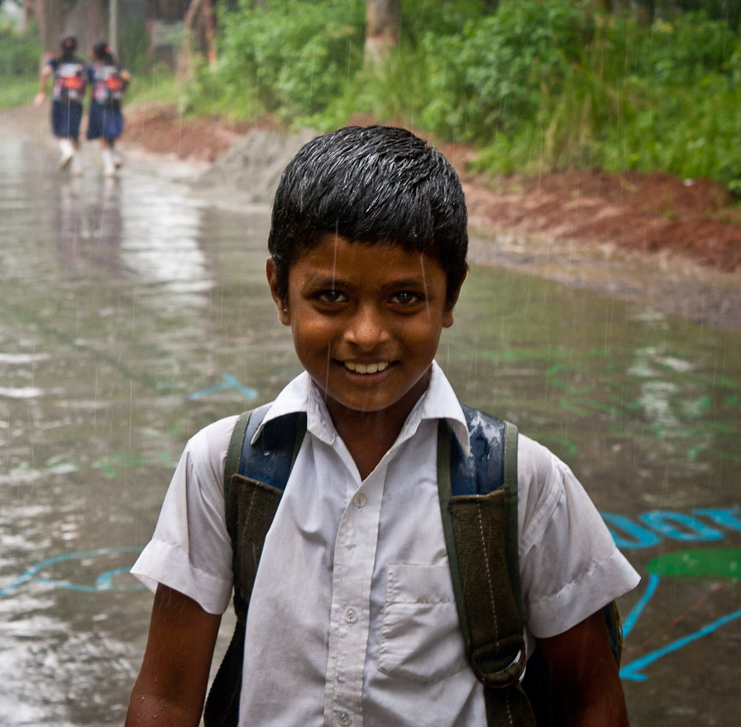
My friend
I’m Radif. I’m eight years old.

Slide 11
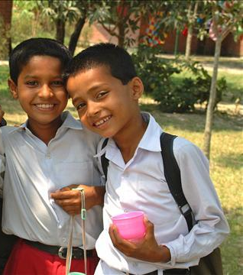
My friend
Anik is my friend. He’s eight years old, too.

Slide 12
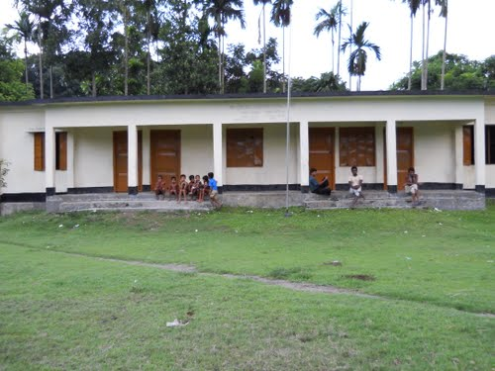
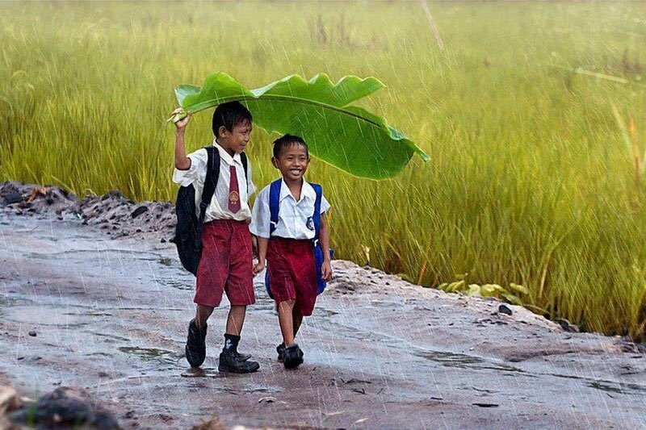
My friend
We go to Rajbari Primary School. We are in the same class.
রাজবাড়ি প্রাথমিক বিদ্যালয়

Slide 13
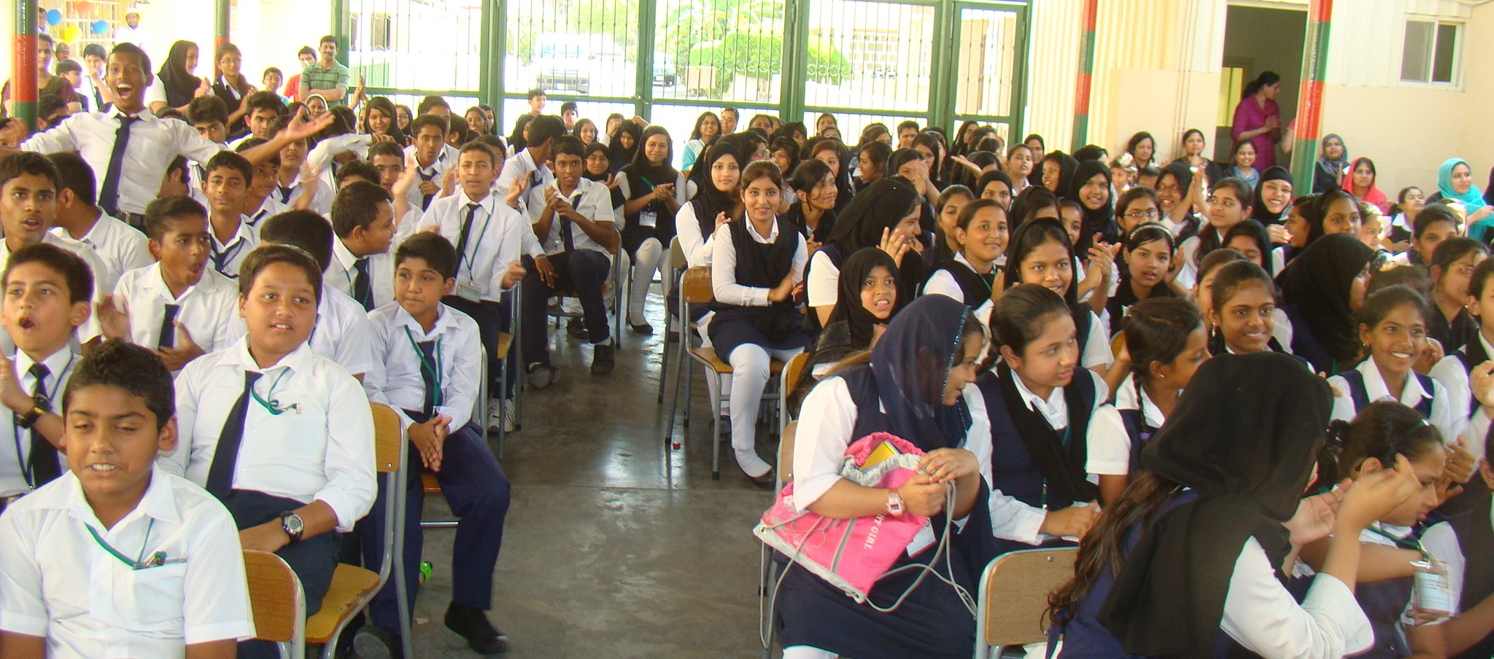
My friend
রাজবাড়ি প্রাথমিক বিদ্যালয়
Anik sits next to me.

Slide 14
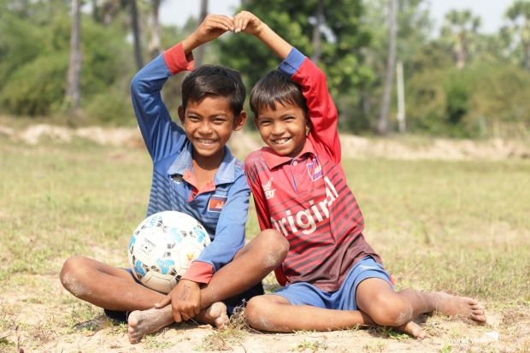
My friend
In the afternoon, we play football.

Slide 15
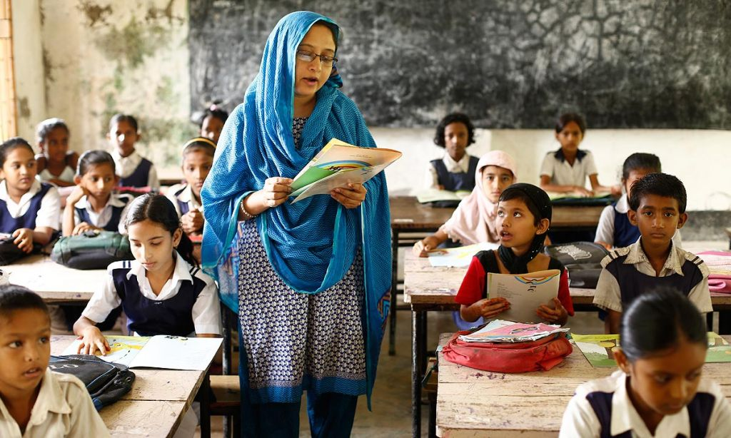
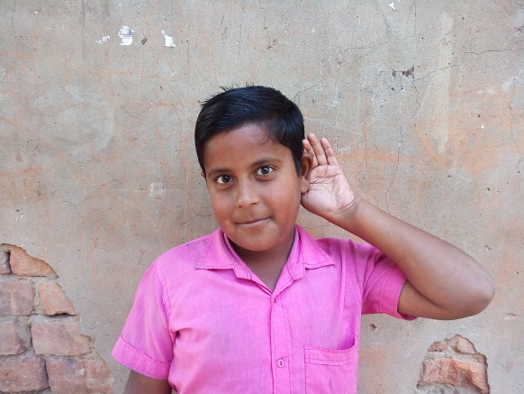
Teacher’s reading
Listen the audio attentively and put your finger under the lines.

Slide 16
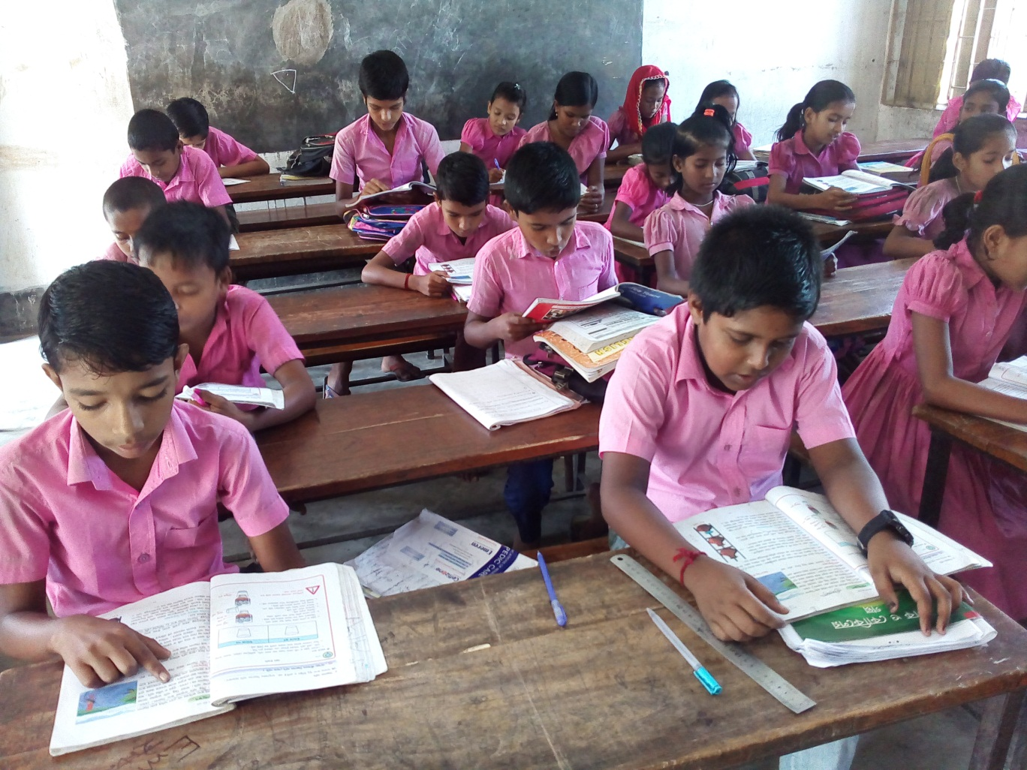
Student’s reading

Slide 17
Student’s silent reading

Slide 18
I’m Radif. I’m eight years old. Anik is my friend. He’s eight years old, too. We go to Rajbari Primary School. We are in the same class. Anik sits next to me. In the afternoon, we play football.
How old is Radif?
What is his friend’s name?
How old is Radif’s friend?
What school do they go to?
Where does Radif sit in the class
What do they do in the afternoon?
Answer
Please click answer button for answer
Answer
Pair Work
Answer
Time: 5 minute's
Answer
Answer
Answer

Slide 19


Group Work
Time: 10 minute's
Talk about Radif’s life:

Slide 20
Evaluation
Look attentively. Now we play a game. Everybody close your eyes.
Open your eyes.
Which word is missing?
Play
Year
Friend

Slide 21
Home Work
Write a paragraph about your friend.
What is your friend’s name?
How old is your friend?
What school do you go to?
Where does your friend sit in class?
What do you do in the afternoon?

Slide 22


