Slide 1
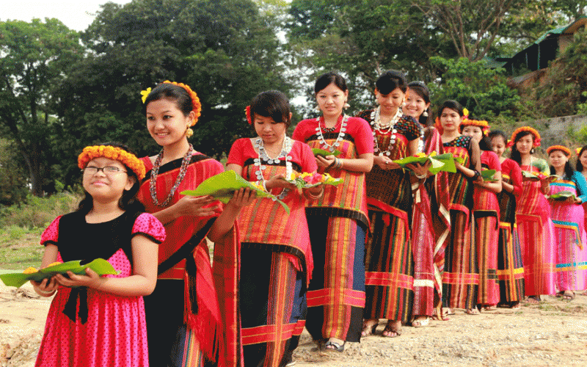
Welcome

Slide 2
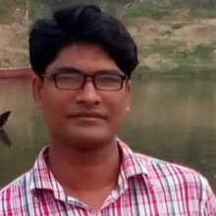
Introduced Myself
Morshed Alam
Assistant Teacher
Dakkhin Horni Sayed Taheria Dakhil Madrasah
Faridganj-Chandpur.

Slide 3
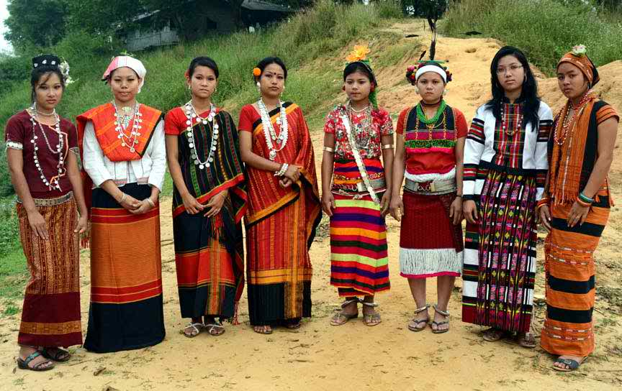
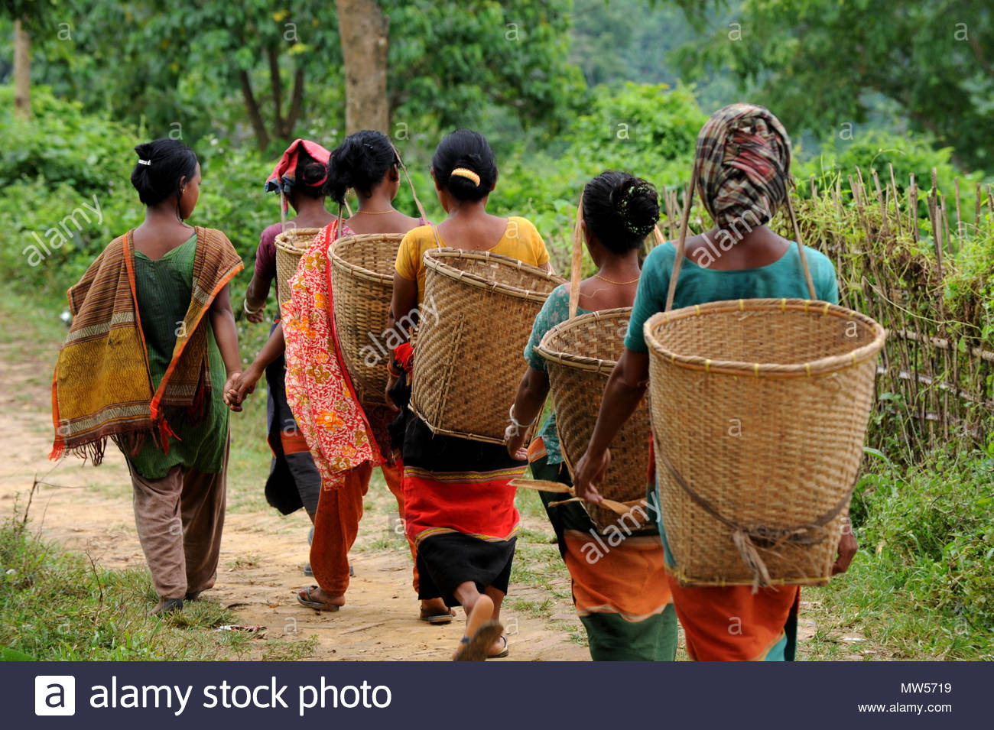
What can you see in this pictures?

Slide 4
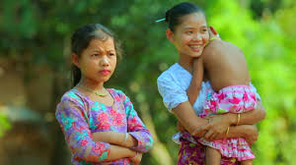
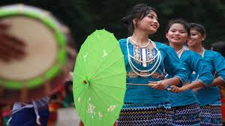
Who are they?

Slide 5
Our Ethnic friends
Unit-1,Lesson-A/B
After this lessons students will be able to…
Identify their living districts,
explain about their foods,
write about the ethnic people.

Slide 7
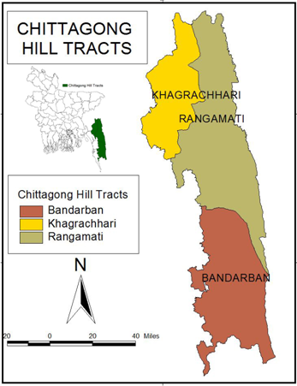
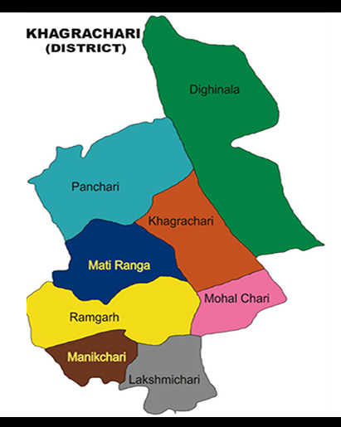
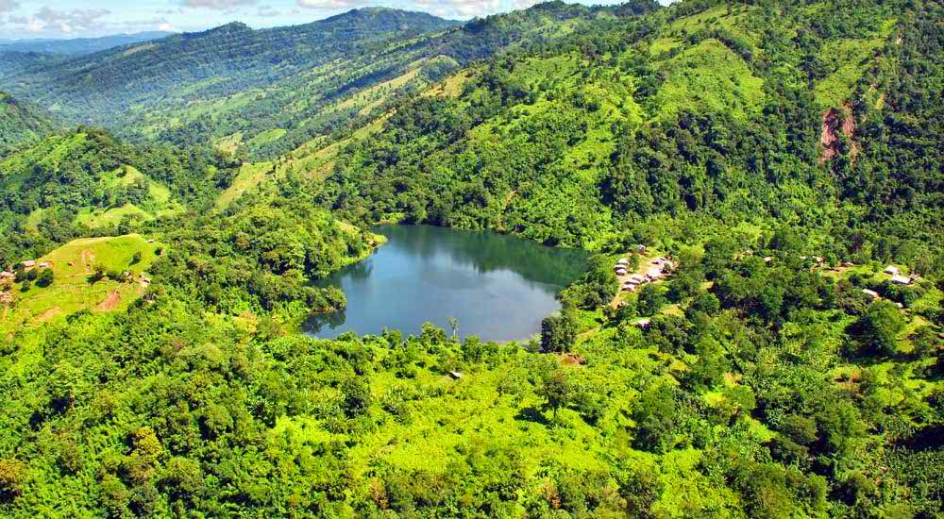
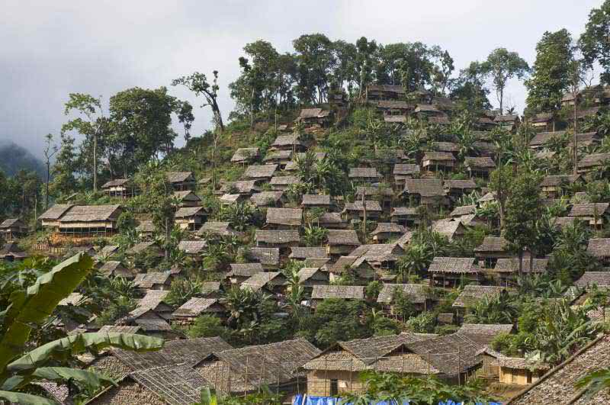
Living place

Slide 8
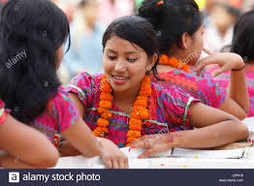
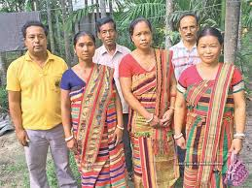
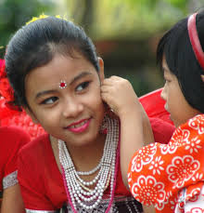
Marma
(Chittagong)
Chakma
(Chittagong)
Tripura
(Sylhet)

Slide 9
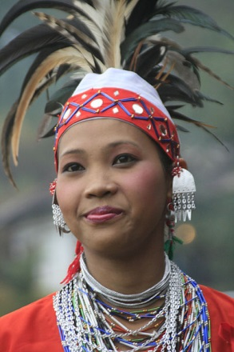
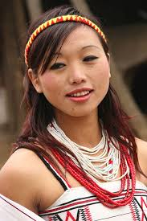
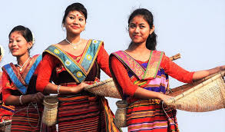
Garo
Mymenshing
Santal
Rajshahi
Khasia
Sylhet
Hajang
Mymenshing

Slide 10
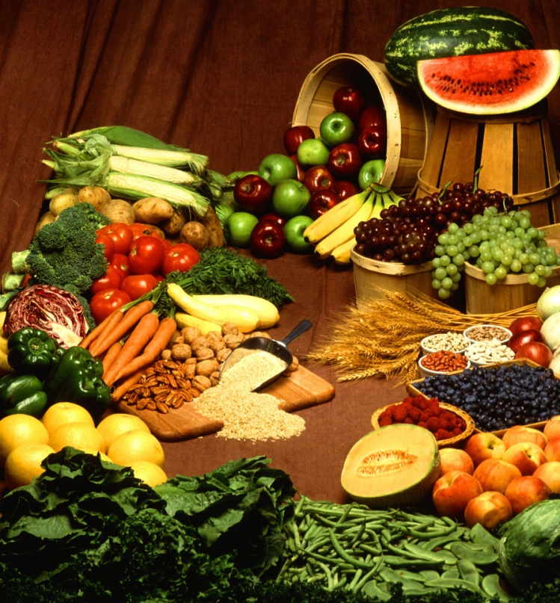
Look at these pictures below
Vegetables
Fishes

Slide 11
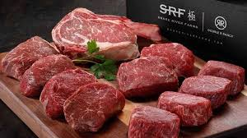
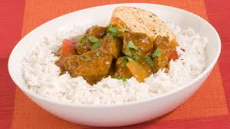
Meat
Rice and Curry

Slide 12
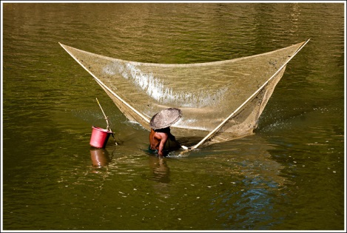
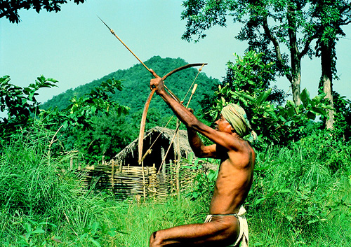
Fishing and hunting

Slide 13
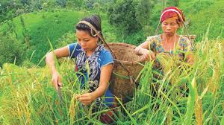
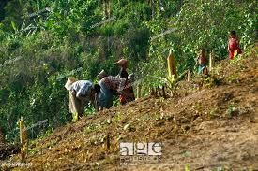
Jhum cultivation and sow seed

Slide 14
GROUP WORK
Explain about the Ethnic people’s food habits.

Slide 15
Homework
Word meaning
Ethnic=
Important=
Culture=
Cultivation=
Rural=
Forest

Slide 16
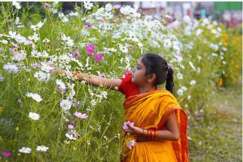
Thank You
Thank You

