Slide 1
The teachers who will use the content in their own classroom may explain all the words if needed
The teachers are requested to follow the notes
given below the slides.

Slide 2
WELCOME

Slide 3
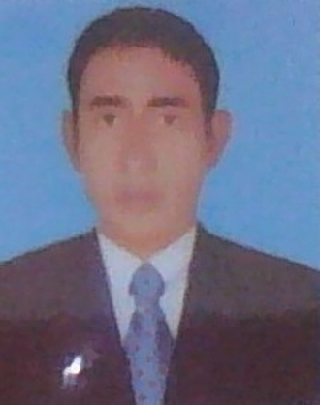
TEACHER IDENTITY
Md: Abdul Matin. Senior Assistant Teacher(English)
Raghunathpur high School
Nawabganj,Dinajpur
E-mail: abmatin1977@gmail.com
Phone:01823385723
UNIT:16
Lesson: One/two
E,F,T :Seven
(Grammar)
Topic :Narration
Time : :45
Date :28/02/2020

Slide 4
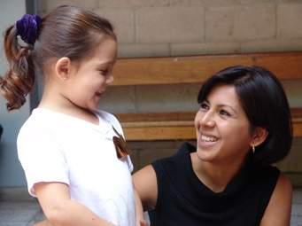
PICTURE AND TEXT
Mother said to the baby,” I am happy.”
The baby said to her teacher that she(Mother) was happy.

Slide 5
What do you understand by
the images and texts?
Students: Direct and indirect speech. (Sir)

Slide 6
Lesson Declaration
Our To day’s our lesson is-
Direct and indirect speech
Narration

Slide 7
Learning outcomes
By the end of the lesson students' will be able to learn…….
1. Students Identify speech
2. students Identify the classification of speech
3.Students change speech from direct to indirect

Slide 8
Follow the chart
Rafi said to me, “ I have done my duty.”
Rafi told me that he had done his duty.
Speeches are classified into two kinds.
Direct speech
Indirect speech

Slide 9
Group work
How many kinds of speech

Slide 10
Solution
There are two kinds of speech?

Slide 11
How to change tense/‘verbs’ from Direct to Indirect speech
Direct | Indirect
Am/is/are | Was/were
Was/were | Had been
Shall/will | Should/would
Has/have/did | Had + past participle
Can/may | Could/might
Must | Had to
Present indefinite | Past indefinite
Past indefinate | Past perfect

Slide 12
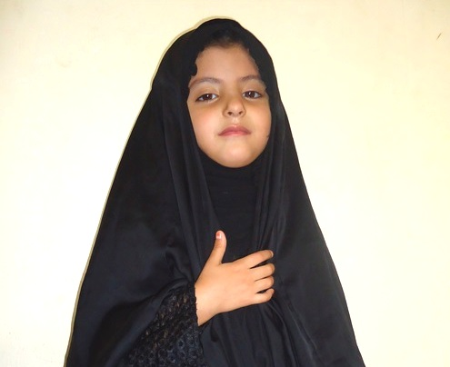
She said to me, “ I was ill.
Direct speech
Indirect speech
She told me that she had been ill.

Slide 13
Pair Work
Make a list of the verbs and their changing form in indirect speech

Slide 14
Solution
Direct | Indirect
Am/is/are | Was/were
Was/were | Had been
Shall/will | Should/would
Has/have/did | Had + past participle
Can/may | Could/might
Must | Had to
Present indefinite | Past indefinite
Past indefinate | Past perfect

Slide 15
Look at the chart
Changing case
Subject | Object | Possitive case
I | Me | My
We | Us | Our
You | You | Your
He | Him | His
She | Her | Her
They | Them | Their
It | It | Its

Slide 16
Home work
Change the following speech from direct to indirect—
The teacher said to me, “The earth moves round the sun.”
Father said to his son, ”I want to make you a man of truth.”
He said to me,” I was there in 2020

Slide 17
THANK’S

