Slide 1
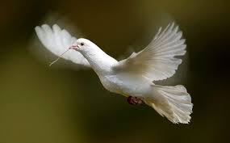
Welcome

Slide 2
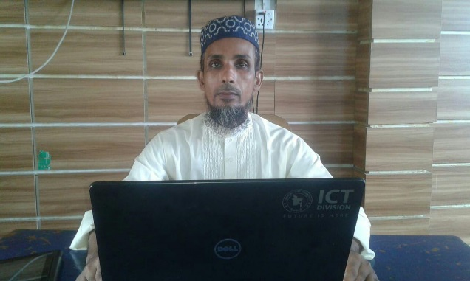
Introduction
Mohammod Helal Uddin
Assistant Teacher (English)
Wahid Siddek High School
Gurarai, Sadar, Moulvibazar
E-mail: helal.bd.mb@gmail.com
Class- Eight
Subject : English for Today
Unit: 01
Lesson: 05

Slide 3
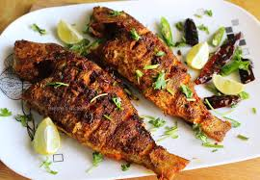
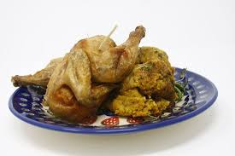
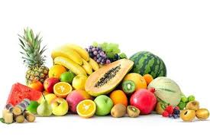
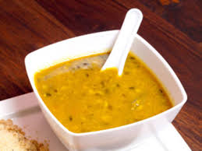
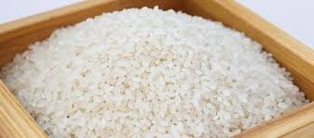
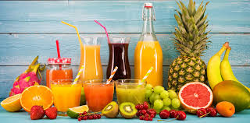
Look at the following pictures then answer the questions
What can you see in the pictures ?
Those are our food and nutrition

Slide 4
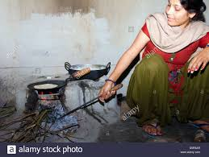
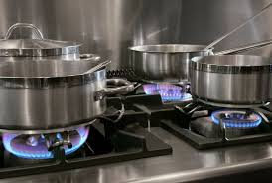
Today our Lesson is……
A glimpse of our culture
Title : Bangladeshi Cuisine

Slide 5
Learning Outcomes
End of this Lesson , The students will be able to……
Read and understand texts through silent reading
Infer meaning from context
Ask and answer questions.

Slide 6
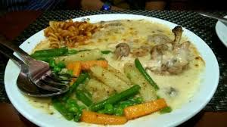
Let’s go practice vocabulary
cuisine
A style or method of cooking
That is our cuisine

Slide 7
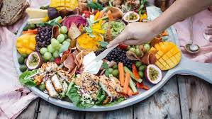
Platter
A large flat dish or plate for serving food

Slide 8
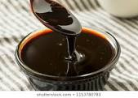
Molasses
Thick, dark, brown juice obtained from raw sugar during the sufficing process.

Slide 9
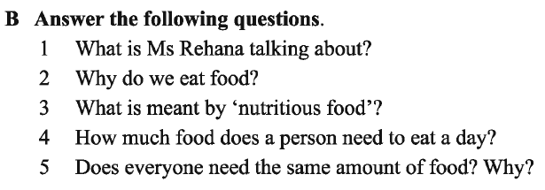
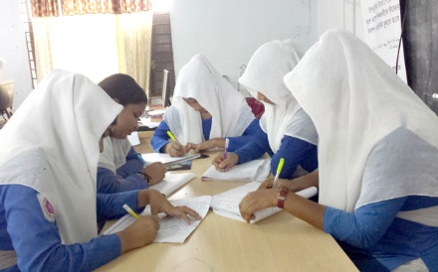
Group Work
Read the text silently then answer the questions

Slide 10
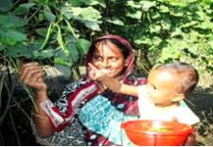
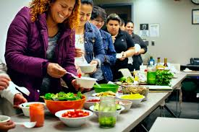
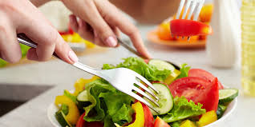
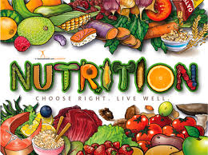
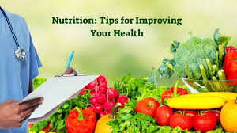
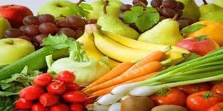
Pair Work
Look at the pictures and complete the sentences in pair
01. We should eat good food to….
02. Good food means….
03. Eating too much food is not…

Slide 11
Evaluation
Choose the best answer from the alternatives.
Foods are divided into classes according to their….
Colours and tastes (c) substances they contain
(b) Shapes and sizes (d) water they contain.
Potatoes contains a lot of …
Carbohydrates (c) vitamins
(b) Protein (d) minerals.
Which food has the most carbohydrate ?
Sugar (c) fruits
(b) Rice (d) vegetables

Slide 12
Home Work
Write answer the following question.
How many kinds of food do we need ? What are they ?

Slide 13
Thank You

Slide 14
Be Remember……..
Stay Home, Stay Safe

