Slide 1
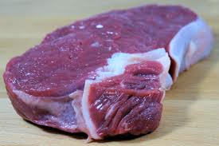

Slide 2
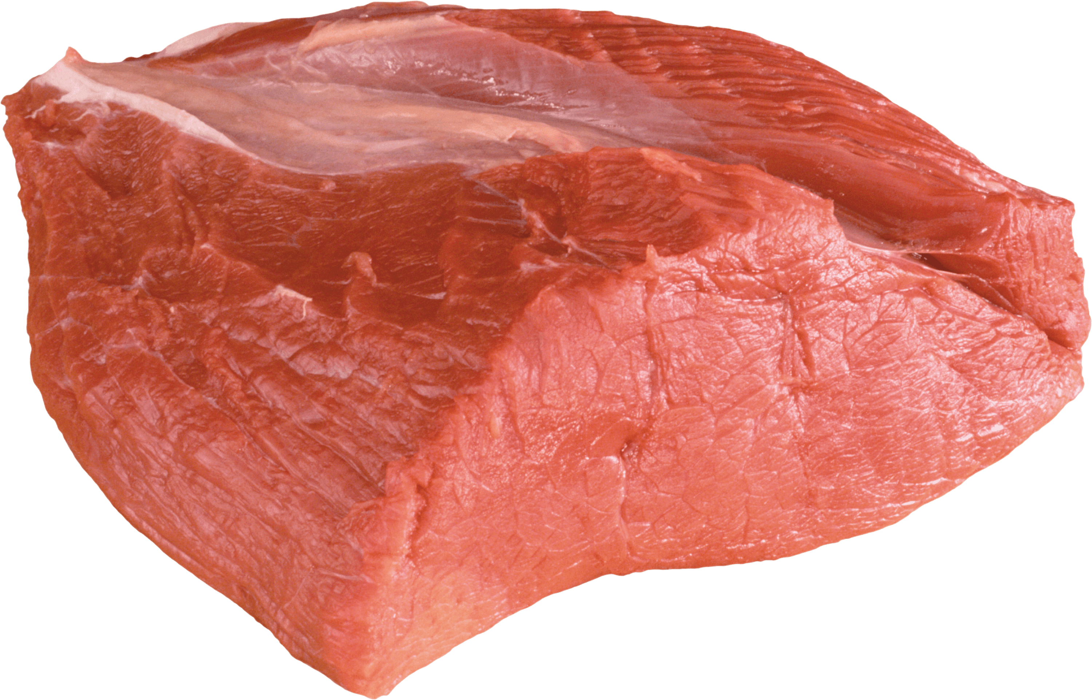
Welcome to all.

Slide 3
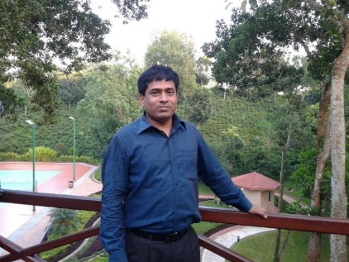
INTRODUCTION
S. M. MONIRUL ISLAM
Assistant Teacher in English
Govt. Model Secondary School, Khulna-9100
monirmodel@gmail.com
Mobile: 01711-397 309
Friday, May 1, 2020

Slide 4
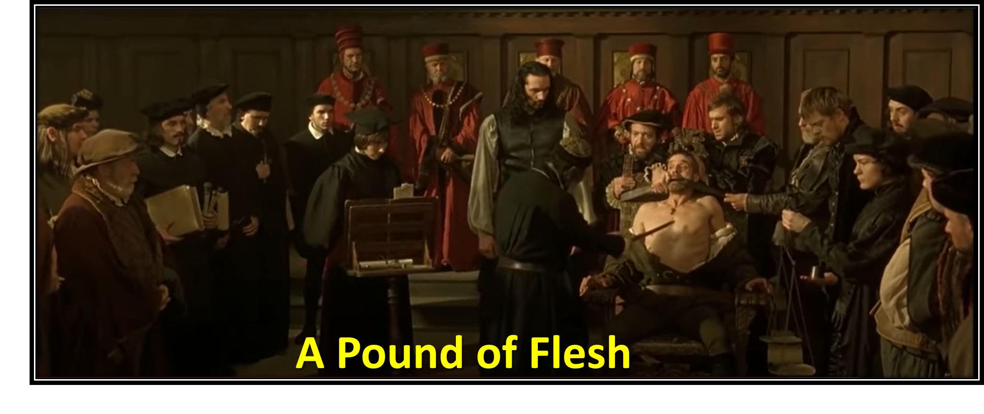

Slide 5
Let us watch the video.
Please click here to go to internet for watching Video.

Slide 6
Today’s topic of the class is----
A Pound of Flesh
Unit : 14
[Pleasure and Purpose]
Lesson : 9

Slide 7
Learning outcomes
After the students have studied the lesson, they will be able to --- ---
recognize and use English sounds, stress, and intonation,
understand text,
interpret, evaluate, and summarise literary texts.

Slide 8
A: Look at the picture and ask and answer questions.
1. What do you see?
2. What are they doing?
3. What type of clothes are they wearing?
4. Are you familiar with such clothes?
5. Who wear such clothes?
6. Mention which clothes of our country are close to the ones men are wearing in the picture?

Slide 9
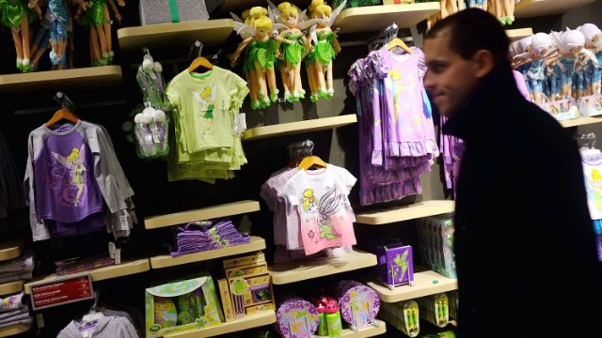
Merchandise
Goods that are for sale
NEW WORDS
Syn.: commodity

Slide 10
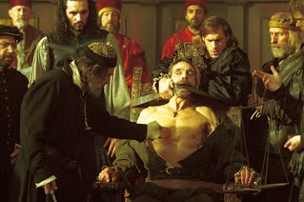
Penalty
A punishment for doing something against law
Syn.: punishment, sanction
Ant.: reward, gain

Slide 11
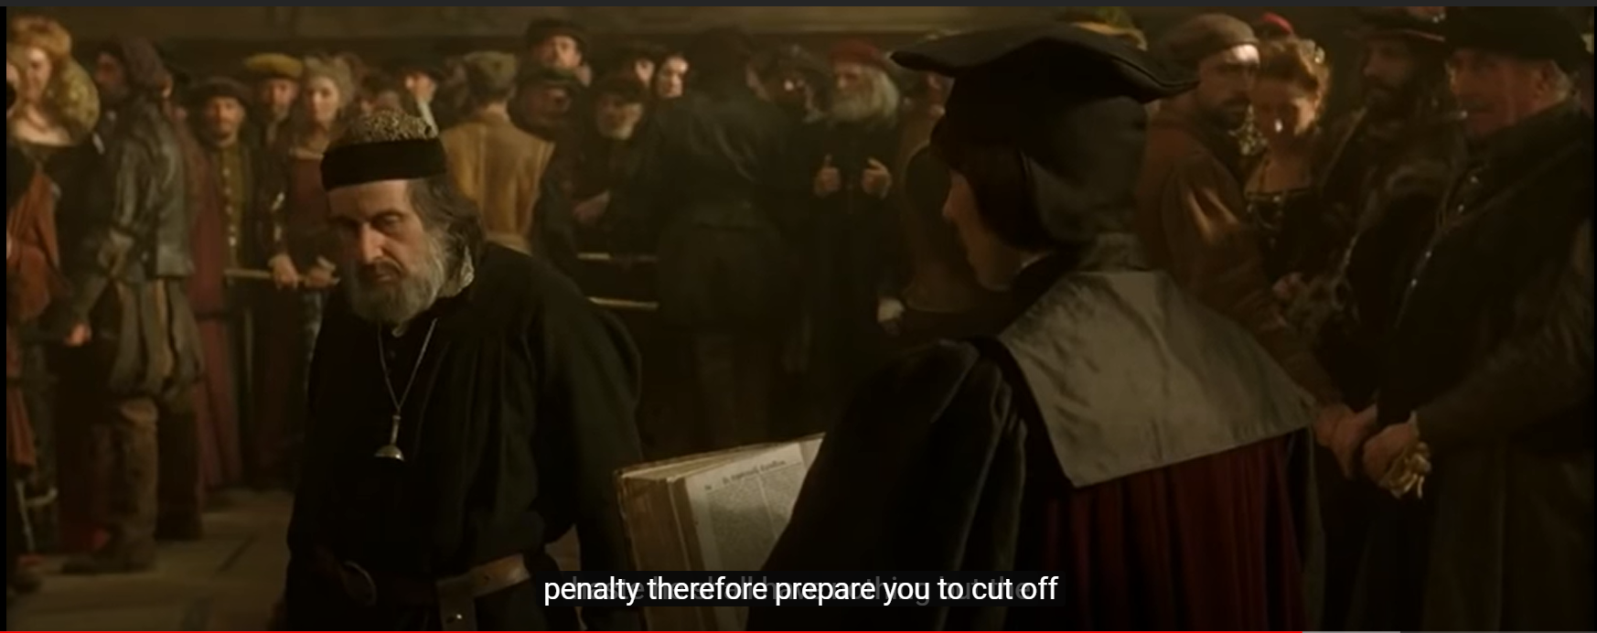
Sue
Take legal action against somebody go/take to court
Syn.: proceed against

Slide 12
B: Now read the text (page no 213-214) to find your answers to the questions that follows.
10 Minutes
Once upon a time in Venice, there was a very rich merchant named Antonio. He had many ships, that sailed in the sea. --- ----- --- --- --- --- --- --- --- --- --- --- --- --- --- --- --- --- --- --- --- --- --- --- --- --- --- --- --- --- Shylock made Antonio sign a bond before giving him the money. Antonio took the money and gave it to Bassanio.
TEXT

Slide 13
Once upon a time in Venice, there was a very rich merchant named Antonio. He had many ships, that sailed in the sea. His ships carried different types of merchandise to other countries. He sold those goods in foreign countries. He bought spices and other valuables with the money and sold them in Venice.
Antonio was a good and kind man. He always helped the poor. The people of Venice loved him very much for his honesty and kindness.
Antonio had a close friend named Bassanio. He was a handsome young man and was born in a noble family. Bassanio like to lived a very luxurious life. He loved grandeur and style. He spent more money than his earning. As a result, he was very often short of money. In such situations, Bassanio would go to his best friend Antonio for help. Antonio would, on the other hand, help him with cash.

Slide 14
It so happened that, Bassanio fell in love with a wealthy lady named Portia. Portia was known not only for her beauty but also for her wisdom. Portia, on the other hand, had softness towards Bassanio too. He wanted to visit Portia in a grand manner but he did not have any money. So he went to Antonio.
Bassanio said, “ Dear friend Antonio, I am in great need of some money. I would like to visit Portia at Belmont, grandly dressed and with many servants. But I don’t have any money right now. Please help me to fulfill my intention.”
Antonio said, “ This is not a problem my friend, how much do you need?” “ Three thousand ducats (Venetian currency) will do.”
“ I don’t have that much money with me now as all my ships have gone out in the sea with merchandise. But don’t worry my friend, I’ll arrange

Slide 15
three thousand ducats for you.”
So he decided to borrow the sum from a moneylender named Shylock. Shylock was a very crooked man. Antonio and Shylock hated each other. Shylock sued to lend money with high interest. He would even send the debtor to prison if he failed to pay his debt.
On the contrary, Antonio used to lend money to help those who need it and would not charge any interest.
Shylock agreed to lend him money but on one condition. If he failed to repay the money in three month’s time then he has to pay a penalty. Shylock would cut a pound of flesh from any part of Antonio’s body.

Slide 16
Antonio willingly agreed thinking that his ships would soon return with all the rich merchandise and he can easily return the money to Shylock by selling them. Shylock made Antonio sign a bond before giving him the money. Antonio took the money and gave it to Bassanio.
BACK

Slide 17
C: True or false? If false, give the correct information.
1. Bassanio was a very rich man.
2. Bassanio and Antonio hated each other.
3. Antonio went to Shylock to borrow money.
4. Shylock happily gave Antonio the money he asked for.
5. Antonio needed the money to my merchandise.

Slide 18
D: Read the text in B again and answer the following questions.
EVALUATION
1. Why was Bassanio short of money all the time?
2. Why did he go to Antonio?
3. Why did Antonio go to Shylock?
4. Why did Shylock bring forward the bond?
5. What could be written on the bond?

Slide 19
HOME WORK
Every student will write a summary of the passage ‘B’ in no more than 90 to 100 words.

Slide 20
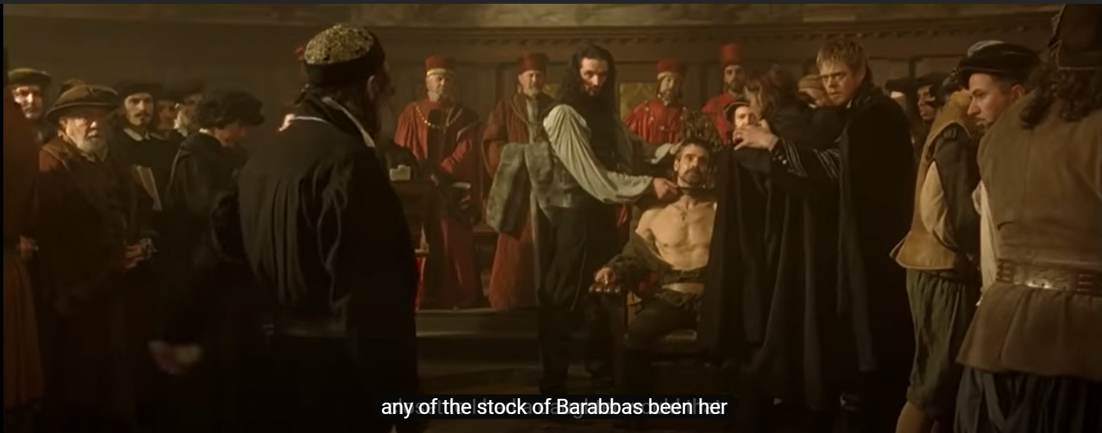
Thank you all.

