Slide 1
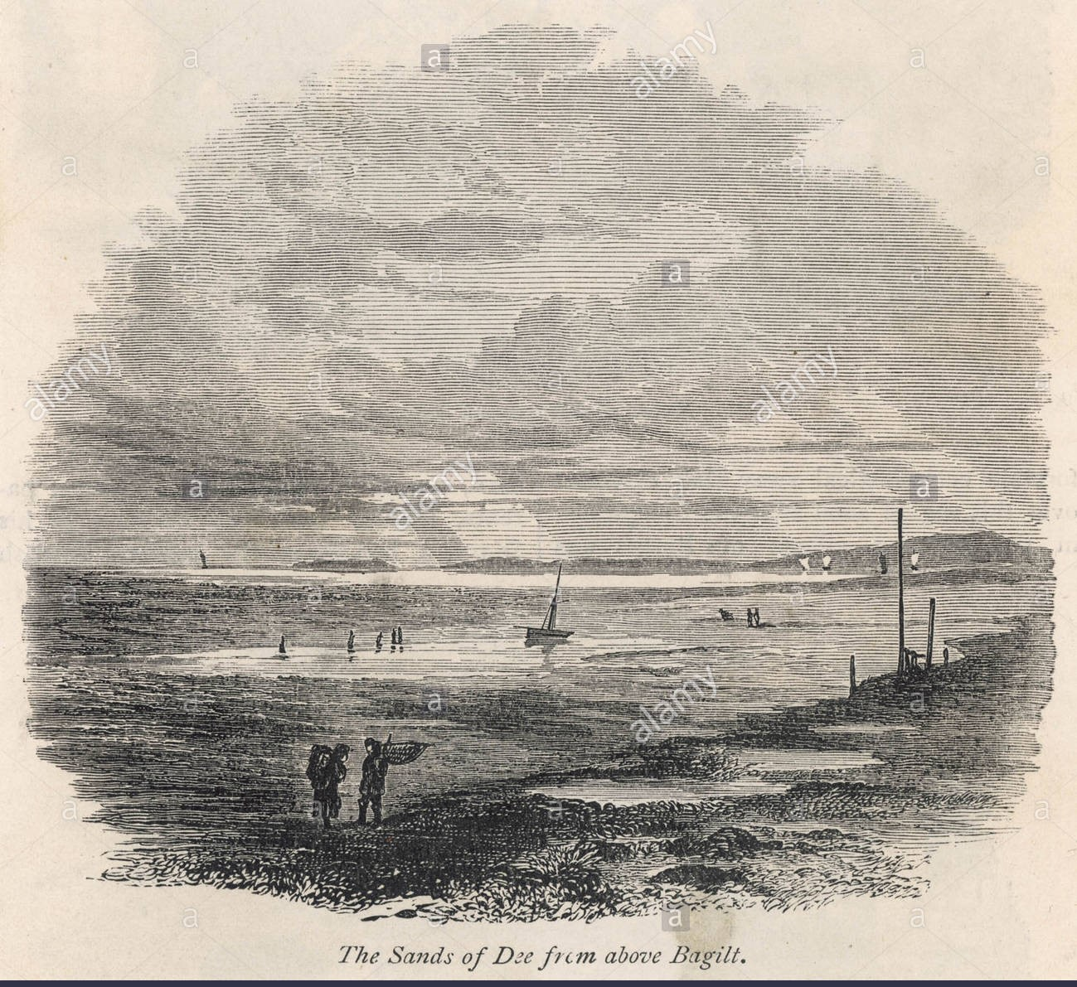

Slide 2
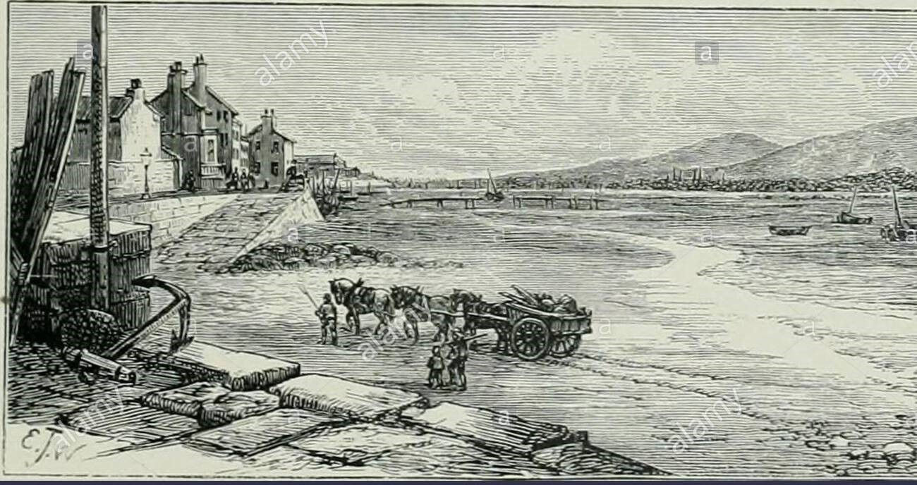
Welcome to all.

Slide 3
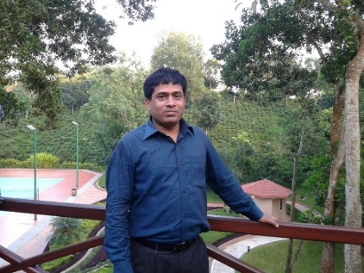
INTRODUCTION
S. M. MONIRUL ISLAM
Assistant Teacher in English
Govt. Model Secondary School, Khulna-9100
monirmodel@gmail.com
Mobile: 01711-397 309
Friday, May 1, 2020

Slide 4
A: Look at the picture.

Slide 5
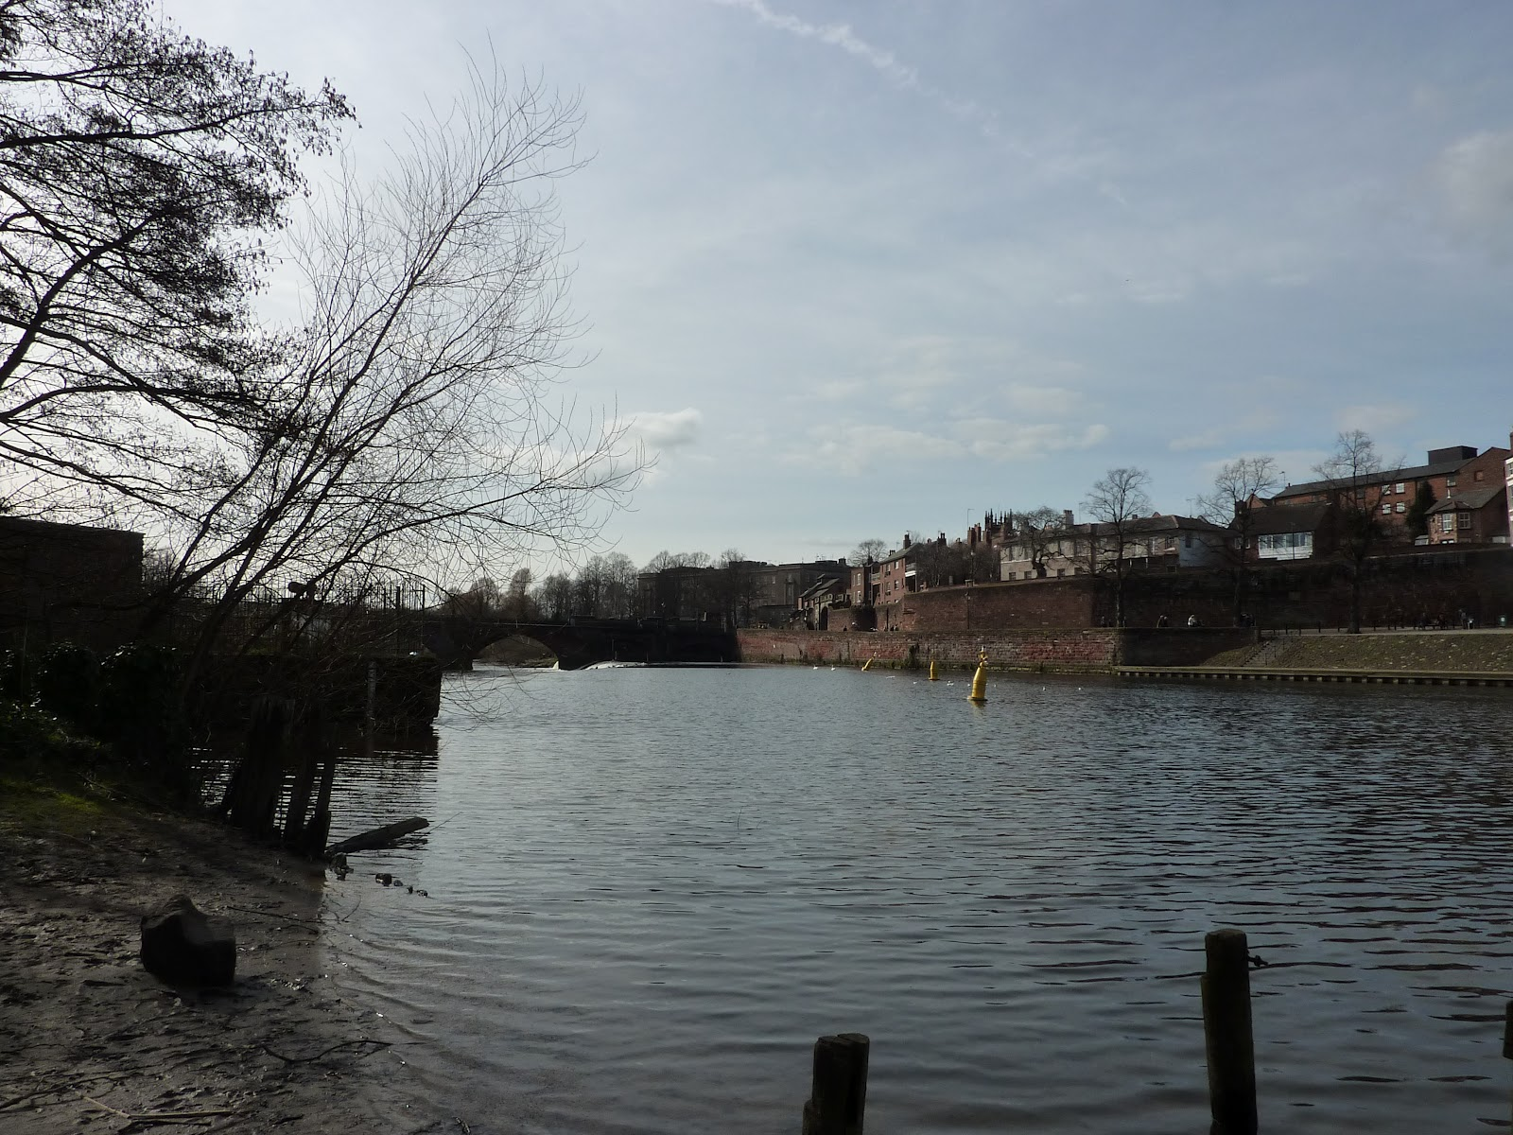

Slide 6
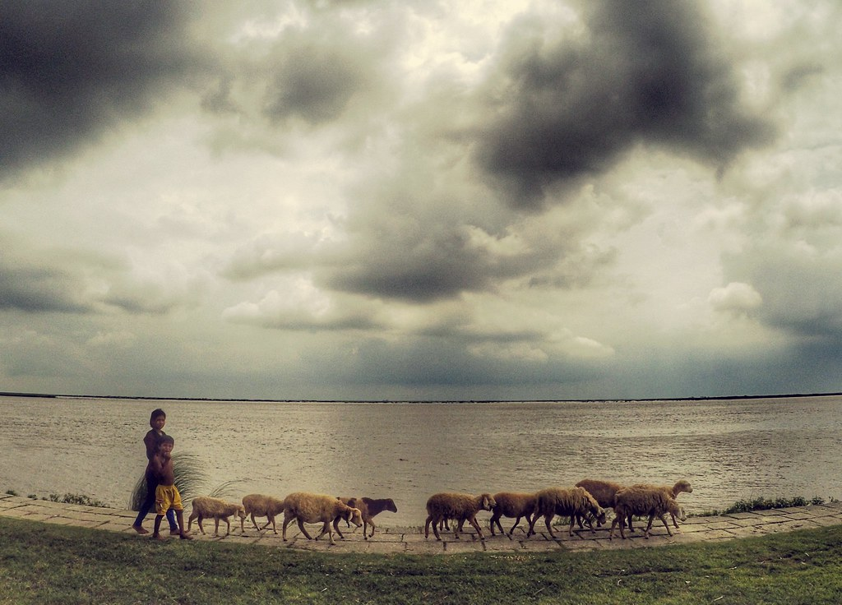

Slide 7
Let us watch the video.
Please click here to go to internet for watching Video.

Slide 8
Today’s topic of the class is----
The Sands of Dee
Unit : 14
[Pleasure and Purpose]
Lesson : 3

Slide 9
Learning outcomes
After the students have studied the lesson, they will be able to --- ---
recognize and use English sounds, stress, and intonation,
understand poem,
interpret, evaluate, and summarise literary texts.

Slide 10
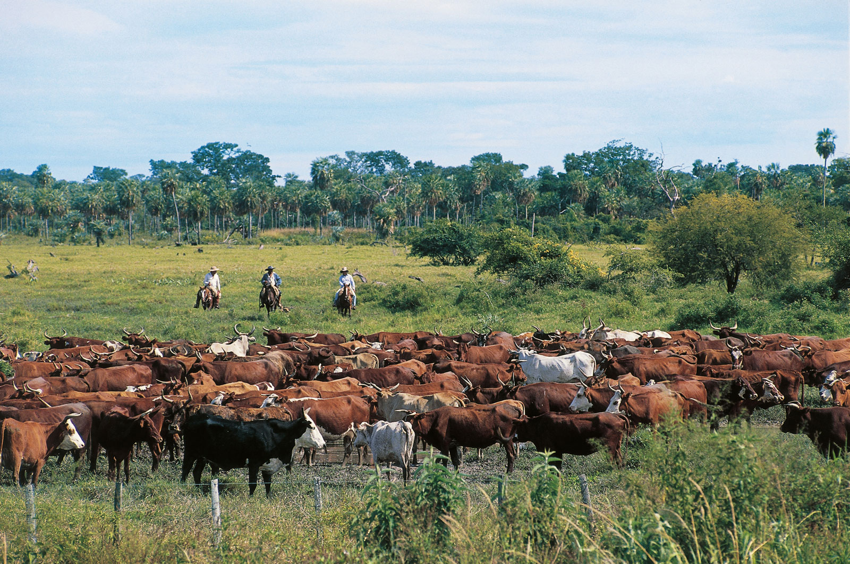
Cattle
Cows and bulls that are kept as farm animals for their milk or meat
NEW WORDS
Syn.: livestock

Slide 11
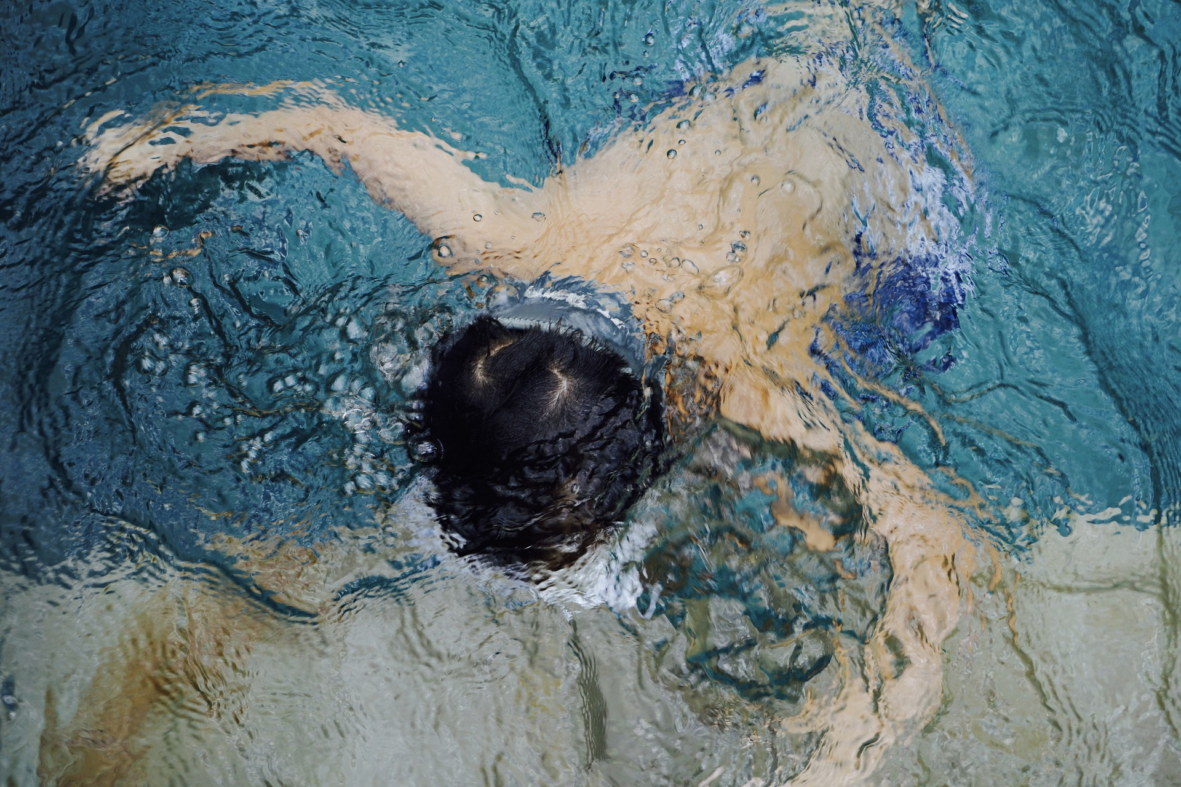
Drowned
To die for having been underwater too long
Syn.: suffocate in water

Slide 12
A: Listen to the poem. Read it aloud in groups.

Slide 13
The Sands of Dee
“O Mary, go and call the cattle home,
And call the cattle home,
And call the cattle home,
Across the sands of Dee!”

Slide 14
The western wind was wild and dank with foam,
And all alone went she.
The western tide crept up along the sand,
And o’er and o’er the sand,
And round and round the sand,
As far as eye could see.
The rolling mist came down and hid the land
And never came home she.
“Oh! Is it weed, or fish, or floating hair—
A tress of golden hair,
A drowned maiden’s hair,

Slide 15
Above the nets at sea?
Was never salmon yet that shone so fair
Among the stakes of Dee.’
They rowed her in across the rolling foam.
The cruel, crawling foam,
The cruel, hungry foam,
To her grave beside the sea:
But still the boatman hear her call the cattle home
Across the sands of Dee.
- Charles Kingsley

Slide 16
B: Answer these questions.
1. What was the weather like when Mary went to bring the cattle home?
2. Look at some words, phrases and sentences that have been repeated several times. Explain why the poet has done that.
3. How has the poet described the sea?
4. Narrate the story of Mary in your own words.
5. Suppose you with a couple of your friends were walking on the shore while Mary was drowning. Describe what you have done.
EVALUATION

Slide 17
HOME WORK
Every student will write a summary of the poem ‘A’ in no more than 90 to 100 words.

Slide 18
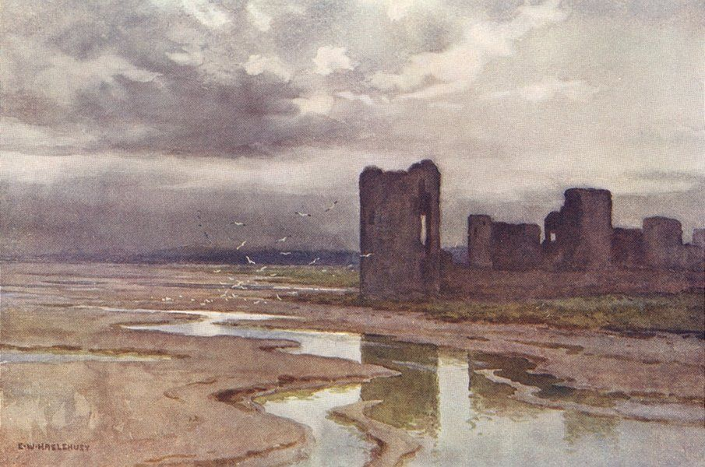
Thank you all.

