Slide 1


Slide 2

Welcome to all.

Slide 3

INTRODUCTION
S. M. MONIRUL ISLAM
Assistant Teacher in English
Govt. Model Secondary School, Khulna-9100
monirmodel@gmail.com
Mobile: 01711-397 309
Friday, May 1, 2020

Slide 4
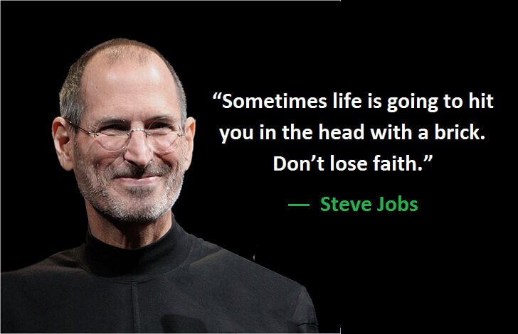
A: Look at the picture.

Slide 5
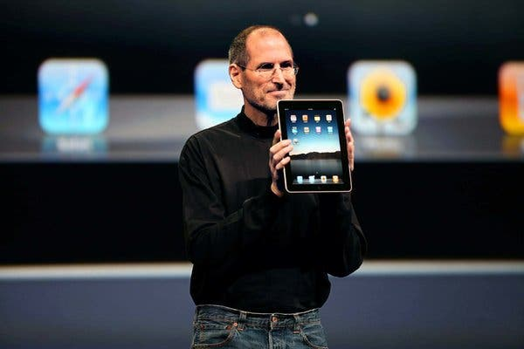

Slide 6
Let us watch the video.
Please click here to go to internet for watching Video.

Slide 7
Jobs’ Childhood
Today’s topic of the class is----
Unit : VII
[People who stand out]
Lesson : 8

Slide 8
Learning outcomes
After the students have studied the lesson, they will be able to --- ---
read and understand text for specific information,
describe a person and product,
ask and answer questions.

Slide 9
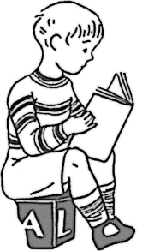


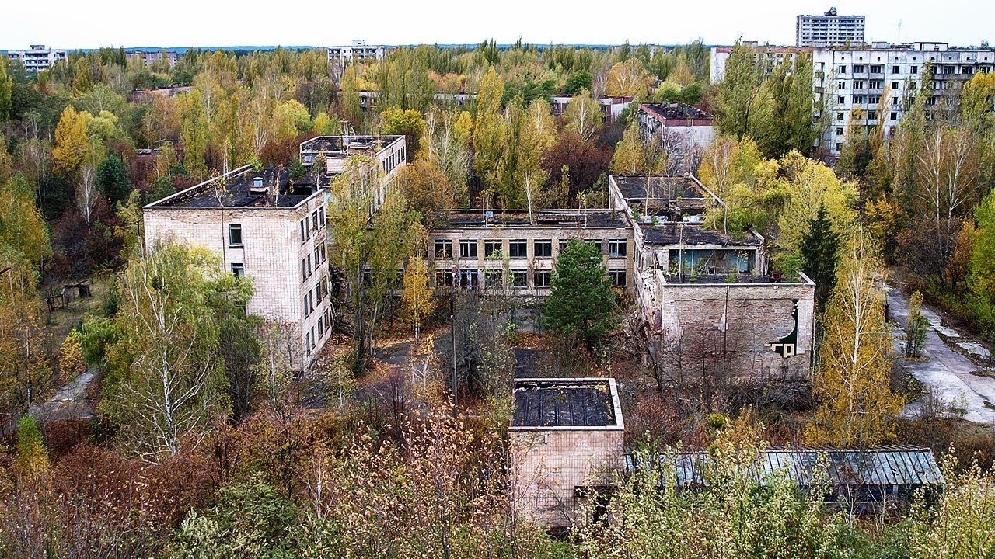
New Word
Abandoned
having been deserted or left
Syn.: deserted, discarded

Slide 10
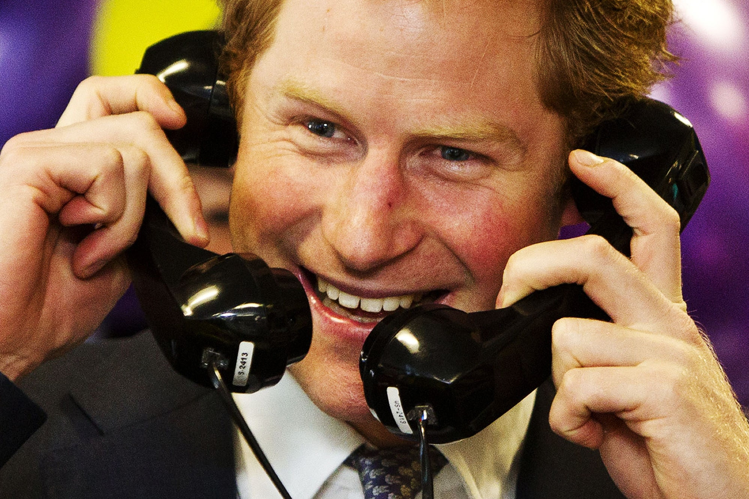
Prank
A trick that is played on somebody as a joke
Syn.: joke, trick

Slide 11
A: Read the text (Page no. 122-123) and give the answer.
A car mechanic Paul Jobs and his wife Clara jobs adopted Steve Jobs. Steve was abandoned at birth. Paul and Clara loved Steve very much. --- --- --- --- --- --- --- --- --- --- --- --- --- --- --- --- --- --- --- --- --- --- --- --- --- --This would mean that Jobs would find the study challenging and he would be motivated to study. His parents had him skip only one grade.
TEXT

Slide 12
A car mechanic Paul Jobs and his wife Clara jobs adopted Steve Jobs. Steve was abandoned at birth. Paul and Clara loved Steve very much. They made him feel that he was ‘chosen’ and very ‘special’.
One of his colleagues, Del Yocam said about Steve, “I think his desire for complete control of whatever he makes derives directly from his personality and the fact that he was abandoned at birth.”
Jobs’ mother taught him how to read and write before he went to the elementary school. So when he went to school, he found out that he knew everything that the teachers were teaching. He got bored and played pranks to keep him busy. This continued for the first few years. It was clear from his behaviour that he could not accept other people’s authority. He said, “I encountered authority of different kind that I have never encountered before, and I did not like it.”
A turning point came when he was in grade four. His teacher Imogene Hill watched him very closely for some time and soon found out how to handle

Slide 13
him and get things done by him. In order to get things done she used to give him money and food. One day after school, she gave Jobs a workbook with math problems in it. She said, “ I want you to take it home and do this.” She showed Jobs a huge lollipop and said, “ When you are done with it, if you get it mostly right, I will give you this and five dollars.” Within two days, Jobs solved the math and returned the book to his teacher.
This continued for a couple of months and Jobs enjoyed learning so much that he did not need any return. Also he liked his teacher very much and wanted to please her. In Ms. Hill’s class, Jobs felt he was special. At the end of the fourth grade, Jobs did very well. It was clear not only to Jobs and his parents but also to the teachers that he was exceptionally intelligent. The school proposed that Jobs should skip two classes and go into seventh grade. This would mean that Jobs would find the study challenging and he would be motivated to study. His parents had him skip only one grade.
TEXT

Slide 14
D: Read the text in A again and answer the following questions.
1. What do the words ‘chosen’ and ‘special’ mean in the text. Explain.
2. Why didn’t Jobs enjoy school?
3. What did he do to keep himself entertained?
4. Why couldn’t Jobs accept other people’s authority at school? Why have he not come across other people’s authority before?
5. Why did Jobs have the wish to control everything?
6. How did Jobs’ teacher Imogene Hill keep him busy

Slide 15
B: Match the words with their meanings as used in the context.
Words | Meaning
adopted | deserted /left alone
abandoned | encourage
encounter | power
authority | mischiefs
pranks | legally raised another’s child
motivate | face

Slide 16

E: Read the text in A again and answer the following questions in Group.
What was Paul Jobs?
Whom was Steve Jobs adopted by?
What did jobs’ mother teach him?
What did Jobs’ mother teach him how to read and write?
Who was Imogene Hill?

Slide 17

Every student will write a paragraph about a person who have similarity with Jobs.

Slide 18

Thank you all.

