Slide 1
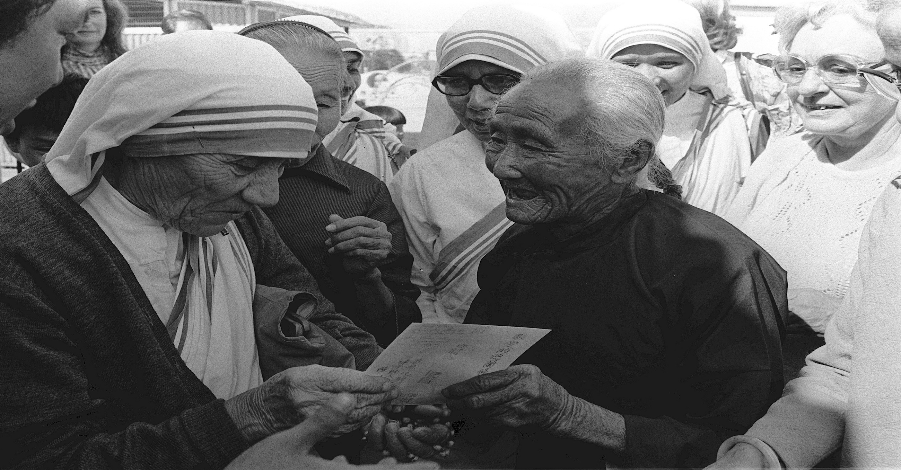

Slide 2
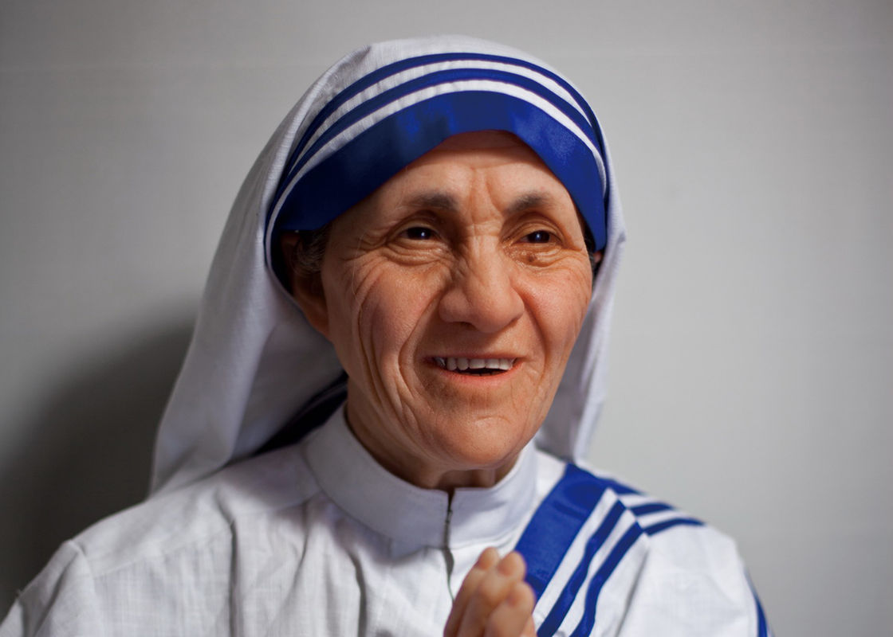
Welcome to all.

Slide 3
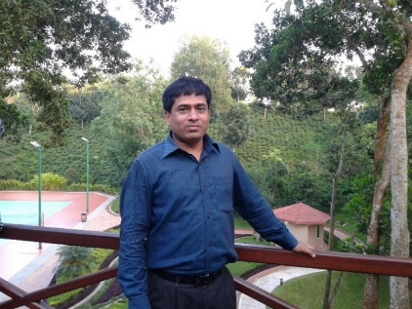
INTRODUCTION
S. M. MONIRUL ISLAM
Assistant Teacher in English
Govt. Model Secondary School, Khulna-9100
monirmodel@gmail.com
Mobile: 01711-397 309
Friday, May 1, 2020

Slide 4
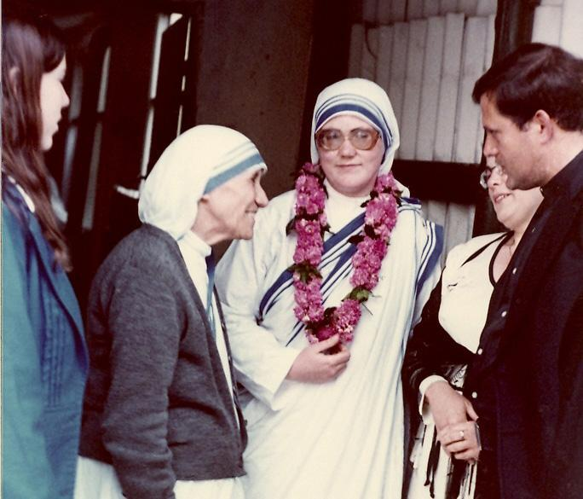
A: Look at the picture.

Slide 5
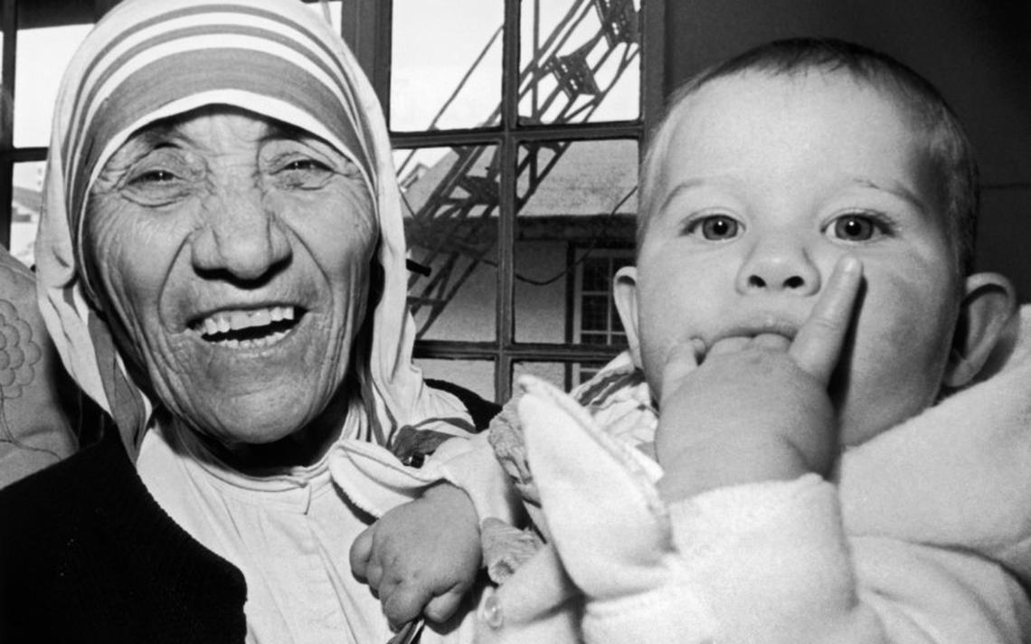

Slide 6
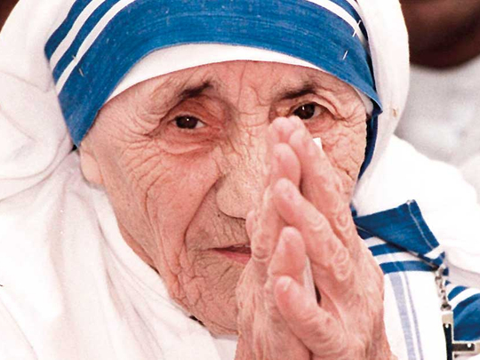

Slide 7
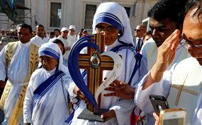

Slide 8
Let us watch the video.
Please click here to go to internet for watching Video.

Slide 9
The Beginning
Today’s topic of the class is----
Unit : VII
[People who stand out]
Lesson : 4

Slide 10
Learning outcomes
After the students have studied the lesson, they will be able to --- ---
read and understand text for specific information,
describe a person,
ask and answer questions.

Slide 11
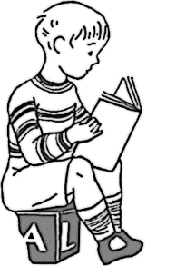

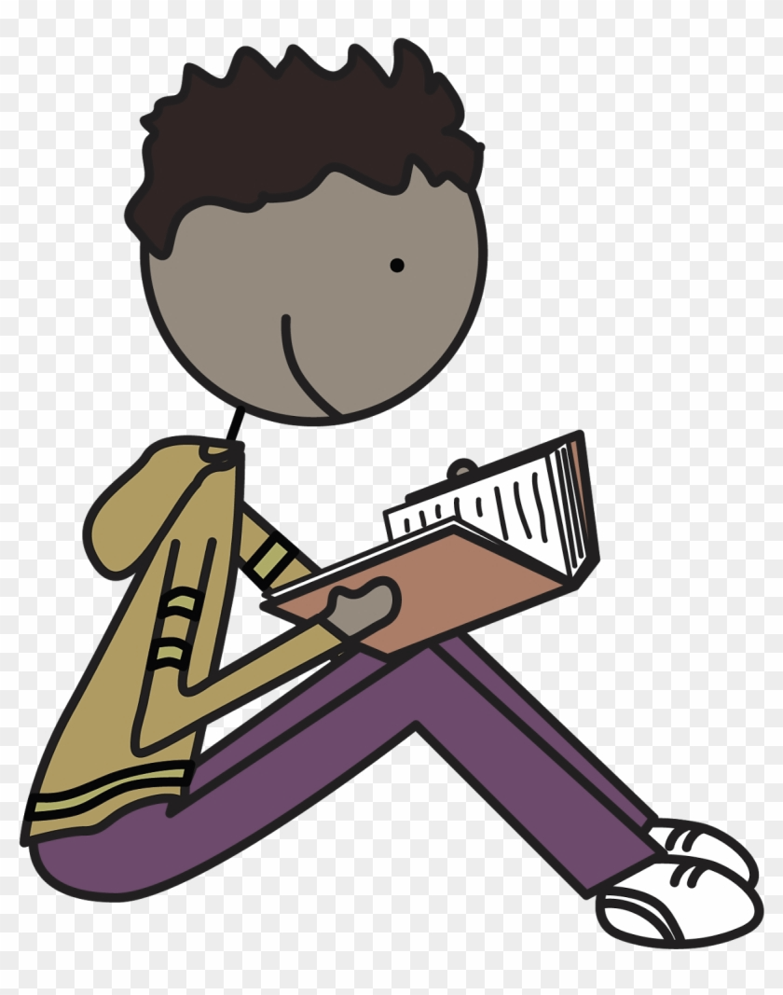
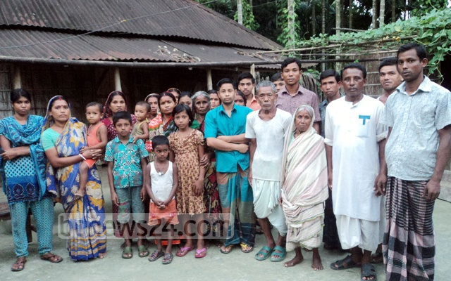
New Word
Ancestor
A person, typically one more remote than a grandparent, from whom one is descended
Syn.: forefather
Ant.: successor

Slide 12
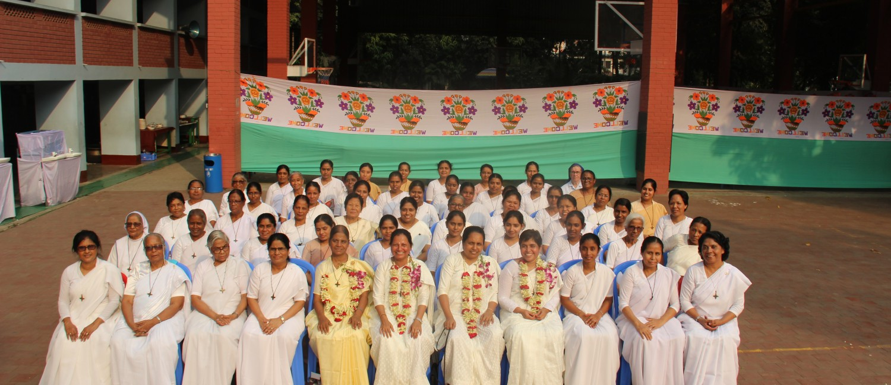
New Word
convent
A community of women who live a life devoted largely to religious worship
Syn.: Nunnery, priory

Slide 13
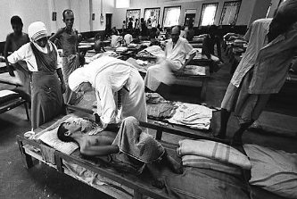
New Word
Devote
To give an amount of time, attention etc. to something
Syn.: dedicate, sacrifice

Slide 14
A: Read the text and choose the best answer.
It was Autumn. August 26, 1910. A little girl was born to an Albanian descent, rich Catholic merchant’s family in a small town called Skopje, Macedonia. --- --- --- --- --- --- --- --- --- --- --- --- --- --- --- --- --- --- --- --- --- --- --- --- --- ---
and in 1948 she received permission from her superiors to leave the convent and devote herself to work among the poorest of the poor in the slums of Kolkata.
TEXT

Slide 15
It was Autumn. August 26, 1910. A little girl was born to an Albanian descent, rich Catholic merchant’s family in a small town called Skopje, Macedonia. She was the youngest of the three siblings and was named Agnes Gonxha Bojaxhiu. Who had known that this tiny, little girl would one day become the servant of humanity– love and serve the poorest of the poor and become the mother of humanity. Yes, we are talking about none other than Mother Teresa.
At the age of 12, she heard a voice from within her that urged her to spread the love of Christ. She decided that she would be a missionary. At the age of 18 she left her parental home. She then joined an Irish community of nuns called the Sisters of Loreto, which had missions in India.

Slide 16
After a few months of training at the Institute of the Blessed Virgin Mary in Dublin, Mother Teresa came to India. On May 24, 1931, she took her initial vows as a nun. From 1931 to 1948, Mother Teresa taught geography and catechism (religious instruction) at St. Mary's High School in Kolkata (then Calcutta). However, the prevailing poverty in Kolkata had a deep impact on Mother Teresa's mind, and in 1948 she received permission from her superiors to leave the convent and devote herself to work among the poorest of the poor in the slums of Kolkata.
BACK

Slide 17
1. What does ‘servant of humanity’ mean in the text?
a) becoming a slave.
b) to work in other people’s house.
c) to be oppressed by others.
d) a mother figure who serves the poor like her own children.
2. Why did Mother Teresa want to be a missionary? Because she heard
a) the voice of her neighbours discussing it.
b) a voice in her dream.
c) a voice within herself.
d) heard the voice of her parents talking about it.
d) a mother figure who serves the poor like her own children.
c) a voice within herself.

Slide 18
3. Mother Teresa set out to join the missionary of the Sisters of Loreto in the year
a) 1927. b) 1928.
c) 1929 d) 1930.
4. Mother Teresa took her first vows at the age of
a) 18. b) 19.
c) 20. d) 21.
b) 1928.
d) 21.

Slide 19
B: Read the text in A again and answer the questions in one or two words or in a sentence if necessary.
1. Where did Mother Teresa’s ancestors come from?
2. Where was her father’s home?
3. Why did she want to become a missionary?
4. What makes her different from other girls at such an early age? What words and expressions are used in the text to describe this difference?
5. What did Mother Teresa do in the first seventeen years in India?

Slide 20
C: Look at the picture and talk about her in pairs. Take the help of the questions given below.
1. How old is she? Why do you think so?
2. What is she wearing?
3. How has she worn it?

Slide 21

D: Read the text in A again and answer the following questions.
When did Mother Teresa take her initial vows as a nun?
Where is St. Mary’s High School?
What had a deep impact on Mother Teresa’s mind?
How long and what did she teach at St. Mary’s High School?
Where is St. Mary’s High School?

Slide 22

D: Write the description of Mother Teresa’s physical features in your exercise book.

Slide 23
Thank you all.

