Slide 1

Welcome to all.

Slide 2
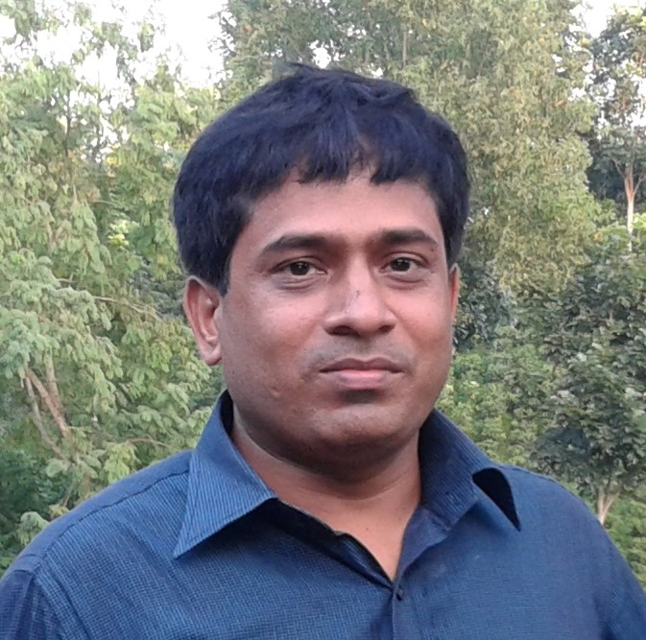
Conducted by
S. M. Monirul Islam
Assistant teacher in English
Govt. Model Secondary School,
Khulna Sadar, Khulna-9100,
Phone – 01711-397 309
E-mail: monirmodel@gmail.com
Subject : English 1st Paper
Class – IX-X,
Wednesday, November 27, 2019
10:28:36 PM

Slide 3
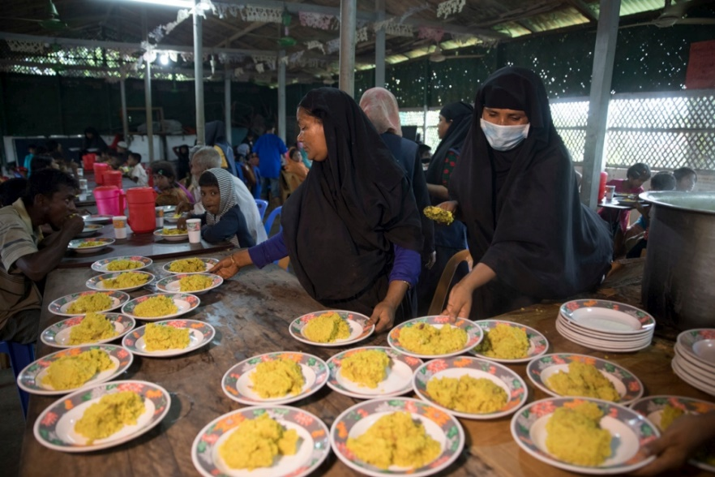
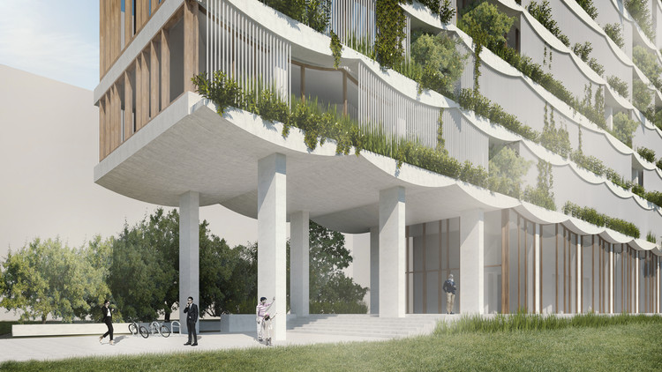
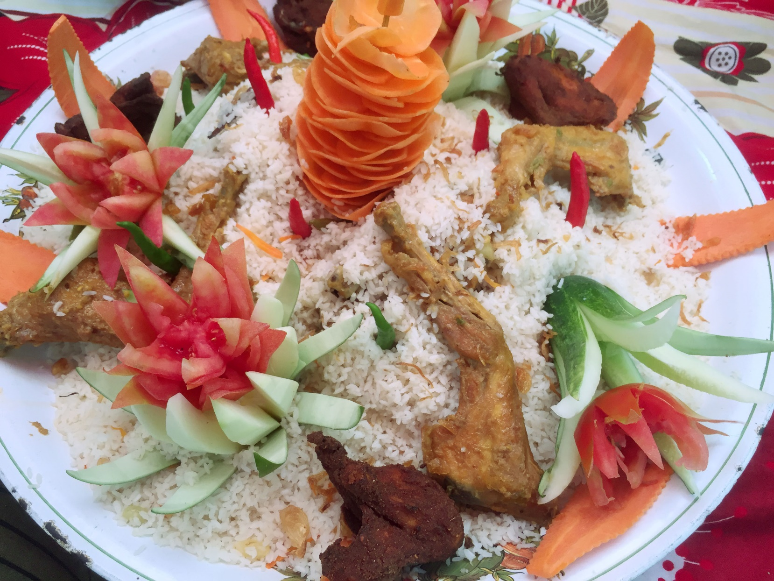
Let’s see some pictures.

Slide 4
Answer the following questions:
1. What do the people do in the trees and the boats?
2. Why do they do so?

Slide 5
See the video to get more information.
Please click here to go to the link to enjoy the video.

Slide 6
Our lesson -
Our Food and Shelter
Unit : IV
[Are We Aware?]
Lesson : 3

Slide 7
Learning outcomes
After the students have studied the lesson, they will be able to --- ---
ask and tell about problems.
seek and give suggestions.
give the answers according to questions.
narrate something in writing.

Slide 8
B: Discuss what will be our problems if our population becomes double the number we have now.

Slide 9
C: Read what the teacher Ms Choudhury and her students are talking about. Open at page no. 48 from your English for Today.

Slide 10
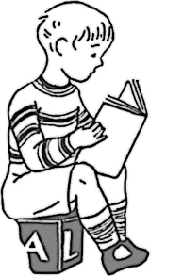



Slide 11
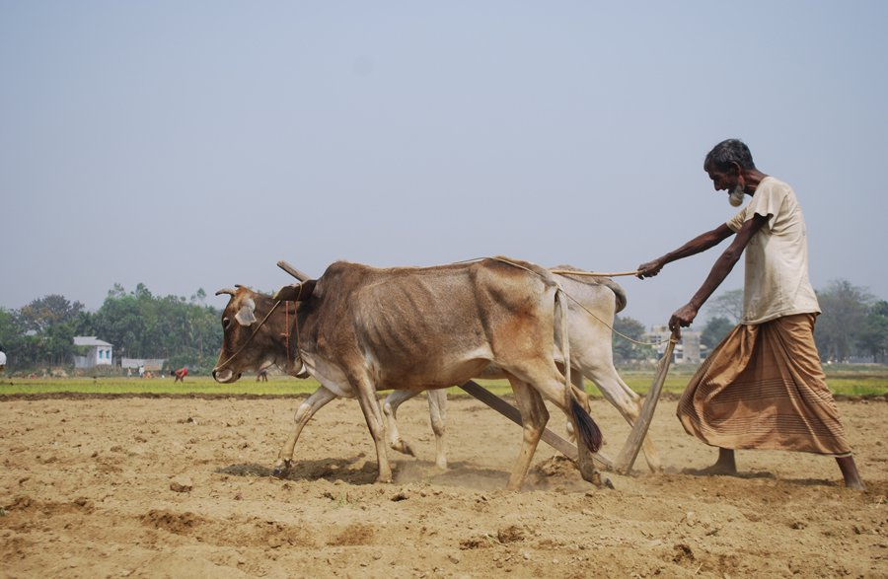
Arable (Adj)
Vocabulary
Meaning:
Suitable for growing crops
Syn.= Cultivable,

Slide 12
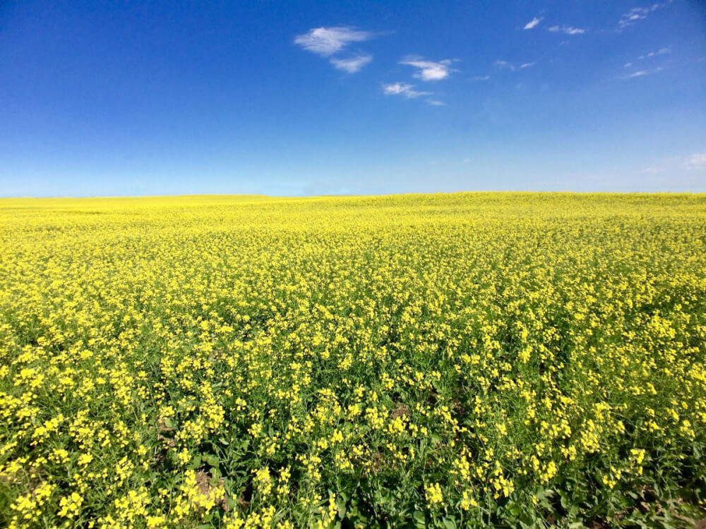
Mustard (N)
Meaning:
Spicy condiment / plant with pungent seeds
Mustardy (Adj.),

Slide 13
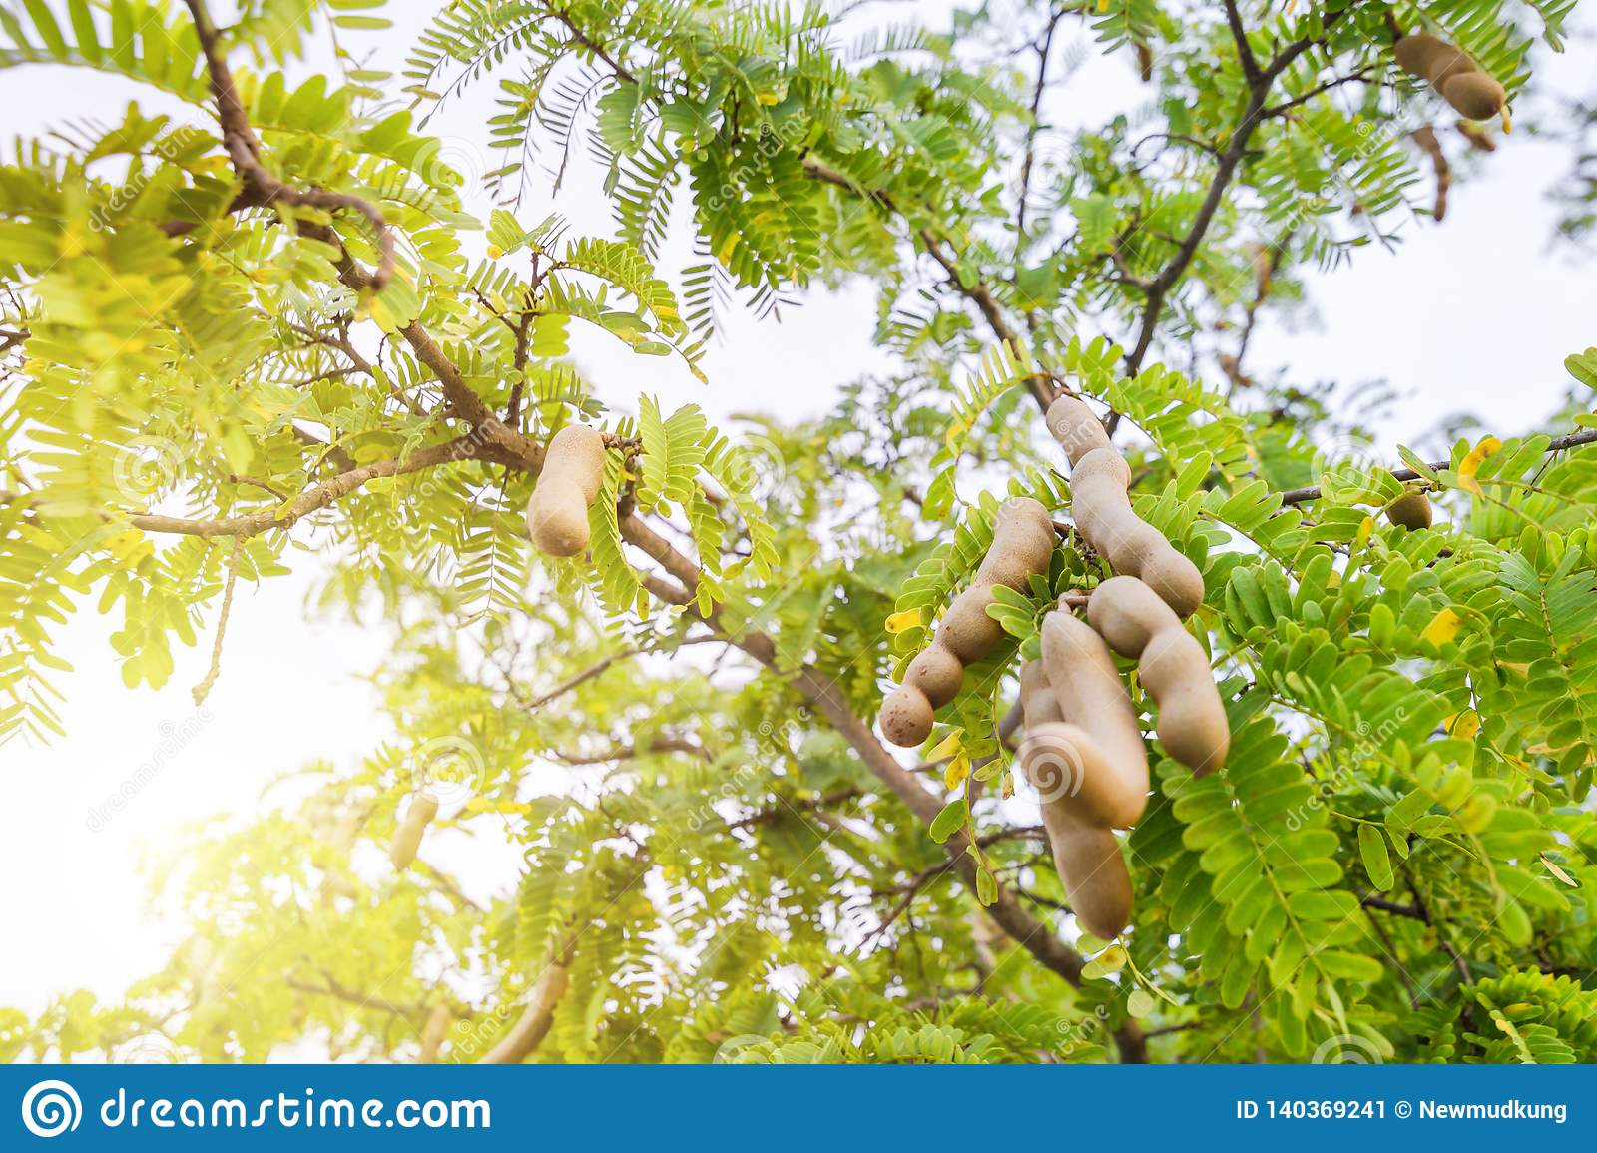
Tarmarind (N)
Meaning:
A tropical evergreen tree or its very sour fruit

Slide 14
D: Tick the best answer.
5. People are cutting trees to
a. plant more trees.
b. keep the environment clean.
c. make articles of furniture.
d. grow crops or make houses.
2. How can our housing problem increase or add to our food problem?
a. After making houses, farmers do not have enough time to work in the field.
b. After making houses, farmers do not have enough money to buy food.
c. If you do not have a house, you cannot store your food.
d. For making too many houses, people are using the crop land.
4. Many people may have to live on trees, because
a. they would like tree houses.
b. making houses on trees is less expensive.
c. they may not find land to make houses.
d. tree houses are safer during floods.
3. What makes our land shrink day by day?
a. Families are growing larger in size.
b. Houses and factories are being built on it.
c. Smaller families need smaller houses.
d. Land grabbers are occupying a portion of our land.
The rate of increase in food production cannot keep pace with the rate of population growth.
The sentence means that the food production
a is as much as needed.
b is less than what is needed.
c is more than what is needed.
d is sufficient for the population.
EVALUATION
√ b. Houses and factories are being built on it.
√ c. they may not find land to make houses.
√ d. grow crops or make houses.
√ b is less than what is needed.
√ d. For making too many houses, people are using the crop land.
TEXT

Slide 15
The class comes up with different problems. One group leader says, “The scarcity of food will be a serious problem. It is true that our agriculturists have developed new varieties of rice and its per acre production has definitely increased. But the rate of increase in food production cannot keep pace with the rate of population growth. This is because our land is fixed, i.e. we cannot increase it, while our population is increasing rapidly.”
Another group leader comes up with the housing problem in the country, which he says adds much to the food problem. He continues, “Families are growing larger in size and breaking into smaller families. Each such family needs a separate house to live in. Also the arable fields are being divided by these smaller families among themselves. Mills and factories are being set up, which occupy a considerable portion of our land. So when we need more land to grow more food to feed more mouths, our land is shrinking day by day. If our population grows at the present rate, a day will come when many people will not find any land to build a house on. And, as a result, many of them might live on trees or on the floating boats in the rivers.”
“No way,” another student argues. “Trees are being cut, hills are being cleared and water bodies are being filled up --- all to meet the needs of too many people.”
“Thank you students,” Ms Choudhury says, “You’re quite right. Let me tell you about this village where I was born and brought up. Things were not like this in the past. I remember as a child, the village was so beautiful! The green paddy fields and yellow mustard fields seemed to be unending. They used to wave and dance in the breeze. There used to be a wood in the northern side of the village. There was a tall tamarind tree in the middle of the wood. Also a big banyan tree looked like a huge green umbrella, with its aerial roots hanging down. I often used to go there with my age-mates. We would often have picnic there. While the boys would climb the tamarind tree and pick some tamarinds, me and my best friend Rima used to swing with the roots. But now, look, the wood is gone. The beauty of the crop fields is spoiled by the unplanned houses built here and there.”
BACK

Slide 16


Slide 17
Group-1:
Make a list of things Ms Choudhury saw as a child in the village. Why do you think she liked them?
The things Ms Choudhury saw as a child in the village are-
(i) Green paddy field,
(ii) Yellow mustard fields,
(iii) A tall tarmarid tree,
(iv) A big banyan tree,
(v) A wood in the northern side of the village.
From the next we know that she linked them as she tells her students in the class that her childhood days were delightful.

Slide 18
Group-2
Make a list of problems that caused by over population.

Slide 19
HOME WORK
F: Write a composition about your village or locality. Describe any change in the things you have noticed over the years such as houses, fields, trees, plants, etc.

Slide 20



