Slide 1
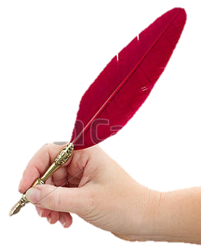
Welcome to my class
Tallest
Taller
Tall

Slide 2
ME
MD. ABDUR RAZZAK
HEAD TEACHER
DHALAHARA WESTPARA
SECONDARY GIRLS’ SCHOOL
E-mail: abdurrazzakmt@gmail.com
Phone number: 01721588402
TOPIC
COMPARISION OF ADJECTIVES
U-4_L-1
CLASS: EIGHT
Time: 50 min

Slide 3
highest
Let’s enjoy a video clip
higher
high

Slide 4
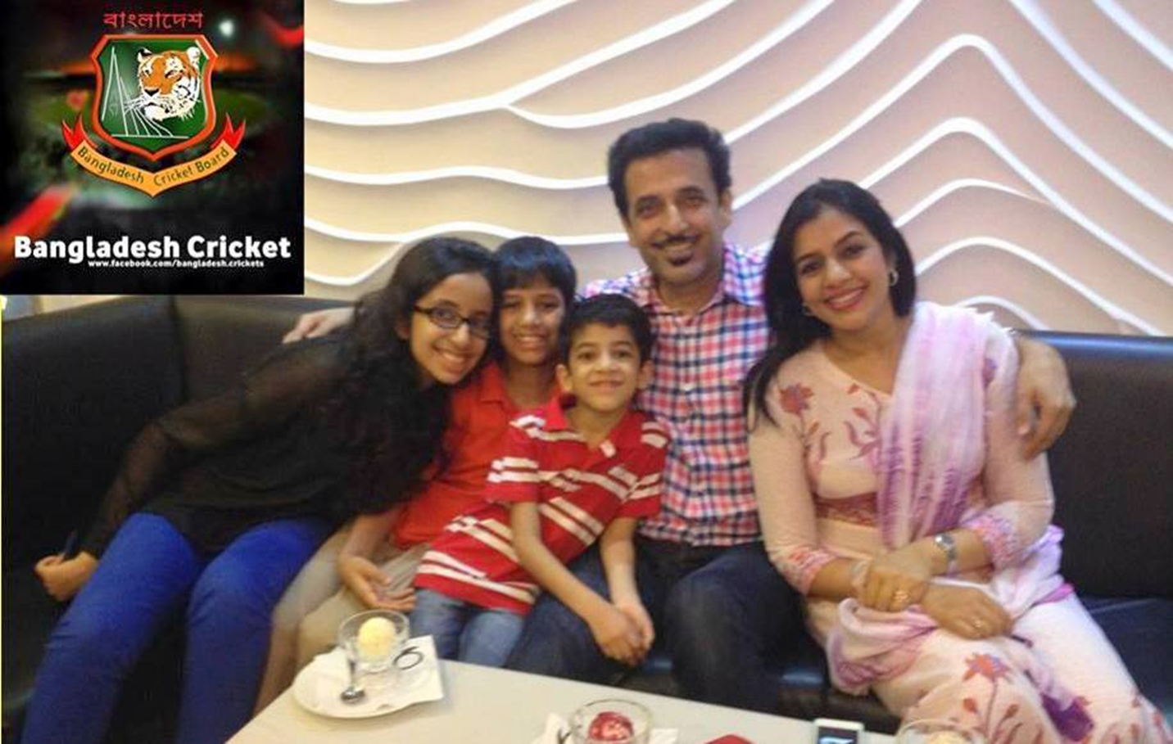
Observe the sentences, think and say.
Mr. Atahar Ali is a tall man of his family.
Qualifies his personality
An adjective
Abir is his younger son.
Qualifies Abir’s quality
An adjective

Slide 5
Observe the sentences, think, compare and say.
?
?
than Riad.
Rafi is --
In comparison Rafi is--
taller
tall
?
?
than Rafi.
In comparison Riad is--
Riad is--
smaller
small
Rafi
Riad

Slide 6
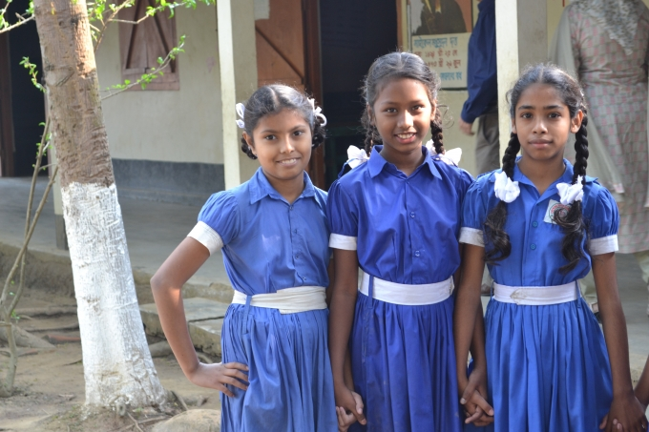
?
of all the three girls.
tallest
Rima is the
-------
?
Rama is the
-------
of all the three girls.
smallest
tall
comparison between--
small
taller
smaller
Rima
tallest
two adjectives
smallest
Rita
Rama
Degree of Adjectives

Slide 7
Could you guise what lesson we are going to enjoy today?
Tallest
Taller
Tall
So, our today’s lesson is—
COMPARISION OF ADJECTIVES /Degree of Adjectives

Slide 8
Learning outcomes
After the end of the lesson the learners will be able to---
1.
define comparison of adjectives/degree of adjectives.
2.
differentiate between singular and plural form of degree.
3.
use different kinds of degree in their real life.

Slide 9
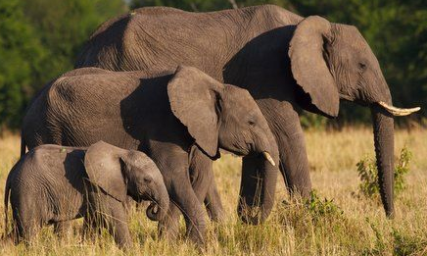
This is a large elephant
This is the largest elephant of all.
The word largest compare the animal’s size.
The word large qualifies animal’s quality
This elephant is larger than the smallest one.
Again, this elephant is not as large as the biggest one.
Similarly
The word larger compare the animal’s size.
So, the words as large as, larger and the largest are called Comparison of Adjectives or Degree of Adjectives and their kinds are of three.

Slide 10
positive degree
singular
plural
kinds of degree
superlative degree
comparative degree

Slide 11
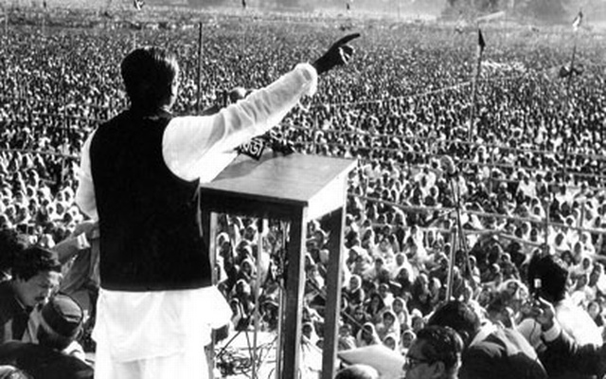
Observe the sentences, of different kinds of degree.
SINGULAR
FORM
positive:
No other speaker is as great as Sheikh Mujib.
Comparative:
Sheikh Mujib is greater than any other speaker.
superlative:
Sheikh Mujib is the greatest speaker.

Slide 12
plural form
positive:
Very few speakers are as great as Sheikh Mujib.
Comparative:
Sheikh Mujib is greater than most other speakers.
superlative:
Sheikh Mujib is one of the greatest speakers.
Difference between singular v plural
Singular form
positive:
No other speaker is as great as Sheikh Mujib.
Comparative:
Sheikh Mujib is greater than any other speaker.
superlative:
Sheikh Mujib is the greatest speaker.

Slide 13
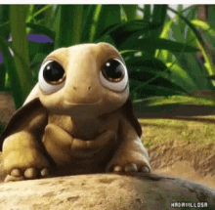
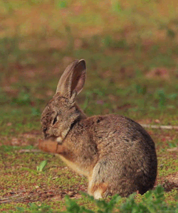
INDIVIDUAL WORK. 3 min
Make four sentences using degree according to direction.
Positive and comparative as singular form.
Positive and superlative as plural form.

Slide 14
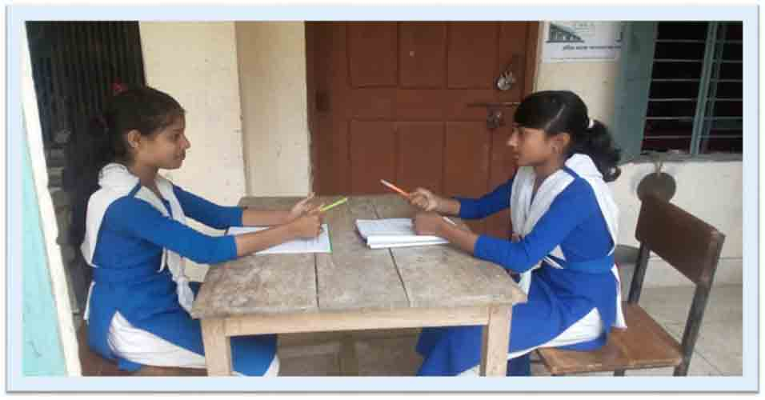
Jenny : Shanta,
you are short.
Let’s enjoy a dialogue
Shanta : Probably I am
not shorter than you.

Slide 15
Jenny : Sorry Shanta, I am taller than you.
Shanta : But you are not the tallest student in the class.

Slide 16
Jenny : I agree. Rita is the tallest girl in our class. Who is the shortest girl in our class?
Shanta : I am sure, it is not me. Probably Rimi is the the shortest girl in our class.

Slide 17
Jenny : Shanta, we should not label one as tall, taller, tallest or short, shorter, shortest without measuring their height.
Shanta : You are quite right, Jenny.

Slide 18
Note for you. 1
If the adjective is one syllabic, (er/r) is added at the end of comparative degree and (est/st) is added at the end of superlative degree. As:
Positive | Comparative | superlative
Tall Short Small Fast Slow Close Long High | Taller Shorter Smaller Faster Slower Closer Longer Higher | Tallest Shortest Smallest Fastest Slowest Closest Longest Highest
Positive | Comparative | superlative
Soft Sweet Weak Poor Rich Large Fine new | Softer Sweeter Weaker Poorer Richer Larger Finer newer | Softest Sweetest Weakest Poorest Richest Largest Finest newest

Slide 19
Note for you. 2
If the adjective is one syllabic, but ends with single consonant and before it vowel comes then consonant must be doubled. At the same the previous rule must be followed. As:
Positive | Comparative | superlative
big fat hot thin | bigger fatter hotter thinner | biggest fattest hottest thinnest
Note for you. 3
If the adjective is one syllabic, but ends with (y) and before (y) consonant comes then (y) must be changed into (i) As:
Positive | Comparative | superlative
busy dry heavy | busier drier heavier | busiest driest heaviest

Slide 20
PAIR WORK. 5 min
Fill in each gap with correct form of degree using the words from the box below.
Happy sad fast hot thin
1. Shila ran --------than Nila did.
2. The weather is -----today than yesterday.
3. Mr. Anin one the ------ men in the village.
4. Sumi is the -----of all the girls in our class.
5. This book is -------I have ever read.

Slide 21
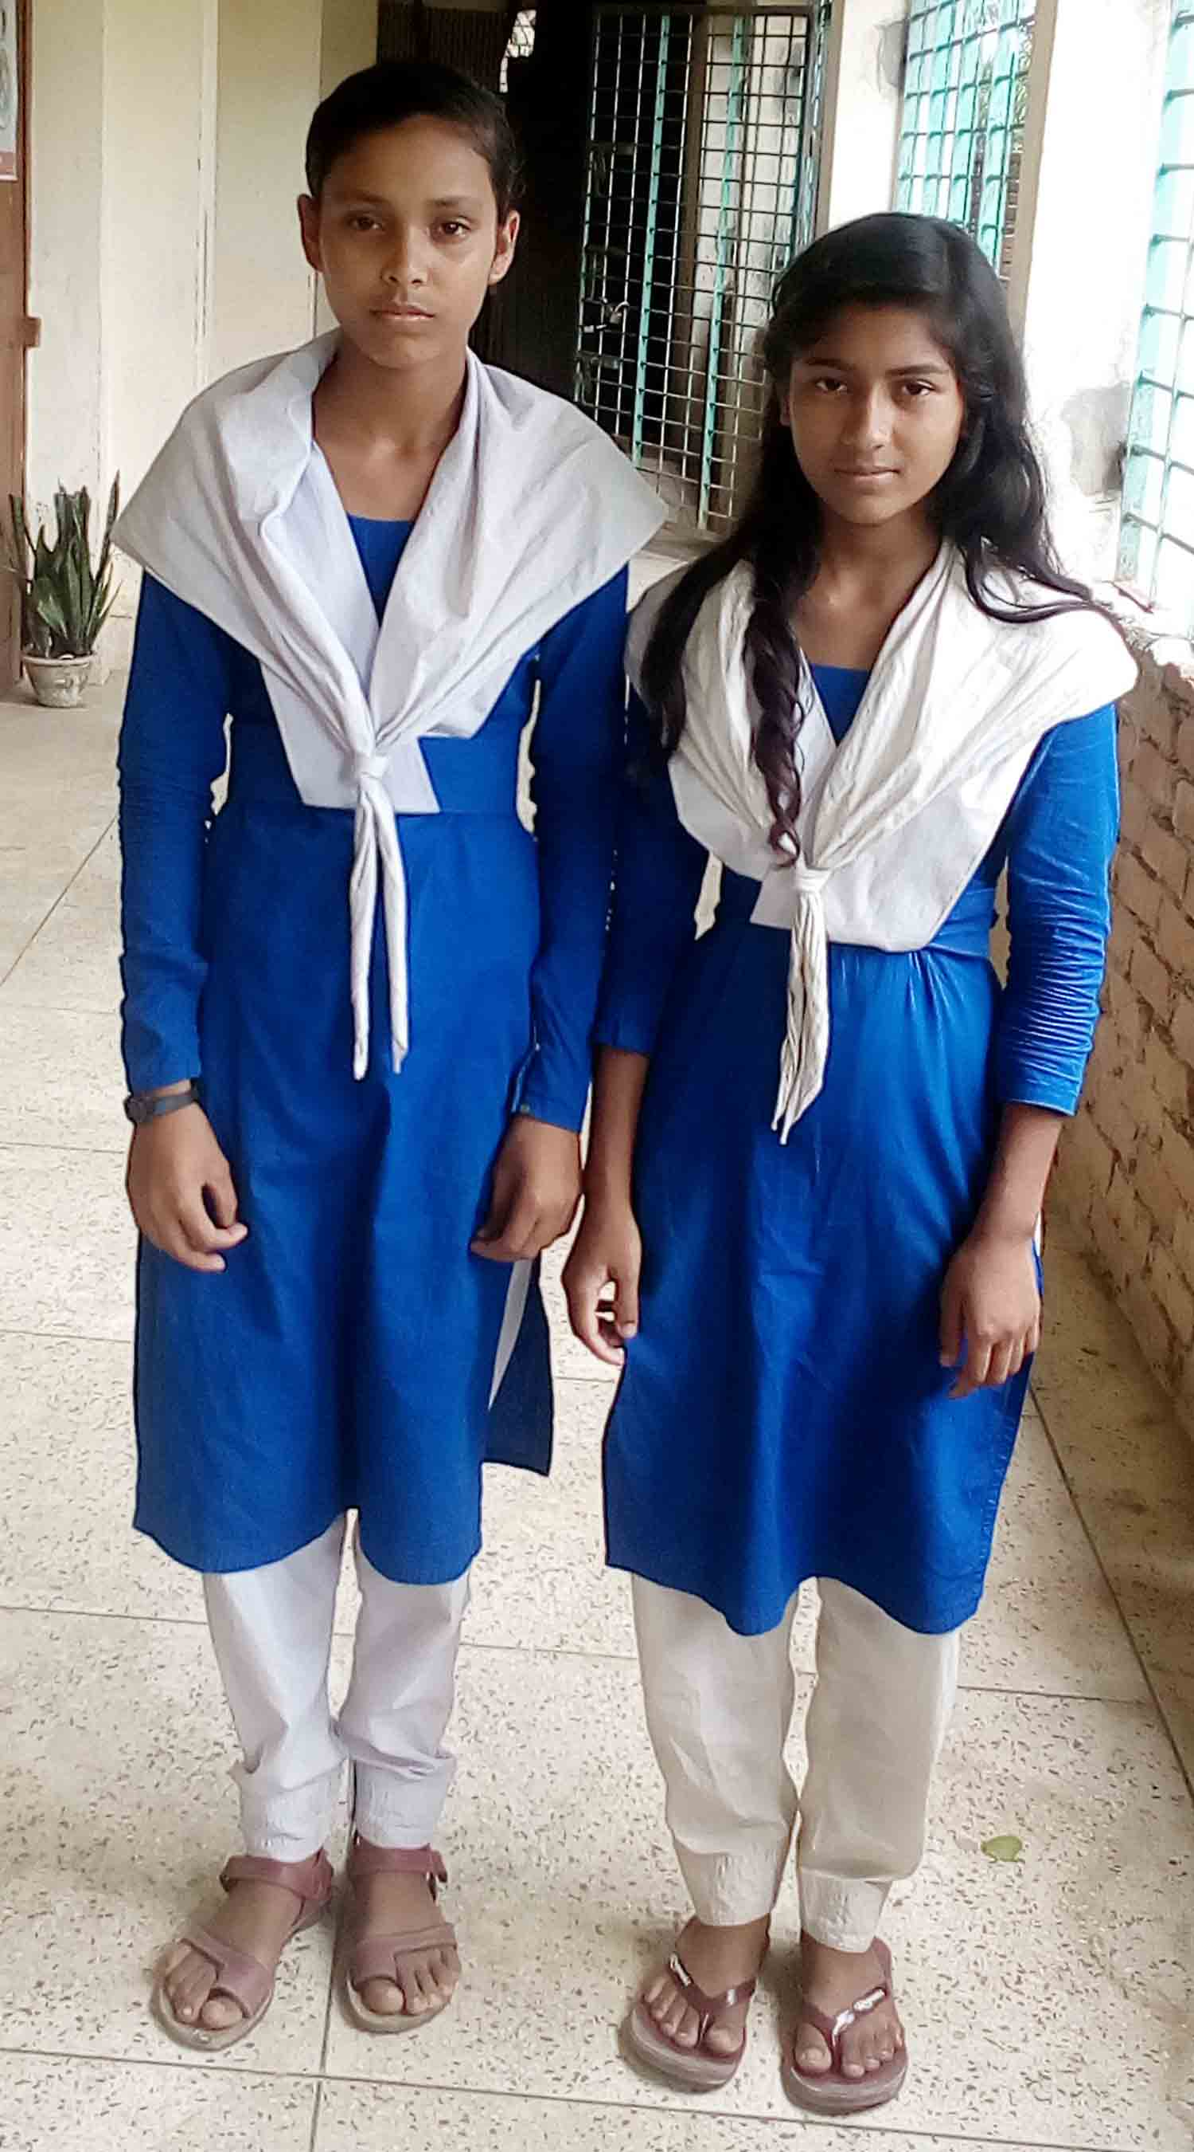
Let’s observe more about them.
positive:
Lili is as beautiful as Nila.
Comparative:
Nila is not more beautiful than Lili.
superlative:
Lili is the most brilliant student.
Note: If the adjective is not one syllabic, more and most are added before comparative and superlative degree. As:
Positive | Comparative | superlative
careful obedient famous | more careful more obedient more famous | most careful most obedient most famous

Slide 22
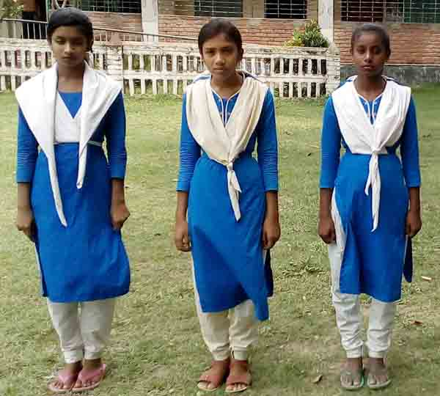
positive:
Rupa is not so good as Mila.
Comparative:
Mila is better than Rupa.
superlative:
Mila is the best student.
Some exceptional degree of adjectives. As:
Positive | Comparative | superlative
little many up Far late | less More upper farther less | least most upmost/uppermost farthest least

Slide 23
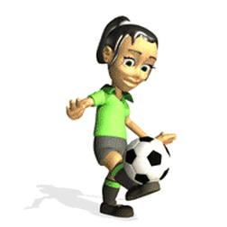
superlative:
Playing football is the most popular of all the games .
Comparative:
Playing football is more popular than all other games.
positive:
No other game is as popular as playing football .
of all/all other
Note: In superlative degree of all and in comparative degree all other is used but in positive degree of all/all other is understood. Sub.-singular

Slide 24
Group work 10 min.
Transform the following sentences as directed in bracket
1. Mr. Bashir is the busiest man. (comparative)
2. No other dramatist is as popular as Shakespeare (superlative)
3. Akbar is one of the greatest kings in India. (positive)
4. Sam is as little as Tamim. (comparative)
5. Habib is not so happy as Hasib. (comparative)
6. Ripa is better than most other girls. (positive)
7. Nothing is as easy as to say no. (superlative)
8. Kakoli is as bad as Nupur. (comparative)

Slide 25
Evaluation
Tick ($√$) the correct answer from alternatives.
1. What is the correct form of comparative degree of the word “careful”?
(b) more careful
(a) careful
$√100$%
$$×$$
(d) carefuller
(c) carefuler
$$×$$
$$×$$
2. What is the correct form of superlative degree of the word “hot”?
(a) hotter
(b) hoter
$$×$$
$$×$$
(c) hottest
(d) most hot
$√$100%
$$×$$

Slide 26
3. Rima is the best girl in our class. positive form of “best”?
(a) best
(b) good
$$×$$
$√100$%
(c) more better
(d) more good
$$×$$
$$×$$
4. Hena is (old) girl. Superlative form of “old”?
(a) older
(b) elder
$$×$$
$$×$$
(c) the eldest
(d) most eldest
$√$100%
$$×$$
5. What is the superlative form of “busy”?
(a) busier
(b) Most busy
$$×$$
$$×$$
(c) busiest
$√$100%
(d) most busiest
$$×$$

Slide 27
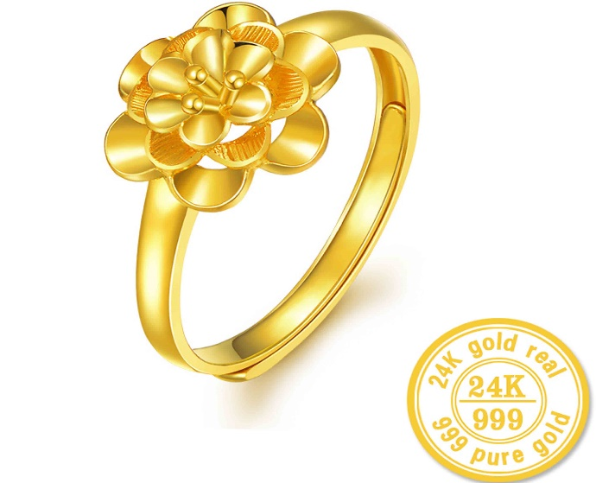
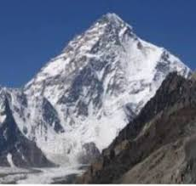
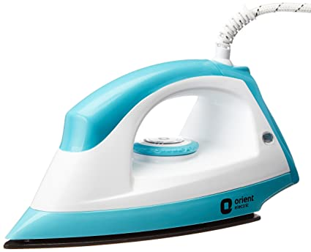
Homework
Make five sentences using degree according to direction (adjective).
Himalayas
iron
gold
precious as positive
& comparative
high as positive
& superlative
useful as superlative-plural

Slide 28
See you next class
Tallest
Taller
Tall

