Slide 1
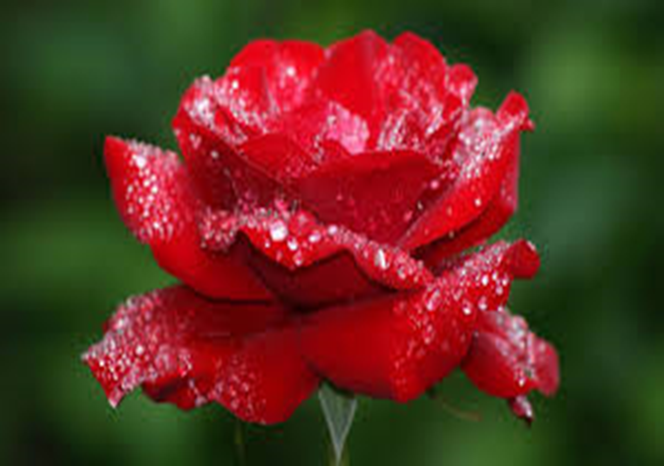
W
E
L
C
O
M
E
W
E
L
C
O
M
E

Slide 2
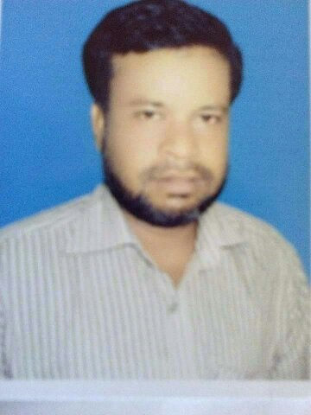
Teacher’s introduction
Md. Mukul Mia M.A in English, B.Ed
English Teacher
M.A Sattar Adarsha High School,Kurigram.
Mob:0 17 17 17 17 41
E-mail:mukulict30@gmail.com

Slide 3
Subject: English
Class: Eight
Section: B
Shift: Day

Slide 4
Look at the following pictures
Gold

Slide 5
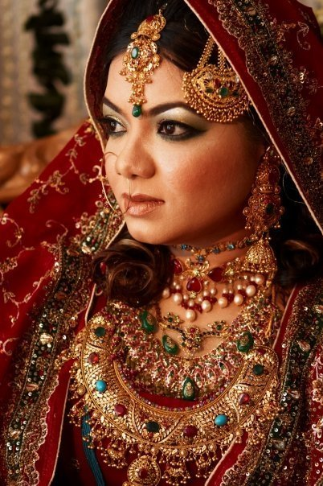

Slide 6
Pearls

Slide 7
Pearls! Pearls! Pearls!
Todays lesson is:
unit:7 lesson 1

Slide 8
Learning Outcomes
After we have studied this lesson, we will be able to
Read and understand texts through silent reading
Ask and answer questions

Slide 9
Learning Outcomes
Students are able to----------
1.Read and understand texts
2.through silent reading
3.Ask and answer questions

Slide 10
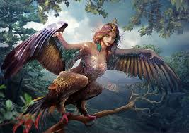
Some Key Words
Mythology
Life begins at forty is a popular mythology
-Ideas that many people think are true but that do not exist or false .

Slide 11
Ancient
These are ancient buildings
Meaning-Belonging to a period of history that is thousands of years in the past.

Slide 12
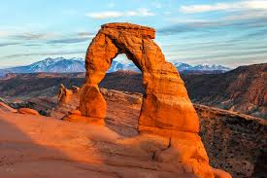
Delicate
Delicate- babies have very delicate skin
Meaning-easily damaged or broken

Slide 13
Read the following questions
1.Do you think ‘pearls’ were discovered by accident ? Why ?
2. Why do you think pearls were valued so much in the past ?
3. What good luck the knights thought would pearls bring them ?

Slide 14
Now read the text in section B silently and answer the above questions

Slide 15
C. Read the text in B again and write the information in the table.
Who | When / Where
The ancient Egyptians | wore | pearls
The Greeks
The ancient Romans
The brave knights

Slide 16
Now check your answers
Who | When / Where
The ancient Egyptians | wore | pearls | when they were buried.
The Greeks |  |  | when they got married
The ancient Romans |  |  | as a sign of wealth and social status.
The brave knights |  |  | in the battles for good luck.

