Slide 1
welcome
How are you?

Slide 2
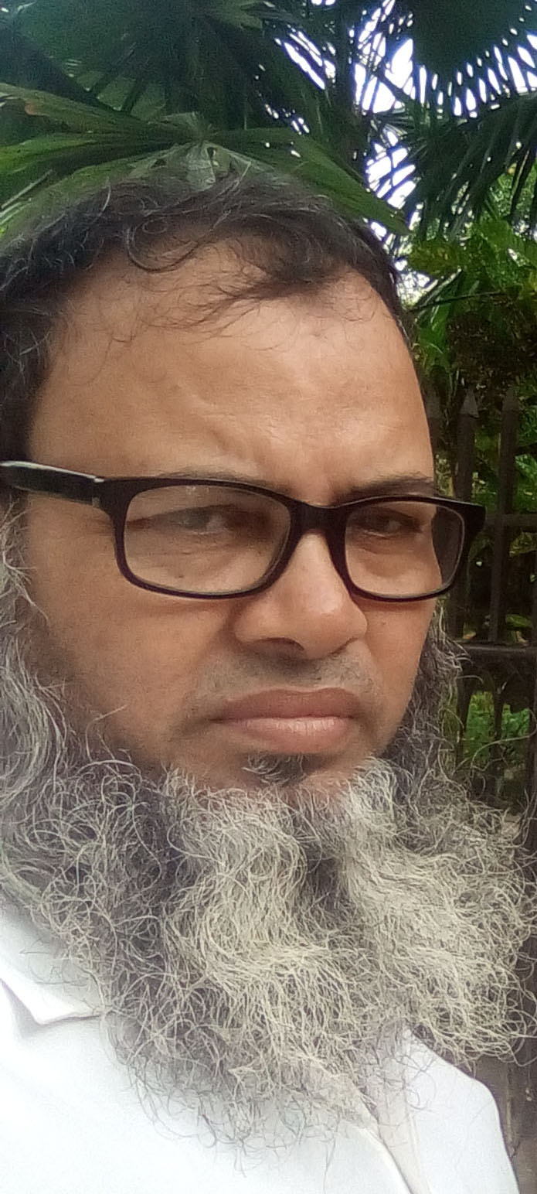
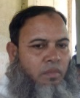
INTRODUCTION
CLASS: 8/9/10
SUBJECT: ENGLISH SECOND PAPER
TOPIC: Voice Change.
Md. Mahfuzu Alam
Head Teacher
Munshinagar High school
Curain, Nawbgonj, Dhaka
-----------------------------------------------------------

Slide 3
What do you think about the picture?
CHANGE IN VOICE, SIR
-----------------------------------------------------------

Slide 4
Today our topic is
Voice change (part-2)
-----------------------------------------------------------

Slide 5
LEARNING OUTCOMES OF THE LESSON
By the end of the lesson the students will be able to
Change in voice ( reflexive pronoun & quasi passive verb)
Change in voice (different types of sentences)
Solve the board question.
-----------------------------------------------------------

Slide 6
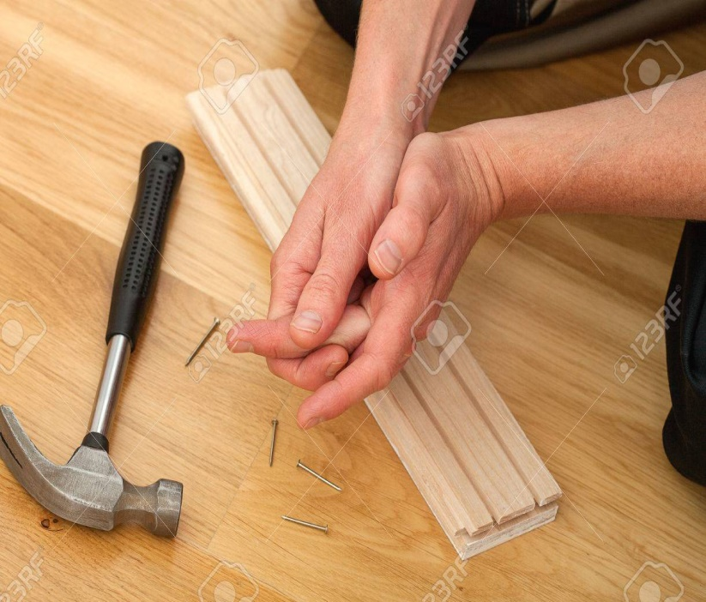
Reflexive pronoun যুক্ত sentence এর voice change।
Self যুক্ত pronoun ই reflexive pronoun (myself, himself)
১। প্রথমে subject যাহা আছে তাহাই লিখবে। ,
২। Tense অনুসারে helping verb লিখবে,
৩। মুল verb এর past paticiple রুপ লিখবে.
৪। Reflexive pronoun এর পুর্বেএকটি by যোগ করবে
He hurt himself.
He
was
hurt
by himself

Slide 7
Quasi-passive verb এর voice change.
১। প্রথমে subject যাহা আছে তাহাই লিখবে। ,
২। is লিখে adjective লিখবে ,
৩। অতপর একটি when it is যোগ করবে.
৪। মুল verb এর past participle লিখবে।
Honey taste sweet
Honey is sweet
when is tasted

Slide 8
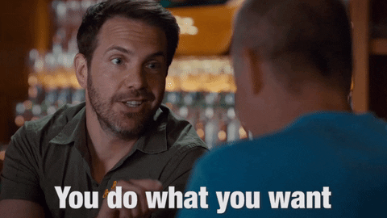
Interrogative sentence
Interrogative sentence what/which দ্বারা শুরু হলে,
১। what/which প্রথমেই থেকে যাবে ,
২। Tense অনুসারে helping verb লিখবে,
৩। মুল verb এর past paticiple রুপ লিখবে,
৪।একটি by যোগ করে subject কে object করবে,
What do you want?
What is wanted by you.
Which book do want ?.
Which book is wanted by you.
--------------------

Slide 9
Interrogative sentence who দ্বারা শুরু হলে,
১। প্রথমেই By whom লিখবে। ,
২। Tense অনুসারে helping verb লিখবে,
৩। object কে subject করবে, ,
৪। মুল verb এর past paticiple রুপ লিখবে
Who opened the door?
By whom
was
the door
opened?

Slide 10
Interrogative sentence whom দ্বারা শুরু হলে,
১। প্রথমে who লিখবে। ,
২। Tense অনুসারে helping verb লিখবে,
৩। মুল verb এর past paticiple রুপ লিখবে.
৪। একটি by করে subject কে object করবে
Whom are you calling?
Who
is being
called
by you?

Slide 11
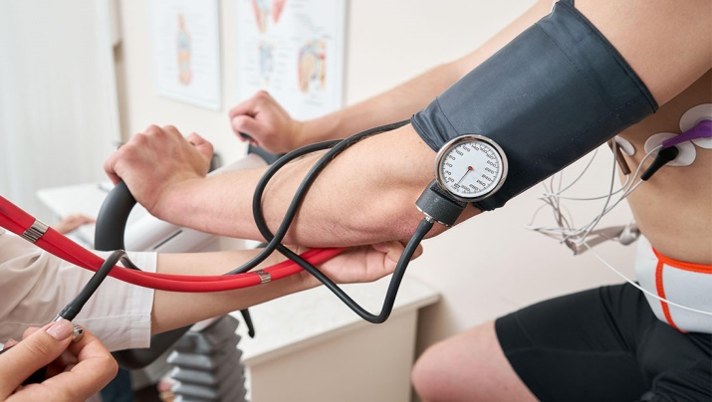
Imperative sentence
Imperative sentence মুল verb দ্বারা শুরু হলে,
১। প্রথমেই let লিখবে,
২। object কে subjectকরবে,
৩। সাহায্য verb হিসেবে be লিখবে
৪। verb এর past paticiple রুপ লিখবে
do the sum
Let
the sum
be
done
Take care of your health.
Let
your health
be
taken care of
--------------------

Slide 12
Imperative sentence যদি Let দ্বারা শুরু হয়
১। প্রথমেই let লিখে শেষের object টি লখবে।
২। সাহায্য verb হিসেবে be লিখবে ,
৩। verb এর past paticiple রুপ লিখবে
৪। একটি by যোগ করে let এর পরের object টি লখবে
let her do the sum
Let
the sum
be
done
by her
Let me have a cup of milk.
Let
a cup of milk
be
had
by me
--------------------

Slide 13
Imperative sentence যদি Let দ্বারা শুরু হয়
১। প্রথমেই let লিখে শেষের object টি লখবে।
২। সাহায্য verb হিসেবে be লিখবে ,
৩। verb এর past paticiple রুপ লিখবে
৪। একটি by যোগ করে let এর পরের object টি লখবে
let her do the sum
Let
the sum
be
done
by her
Let me have a cup of milk.
Let
a cup of milk
be
had
by me
--------------------

Slide 14
Active voice এ যদি determine /decide /demand/ agree/arrange + to + verb/ verb+ ing থাকে তবে
১। প্রথমেই subject + ঐ verb টি লখবে।
২। একটি that যোগ করে object টি লিখবে ,
৩। একটি should be যোগ করবে
৪। verb এর past paticiple রুপ লিখবে
He determined to sell the house
He determined that
the house
should be
sold
--------------------

Slide 15
Evaluation
He determined to sell the house (passive)
He determined that the house should be sold.
He advised giving up smoking. (passive)
He advised that smoking should be given up.
She fans herself. (passive)
She is fanned by herself.
The pen writes well. (passive)
The pen is well when it written with.
Who can do this? (passive)
By whom can this be done?
Buy me a shirt. (passive)
Let a shirt be bought for me.
Let me write a letter. (passive)
Let a letter be written by me.

Slide 16
Board questions
Do you know it? (passive)
Is it known to you?
All the students respect him very much. (passive)
He is very much respected by all the students.
More and more books should be read (active)
We should read more and more books
Fundamental education had been given to him at the school . (active)
His teacher had given him fundamental education at the school .
He did not find any way. (passive)
Any way was not found by him.
The bear smelt his ears, nose and face. (passive)
His ears, nose and face were smelt by bear
People hate a corrupted man. (passive)
A corrupted man is hated by people.

Slide 17
Homework
Every year natural disasters visit us (passive).
I accepted the invitation (passive).
Television should telecast educative programmers (passive).
We present flower our friends (passive).
The thief was caught (active).
It paralyses the whole nation (passive).

Slide 18
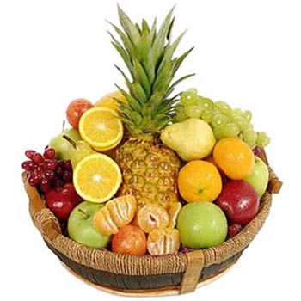
Thanks for Everybody

