Slide 1
Welcome

Slide 2

Teacher’s Information
Md. Rabiul Mowla
Assistant teacher
Mogdhara Adorshopara govt. primary school

Slide 3
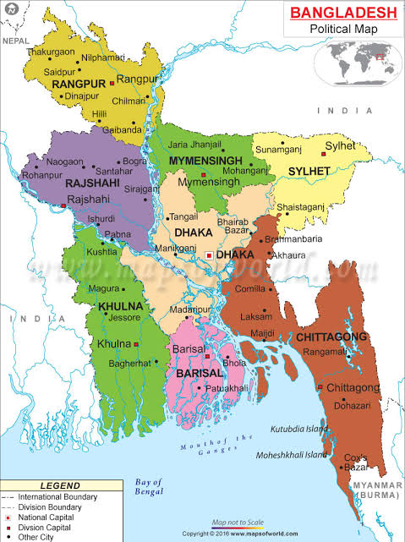
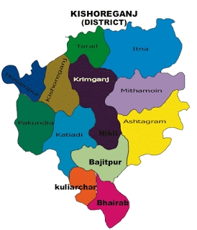
Can you see the picture?

Slide 4
Today’s Lesson
My home district
Unit-10
Lesson 1-2

Slide 5
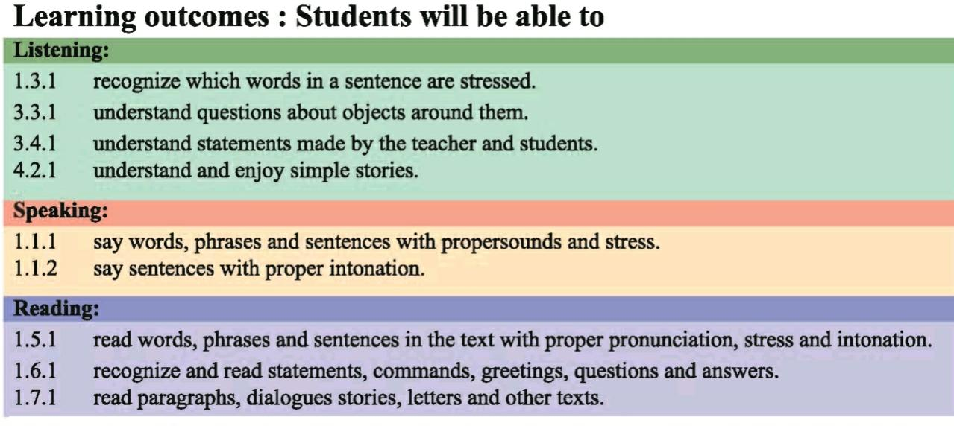
Learning Outcomes

Slide 6
Mamun’s home district

Slide 7
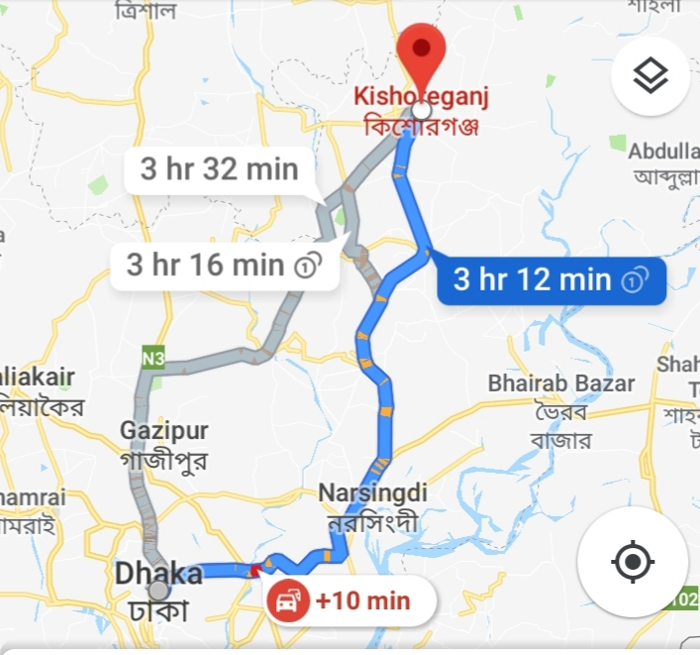
Kishoreganj is about 145 kilometres from Dhaka.

Slide 8
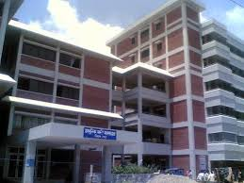
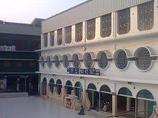
108 unions
8 municipalities
1745 villages
13 Upazilas

Slide 9
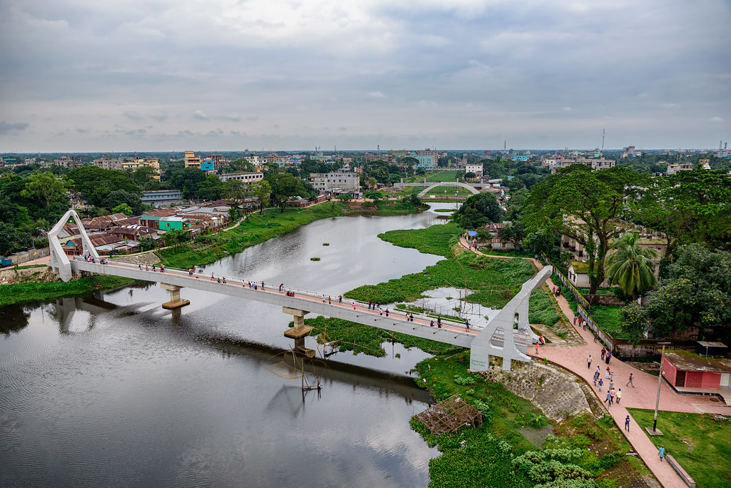
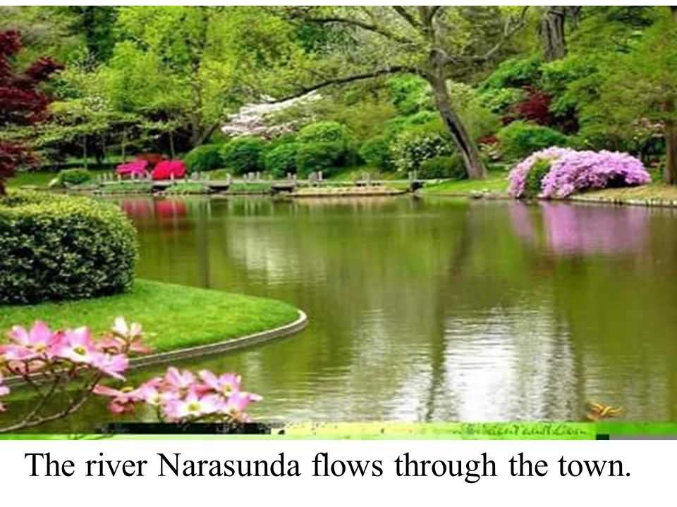

Slide 10
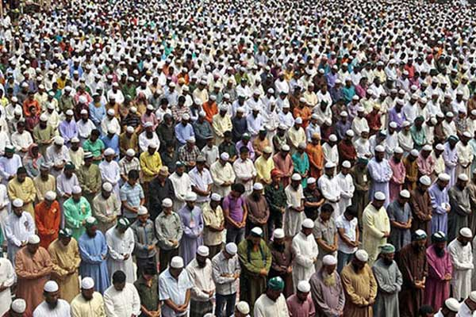
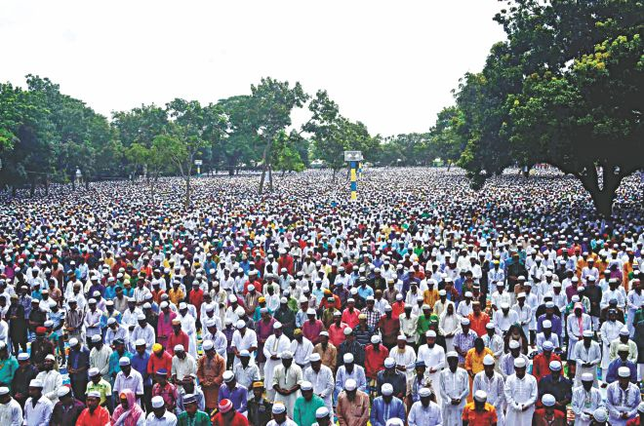
Largest Eid Ground at Solakia

Slide 11
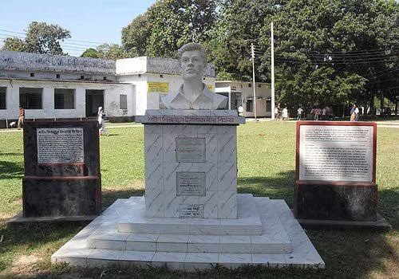
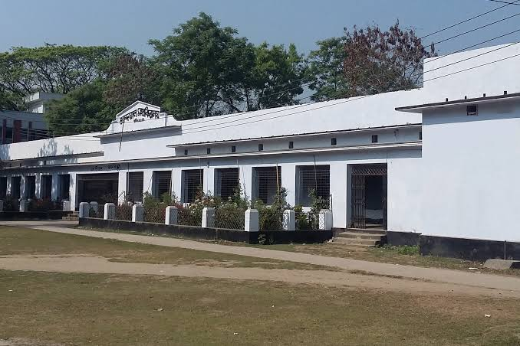
Government Gurudayal College

Slide 12
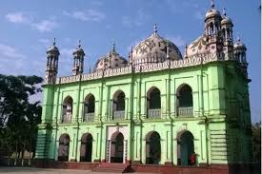
Pagla Mosque

Slide 13
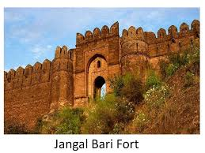
Fort of Isha khan at jangle Bari

Slide 14
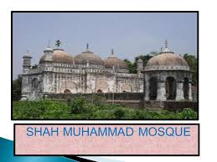
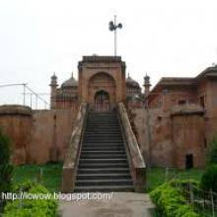
Shah Mohammad Mosque

Slide 15
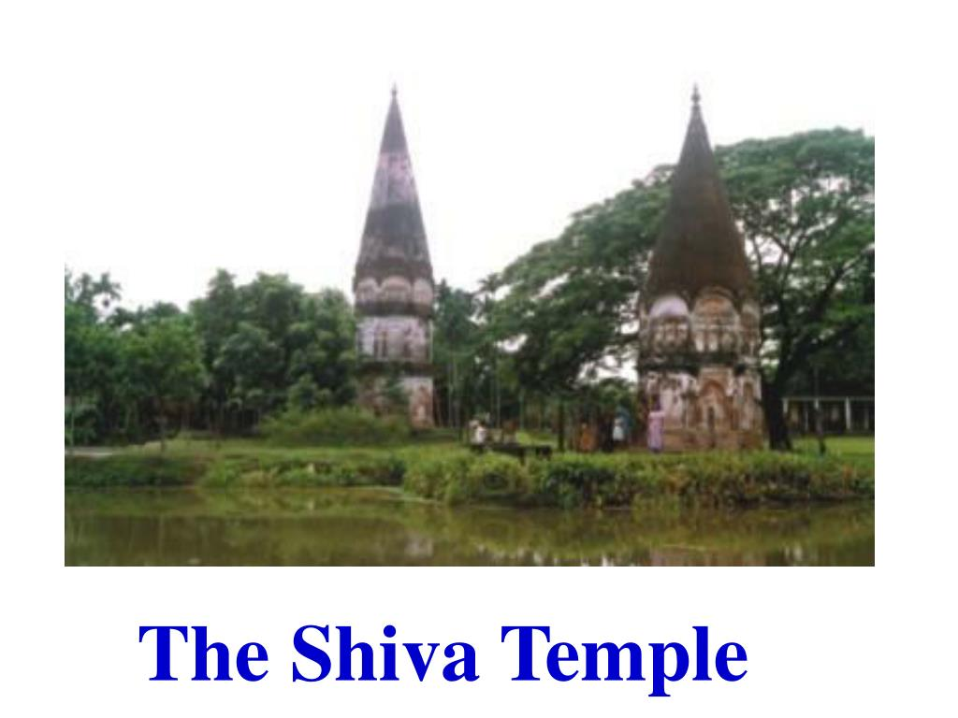
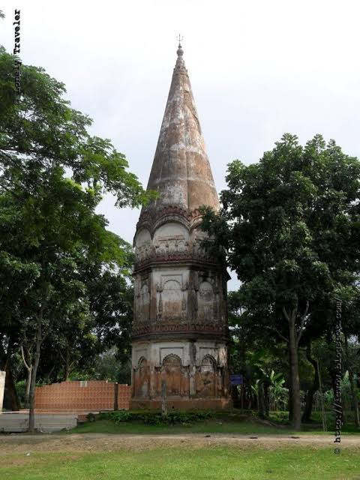
Shiva Temple at Fuleshori river

Slide 16
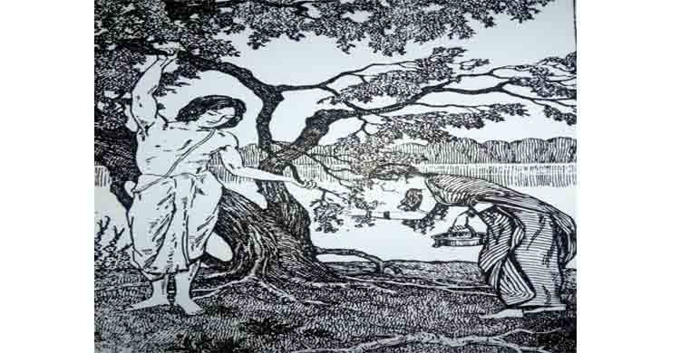
The first woman poet of bangla literature.
Chandrabati

Slide 17
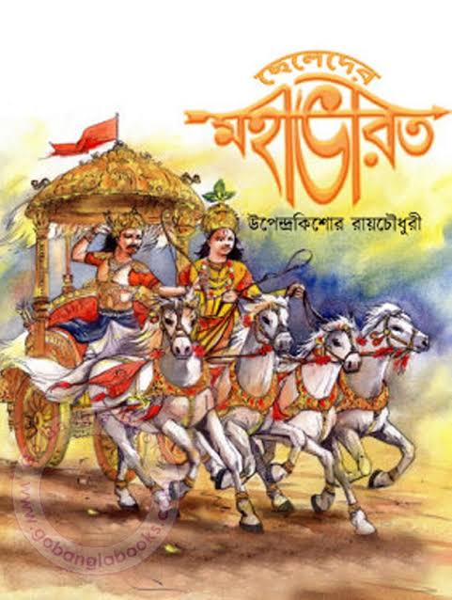
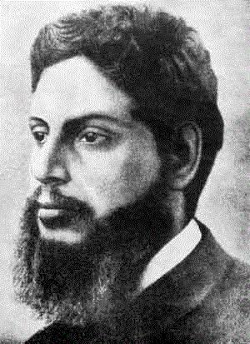
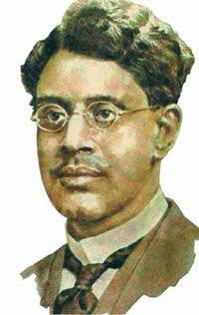
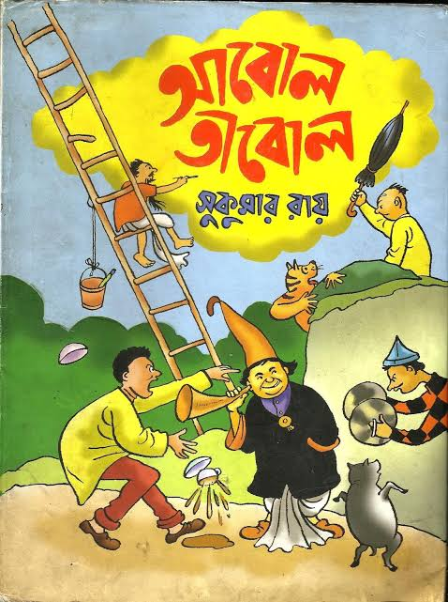
Upendrakishore Roy
Two famous writers of children literature
Sukumar Roy

Slide 18
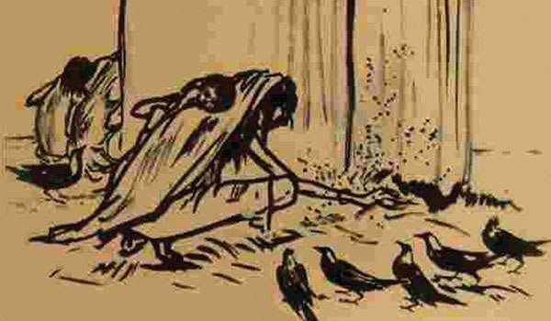
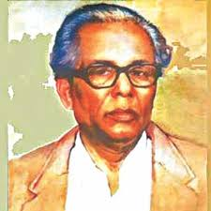
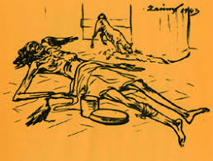
The great painter
Zainul Abedin

Slide 19
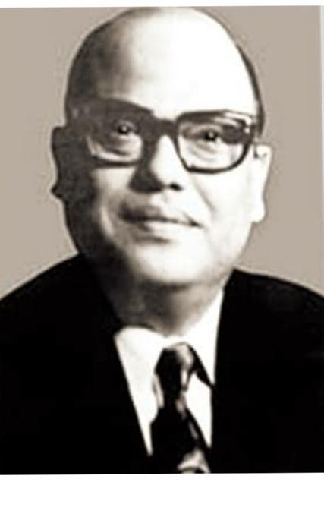
Syed Nazrul Islam
The first acting President of Bangladesh

Slide 20
Now read the text silently.

Slide 21
Evaluation
Say true or false
1. Kishoreganj is about 140 kilometres from dhaka.
2. Kishoreganj is a small town.
3. The fuleshwari river flows through the town.
4. Chandrabati was the first woman poet of bangla literature.
5. Syed Nazrul Islam was the first acting prime minister of Bangladesh.
False
True
False
True
False

Slide 22
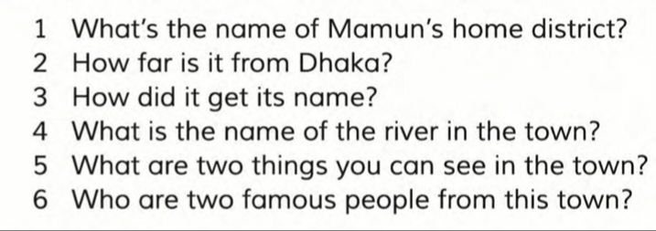
Pair work

Slide 23
Group work
Make a list of important places in Kishoreganj. Which place do you think is the most interesting? Why? Discuss with your groupmates.

Slide 24
Thank you

