Slide 1
Welcome

Slide 2

Teacher’s Information
Md. Rabiul Mowla
Assistant teacher
Mogdhara Adorshopara govt. primary school

Slide 3
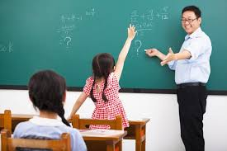

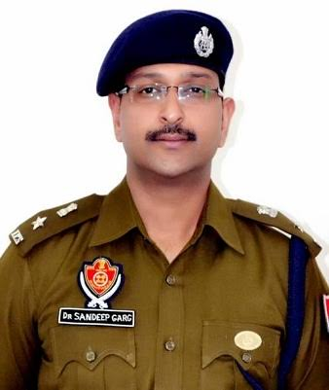
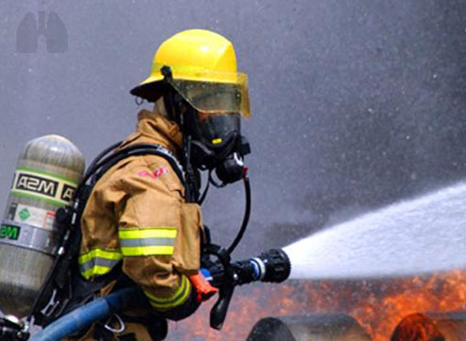
Can you see the picture ?

Slide 4
Today’s Lesson
Occupation
Unit-9
Lesson 1-2

Slide 5
Learning Outcomes
After the lesson students will be able……….
to become a firefighter.
to safe himself from the fire.
to explain the fire.

Slide 6
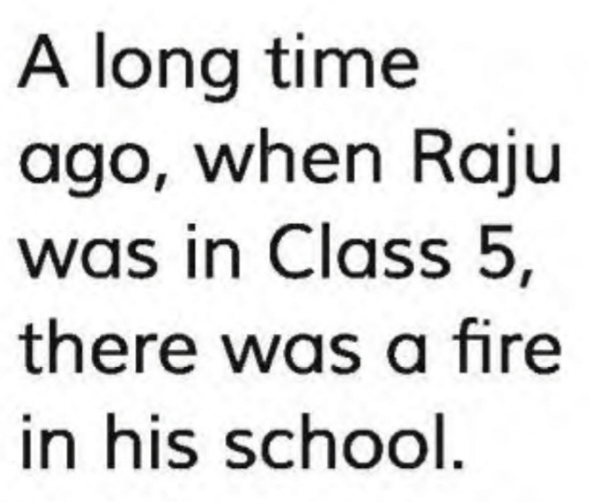
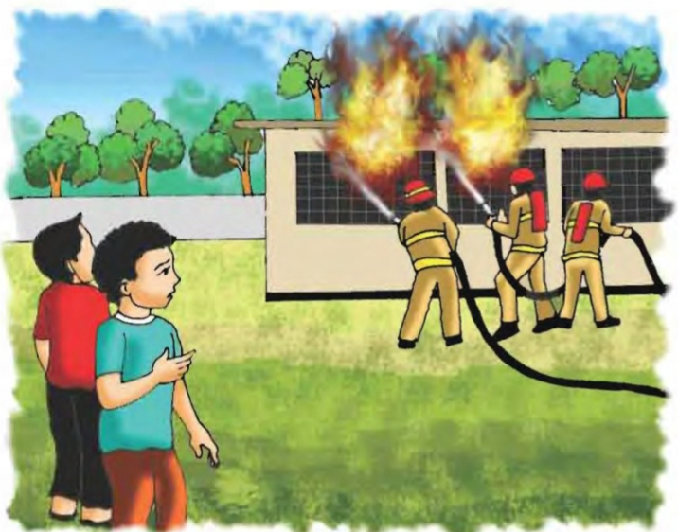

Slide 7

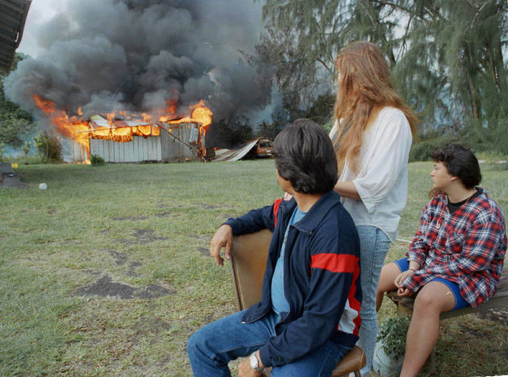

Slide 8
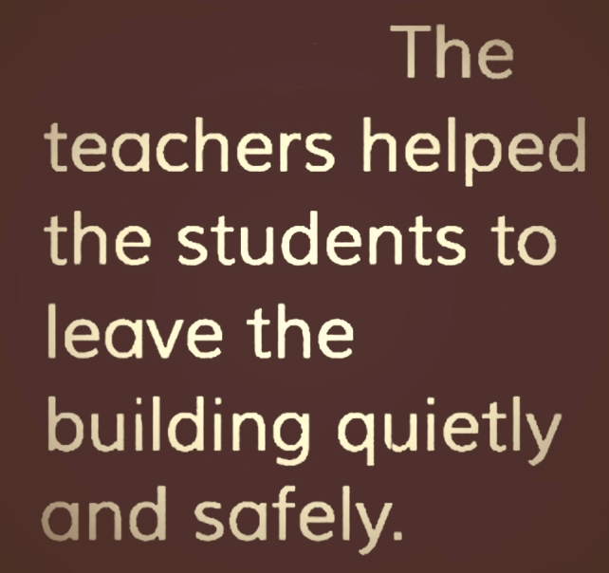
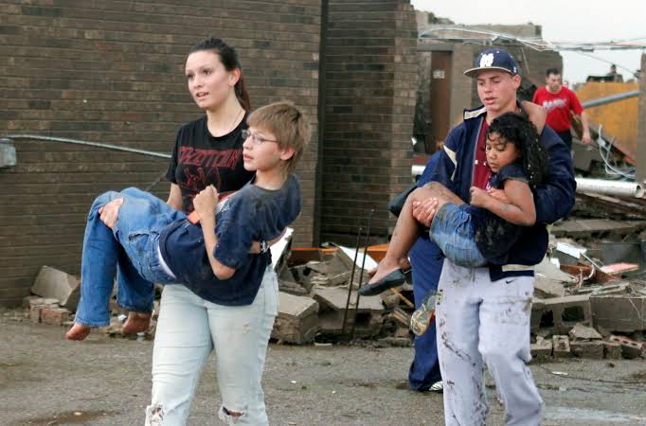

Slide 9
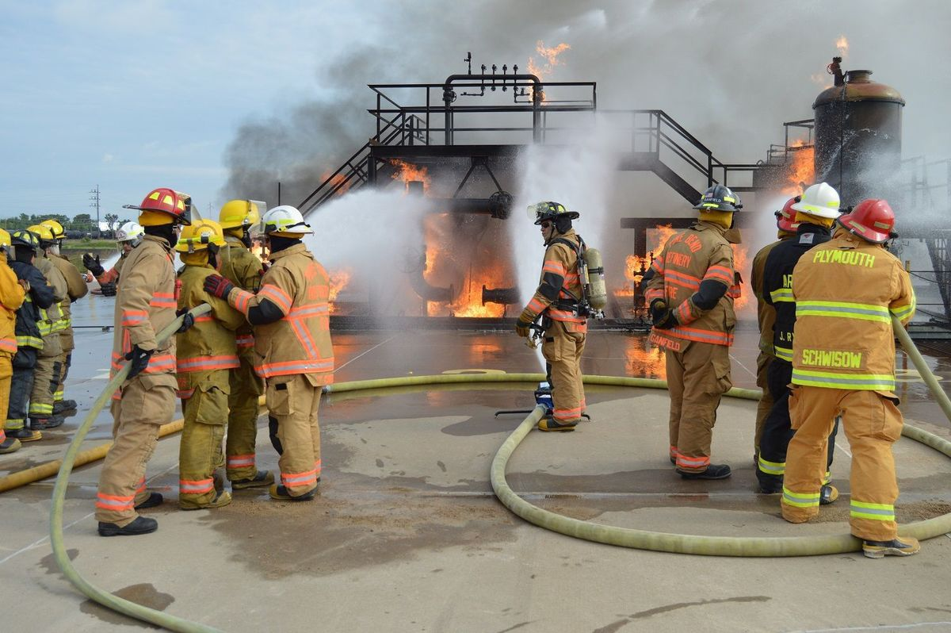
Soon the firefighters came and put out the fire.

Slide 10
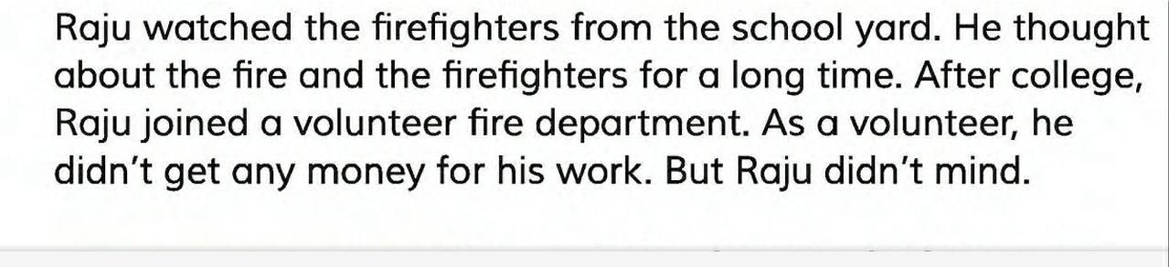
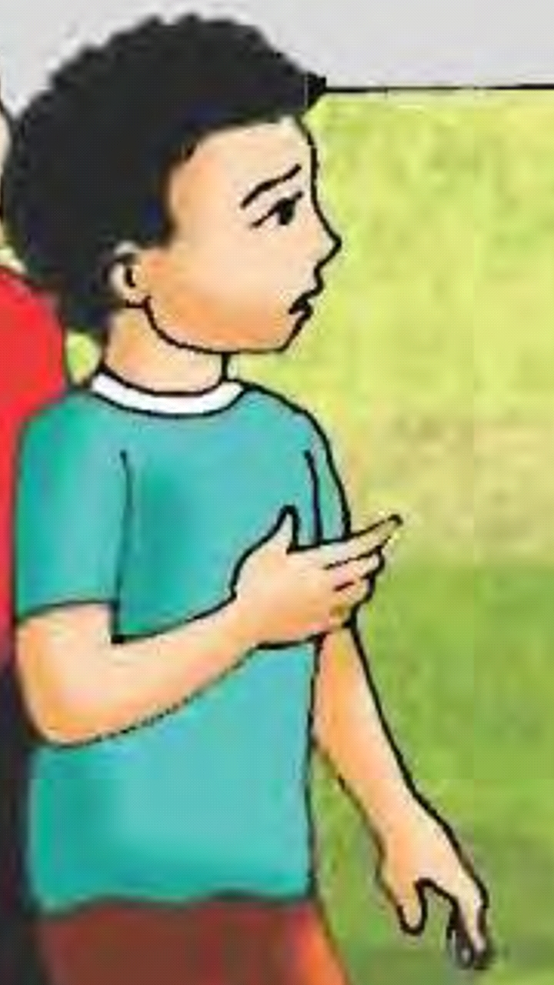

Slide 11
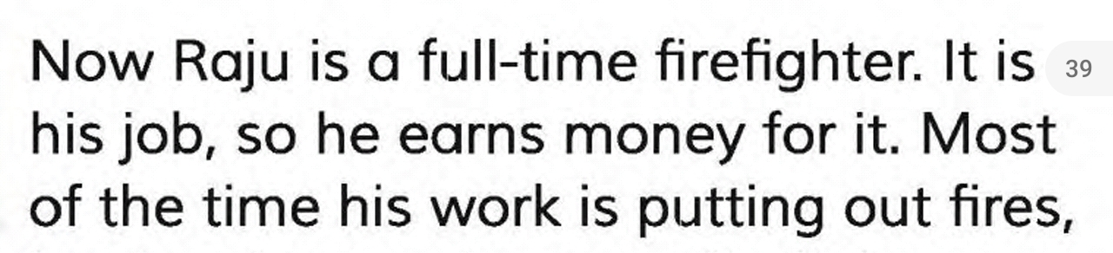
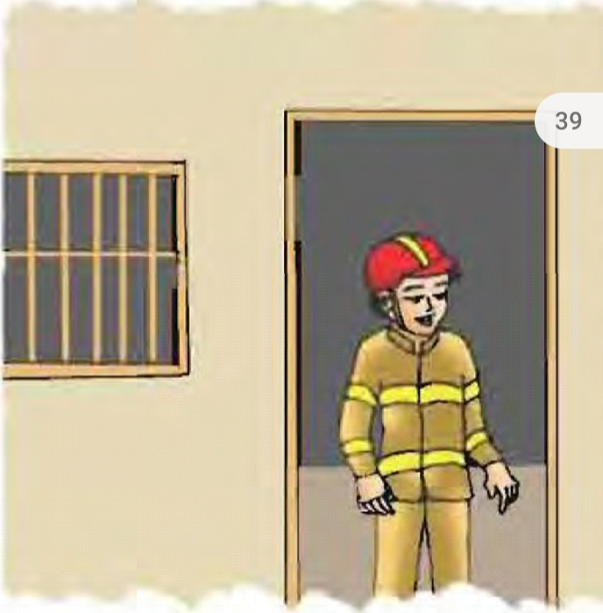

Slide 12
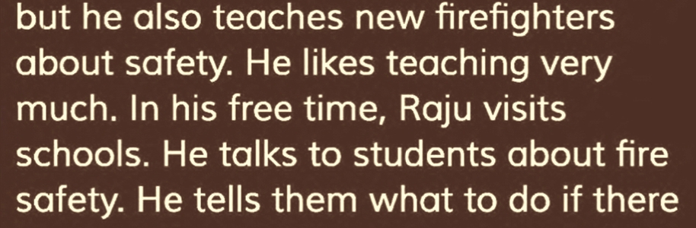
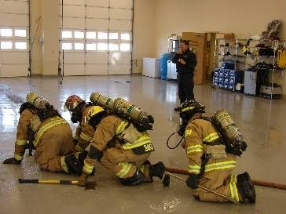
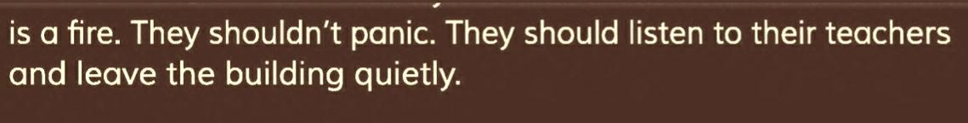

Slide 13
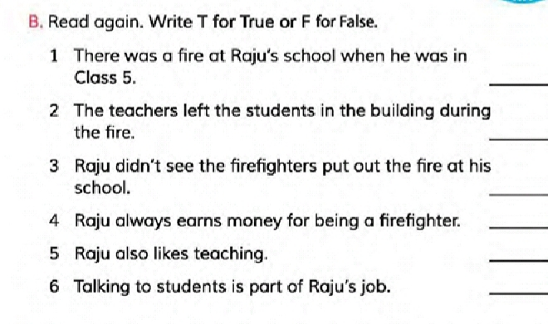
Evaluation
T
F
F
F
T
T

Slide 14
Exercise
C. Correct the false sentence.
Write them in your exercise book.

Slide 15

Group Work
Why do you think Raju became a firefighter?

Slide 16
Thank you

