Slide 1
Welcome

Slide 2

Teacher’s Information
Md. Rabiul Mowla
Assistant teacher
Mogdhara Adorshopara govt. primary school

Slide 3
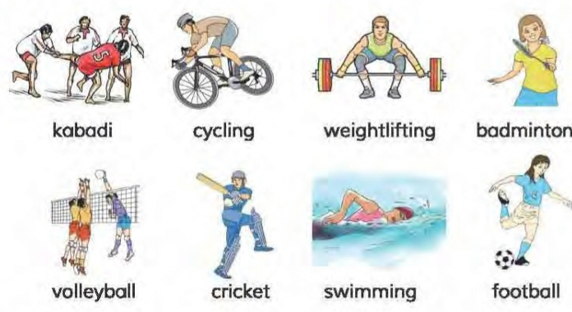
Can you see the picture ?

Slide 4
Today’s Lesson
Sports
Unit-17
Lesson 5-6

Slide 5
Learning Outcomes
Students wii be able…
to explain about Olympic game.
to participate in the sports competition.
to make himself as a athletic.

Slide 6

What is it?
The flag of Olympic

Slide 7
  How often are the Olympics held?
  The Olympic game is the biggest sport competition in the world. The Olympics are held every four years in different host city.

Slide 8
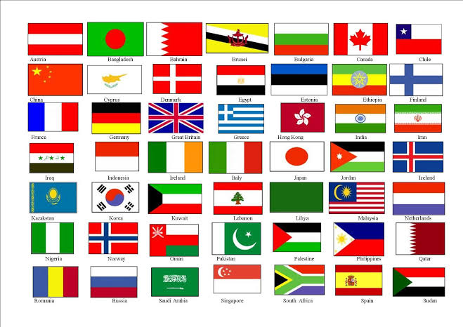
How many countries compete in the Olympics?
More than 200 nations send a total of about 13,000 athletics to complete in more than 30 different sports.
About 200 countries

Slide 9
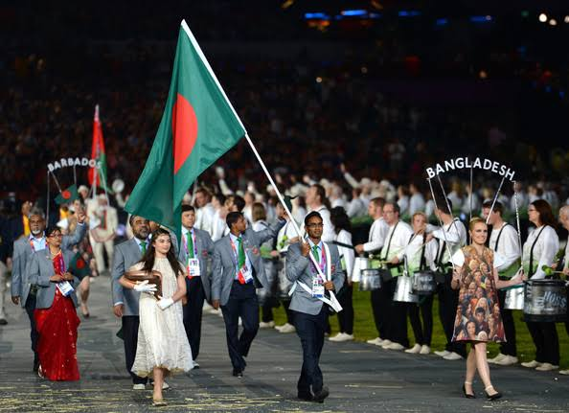
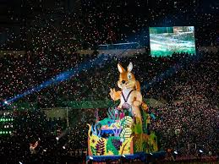
About 13,000 athletics participate

Slide 10
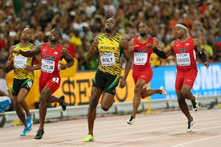
About 30 different sports
100m Sprinter

Slide 11
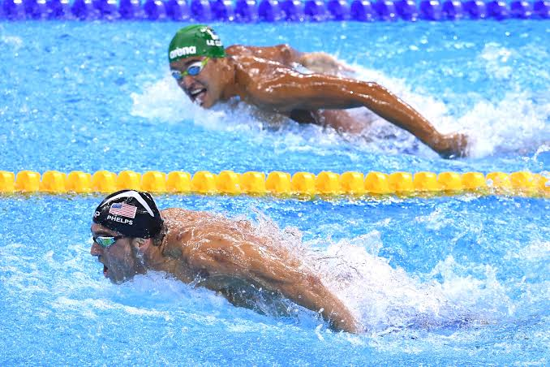
Swimming

Slide 12

Hockey

Slide 13
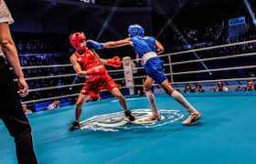
Boxing

Slide 14
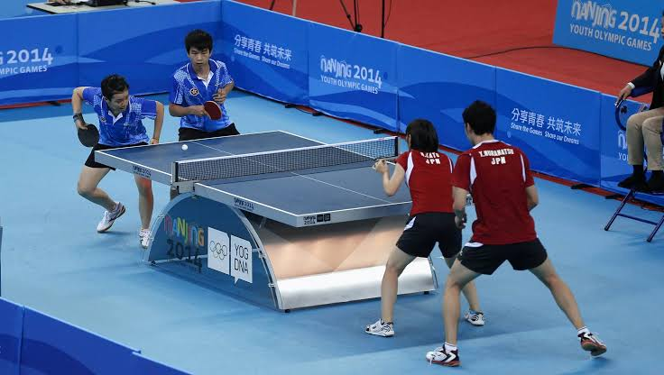
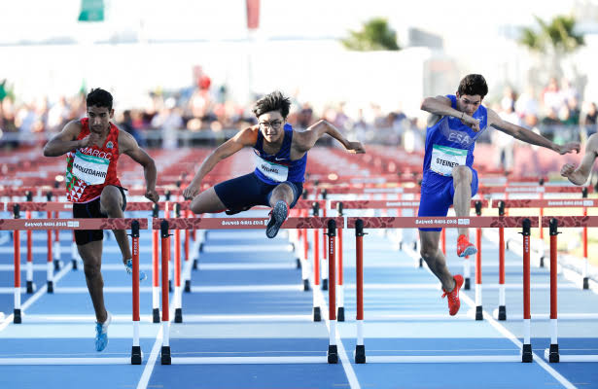
Tenis
Jumping

Slide 15
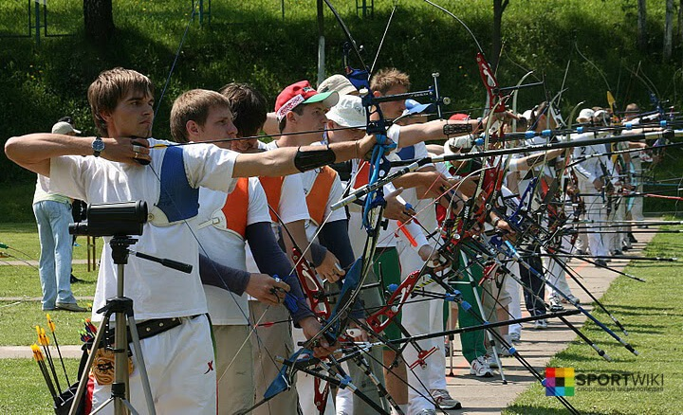
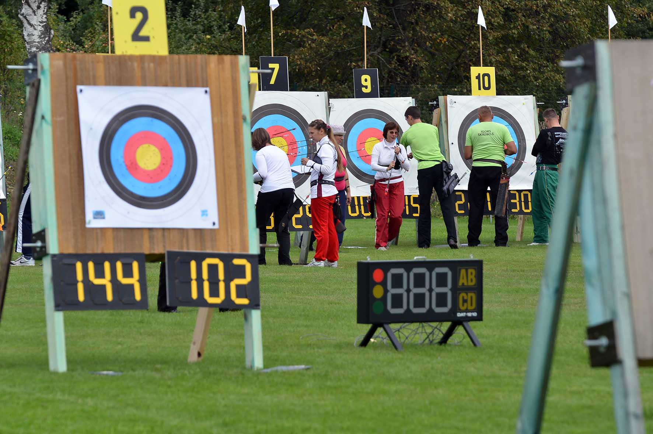
Archery

Slide 16
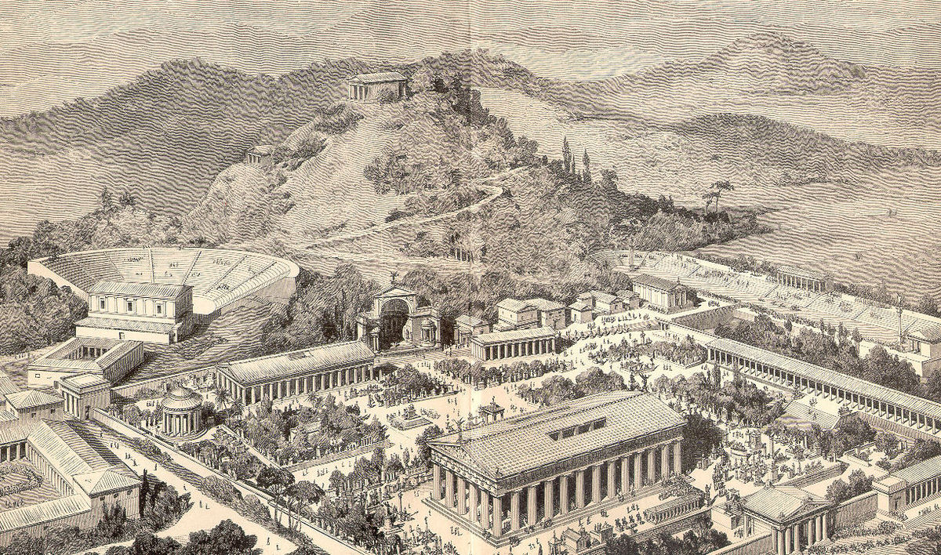
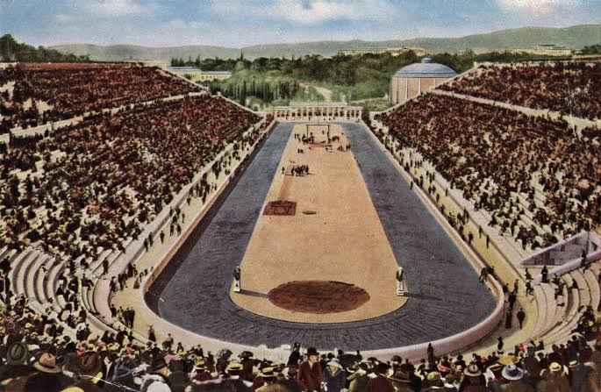
First Olympic 3000 years ago
Modern Olympic started in 1896

Slide 17
Evaluation
How many countries compete in the Olympics ?
a) 190. b) 200. c) 210. d) 220.
How many athletics compete in the Olympic ?
a) 11,000 b) 12,000 c) 13,000 d) 14,000
When the first Olympic game held?
a) 3000 years ago b) 3500 years ago c) 4000 years ago d) 4500 years ago

Slide 18
Pair Work
# Write down the name of different events of Modern Olympic Game .

Slide 19

Home Work
Write a paragraph on “Olympic Game”

Slide 20
Thank you

