Slide 2
A healthy and happy family
W
e
l
come

Slide 3
A healthy and happy family
Identity
The Wheel
Md. Noor -E- Alam Siddiki
Asstt. Teacher
Nageswari Keramotia M.L High School.
Mobile- 01716962418
E- Mail- nooralam.na35@gmail.com
Unit-3, Lesson -7

Slide 4
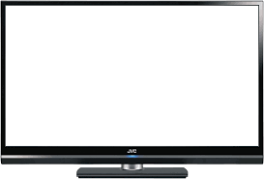
A healthy and happy family
…
Watch the video carefully
What’s picture is it about?
About a family

Slide 5
A healthy and happy family
Todays lesson is
A healthy and happy family
Unit- 9, lesson-1

Slide 6
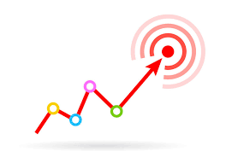
A healthy and happy family
After we have studied the lesson, we will be able to…
ask and answer questions.
listen for information.
develop vocabulary.

Slide 7
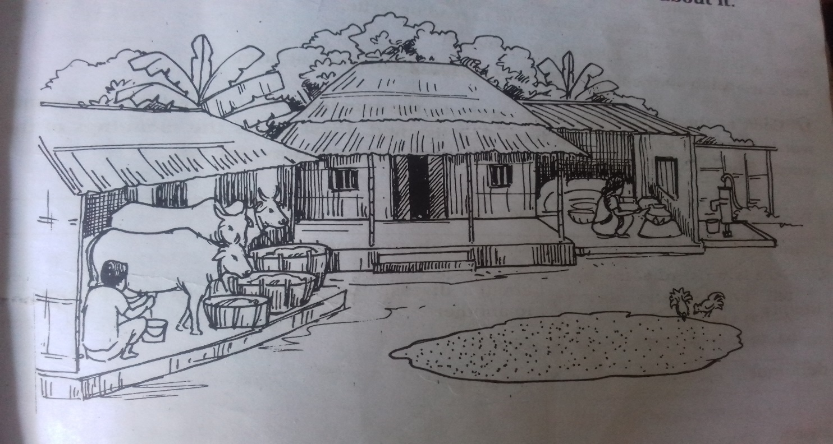
Look at the picture. Then ask and answer the questions about it…
A healthy and happy family
What do you see in the picture?
Who do you think is the owner of the house?
Where can you find this type of house ? Why do you think so?

Slide 8
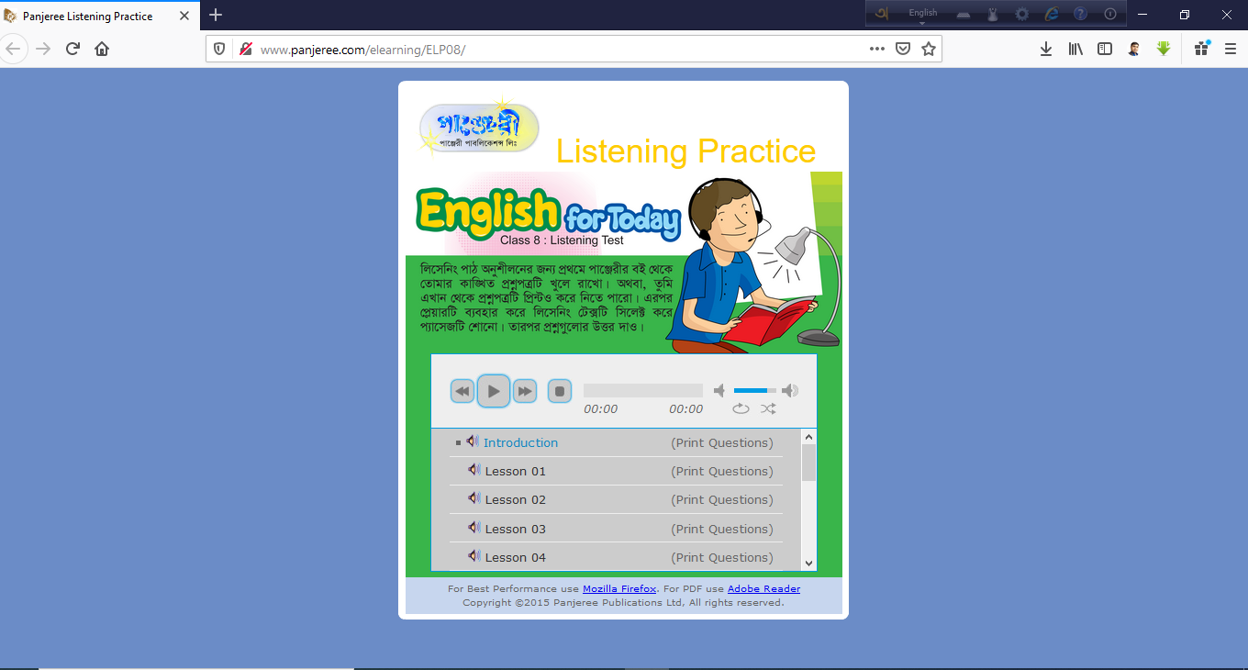
A healthy and happy family
http://www.panjeree.com/elearning/ELP08/
Click here to go to the link
Click here to play the listening test.

Slide 9
Now answer the following questions…
1. How far is Shakib’s house from his school?
2. Why is Shakib’s house free from mosquitoes?

Slide 10
A healthy and happy family
Listen again and write ‘True’ or ‘False’ against each of the following statement.
1. Shakib’s family lives in a remote town.
2. He has no brothers or sisters.
3. His parents do not know how to read or write.
4. His mother is an excellent cook.
5. Shakib does not participate in cleaning activities at home.

Slide 11
A healthy and happy family
Match your answer.
1. Shakib’s family lives in a remote town.
True
False
2. He has no brothers or sisters.
True
False
3. His parents do not know how to read or write.
True
False
4. His mother is an excellent cook.
True
False
5. Shakib does not participate in cleaning activities at home.
True
False

Slide 12
A healthy and happy family
Look at the table. Then listen to the teacher / CD. Then match them with their meaning.
Word
Meaning
Remote
Knowing about something.
About a discuss that spreads from one person to another.
literate
delicious
Isolated.
aware
That causes harm to your health.
harmful
Having a very pleasant taste.
contagious
Able to read and write.

Slide 13
A healthy and happy family
Match your answer.
Word
Meaning
Remote
Knowing about something.
About a discuss that spreads from one person to another.
literate
delicious
Isolated.
aware
That causes harm to your health.
harmful
Having a very pleasant taste.
contagious
Able to read and write.

Slide 14
A healthy and happy family
Class Over
Bye. See you again tomorrow.

