Slide 1
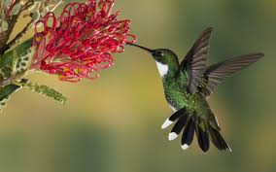
Welcome

Slide 2
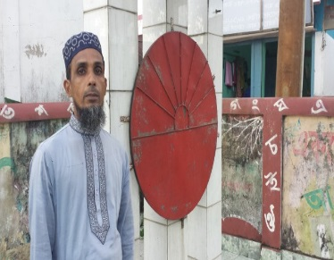
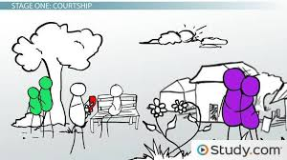
Introduction
A healthy & happy family
Mohammod Helal Uddin
Assistant Teacher (English)
Wahid Siddek High School
Gurarai, Sadar, Moulvibazar.
E-mail: helal.bd.mb@gmail.com
Mobile: 01720630018
Class- Eight
Subject- English For Today
Unit- Three
Lesson- 07

Slide 3
Look at the pictures and answer the questions
What do you see in the pictures ?
Who do you think is the owner of the house ?
Where can you find this type of house ?

Slide 4
Today our Lesson is….
A healthy and happy family

Slide 5
Learning Outcomes
End of this Lesson, The student will be able to…
Read the texts silent and answer the questions
Ask and answer the questions
Write a short paragraph

Slide 6
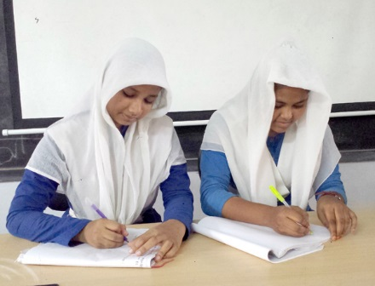
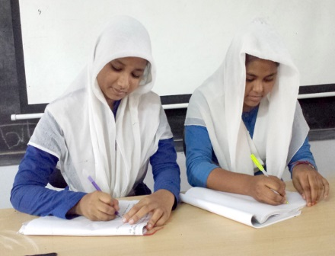
Read the passage and answer the questions in pairs
How far is Sahib's house from his school ?
Why is Sahib's house free from mosquitoes ?

Slide 7
Evaluation
Write True Or false:
Shakib's family lives in a remote town.
He has no brothers or sisters.
His parents do no know how to read or write.
His mother is an excellent cook.
Shakib does not participate in cleaning activities at home.

Slide 8
Home Work
Write a paragraph about your family.

Slide 9
Thank You
Stay Home, Stay Safe

