Slide 1
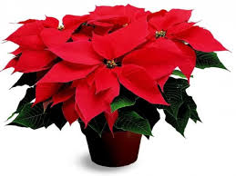
Welcome to the students
Notes:
Greeting the students.

Slide 2
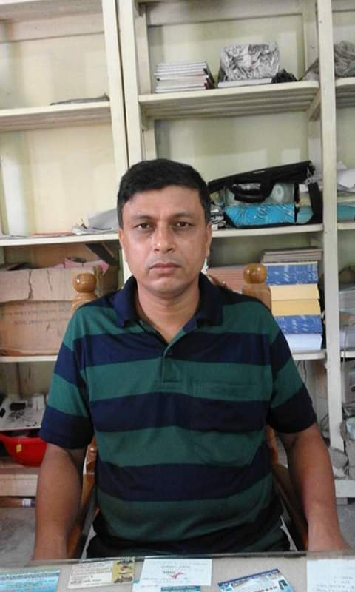
Introduction
Class- VI
Subject- Grammar
English 2nd Paper
Time- 45 min
Sultan Ahmed Miazi
Assistant Teacher of English
Balia K.B.D.N.Dakhil Madrasah
Chandpur Sadar,Chandpur.
Notes:
Introducing the teacher & Subject-Lesson.

Slide 3
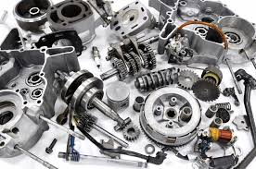
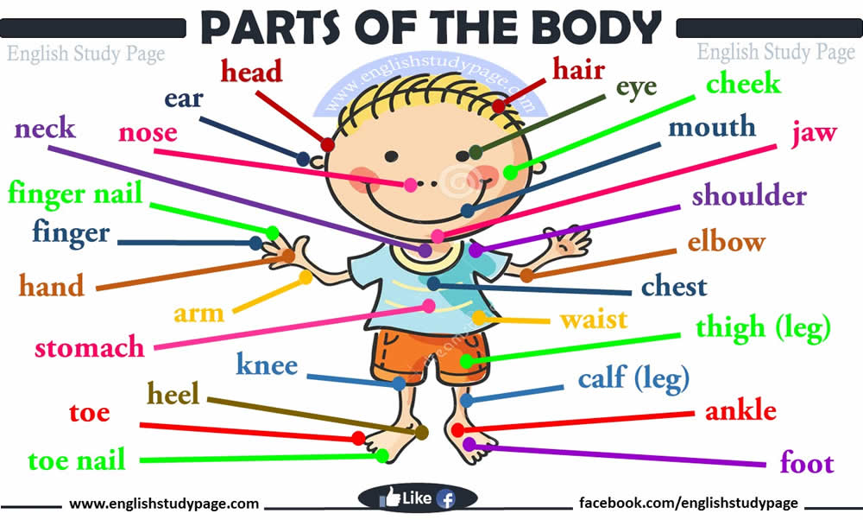
What do you see in the pictures?
Parts of Machine
Parts of the Body
Notes:
Preparation for the lesson.

Slide 4
What are the moving things?
What is it?
I love my mother
Sentence or Speech
Words or Parts of Speech
Notes:
Preparation for the lesson.

Slide 5
Today’s lesson is on
Can you tell today’s lesson?
Parts of Speech
Notes:
Declaration of the lesson.

Slide 6
Learning Outcomes
By the end of the lesson, students will be able
To define parts of speech.
To classify the parts of speech.
To give examples of the parts of speech.
Notes:
Proclamation of learning outcomes.

Slide 7
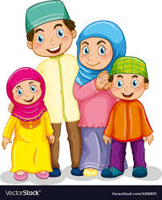
What do see in the picture?
Who are they?
Father
Mother
Daughter
Son
The Members of A family
A family
Notes:
Preparation for presenting the parts of speech.

Slide 8
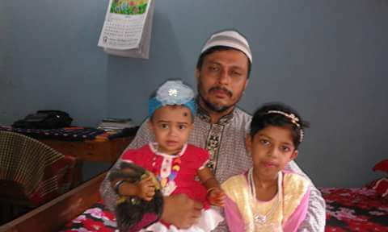
The persons who make a family are called
the members of family.
Notes:
Preparation for presenting the parts of speech.

Slide 9
Sentence or Speech
I love my mother.
Pronoun
Verb
Determiner
Noun
Parts of Speech
The words which make a sentence
are called the parts of speech.
Notes:
Presenting the parts of speech.

Slide 10
There are eight parts of speech.
Noun
Adverb
Pronoun
Verb
Adjective
Conjunction
Preposition
Determiner
There is a minor part of speech.
Interjection
Notes:
Presenting the classification of the parts of speech.

Slide 11
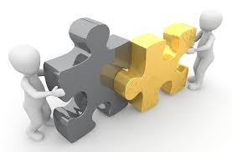
Pair Work
5 minutes
How many parts of speech are there?
Write down their name.
Notes:
Arrangement for Pair Work. Monitoring the given work.

Slide 12
There are eight parts of speech.
Parts
Of
Speech
Noun
Pronoun
Conjunction
Determiner
Preposition
Adverb
Verb
Adjective
There is a minor part of speech.
Interjection
Notes:
Feedback.

Slide 13
Noun
Noun
Rana bought a nice pen.
He has already lost it.
Pronoun
Pronoun
Noun: Naming Words. Such as- Rina, book, tiger,
Bangladesh, gold, army, honesty etc.
Pronoun: used exchange for noun. Such as- I, me,
We, us, You, He, him, She, her, it, They, them etc.
Notes:
Presenting Noun & Pronoun.

Slide 14
Adjective
Rana is an honest boy.
He talks to us honestly.
Adverb
Adjective: Noun modifier. Such as- honest, good, nice,
beautiful, sorry, useful etc.
Adverb: Verb Modifier. Such as- always, usually, nicely.
Most Adverbs structure as ‘Adjective + ly’.
Notes:
Presenting Adjective & Adverb.

Slide 15
I am a student.
Verb
I read in class six.
Verb
He is coming to me.
Verb
Verb: Heart of the sentence.
In a sentence, there must be one verb.
There may be more than one verb.
Notes:
Presenting Verb.

Slide 16
Group Work
6 minutes
Write down five examples of
-Noun
-Adjective
-Verb
Notes:
Arrangement of Group Work. Monitoring their work.

Slide 17
I am a student of class six.
Preposition
I read in class six.
Preposition
He is coming to me.
Preposition
Proposition: connecting word.
Notes:
Presenting Preposition.

Slide 18
I am a student and I read in class six.
Preposition
Do or die
Preposition
Conjunction: connecting word.
For example- and, or, but, so, that, If, As etc.
Notes:
Presenting Conjunction.

Slide 19
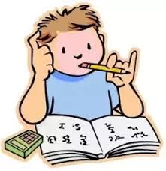
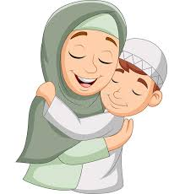
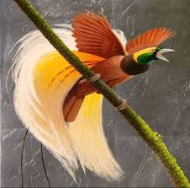
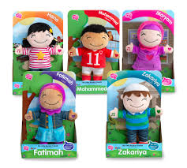
I am a student
Article
I love my mother.
Possessive
This bird is nice.
Demonstrative
She has some dolls.
Quantifier
Notes:
Presenting Determiner.

Slide 20
Determiner
Article
a, an, the
Possessive
my, our, your, his, her, its, their
Demonstrative
this, these, that, those
Quantifier
some, few, little, many, no, one,
two, three, first, second, a lot of etc.
Notes:
Presenting Determiner.

Slide 21
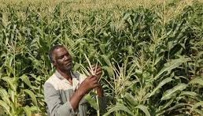
Hurrah! I have got A+.
Interjection
Alas! I have lost my crop.
Interjection
Interjection: Hurrah! Alas! Oh! Fie! Shame!
Notes:
Presenting Interjection.

Slide 22
Evaluation
3 minutes
How many parts of speech are there?
1. Eight
2. What is noun?
2. Naming word.
3. What is heart of a sentence?
3. Verb
4. What kind of words are ‘my’ ‘his’ ?
4. Possessive
5. What kind of word is ‘Hurrah!’?
5. Interjection
Notes:
Evaluation about today’s learning.

Slide 23
Write a list of 5 words for each part of speech.
Notes:
Giving Home Work.

Slide 24
Thank You All
for concentration
Notes:
Ending the class.

