Slide 1
Welcome

Slide 2
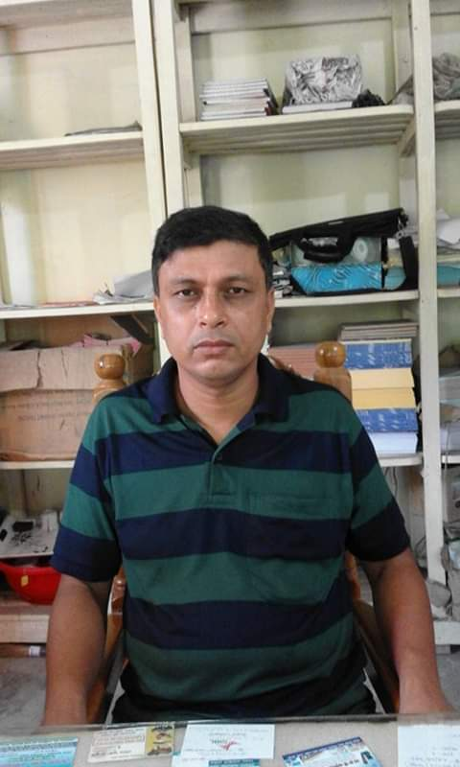
Introduction
Subject: English 2nd Paper
Class : IX-X
Sultan Ahmed Miazi
Astt. Teacher
Balia K.B.D.N.Dakhil Madrasah
Chandpur.

Slide 3
The old man is so week __________
that he can not walk.
What are we going to discuss today?
Completing sentence

Slide 4
Learning outcomes
At the end of the lesson , we will be able to –
identify the definition of completing sentence
identify the method of completing sentence
complete incomplete sentences
Notes:
The above outcomes will be achieved from this content.

Slide 5
What is a completing sentence?
When a part of a sentence is completed with a
clause or a phrase is called a completing sentence.

Slide 6
Rule -1
Use of ‘so………… that’.
that she could not study at all
She was so ill _______________________.
১ম ‍Sentence এ so থাকলে
২য় sentenceটি that দ্বারা শুরু হয়

Slide 7
Activities
The load is so heavy that ________________________________
He is so dishonest that_______________________________________

Slide 8
Rule -2
Use of ‘so that’.
Conjunction so that এর পর can বা could বসে
He reads attentively so that________________________.
he can make a good result

Slide 9
Activities
The farmers sow good seeds so that _________________________________
He was so weak that______________________________________________

Slide 10
Rule -3
Use of ‘lest’.
you should miss the train
Walks fast lest _________________________.
Conjunction lest থাকলে subject এর পর should বসে
Notes:
Lest (পিছে ভয় হয়)

Slide 11
Activities
He ran away fast lest _________________________
Read diligently lest___________________________

Slide 12
Rule-4
Use of Unless
you will fail.
Unless you work hard, _____________
Unless দ্বারা Sentence শুরু হলে
২য় sentenceটি negative হয়

Slide 13
Activities
Unless you read attentively,_________________
Unless you start at once,___________________

Slide 14
Rule -5
Use of Though, although
Though he is poor,_____________
he is honest.
Though বা Although দ্বারা Sentence শুরু হলে ২য় sentenceটি বিপরীতধর্মী হয়

Slide 15
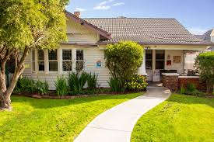
Home Work
Practice of the class rule 1 to 5.

Slide 16
All the best.
Continue to next content
Notes:
Ending slide

