Slide 1
It’s my pleasure to welcome you all.

Slide 2
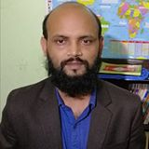
Nurul Aziz
Assistant Teacher (English)
Krishnakumari City Corp. Girls’ High School,
Nandankanan,Chittagong
E-mail : naziz13.na@gmail.com
Mobile : 01843773924
English For Today
Class : 7
Time : 45 Minutes
Date : 14/03/2020

Slide 3
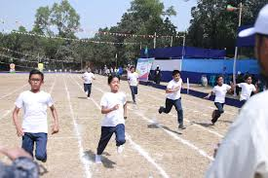
What do you see in the picture?
some students are running a race during annual sports.

Slide 4
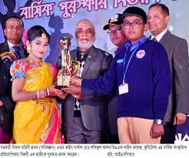
What do you see in the picture?
A participant is receiving prize for good performance.

Slide 5
Our Today’s lesson is on……
Prize-giving day at school
Unit : 3, Lesson: 1
English For Today (Page: 17)

Slide 6
Learning outcomes
After the end of the lessons students will have…
read and understood the texts
asked and answered questions
talked about familiar events
made sentences using new words

Slide 7
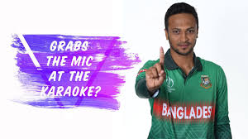
Vocabulary
Eminent (Adjective)
Famous , celebrated
Shakib Al Hasan is an eminent al-rounder in the world cricket.

Slide 8
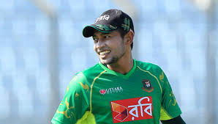
Vocabulary
Outstanding (adjective)
Striking, arresting
Mushfiqur Rahim is an outstanding criketer.

Slide 9
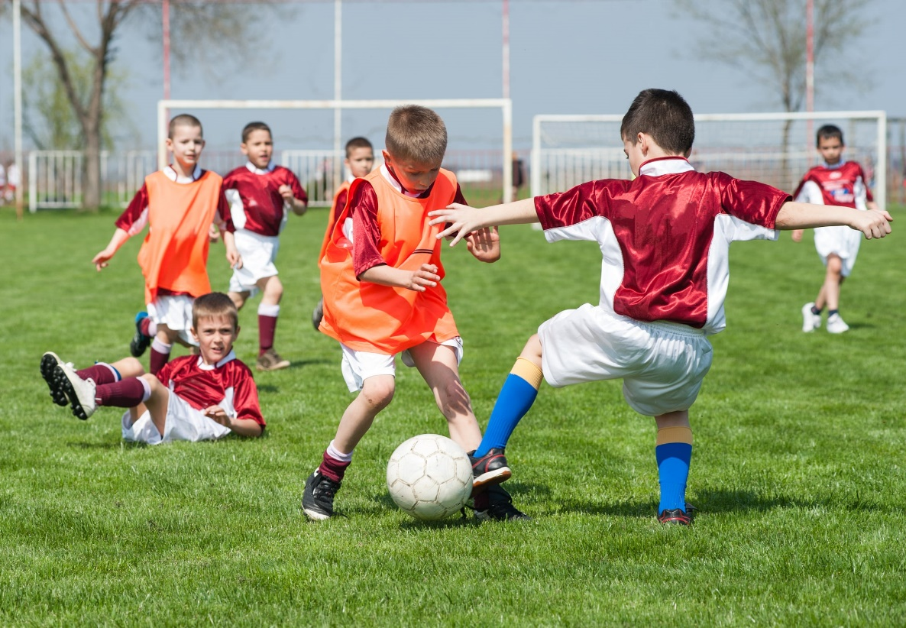
Vocabulary
Performance (noun)
An act of presenting a play, concert etc.
The children’s performance in the match was eye-catching.

Slide 10
Section B: Read the text and answer the questions.
Farabi is Flora’s best friend. They live in the same area. Also they are both in class 7. But they go to different schools.
It is a school holiday. Flora has come to visit Farabi. They are talking. Flora wants to know about the prize-giving ceremony of Farabi’s school. “Yesterday was our school’s prize-giving day,” Farabi says. “On this occasion our school auditorium and its dais were brightly decorated. Prizes were also neatly displayed on a separate table on the dais. All the students were present at the function. Among others, the guardians and some eminent persons of the locality attended the function, “ Farabi continues. “ The principal of PN College was the chief guest.”
“When did the function start?” Flora asked.
“Oh, it started on time—just at 4 pm,” Farabi says. “Our Head Teacher first read out the annual report. Then the Chief Guest gave a short speech. He highly praised the overall performance of the school and its excellent JSC and SSC Exam results. Then he gave away the prize among the students for their outstanding activities.”
“Did you get any prize, Farabi?” Flora enquires.
“Yes, I did,” Farabi replies. “I’ve got two prizes-----one for regular attendance and the other for good results in the last year-ending exams.”

Slide 11
Individual work
C) Match the words with their meanings.
Visit
To go to see a person or place
Ceremony
function
Praise
Speak highly of somebody or something
Outstanding
Extremely good
Display
Putting something in a place where you can see it easily
Eminent
People having lots of power and influence

Slide 12
Pair work
D) Ask and answer in pairs. Make questions and then choose answer from this table.
Questions |  |  | Answers
How | Was Did | the prize-giving function held? | The Principal of PN College.
What |  | the auditorium decorated? | In the school auditorium.
Who |  | the chief guest at the function? | Read out the annual report.
Where |  | the Head Teacher do at the beginning of the function? | Brightly.

Slide 13
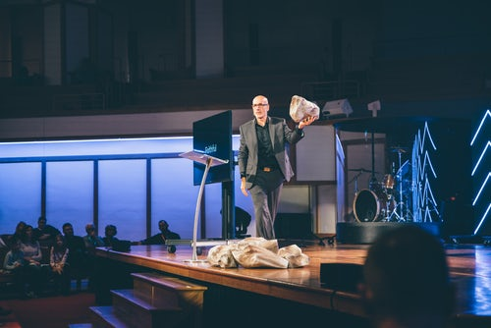
Now think about the picture
Staging one-act play

Slide 14
Group Work
E) Complete the passage with the verbs in the box. Give their correct forms.
Be sing speak stage
At the end of the prize-giving function there a cultural show. The students , danced and a one-act play. It was so good that everyone highly of it.
was
a)
sang
b)
staged
c)
spoke
d)

Slide 15
Home Work
F) Write a paragraph on Sports day at your school.

Slide 16
Thank you all.

