Slide 2
You are welcome

Slide 3
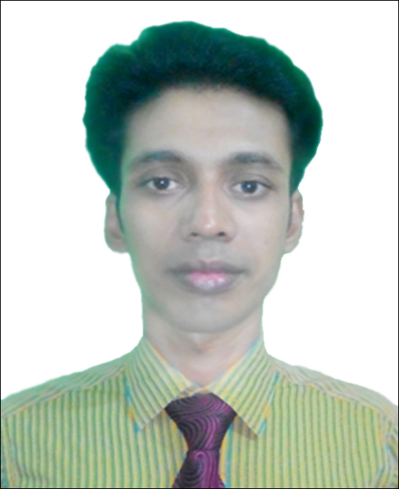
Introduction
Swandip Banerjee
Asst. Teacher (English)
Pallimangal Secondary School
Sonadanga, Khulna.
Mob: 01718503573
E-mail: swandipb1@gmail.com

Slide 4
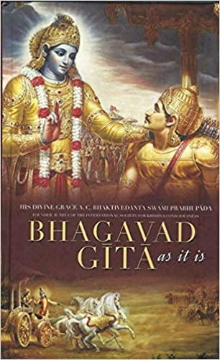
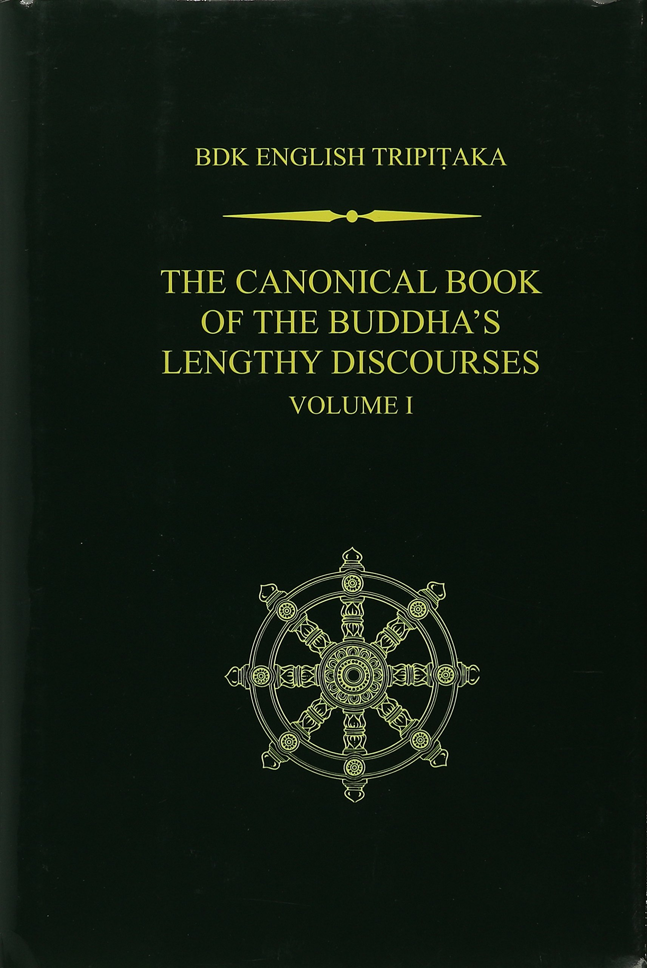
Click me
What are these?
They are books.

Slide 5
Today, Our topic of the class is……….
BOOKS
(a poem written by- Eleanor Farjeon)
Unit-14 Lesson-01

Slide 6
Learning Outcomes
After we have studied the poem (Lesson-01), we will be able to………………..
recognize and use English sounds, stress and intonation.
understand and enjoy the poem.
interpret, evaluate and summarise literary texts.

Slide 7
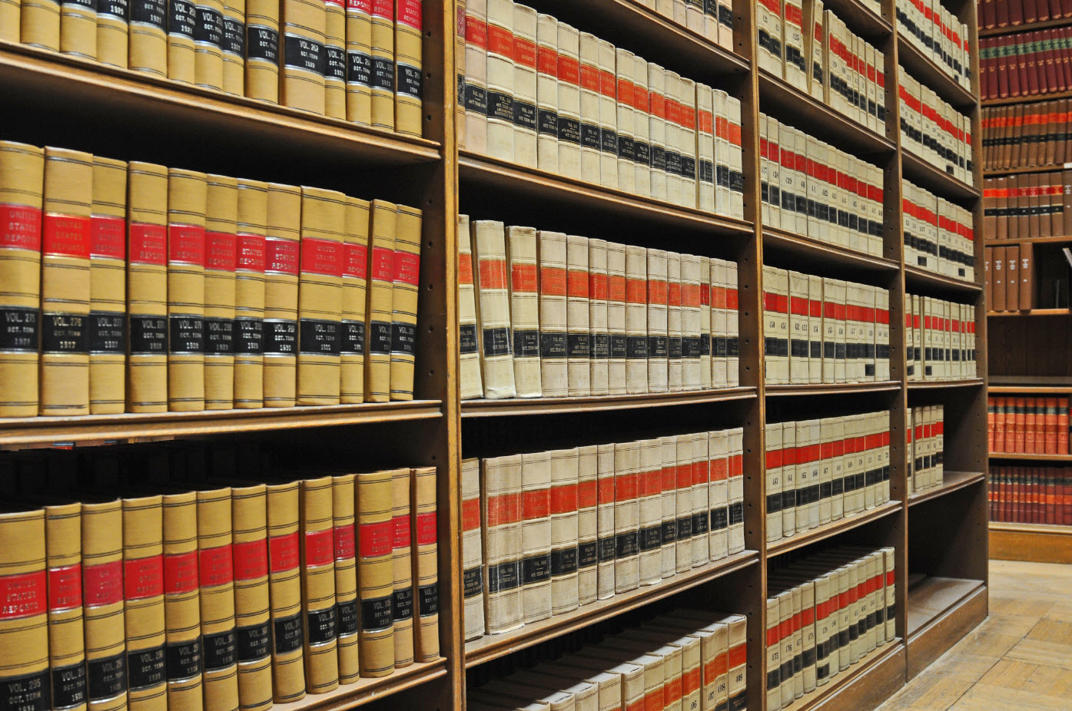
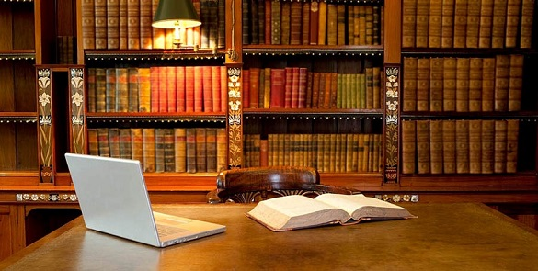
Do you read any books other than your English and Bangla textbooks?
If yes, what kind of books do you read?
Now, write one or two reasons why you read those books and share with your partner.

Slide 8
Cover
A thing that lies on, over or around something.
Unknown words
Synonym: Casing.

Slide 9
Unlock
Undo the lock of something by using a key.
Synonym: Open, Reveal.

Slide 10
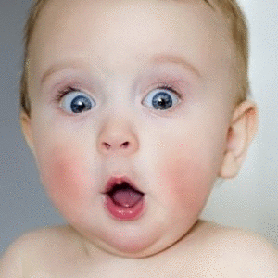
Wonder
a feeling of surprise.
Synonym: astonishment, amazement.

Slide 11
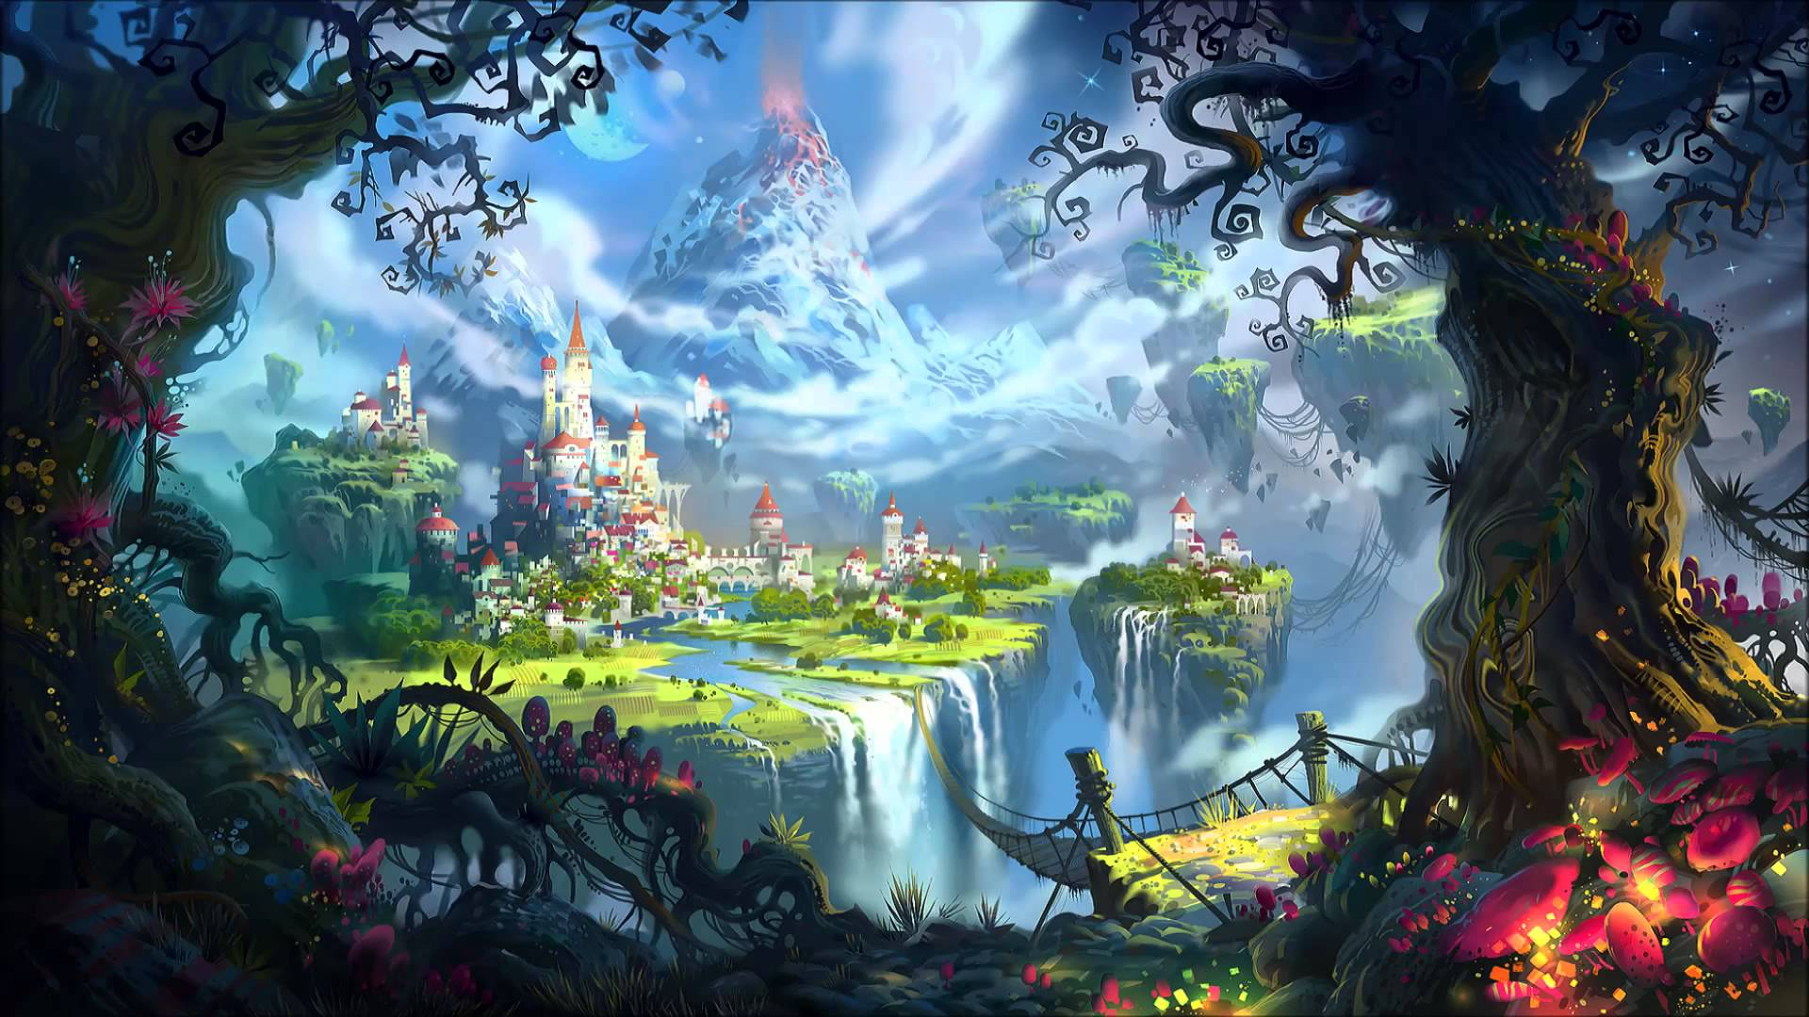
Fantasy
The activity of imagining things, especially things that are impossible or improbable.
Synonym: imagination, visualization.

Slide 12
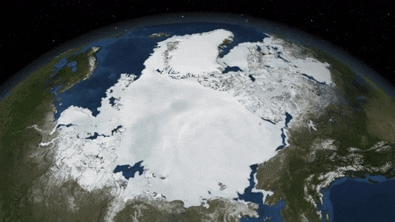
Melt
Become liquefied by heat.
Synonym: dissolve, defrost.

Slide 13
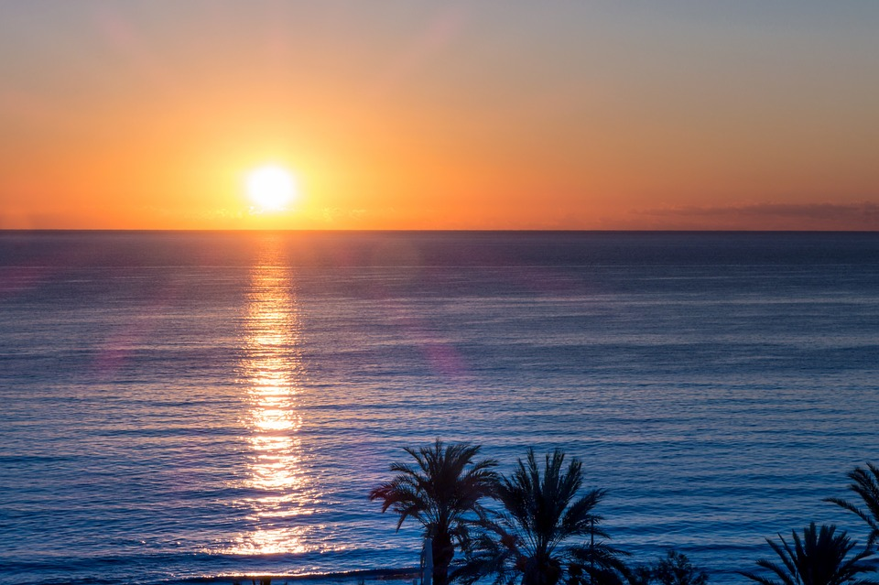
Rise
Move from a lower position to higher one.
Synonym: ascend, get up.

Slide 14
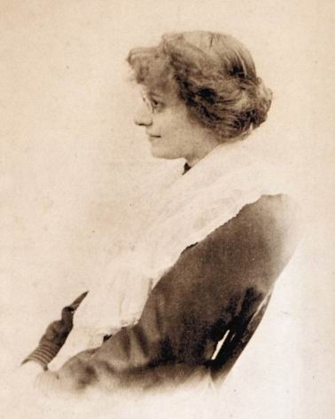
At a glance
Eleanor Farjeon
Born | 13 February, 1881 Strand, London, England.
Died | 5 June, 1965 (aged 84) Hampstead, London, England.
Pen name | Tomfool, Merry Andrew, Chimaera
Nationality | British
Genre | Children's literature
Notable works | Morning Has Broken
Notable awards | Carnegie Medal1955 Hans Christian Andersen Award 1956

Slide 15
Let’s listen to the poem.
Books
Eleanor Farjeon
What worlds of wonder are our books! As one opens them and looks, New ideas and people rise In our fancies and our eyes.
The room we sit in melts away, And we find ourselves at play With some one who, before the end, May become our chosen friend.
Or we sail along the page To some other land or age. Here's our body in the chair, But our mind is over there.
Each book is a magic box Which with a touch a child unlocks. In between their outside covers Books hold all things for their lovers.

Slide 16
Poem
Explanation
In this poem "The Book ", Eleanor Farjeon brings forward the importance of books in a man's life. She says that books play a wonderful job in our lives. Books arouse in men many new ideas that help them to awake and see the world in a new way.
What worlds of wonder are our books! As one opens them and looks, New ideas and people rise In our fancies and our eyes.
We study or go through a book sitting in a room all alone. But in our thoughts we find ourselves in some other ground where there is some other character as our much loved company.
The room we sit in melts away, And we find ourselves at play With some one who, before the end, May become our chosen friend.

Slide 17
Poem
Explanation
Or we sail along the page To some other land or age. Here's our body in the chair, But our mind is over there.
Books take us away to some other land or era/time. As such, physically we are in the chair of our room but mentally we sail out with the words of the books to somewhere unknown.
Poetess calls every book a magic box. It's very touch unlocks a child's mind. The one who loves books can find every turn of the world and his life in its words. He would hardly strive for any other company.
Each book is a magic box Which with a touch a child unlocks. In between their outside covers Books hold all things for their lovers.

Slide 18
Group work
1. What does the poet say about the good things that reading a book can do to you?
2. What other benefits can you think of reading books?

Slide 19
Evaluation
1. How does a book help us to go to a new world?
2. Why is a book compared to magic box?

Slide 20
Home work
Write a summary of the poem ‘B’ ‘Books’ in no more than 90 to 100 words.

Slide 21
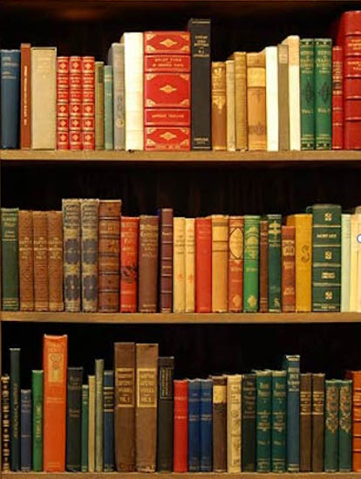
Thank you all
Books be your constant company.

