Slide 1
স্বাগতম

Slide 2
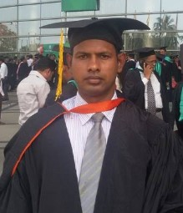
Identity myself.
Md. Ikramul Haque
Senior Asst. Teacher
Mirzapur Islamia Dakhil Madrasah
Paban Sadar, Pabna.
Email:ikramulhaque1980@gmail.com
Phone:01716845666
Class viii
Unseen passage

Slide 3
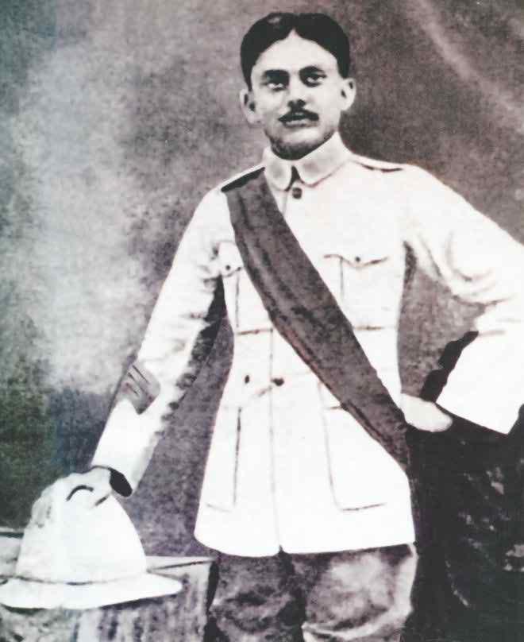
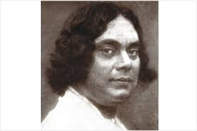
Do you know the man in the picture?
He is our national poet “Kazi Nazrul Islam”

Slide 4
Our today’s topic is “Kazi Nazrul Islam”
Unseen passage

Slide 5
Learnings out comes
By the end of this lesson
SS will be able to---
Describe about our national poet
Learn some new words meaning
Write the statement true or false
Complete the incomplete chart

Slide 6
Dear student let us enjoy a Audio

Slide 7
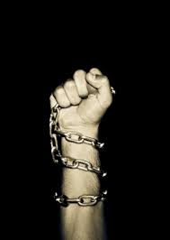
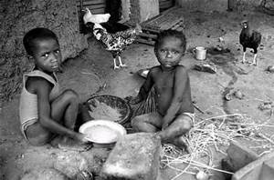
Let us some new words meaning
Rebel
(Adj.)
rebellious
Poverty
(noun)
suffering
Always motion
Restless
(Adj.)
Masterpiece
(noun)
The best art

Slide 8
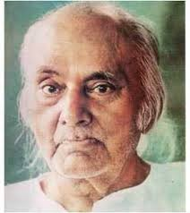
Text analysis
Kazi Nazrul Islam
Birth place: Churulia,Bardawan.
Date of birth:24May,1899.
Father’s name:Kazi Fakir Ahmed.
Mother’s name:Jaheda khatun.
Famous writing: Agnibina,Bisherbanshi.
Died on:29 August,1976.

Slide 9
Dear student now open your book at Unseen passage
Kazi Nazrul Islam
And read the text very carefully.After your reading I shall ask some question. You will get 10 minutes for the purpose.

Slide 10
Group Work
Complete the following table with the information given in the passege
Name of event | Place | Year
Nazrul’s birth | a) | 24 May,1899
Nazrul lost his father |  | b)
He worked | c) | During his childhood
d) | In the Indian Army | in 1917
He passed away in | e) | On August 29,1976
Churulia in Bardawan
In 1908
In a bread factory
He joined
Dhaka

Slide 11
Pair work
Write whether the following statement true or false.If false give the correct statement.
a) Kazi Nazrul Islam was known as “dukhu Mia”during his childhood.
Ans.True
b) He was born in a wealthy and respected family.
Co. Ans. He was born in a poor but respected family.
Ans. False
c) He joined the Indian Army in1917.
Ans.True
d) He wrote some masterpieces criticising the British rule.
Ans.True
e) He passed away in Dhaka on August 29 1975.
Co. Ans. He passed away in Dhaka on August 29 1976
Ans.False

Slide 12
Evoluation
a) Where Kazi Nazrul Islam was born?
Ans. Kazi Nazrul Islam was born in Churulia in Bardawn.
b) What was his father’s name?
Ans. His father’s name was Kazi Fakir uddin Ahmed.
c) Why he was called the rebel poet?
Ans. All of his writing were againest British rules. So for this he was called the rebel poet.

Slide 13
Homework
Write five sentences about Kazi Nazrul Islam.

Slide 14
Thanks to All

