Slide 1


Slide 2

Welcome to all.

Slide 3



Slide 4

A: Look at the picture.

Slide 5
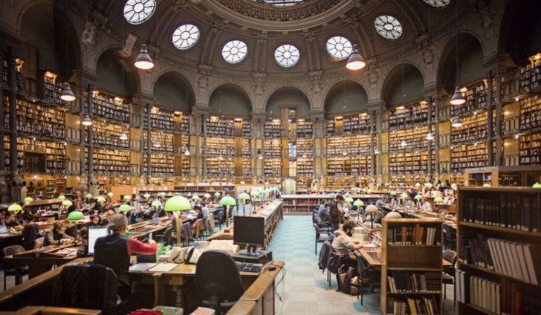

Slide 6


Slide 7
Today’s topic of the class is----
BOOKS
Unit : 14
[Pleasure and Purpose]
Lesson : 1

Slide 8
Learning outcomes
After the students have studied the lesson, they will be able to --- ---
recognize and use English sounds, stress, and intonation,
understand poem,
interpret, evaluate, and summarise literary texts.

Slide 9
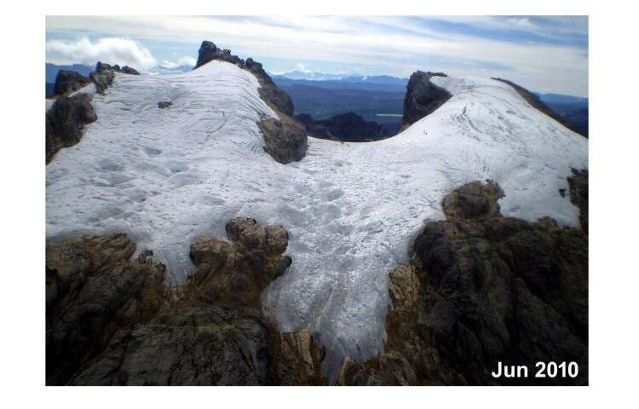
Melt away
To disappear slowly
NEW WORDS
Syn.: soften, dissolve
Ant.: strengthen

Slide 10

Fancy
A superficial or temporary feeling of linking or attraction
Syn.: imagination, fantasy
Ant.: reality

Slide 11
A: Ask and answer these questions in pairs.
1. Do you read any books other than your English and Bangla textbooks?
2. If yes, what kinds of books do you read? (stories, poems, etc.)
3. Now write one or two reasons why you read those books and share with your partner.

Slide 12
B: Read the poem from the text (page no 199).
10 Minutes
What worlds of wonder are our books!
As one opens them and looks,
--- ----- --- --- --- --- --- --- ---
--- ----- --- --- --- --- --- --- ---
In between their outside covers,
Books hold all things for their lovers.
- E. Farjeon
TEXT

Slide 13
Books
What worlds of wonder are our books!
As one opens them and looks,
New ideas and people rise
In our fancies and our eyes.
The room we sit in melts away,
And we find ourselves at play
With someone who, before the end,
May become our chosen friend.

Slide 14
Or we sail along the page,
To some other land or age.
Here’s our body in the chair,
But our mind is out there.
Each book is a magic box,
Which with a touch a child unlocks.
In between their outside covers,
Books hold all things for their lovers.
- E. Farjeon
BACK

Slide 15
C: What does the poet say about the good things that reading a book can do to you?
What other benefits can you think of reading books?

Slide 16
C: What does the poet say about the good things that reading a book can do to you?
What other benefits can you think of reading books?
EVALUATION

Slide 17
HOME WORK
Every student will write a summary of the poem ‘A’ in no more than 90 to 100 words.

Slide 18

Thank you all.

