Slide 1
WELCOME

Slide 2
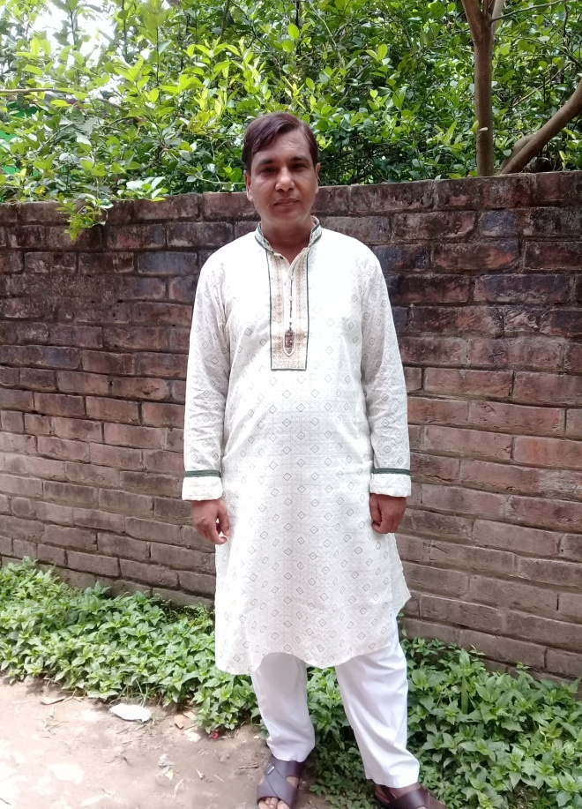
TEACHER IDENTITY
A.K.M. SHARIFUL ALAM
HEADTEACHER
MUKTARPUR AM-JAMTALA SECONDARY SCHOOL
CHOWGACHA, JASHORE
Cell-01717251605

Slide 3
LESSON INTRODUCTION
SUBJECT-ENGLISH 2ND PAPER
CLASS-NINE/TEN
UNIT-COMPLEX TO SIMPLE
TIME-45 MINUTES
DATE-00-00-2020

Slide 4
Classification of Sentence
Simple Sentence: Because of his being ill, he could not play.
Compound Sentence: He was ill and he could not play
Complex Sentence: As he was ill, he could not play

Slide 5
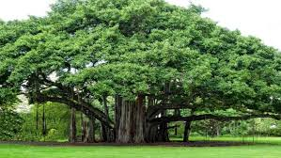
Our Today’s topic is---
Complex
Simple Sentence

Slide 6
Learning outcomes
The students will be able to-
identify simple and complex sentences,
make structures of each form of sentences,
change the simple form into complex.

Slide 7
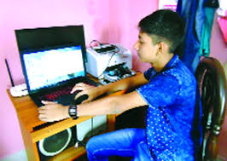
Complex to simple Rule-1. Since/ as/when যুক্ত Complex Sentence এর Subject এক হলে এবং উভয় পাশে verb থাকলে Simple করার নিয়ম। Structure: প্রথম Sentence এর মুল verb এর present আকারের সাথে ing যোগ+ ১ম Sentence এর বাকী অংশ+ comma+ ২য় Sentence.
Complex: Since/as the boy worked hard, he shone in life.
Simple: Working hard , the boy shone in life.

Slide 8
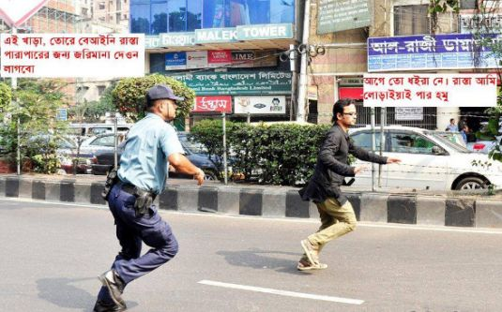
Com: When the thief saw the police, he ran away.
Sim: seeing the police, the thief ran away.
Com: As I forgotten him, I went out.
SimL: Forgetting him, I went out.

Slide 9
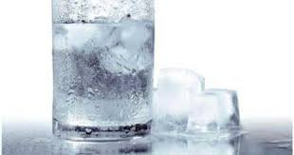
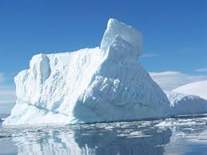
Rule-2. Since/as/when +am/is/are/was/were/have/has/had+ sub+বাকী অংশ+ ২য় clause হলে Simple করার নিয়ম। (Subject ভিন্ন হলে) Structure: Subject+ am/is/ are/was/were এর পরিবর্তে being have/has/had এর পরিবর্তে having+ বাকী অংশ+comma+ ২য় clause.
Complex: Since the weather was very cold , there was no birds or animals in the snow country.
Simple: The weather being very cold , there was no birds or animals in the snow country.
Com: When the meeting was over, we went back home.
Sim: the meeting being over, we went back home.

Slide 10
Rule-3. Since/as/when +am/is/are/was/were/have/has/had+ sub+বাকী অংশ+ ২য় clause হলে Simple করার নিয়ম। (Subject একই হলে) Structure: Because of+ Subject এর possessive form+ am/is/ are/was/were এর পরিবর্তে being have/has/had এর পরিবর্তে having+ বাকী অংশ+ comma+ ২য় clause.
Complex: Since he was ill, he could not work hard.
Simple: Because of his being ill, he could not work hard.
Or: Because of his illness, he could not work hard.
Com: Selim was loved by the authoress as he had integrity.
Sim: Selim was loved by the authoress because of his having integrity.

Slide 11
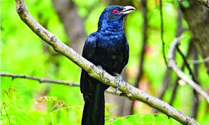
Rule-4. When দ্বারা সময় বুঝালে Complex কে Simple করার নিয়মঃ Structure: When,sub,verb উঠে যায়+ছোট সময় বুঝালে at/in, ঋতু বুঝালে in,বয়স বুঝালে at the age of বসে+ বাকী অংশ+ ২য়
Com: When it is spring, the cuckoo sings.
Sim: In spring, the cuckoo sings.
Com: When he was four, he left the village.
Sim: At the age of four, he left the village.

Slide 12
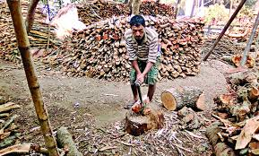
Complex: When it was daylight, I was half wakened by the sound of chopping wood.
Simple: At daylight, I was half wakened by the sound of chopping wood.

Slide 13
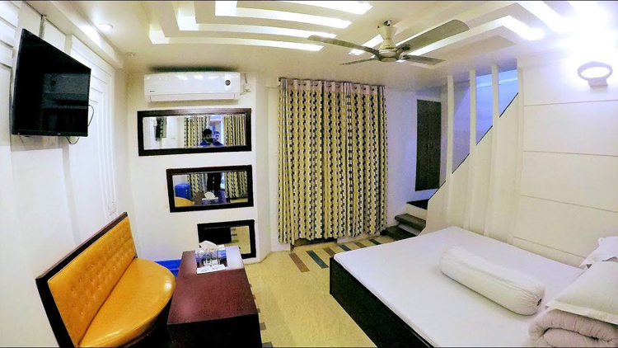
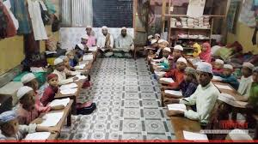
Rule-5. Relative pronoun যুক্ত Complex Sentence কে Simple করার নিয়মঃ Structure: Relative pronoun এর পুর্ব পর্যন্ত+ Relative pronoun বাদ দিয়ে পরের verb এর presentআকারের সাথে ing যোগ+ বাকী অংশ।
Complex: The writer lived in a cabin that belonged to the orphanage.
Sim: The writer lived in a cabin belonging to the orphanage.
Com: A solar pond that absorbs heat from the sun can cook our food.
Sim: A solar pond absorbing heat from the sun can cook our food.

Slide 14
Rule-6. If /unless যুক্ত Complex Sentence টি Negative হলে Simple করার নিয়মঃ Structure: Without+verbএর সাথে ing যোগ+বাকী অংশ + Comma+ ২য় Clause.
Complex: If you do not work hard, you will not prosper in life.
Simple: Without working hard, you will not prosper in life.
Com: If you do not read attentively, you will not pass the examination.
Sim: Without reading attentively, you will not pass the examination.

Slide 15
Rule-6. If যুক্ত Complex Sentence টি Positive হলে Simple করার নিয়মঃ Structure: By+verbএর সাথে ing যোগ+বাকী অংশ + Comma+ ২য় Clause.
Complex: If you work hard, you will shine in life.
Sim: By working hard, you will shine in life.
Com: If you work hard, you will prosper in life.
Sim: By working hard, you will prosper in life.

Slide 16
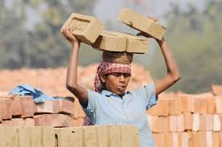
Rule-7. So that /in order that যুক্ত Complex sentence কে Simple Sentence করার নিয়মঃ Structure: sothat এর পুর্ব পর্যন্ত+to+ মুল verbথেকে শেষ পর্যন্ত।
Complex: He work hard so that he could prosper in life.
Sim: He work hard to prosper in life.
Com: I read more so that I can make a good result.
Sim: I read more to make a good result.
Com: We eat so that we may live.
Sim: We eat to live.

Slide 17
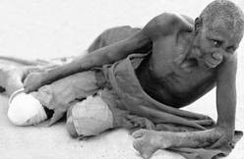
Rule-8. So----that যুক্ত Complex Sentence কে Simple Sentence করার নিয়ম। Structure: Sub+verb+ Soএর স্থলে too+বাকী অংশ+ that থেকে not পর্যন্ত বাদ দিয়ে to+ verb থেকে শেষ পর্যন্ত।
Complex: He is so weak that he can not walk.
Simple: He is too weak to walk.
Com: The boy was so poor that he could not buy book.
Sim: The boy was too poor to buy book.
Com: The boy is so lazy that he can not do any work.
Sim: The boy is too lazy to do any work.

Slide 18
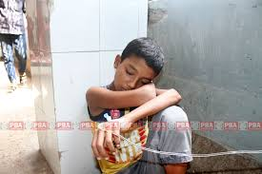
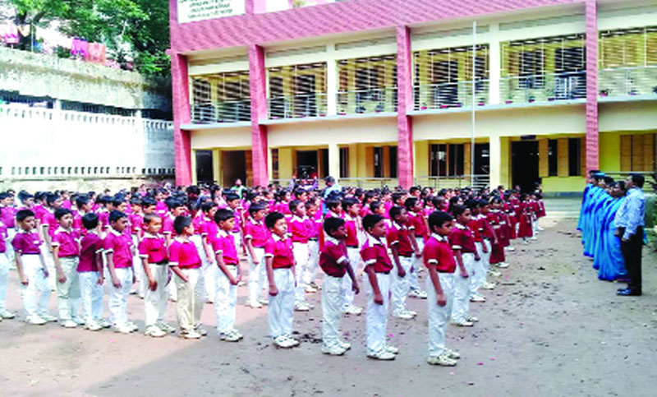
Rule-9. Though/ although যুক্ত Complex Sentence কে Simple Sentence করার নিয়মঃ Structure: Though/although এর স্থলে in spite of /despite+ Pronoun এর possessive form + am/is/are/was/were এর পরিবর্তে being এবং have/has/had having এর পরিবর্তে having/মুল verb এর সাথে ing যোগ+ clause এর বাকী অংশ+ ২য় clause.
Complex: Though he is ill, he went to school.
Simple: In spite of his being ill, he went to school.
Or: In spite of his illness , he went to school.

Slide 19
Com: Though he tried hard and soul, he could not pass the examination.
Sim: In spite of his trying hard and soul, he could not pass the examination.
Com: Although the man has vast riches, he wants more.
Sim: In spite of his having vast riches, the man wants more.

Slide 20
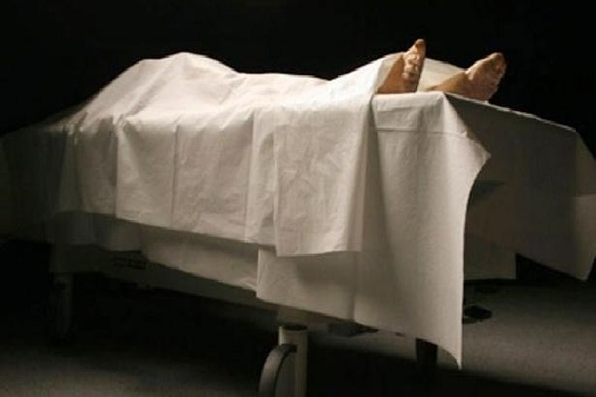
Rule-10.After/before/till/untill যুক্ত complex sentence কে simple sentence করার নিয়ম। Structure: After/before/till/untill এর পুর্ব পর্যন্ত +possessive+gerund/noun+ বাকী অংশ।
Complex: The patient had died before the doctor came.
Simple: The patient had died before the doctor’s coming.
Com: Wait here untill I return.
Sim: Wait here untill my return.
Com: We waited the till they arrived.
Sim: We waited the till their arrival.

Slide 21
Rule-11. As if/as though যুক্ত Complex Sentenceকে Simple করার নিয়মঃ Structure: As if/as though এর স্থলে like+ Prepositional Phrase.
Complex: He speaks as if he were a mad.
Simple: He speaks like a mad man.
Com: He talks as though he knew everything.
Sim: He talks like all-knowing man.
Com: He talks as if he were present there.
Sim: He talks like a man present there

Slide 22
Rule-12. As + adj/adv+ so/as+adj/adv যুক্ত adverb clause of degree prepositional phrase সহ complex কে simple করা যায়। Complex: He is as intelligent as you. Sim: He is intelligent like you. Com: He is as brave as a lion. Sim: He is brav like a lion. Com: He is not so foolish as you. Sim: He is not foolish like you. Com: He acted as foolishly as your brother. Sim: He acted foolish like your brother.

Slide 23
Rule-13.Verb of thinking এর পরের clause কে infinitive phrase এ রুপান্তর করে Simple করা যায়।
Complex: I think that he is honest.
Simple: I think him to be honest.
Com: I believe that he is a liar.
Sim: I believe him to be a liar.
Com: I believe that he was once dishonest.
Sim: I believe him to have once been dishonest.
Com: He considers that you are a truthful boy.
Sim: He considers you a truthful boy.
Com: Do you think that it is easy to pass exam?
Sim: Do you think it easy to pass exam?

Slide 24
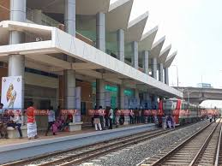
Rule-14. As soon as/ no sooner –than/ hardly----when/ scarcely----when যুক্ত Complex Sentence কে Simple করার নিয়মঃ Structure: Just after/Immediately+ Possessive+gerund/noun
Complex: No sooner had we reached the station than the train left.
Simple: Just after our reaching the station , the train left
Com: As soon as the thief saw the police, he ran away.
Sim: Just after seeing the police, the thief ran away.

Slide 25
Home Task
1.The thief ran so fast that we could not catch him.
2. When I found him, he was reading a novel.
3. Though he is rich, he is unhappy.
4. If you do not work hard , you will fail.
5. The man is so foolish that he could not understand it.
6. When my mutton chop was arrived , she took me to task.
7. There is no mother but loves her child.
8. I do not know why it disturb me.

Slide 26
Thank for all

