Slide 1
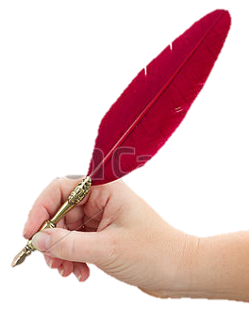
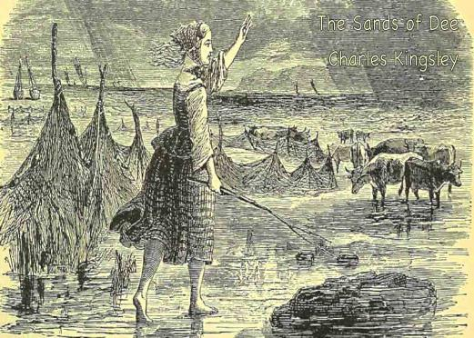
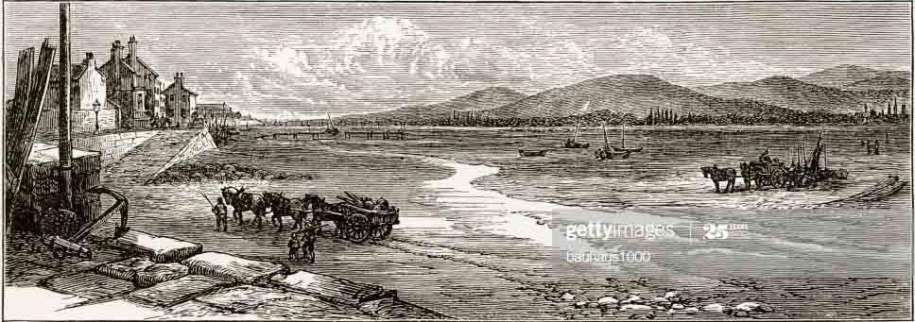

Welcome to my class

Slide 2
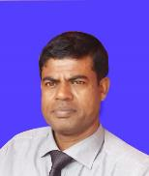
The Sands of Dee
Charles Kingsley
Introduction
MD. ABDUR RAZZAK
Head Teacher
Dhalahara Poshcimpara Secondary Girls’ School
E-mail: abdurrazzakmt@gmail.com
Phone number: 01721588402
Class: 10
U-14_L-3
Time: 50 min
Md. Abdur Razzak, Head teacher, Dhalhara Poshcimpara Secondary Girls’ School, Sadar, Magura, phone number: 01721588402

Slide 3
Let’s enjoy a video clip
Md. Abdur Razzak, Head teacher, Dhalhara Poshcimpara Secondary Girls’ School, Sadar, Magura, phone number: 01721588402

Slide 4
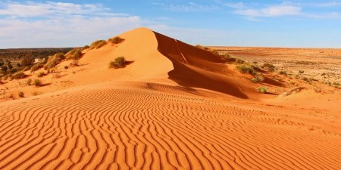
What does the picture mean?
Observe, imagine and say
sands
Md. Abdur Razzak, Head teacher, Dhalhara Poshcimpara Secondary Girls’ School, Sadar, Magura, phone number: 01721588402

Slide 5
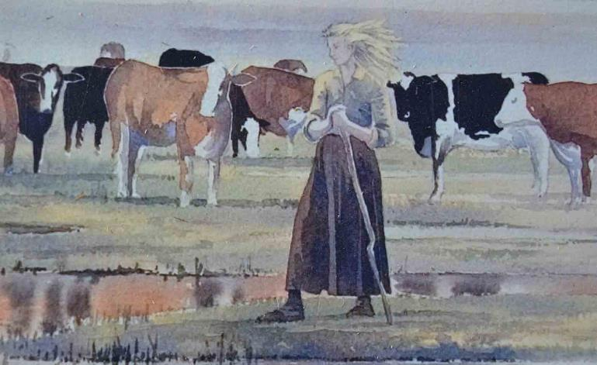
What do you see in this the picture?
A girl with cattle
Md. Abdur Razzak, Head teacher, Dhalhara Poshcimpara Secondary Girls’ School, Sadar, Magura, phone number: 01721588402

Slide 6
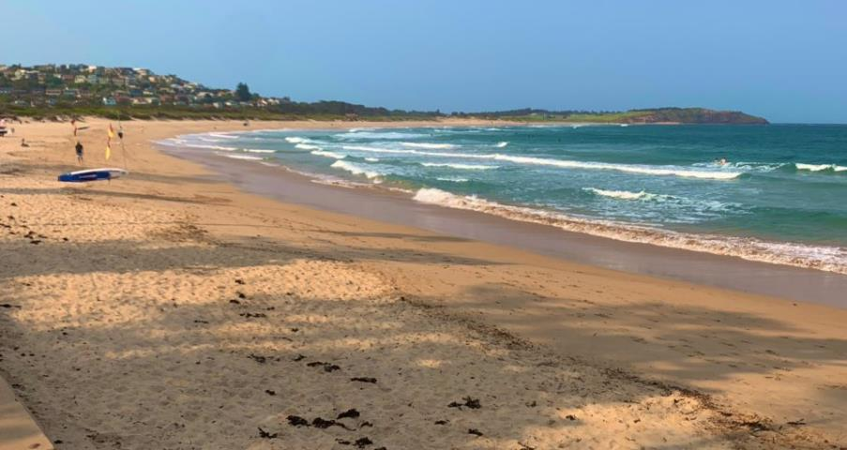
Could you guise which river this one is ?
Dee
Md. Abdur Razzak, Head teacher, Dhalhara Poshcimpara Secondary Girls’ School, Sadar, Magura, phone number: 01721588402

Slide 7
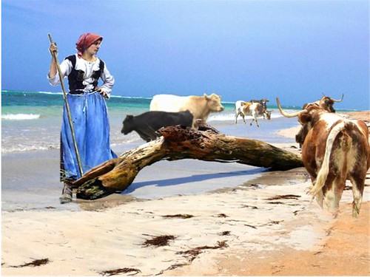
So, what is the picture about?
A girl is grazing cattle by the river Dee
Md. Abdur Razzak, Head teacher, Dhalhara Poshcimpara Secondary Girls’ School, Sadar, Magura, phone number: 01721588402

Slide 8

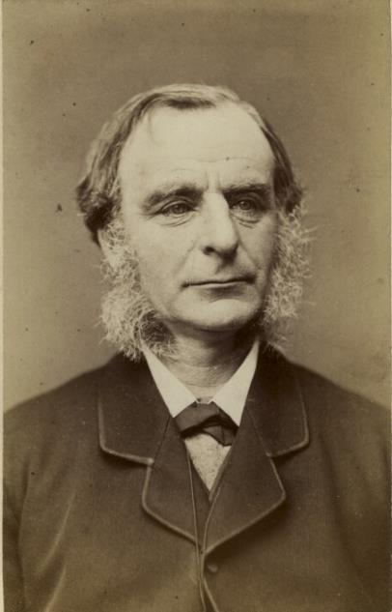
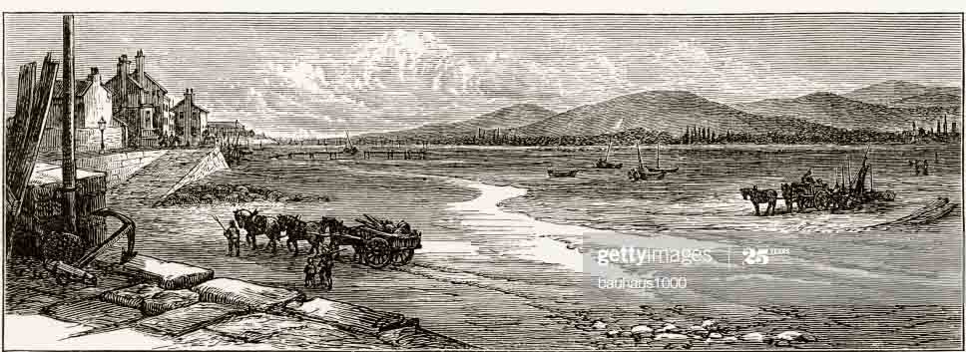
Could you guise what is today’s lesson?
Lesson declaration
The Sands of Dee
Charles Kingsley

Slide 9
Learning outcomes
After the end of the lesson the learners will be able to--
1.
say poet’s biography.
2.
use English sounds, stress, and intonation.
3.
understand and enjoy poem.
4.
interpret, evaluate and summaries literary texts.
Md. Abdur Razzak, Head teacher, Dhalhara Poshcimpara Secondary Girls’ School, Sadar, Magura, phone number: 01721588402

Slide 10
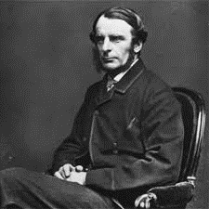
Priest, poet, novelist, dramatist & university professor
Poet’s introduction
English
occu-
pation
‘Yeast’, ‘Westward Ho!’, ‘Hypatia’, ‘The Water Babies’ etc.
Natio-nality
Works
June 12, 1819, Holne Vicarage, Devon, England
born
died
January 23, 1875, Eversley, Hampshire
Charles Kingsley
Md. Abdur Razzak, Head teacher, Dhalhara Poshcimpara Secondary Girls’ School, Sadar, Magura, phone number: 01721588402

Slide 11

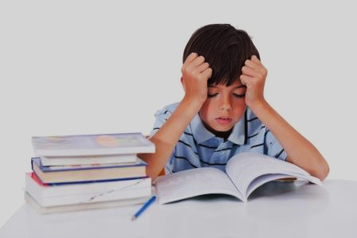
Individual work 3 min
Write pot's biography in short.
Md. Abdur Razzak, Head teacher, Dhalhara Poshcimpara Secondary Girls’ School, Sadar, Magura, phone number: 01721588402

Slide 12
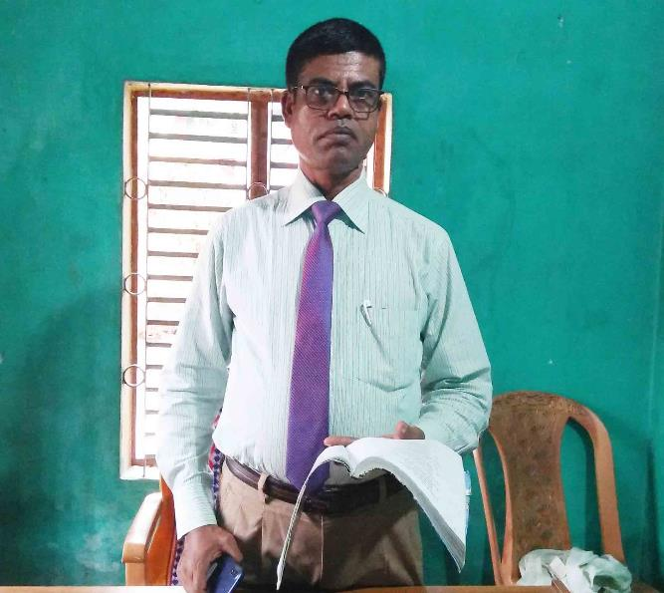

A
The western tide crept up along the sand,
Listen to the poem
And o’er and o’er the sand,
And round and round the sand,
As far as eye could see.
The rolling mist come down and hid the land
And never home came she.
Teacher’s recitation
‘Oh! Is it weed, or fish, or floating hair,
A tress of golden hair,
A drowned maiden’s hair,
The Sands of Dee
Charles Kingsley
Above the nets at sea?’
Was never salmon yet that shone so fair
Among the stakes of Dee.
“O Mary, go and call the cattle home,
And call the cattle home,
They rowed her in across the rolling foam,
And call the cattle home
The cruel crawling foam,
Across the sands of Dee!’’
The cruel hungry foam,
The western wind was wild and dark with foam,
To her grave beside the sea.
And all alone went she.
But still the boatmen hear her call the cattle home
Across the sands of Dee.

Slide 13
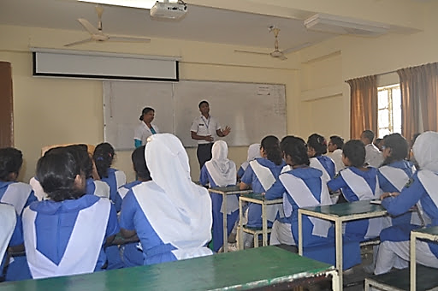
Loud reading
Md. Abdur Razzak, Head teacher, Dhalhara Poshcimpara Secondary Girls’ School, Sadar, Magura, phone number: 01721588402

Slide 14

B
Pair work 5 min
Every single pair answer the following questions.
1. What was the weather like when Mery went to bring the cattle home?
2. Look at some words, phrases and sentences that have been repeated several times. Explain why the poet has done so.
3. How has the poet describe the sea?
Md. Abdur Razzak, Head teacher, Dhalhara Poshcimpara Secondary Girls’ School, Sadar, Magura, phone number: 01721588402

Slide 15
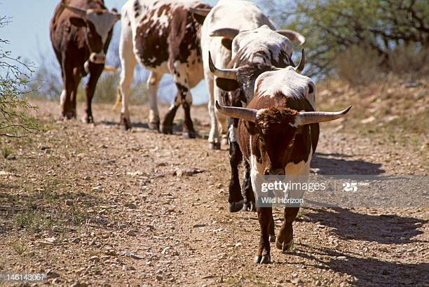
Let’s introduce with some new words
cattle
Cows/oxen
bulls/
livestock/
domestic animals
synonyms
We get milk and meat from cattle.
Md. Abdur Razzak, Head teacher, Dhalhara Poshcimpara Secondary Girls’ School, Sadar, Magura, phone number: 01721588402

Slide 16
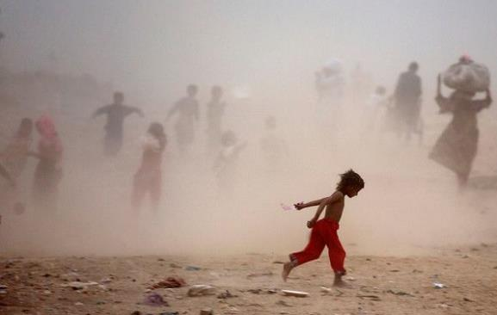
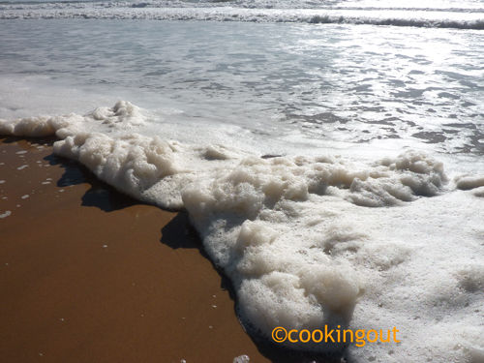
dank/mist
Dank with foam
Foam/bubble
Synonyms: dank -foggy and foam-bubble
When storm starts by the river Dee, weather seems to be dank with foam.
Md. Abdur Razzak, Head teacher, Dhalhara Poshcimpara Secondary Girls’ School, Sadar, Magura, phone number: 01721588402

Slide 17
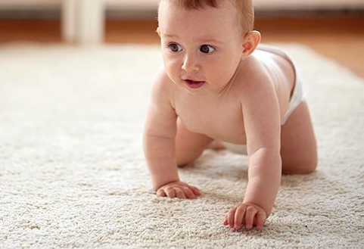
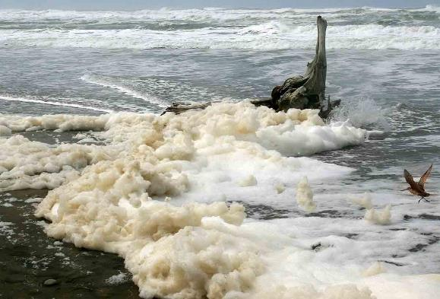
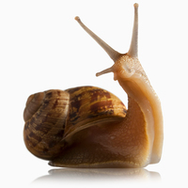
crept up
Someone / something moves slowly
Synonyms: snail/lag
Western wind creeps along the sand.
Md. Abdur Razzak, Head teacher, Dhalhara Poshcimpara Secondary Girls’ School, Sadar, Magura, phone number: 01721588402

Slide 18

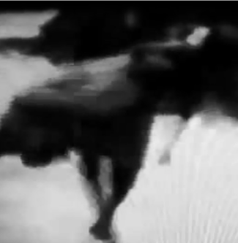
sinking
drowned
Synonyms: submerge, going under water
Mery drowns into the river Dee.
Md. Abdur Razzak, Head teacher, Dhalhara Poshcimpara Secondary Girls’ School, Sadar, Magura, phone number: 01721588402

Slide 19
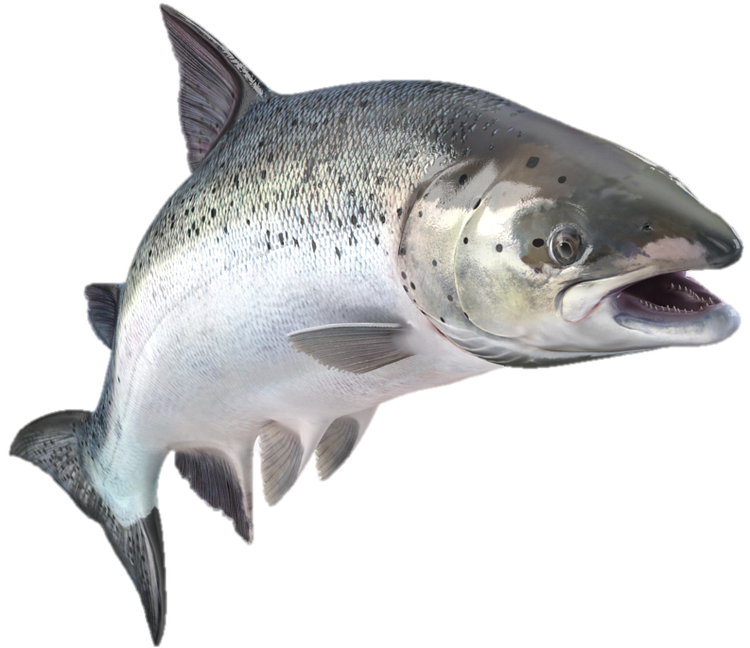
salmon
a kind of fish
Salmons are available in the river Dee.
Md. Abdur Razzak, Head teacher, Dhalhara Poshcimpara Secondary Girls’ School, Sadar, Magura, phone number: 01721588402

Slide 20
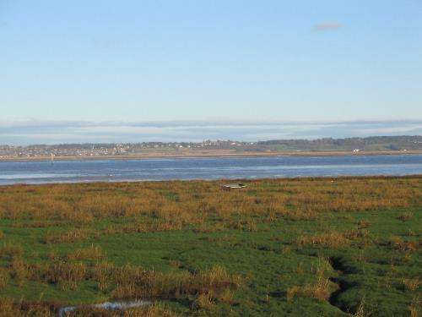
“O Mary, go and call the cattle home,
And call the cattle home,
Across the sands of Dee!’’
And call the cattle home
Md. Abdur Razzak, Head teacher, Dhalhara Poshcimpara Secondary Girls’ School, Sadar, Magura, phone number: 01721588402

Slide 21

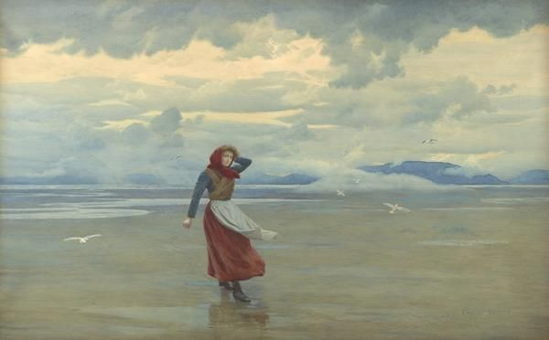
The western wind was wild and dank with foam,
And all alone went she.
Md. Abdur Razzak, Head teacher, Dhalhara Poshcimpara Secondary Girls’ School, Sadar, Magura, phone number: 01721588402

Slide 22
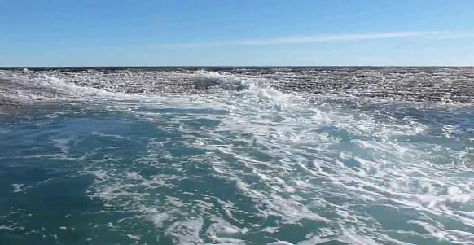
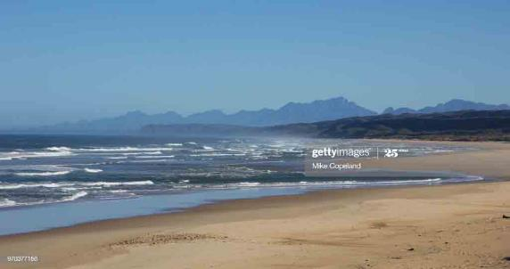
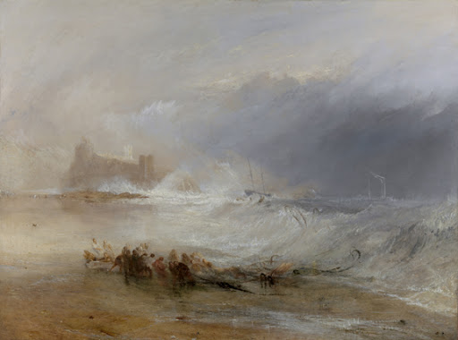

The western tide crept up along the sand,
And o’er and o’er the sand,
And round and round the sand,
As far as eye could see.
Md. Abdur Razzak, Head teacher, Dhalhara Poshcimpara Secondary Girls’ School, Sadar, Magura, phone number: 01721588402

Slide 23
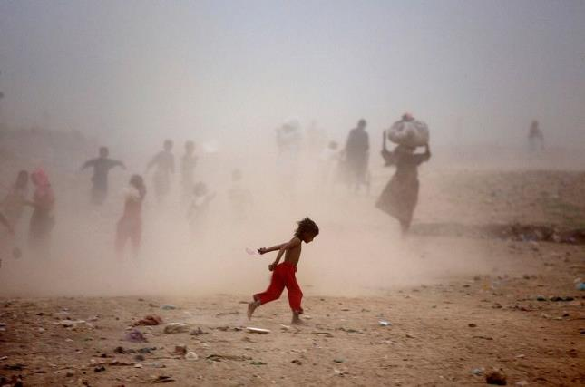

The rolling mist come down and hid the land
And never home came she.
Md. Abdur Razzak, Head teacher, Dhalhara Poshcimpara Secondary Girls’ School, Sadar, Magura, phone number: 01721588402

Slide 24
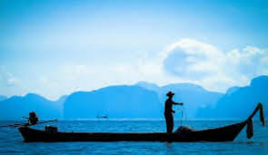
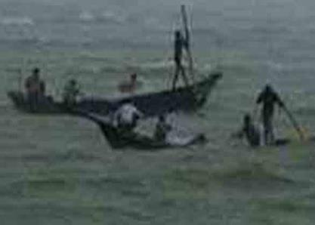
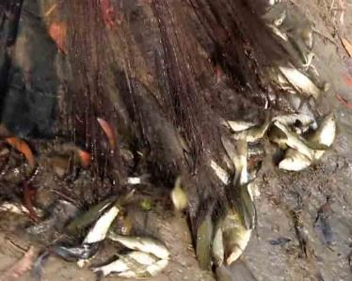
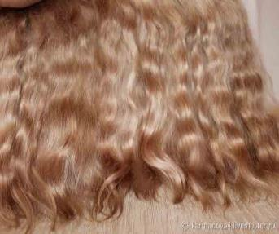
‘Oh! Is it weed, or fish, or floating hair,
A tress of golden hair,
A drowned maiden’s hair,
Above the nets at sea?’
Md. Abdur Razzak, Head teacher, Dhalhara Poshcimpara Secondary Girls’ School, Sadar, Magura, phone number: 01721588402

Slide 25

Was never salmon yet that shone so fair
Among the stakes of Dee.
Md. Abdur Razzak, Head teacher, Dhalhara Poshcimpara Secondary Girls’ School, Sadar, Magura, phone number: 01721588402

Slide 26
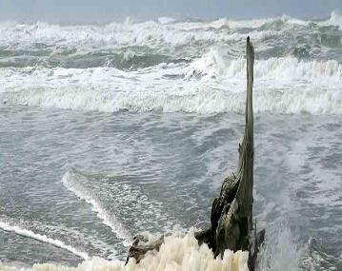
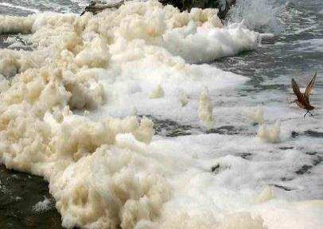
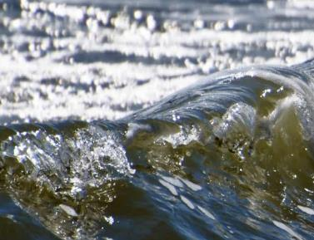
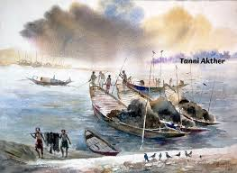
They rowed her in across the rolling foam,
The cruel crawling foam,
The cruel hungry foam,
To her grave beside the sea.
Md. Abdur Razzak, Head teacher, Dhalhara Poshcimpara Secondary Girls’ School, Sadar, Magura, phone number: 01721588402

Slide 27



But still the boatmen hear her call the cattle home
Across the sands of Dee.
Md. Abdur Razzak, Head teacher, Dhalhara Poshcimpara Secondary Girls’ School, Sadar, Magura, phone number: 01721588402

Slide 28

Group work 10 min
Each group summarise the poem.
to check click
Md. Abdur Razzak, Head teacher, Dhalhara Poshcimpara Secondary Girls’ School, Sadar, Magura, phone number: 01721588402

Slide 29
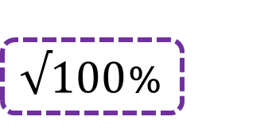








Evaluation
Tick ($√$) the correct answer from alternatives.
1. Who was Mery?
(b) Shepherdess
(a) shepherd
    $√100$%
    $$×$$
(d) village wife
(c) poor girl
    $$×$$
    $$×$$
2. How was the western wind ?
(a) nice
(b) stormy
    $$×$$
    $$×$$
(c) wild
    (d) calm
    $√$100%
    $$×$$

Slide 30



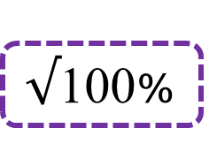
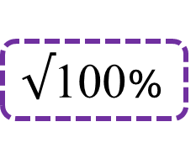
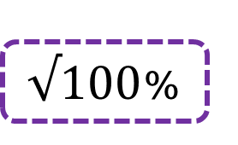






3. How was mery’s hair to look at?
(a) silver
(b) golden
    $$×$$
    $√100$%
(c) black
(d) gray
    $$×$$
    $$×$$
4. what is salmon?
(a) a kind of animal
(b) a kind of bird
    $$×$$
    $$×$$
(c) a kind of fish
    (d) a kind of cow
    $√$100%
    $$×$$
5. How was the mist?
(a) thick
(b) wild
    $$×$$
    $$×$$
(c) rolling
    (d) dank
    $√$100%
    $$×$$

Slide 31
Home work
Write an imaginary story related to Mery within ten sentences.
Md. Abdur Razzak, Head teacher, Dhalhara Poshcimpara Secondary Girls’ School, Sadar, Magura, phone number: 01721588402

Slide 32




See you next class

