Slide 1
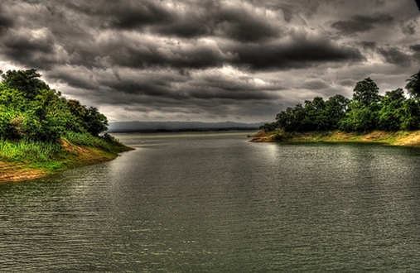
Welcome to multimedia class

Slide 2
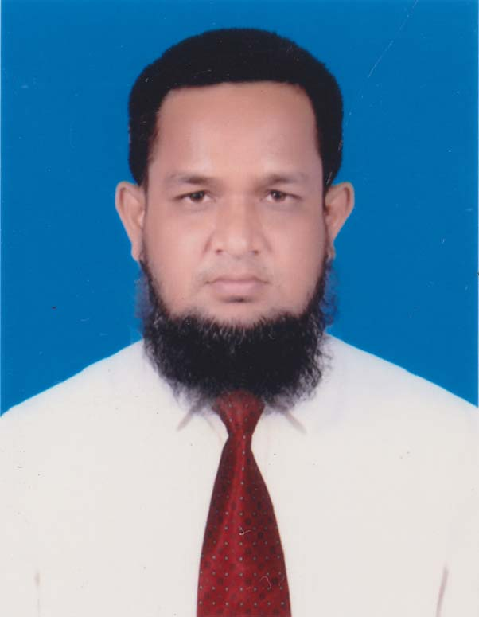
TeacHers identity
MD.ABDUR ROUF
Lecturer(English) Khalna Islamia Fazil(Degree) Madrasah .Patnitola,Naogaon. Mob:01767650169 Email:rouf301285@gmail.com

Slide 3
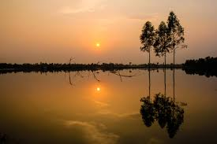
Look At The Picture

Slide 4
Bengal’s face

Slide 5
TODAY’s LESSON-
UNIT :Fourteen: Myths and Literature
Lesson :One
Title of the Lesson:Bengal’s Face

Slide 6
Learning outcomes:
After the lesson Ss will be able to-
#To Tell about Bengal’s picture
#To Tell about Poet-Jibanananda Das
# To Recite the poem
#To Tell some words Dictionary Meaning

Slide 7
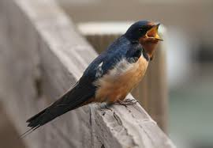
Now,we also see some Picture
swallow
দোয়েল

Slide 8
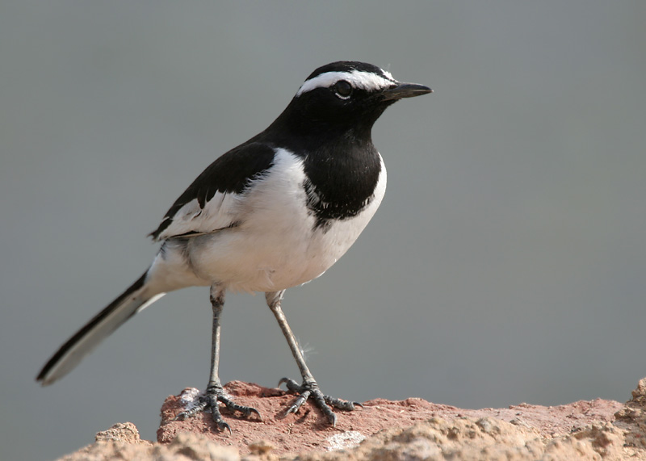
wagtail
আফ্রিকার গায়ক পাখি

Slide 9
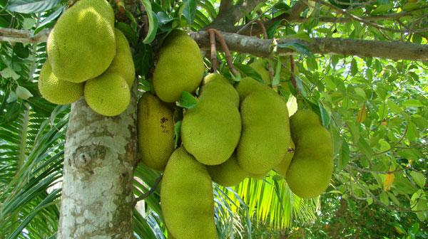
Kanthal

Slide 10
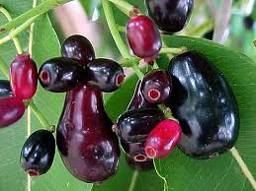
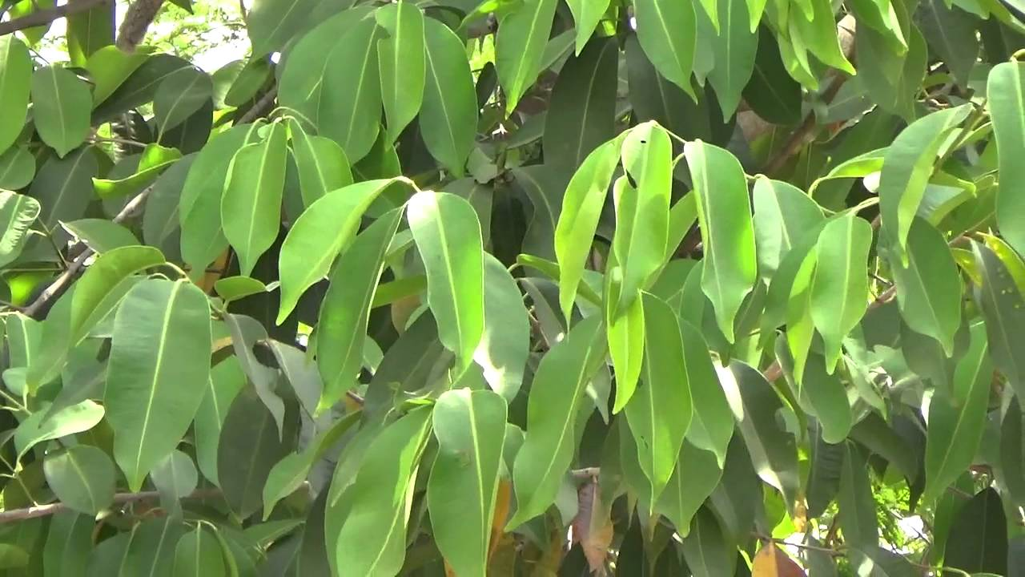
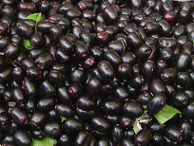
Jam

Slide 11
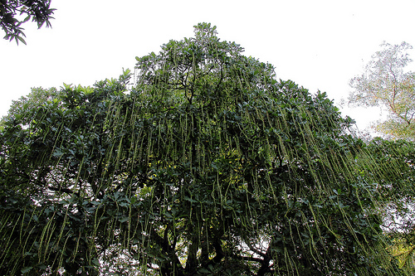
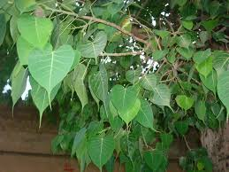
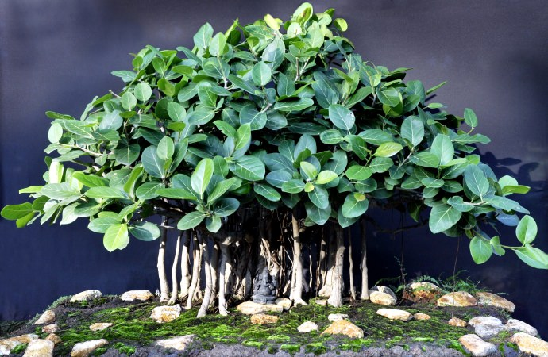
Aswatha
Hijol
Bot

Slide 12
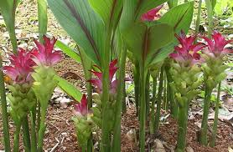
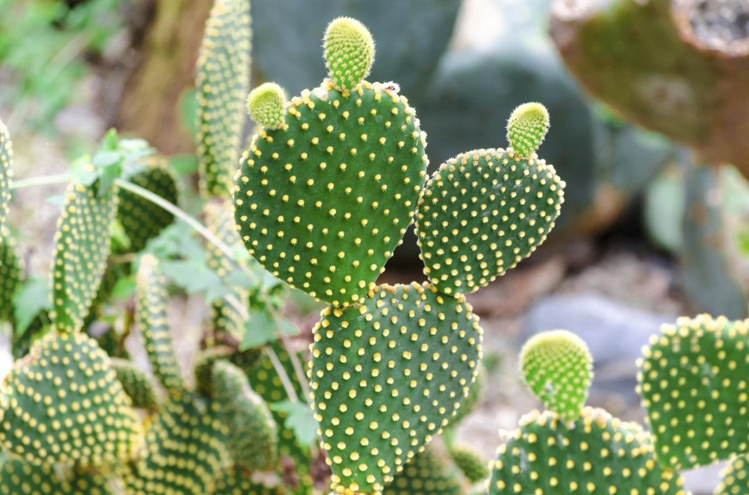
cactus and zedoary bushes

Slide 13
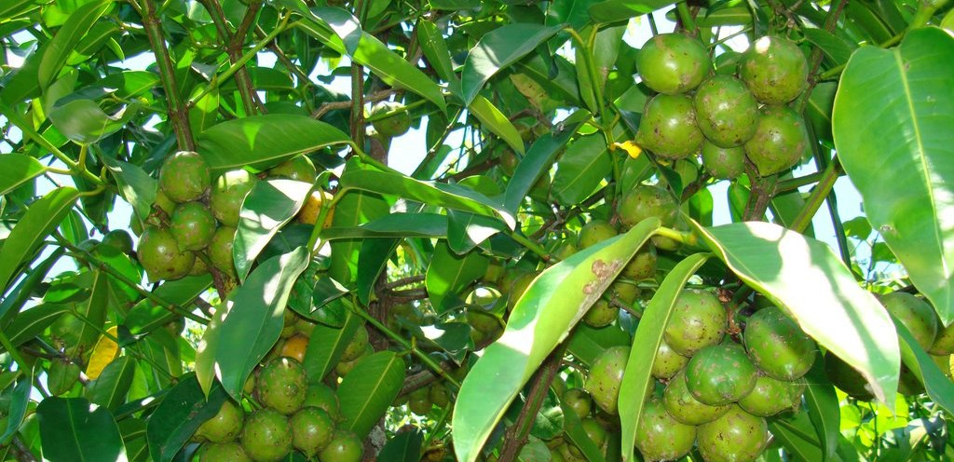
Fig tree

Slide 14
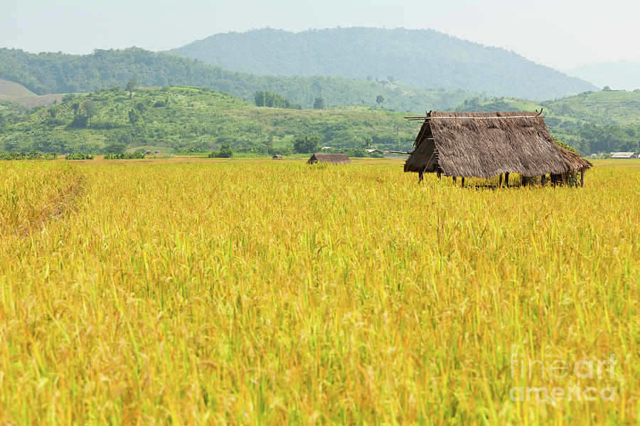
golden rice fields

Slide 15
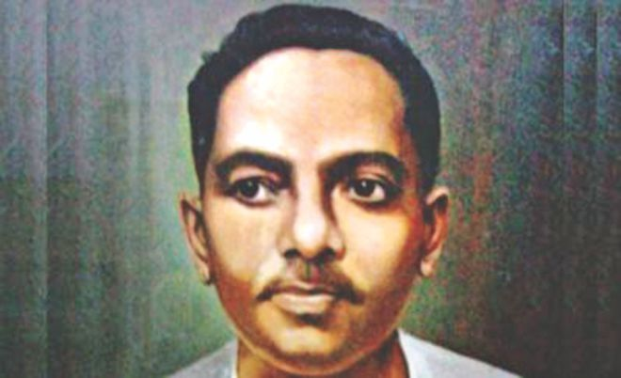
Now, we are known to Jibanananda Das.
Native name জীবনানন্দ দাশ
Jībanānanda Dāś
Born জীবনানন্দ দাশগুপ্ত
Jībanānanda Dāśagupta
17 February 1899
Barisal, Bengal Presidency (present day Bangladesh), British India
Died 22 October 1954 (aged 55)
Parents: Kusumkumari Das, Satyananda Das

Slide 16
Jībanānanda Dāś (Bengali: জীবনানন্দ দাশ, (17 February 1899 – 22 October 1954) was a Bengali poet, writer, novelist and essayist. Popularly called "Rupashi Banglar Kabi'' (Poet of Beautiful Bengal),Das is probably the most read poet after Rabindranath Tagore and Nazrul Islam in Bangladesh and West Bengal.While not particularly recognised initially, today Das is acknowledged as one of the greatest poets in the Bengali language.

Slide 17
Born in Barishal to a Vaidya-Brahmo family, Das studied English literature at Presidency College, Kolkata and earned his MA from Calcutta University. He had a troubling career and suffered financial hardship throughout his life. He taught at many colleges but was never granted tenure. He settled in Kolkata after the partition of India. Das died on 22 October 1954, eight days after being hit by a tramcar. The witnesses said that though the tramcar whistled, he did not stop, and got struck. Some deem the accident as an attempt at suicide.

Slide 18
Now Recite the poem
I Have Seen Bengal’s Face –Written By:Jibanananda Das
Because I have seen Bengal’s face I will seek no more;
The world has not anything more beautiful to show me.
Waking up in darkness, gazing at the fig-tree, I behold Dawn’s swallows roosting under huge umbrella-like leaves.
I look around me

Slide 19
And discover a leafy dome-Jam, Kanthal, Bat, Hijol and Aswatha trees-
All in a hush, shadowing clumps of cactus and zedoary bushes.
When long, long ago, Chand came in his honeycombed boat

Slide 20
To a blue Hijal, Bat and Tamal shade near the Champa, he too sighted
Bengal’s incomparable beauty. One day, alas. In the Ganguri,
On a raft, as the waning moon sank on the river’s sandbanks,

Slide 21
Behula too saw countless aswaths bats besides golden rice fields
And heard the thrush’s soft song. One day, arriving in Amara,
Where gods held court, when she danced like a desolate wagtail,
Bengal’s rivers, fields, flowers, wailed like strings of bells on her feet.

Slide 22
Words-------
Meaning
1.Fig-tree ---------------- A tree which looks like a huge umbrella
2.Roosting ----------------- Resting under a huge umbrella
3.Hush ----------------- All trees seem to be in silence
4.Honeycombed --------------- Filled with tunnels
5.Waning ----------------- The moon which was disapearing
6.Desolate ------------------ Isolated
7.Wagtail ------------------ A bird with a long tail
8.Dome ------------------ The vaults of trees like berry,jackfruit,etc

Slide 23
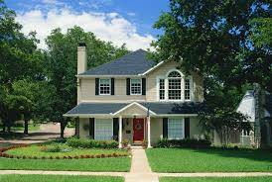
Home Work
Write down a summery of this poem.

Slide 24
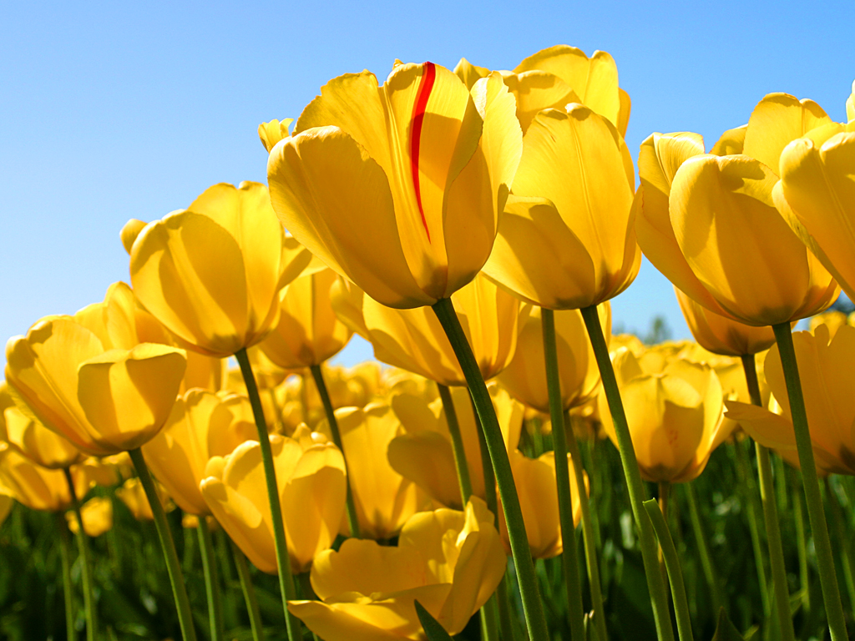
Thanks of all

