Slide 1
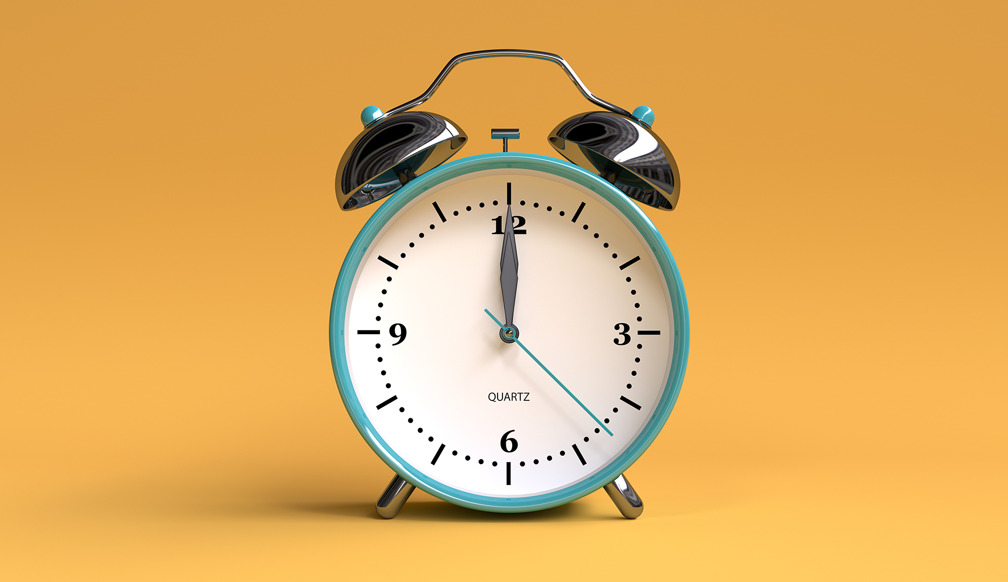

Slide 2
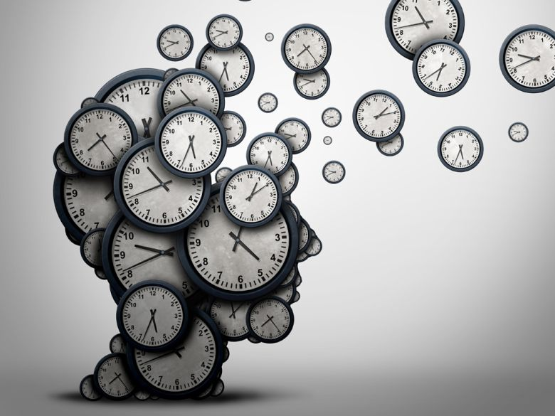
Welcome to all.

Slide 4
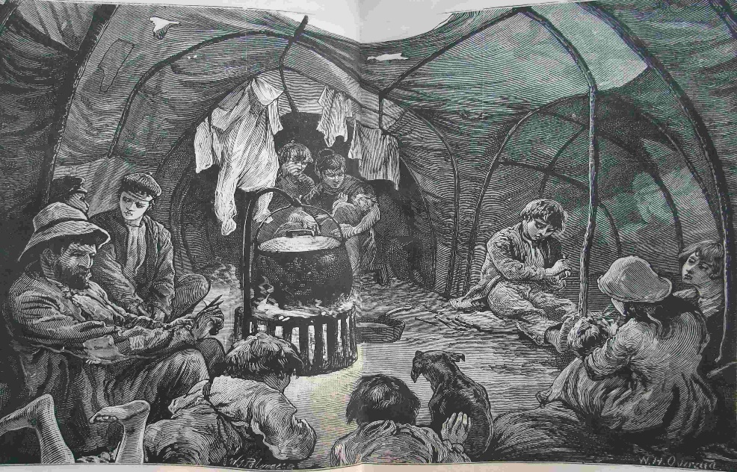
Time, You Old Gipsy Man

Slide 5
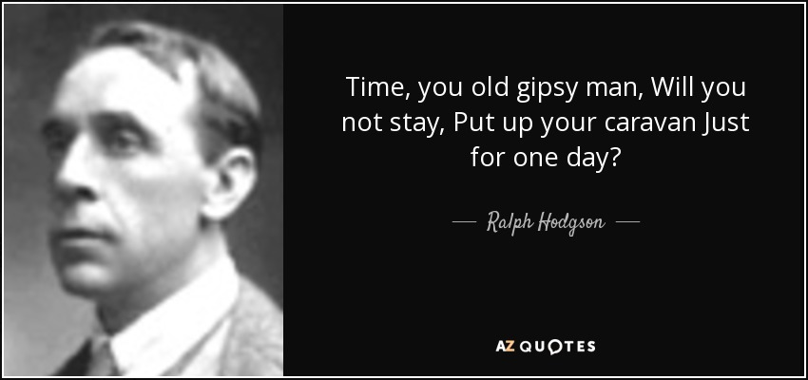
A: Look at the picture.

Slide 6
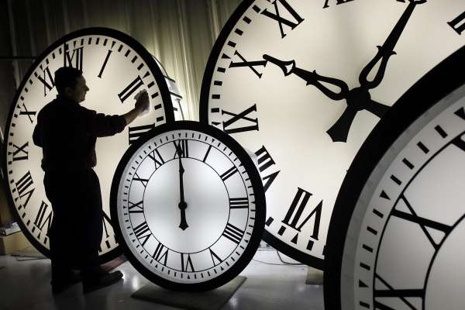

Slide 7
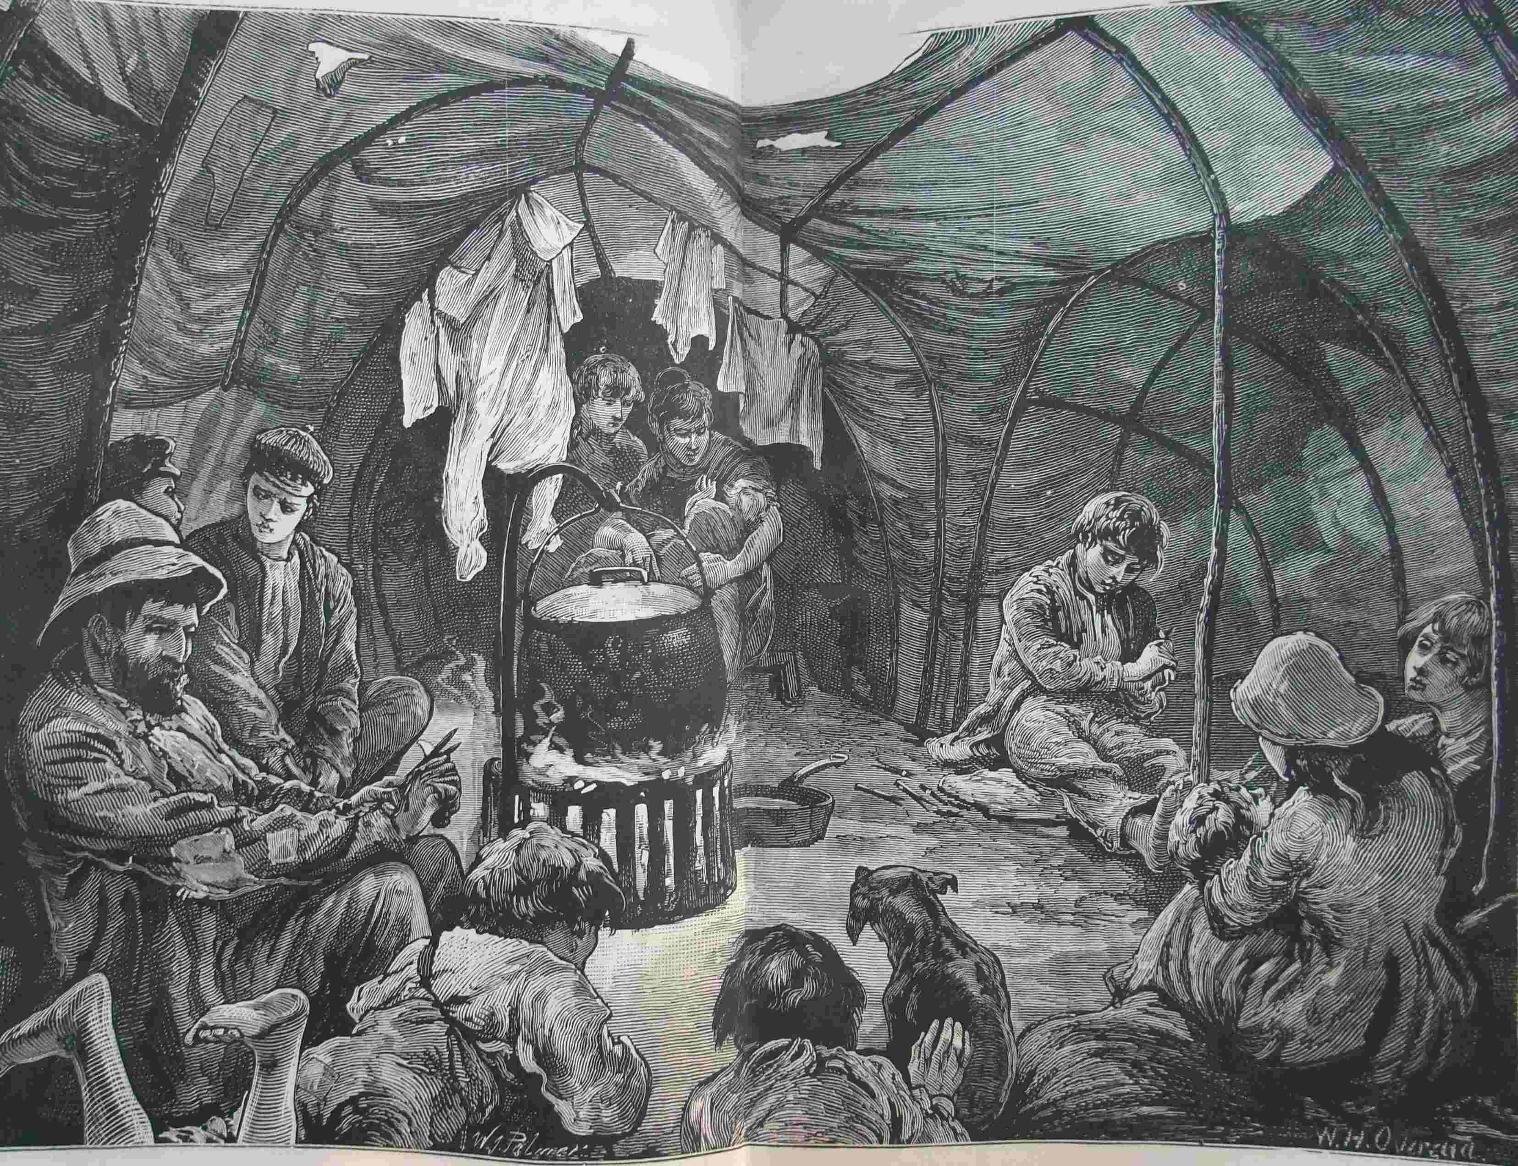

Slide 8
A: Read and answer the following questions.
1. Have you seen any gipsy? If yes, where?
2. Do gypsies live in our country?
3. In what ways are they different from the general people?

Slide 9
Let us watch the video.
Please click here to go to internet for watching Video.

Slide 10
Today’s topic of the class is----
Time, You Old Gipsy Man
Unit : 14
[Pleasure and Purpose]
Lesson : 4

Slide 11
Learning outcomes
After the students have studied the lesson, they will be able to --- ---
recognize and use English sounds, stress, and intonation,
understand poem,
interpret, evaluate, and summarise literary texts.

Slide 12
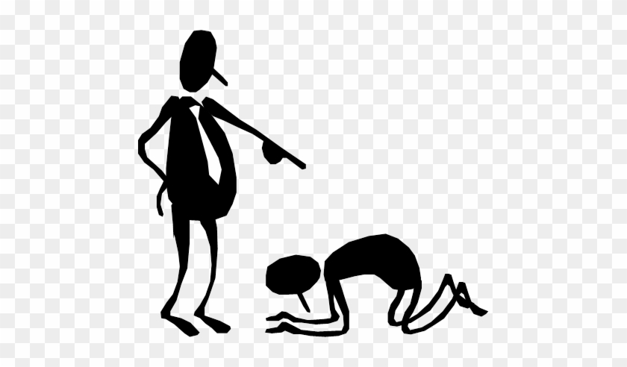
Bow
Bend head or body forward
NEW WORDS
Syn.: knot, loop
Ant.: straight

Slide 13
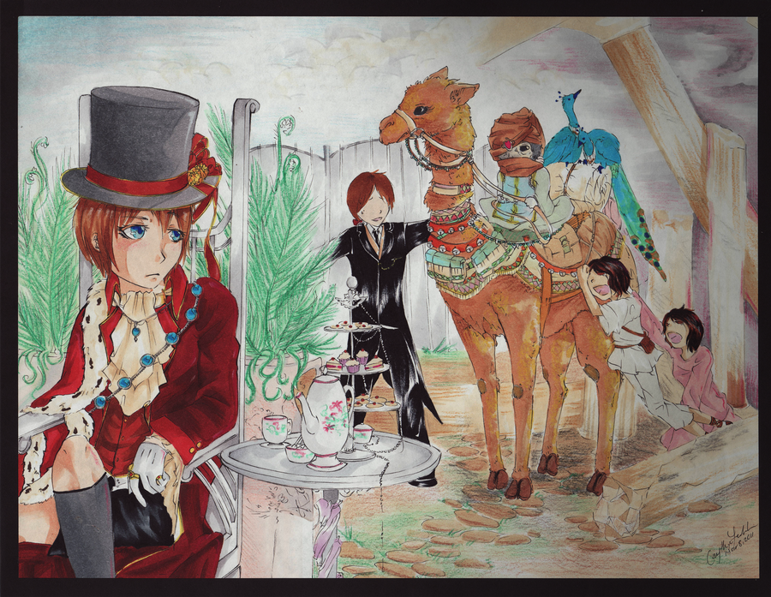
Gipsy
People who do not have a fixed living place and who travel from one place to another
Syn.: nomad, traveler

Slide 14
B: Now read the poem and answer the questions follow.
Time, You Old Gypsy Man
Time, you old gipsy man,
Will you not stay,
Put up your caravan
Just for a day?
All things I’ll give you,
Will you be my guest?
Bells for your jennet
Of silver the best,
Goldsmiths shall beat you
A golden ring,

Slide 15
Peacocks shall bow to you,
Little boys sing,
Oh, and sweet girls will
Festoon you with May.
Time, you old gipsy,
Why hasten away?
Last week in Babylon,
Last night in Rome,
Morning, and in the crush
Under Paul’s dome;
Under Paul’s dial
You tighten your rein—

Slide 16
Only a moment
And off once again;
Off to some city
Now blind in the womb,
Off to another
Ere that’s in the tomb.
Time, you old gipsy man,
Will you not stay,
Put up your caravan
Just for a day?
---- Ralph Hodgson

Slide 17
B: Answer these questions.
1. Why does the poet call time an old gipsy man?
2. Make a list of things the poet will offer time if it stays just for a day.
3. What else can you offer time if it stays for a day?
EVALUATION

Slide 18
HOME WORK
Every student will write a summary of the poem ‘A’ in no more than 90 to 100 words.

Slide 19
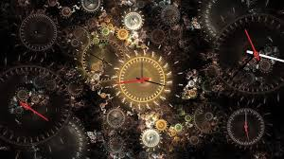
Thank you all.

