Slide 1

Welcome,
to the English class.

Slide 2


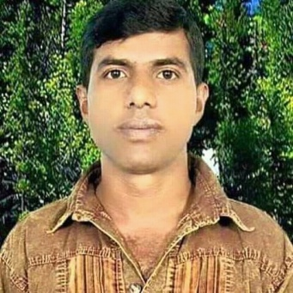
Lesson’s Introduce
Teacher’s Introduce
Unit: 5 ( How old…..?)
Lessons:(4-6)
Alphabet( u - z )
Parts of lesson: Activity- C
( Look and say).
Subject: English.
Class: Two
Time: 45 minutes
Kalyan Brata Biswas
Assistant Teacher
Kayesthorail Govt. Primary School
Dakshin Surma ,Sylhet.
Email: kalyanbratabiswas1979@gmail.
com.

Slide 3

Safety environment by greetings song.
.
Hello! Hello!
How are you?
I’m good,
I’m great!
How about you?
Na na nana na na na na,
Hei, na na nana na na na na!

Slide 4
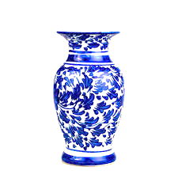
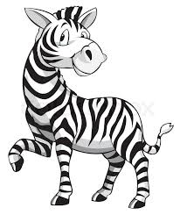




Checking homework and ask the following questions.
What’s this?
Answer the above questions I will declaration today’s lesson.

Slide 5

Today’s our lesson is....
Unit :5(How old……..?)
Lessons: 4-6(Alphabet)
Activity- C

Slide 6
LEARNING OUTCOMES
By end of the lesson students will be able to------
Speaking: 1.1.2 say simple words and phrases with proper sounds and stress.
Reading: 1.4.1 read words and phrases with the help of the visual clues and simple sentences.
Writing: 1.2.1 write non-cursive small letters.

Slide 7
Spell out the words which we learned in the previous lesson.
umbrella
vase
window
x-ray
yo-yo
zebra

Slide 8
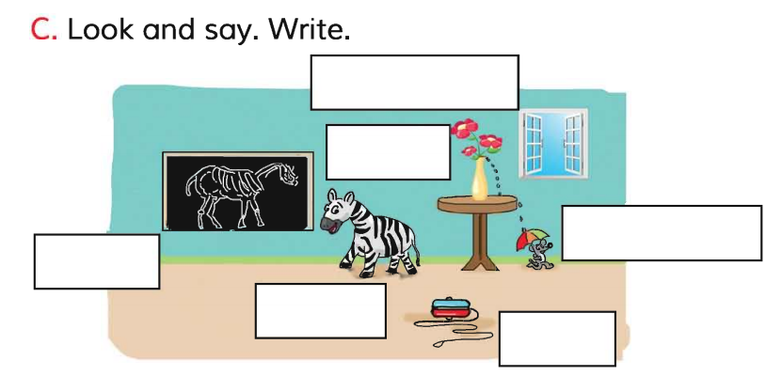
Dear students now open your English book at page - 11 and see the Activity-C
window
What can you see in the picture?
vase
umbrella
x-ray
zebra
yo-yo
Exchange your book to other and check the text other .
Match your answers.

Slide 9

Now say and write the
non-cursive small letters beside the capital letters
in your exercise book.
W --
X --
Y --
Z --
U --
V--
Techniques: SGW

Slide 10
Read and say.
zebra
x-ray
window
yo-yo
umbrella
vase
x-ray
window
yo-yo
umbrella
vase
zebra
window
yo-yo
umbrella
vase
zebra
x-ray
yo-yo
umbrella
vase
zebra
x-ray
window
Marking weak students and take to care.

Slide 11
One Day One Word
What is this?
x-ray
রঞ্জনরশ্মি।
Spell out the word
Technique - SGW

Slide 12
Find out the following letters that are made by a meaningful word.
i
w
d
y
n
z
w
o
n
The find out word is ---------------------
windwo
window
wondiw
winodw

Slide 13
Dear students now say the missing letter.
vas--
va--e
v--se
--ase
Write the word in your exercise book.
vase
ফুলদানি।

Slide 14
Dear students look at the below picture and
re-arrange the following letters which will be make a meaningful word.
z
b
e
r
a
The meaningful word is………………

Slide 15
Evaluation
Write non-cursive small letters beside the capital letters in your exercise book.
X --
Y ---
Z--
U --
V --
W --

Slide 16

Home work
Page no-11 activity-C will well read and write.

Slide 17

Thank you, that’s all
for today.
Goodbye.

