Slide 1
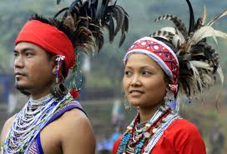
Welcome to my multimedia classroom

Slide 2
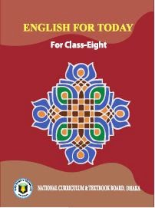
Identity
Md. Robiul Islam
Assistant Teacher English
Pioneer Girls’ High School, Khulna
E-mail. robittck@gmail.com
Cell. 01914223493
English For Today
For Class- Eight
Unit- One
Lesson- Three

Slide 3
Look at the question and discuss in groups.
Have you heard the word ‘ethnic people’? Can you tell what it means?

Slide 4
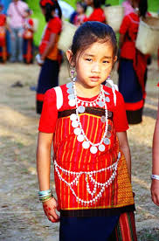
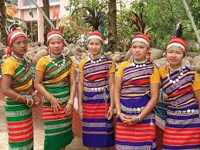
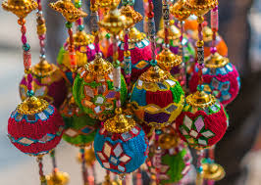
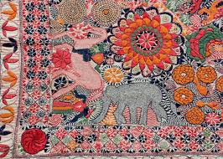
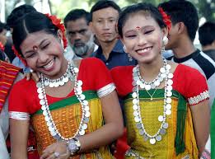
Now look at the pictures. Then discuss the following questions.
Do you know where the ethnic people live in Bangladesh?
What are they called?

Slide 5
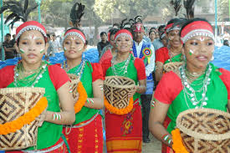
Today’s topic is
Our ethnic friends (1)

Slide 6
Student will be able to –
read and understand texts through silent reading.
ask and answer questions.
infer meaning from text.

Slide 7
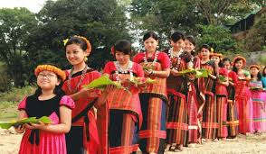
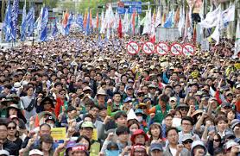
Ethnic
Racial, Generic
The ethnic people in Bangladesh hold a very important place in the culture of the country.
Adjective
Multiplicity, Better part of
Majority
The majority of ethnic people live in Chottogram Hill Tracts.
Noun

Slide 8
Ethnic people living place
Ethnic People
Chattogram
Mymensingh
Rajshahi
Sylhet

Slide 9
Religion of ethnic people
Hindus
Christian
Buddhist

Slide 10
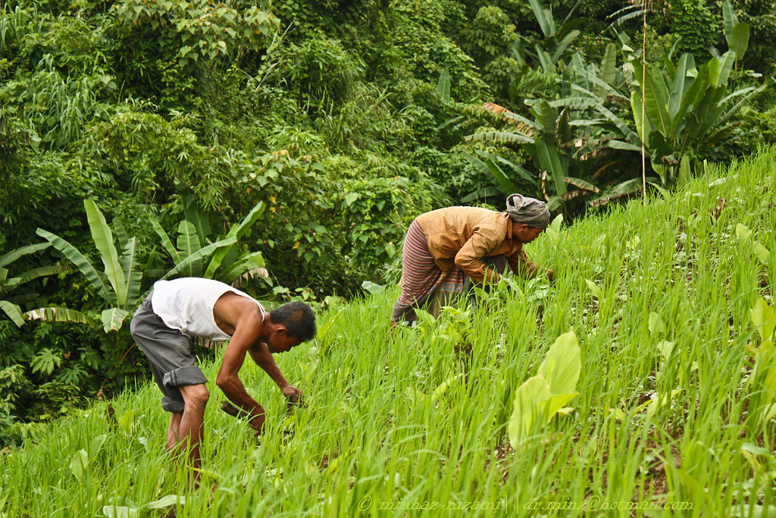
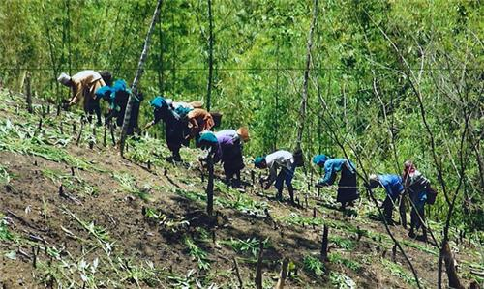
Profession of Ethnic people
They are mostly farmers.
They do Jhum cultivation

Slide 11
Some ethnic’s in Bangladesh
Chakma
Marma
Tippera
Moorang
Santal
Khasia
Monipuri
Hajang
Garo

Slide 12
B. Now read the text.
The ethnic people in Bangladesh hold a very important place in the culture of the country. The majority of these people live in the Chattogram Hill Tracts. The others live in the regions of Mymensingh , Rajshahi and Sylhet. They live in forest areas, in the hills and rural areas. They do Jhum cultivation. For this work they clear a piece of land in the forest, prepare it and sow seeds in it. They are mostly farmers. By religion they are Hindus, Christians or Buddhists. They speak their own mother tongues. Some of them are the Chakmas, the Marmans, the Tipperas and the Moorangs who live in the Hill Tracts. The Santals live in Rajshahi. The Khasias and the Monipuries , live in Sylhet and the Hajangs and the Garos in Mymensingh.

Slide 13
C. True or false. If false , give the correct answer.
1. All the ethnic people of our country live in Chattogram Hill Tracts.
2. Most of them are farmers.
3. By religion all of them are Buddhists.
4. The Moorangs are an ethnic group.
5. They practice Jhum cultivation.
True
False
True
False
True

Slide 14
D. Ask and answer the questions in pairs.
1. Where do you find the Marmans?
2. What language do they speak at home?
3. Where and how do they do the Jhum cultivation?

Slide 15
Grammar Task
Present Indefinite Tense:
Structure:
Subject. + Verb+ Object
Example:
The sun rises in the East.

Slide 16
Home Work
Write a paragraph about
“ Ethnic People of Bangladesh.”

Slide 17
Allah Hafez

