Slide 2
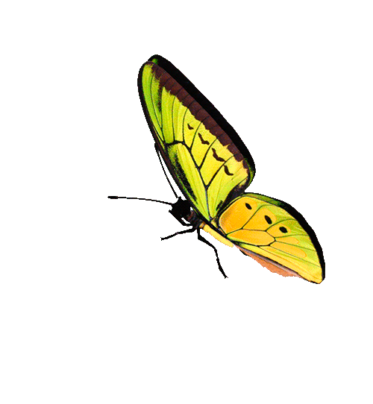
W
e
l
come

Slide 3
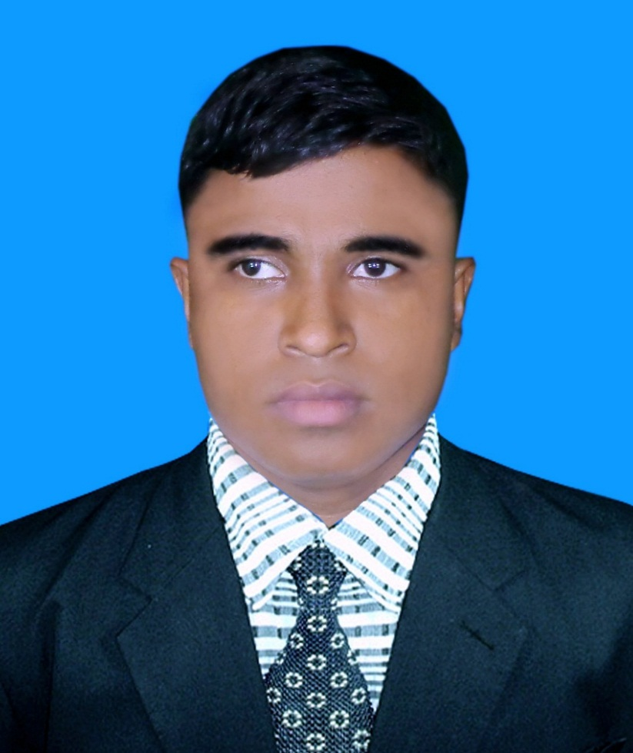
Teacher’s Identity A. Sukur Ali Khan B.A hons.M.A In English Assistant Teacher(English)
Naldha Secondary School
Naldha,Fakirhat,Bagerhat.
Email : sukur360720@gmail.com Mobile no-01922360720
Class-VIII
English First Paper

Slide 4
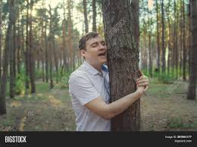
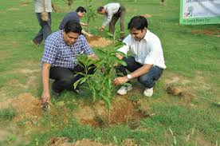
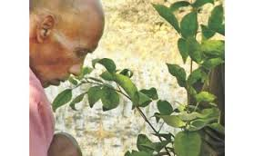
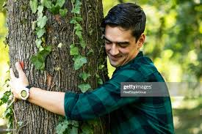
Look at the pictures and discuss with your partner what you see.
What do you see in the picture ?
What are they doing?
Notes:
Suspension to take out loving tree.

Slide 5
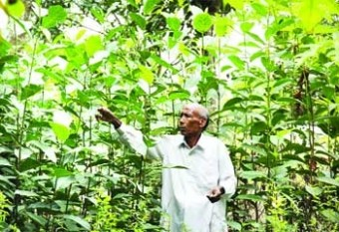
Our todays lesson is about “A man who loves trees.”
Unit -5’Lesson-4

Slide 6
Learning outcomes:
After completing the lesson the students will be able to
1. ask and answer questions
2. and understand text through silent reading
3. infer meaning from context
4. understand true and false
5. write answer to questions

Slide 7
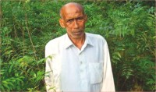
Do you know this person?
Yes,He is Kartik Poramanik
Notes:
Students may not answer the question. Just go to the next page.

Slide 8
Let us introduce with him.
Name : Kartik Poramanik
Father : Suren Poramanik
Mother : Subas Bala
Village : Tarapur
Upazilla : Shibgonj
Dist. : Chapainawabgonj
Birth Year : 1942
Profession : Hair dresser
Passion : Planting trees
Quantity of pant : More than hundred.
Identity : Nature lover.

Slide 9
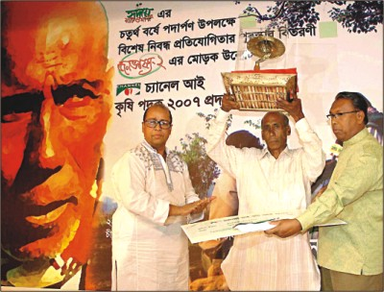
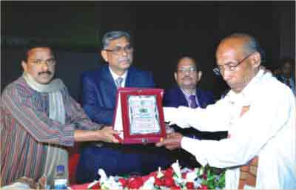
His Achivement

Slide 10
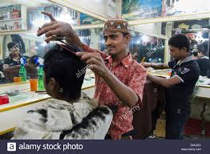
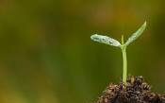
Key words
Profession-->
Occupation
Hairdresser by profession
Sapling-->
A young tree
A sapling

Slide 11
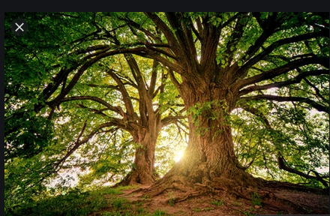
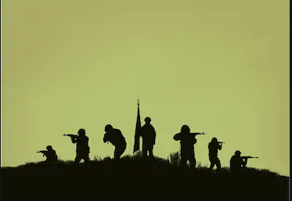
Gigantic-->
Very large
A gigantic tree
Mission-->
A set task to fulfill a purpose
Mission to fight for the country.

Slide 12
Read the lesson silently to understand the passage.
At the farthest corner of Bangladesh there is a village called Tarapur. In this village there lives a man named Kartik Poramanik. He is a hair dresser by profession , but a nature lover at heart. His passion is to plant saplings, which grow into gigantic trees. He started planting trees when he was only 10 years old. He remembers what his father once told him. ``My son, you can earn the blessings of God by planting trees. He has never forgotten what his father told him. At present he is 63 years old. He has planted hundreds of trees in his village. Many of the trees are now 35-40 years old.
Once there were hardly any trees in this village. Kartik used to go to different houses for his job. At times he would get tired in the scorching sun, but there were no trees under which he could sit and rest for a while. Thinking how people suffer in the heat. Kartik began his tree planting mission.

Slide 13
Kartik would wake up early in the morning, take one or two labourers with him and set out to plant trees. He would walk long distance to plant trees, carrying with some dry food and water. He would pay all the expenses from his own pocket. Kartik has planted trees beside the roads, in and around the bazar, schools and colleges, open fields and many other places.
At times it so happened that Kartik would go to water his plants at 10 or 11 pm people asked him, ``Kartik, are you mad? What are you doing so late at night? Kartik would smile and say, ``What to do, sir. I have to work hard the whole day to earn money for my family. I don`t get time during the day. But my trees would die if I don`t water them. So come late at night to look after them.’’
Even today this old man continues planting trees aw many aw he can. A man, who can hardly sign his name, is leaving his signature all around in nature.

Slide 14
Individual Work
B. True or false? If false give the correct information.
1.He planted the trees 50 years ago.
2. Kartik borrowed money from others to plant trees.
3. He would plant trees around his hut only.
Ans. False. Corr. Inf. He planted the first tree 53 years ago.
Ans. False. Corr. Inf. Kartik paid all the expenses from his own pocket to plant trees.
Ans. False. Corr. Inf. He would plant trees not only around his hut but also around the bazar, schools, colleges, open fields, beside the roads and many other places.

Slide 15
Pair Work
D. Read the text again and answer the following questions.
Who is kartik poramanik?
How do you understand that he is a nature lover?
Why did he plant trees?
What do you understand by the saying , “A man , who can hardly sign his name, is leaving his singature all around in nature?”

Slide 16
Evaluation
@ Say true or false ? If false give correct information
1.Kartik began planting at the of 34
2.He one or helpers with him.
@ Choose the best answer
1.Kartik has a passion for
a.flowers b.trees c.hair . d. people
2.He came late for want of
a.money b.time c.labourers d.hair

Slide 17
Individual Work
Home Work
Write the answer of the following questions.
How can we get the blessing of God?
What motivation worked behind his planting trees?

Slide 18
Class Over
Bye. See you again tomorrow.

