Slide 1
There is no love
pure than a mother’s love in this world.

Slide 2
WELCOME
to my
Class

Slide 3
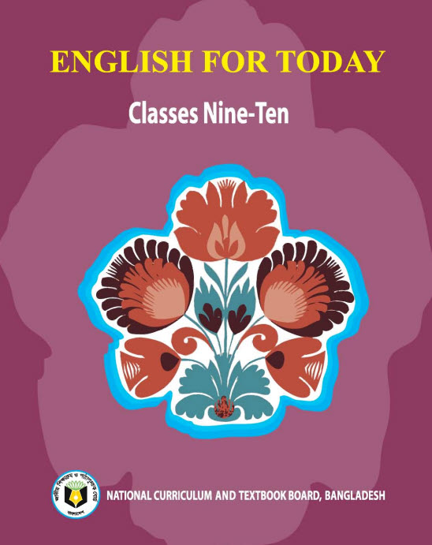
Introduction
Swandip Banerjee
Assistant Teacher (English)
Pallimangal Secondary School
Sonadanga, Khulna.
Mobile: 01718503573
E-mail: swandipb1@gmail.com

Slide 4
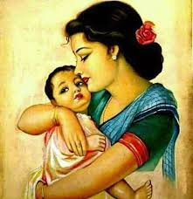
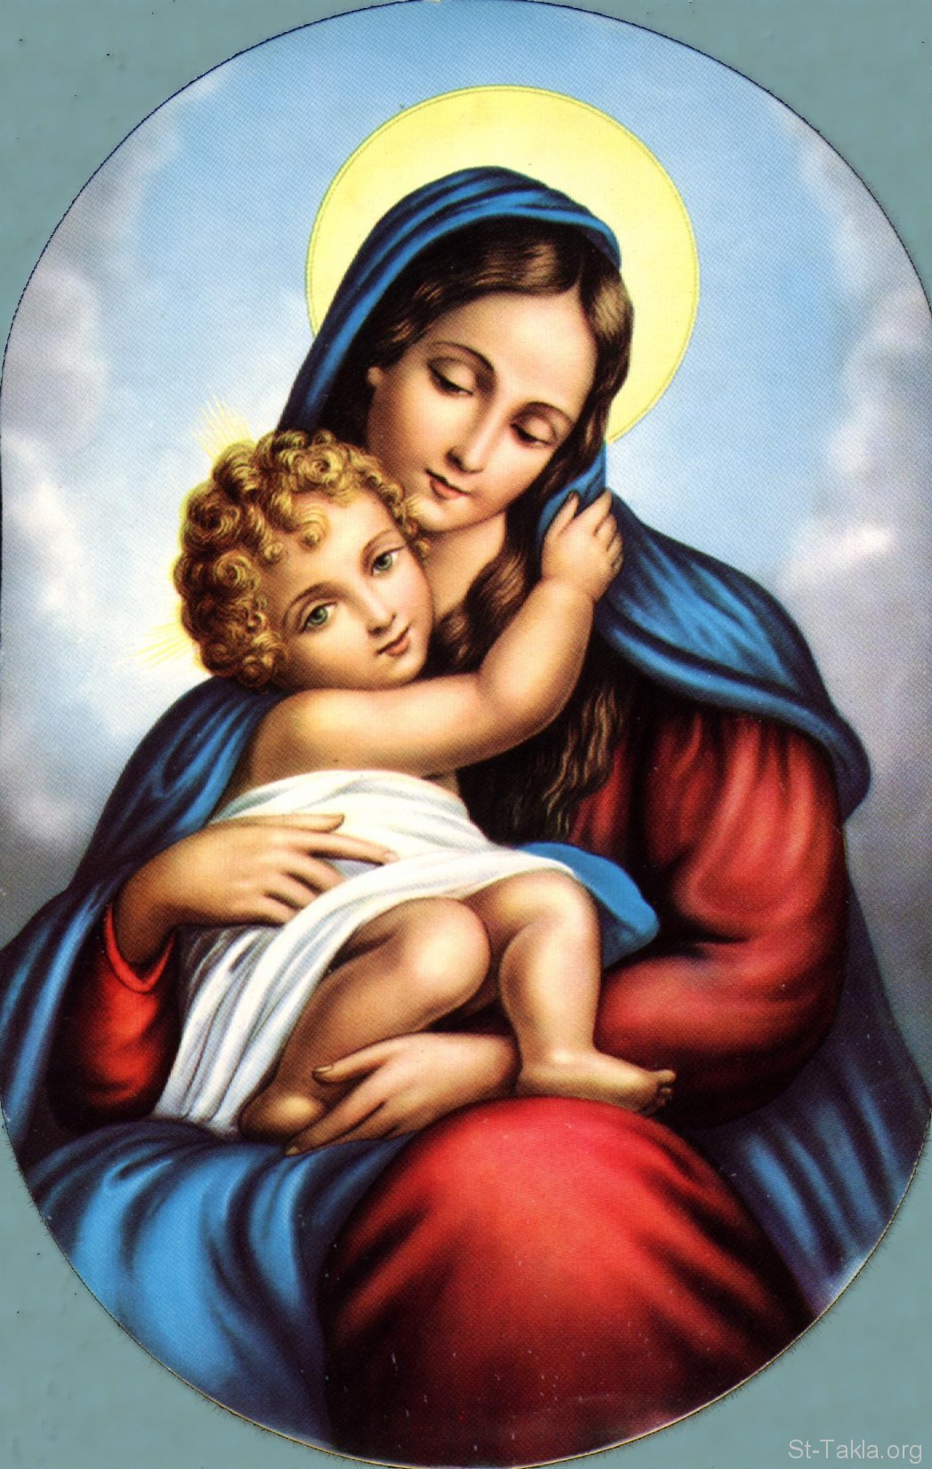
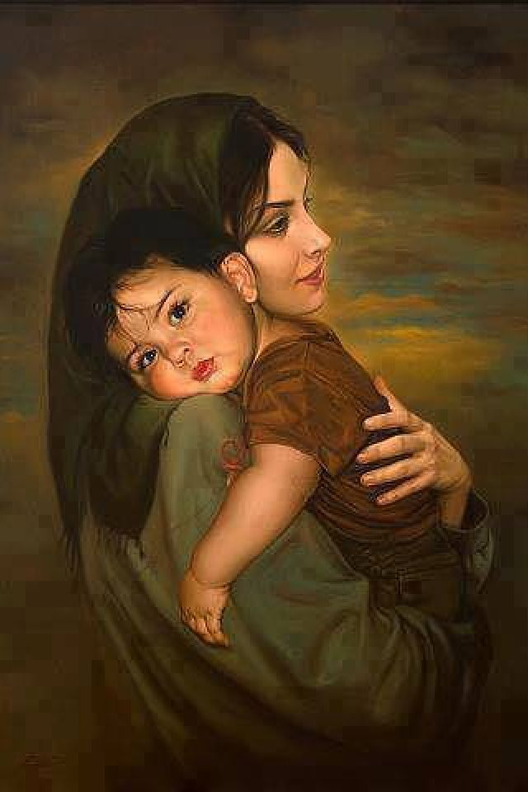
What do you see in each picture?
They are mothers

Slide 5
Our today’s poem is……..
Two Mothers Remembered
(Joann Snow Duncanson)
Unit: 14 Lesson: 02

Slide 6
Learning Outcomes
After we have studied this poem, we will be able to ...........
recognize and use English sounds, stress and intonation.
understand and enjoy the poem.
interpret, evaluate and summarise literary texts.

Slide 7
Unknown word and its meaning
Circle
A round plane figure whose boundary consists of points equidistant from a fixed point.
Synonym: ring

Slide 8
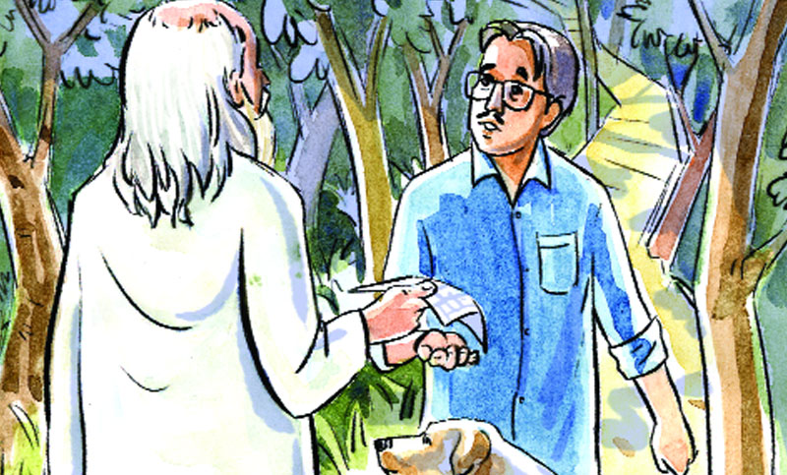
Unknown word and its meaning
Stranger
A person whom one does not know or with whom one is not familiar.
Synonym: Unknown person

Slide 9
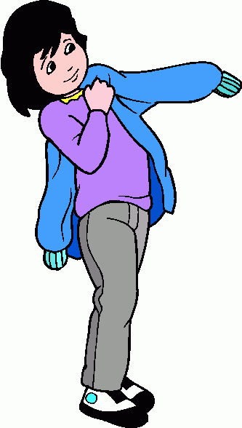
Unknown word and its meaning
Wear
To have something on your body as a piece of clothing, an ornament etc.
Synonym: Put on

Slide 10
Unknown word and its meaning
Strength
The quality or state of being strong.
Synonym: Power, Force.

Slide 11
Two Mothers Remembered Joann Snow Duncanson
I had two Mothers – two Mothers I claim Two different people, yet with the same name. Two separate women, diverse by design, But I loved them both because they were mine. The first was the Mother who carried me here, Gave birth and nurtured and launched my career. She was the one whose features I bear, Complete with the facial expressions I wear. She gave me her love, which follows me yet, Along with the examples in life that she set. As I got older, she somehow younger grew, And we’d laugh as just Mothers and daughters should do.
But then came the time that her mind clouded so, And I sensed that the Mother I knew would soon go. So quickly she changed and turned into the other, A stranger who dressed in the clothes of my Mother. Oh, she looked the same, at least at arm’s length, But now she was the child and I was her strength. We’d come full circle, we women three, My Mother the first, the second and me. And if my own children should come to a day, When a new Mother comes and the old goes away, I’d ask of them nothing that I didn’t do. Love both of your Mothers as both have loved you.

Slide 12
Poem
Explanation
'Two Mothers Remembered ", written by the American poet and columnist Joann Snow Duncanson, is a wonderful lyric poem about a daughter's love and sense of responsibility towards her mother. The poem, which is written in a lucid and simple style, describes a loving bond between a daughter and her mother. The poem is written in six stanzas.
The poem opens with the speaker's assertion that she had two mothers, which may surprise a reader as how a person can have two mothers. The speaker also says that the two mothers were different but had the same name. To the speaker the two women seemed "diverse by design" but she loved both of her mothers because she thinks that they are hers.
In the second stanza the speaker describes the contribution of the first mother to her life. She carried the speaker to the earth and nurtured her. She also helped the speaker to start her career. The speaker also says that she bears the features and facial expressions of her mother.
I had two mothers – two mothers I claim, two different people, yet with the same name. Two separate women, diverse by design, but I loved them both because they were mine.
The first was the mother who carried me here, gave birth and nurtured and launched my career. She was the one whose features I bear, complete with the facial expressions I wear.

Slide 13
Poem
Explanation
In the next stanza, the speaker elaborates her biological and emotional attachment with her mother. She says that the love that was set by her mother in her still flows through her vein. But surprisingly, the older her mother grew the younger she became. The speaker and her mother used have some wonderful time together. They used to laugh and have fun together like every other daughter and mother.
Then a time came when her mother's mind became clouded and she felt that her mother would soon pass away. The speaker found that her mother quickly changed and turned into a stranger to her. Her mother put on the same clothes but inwardly she got totally changed.
She gave her love, which follows me yet, along with examples in life that she set. As I got older, she somehow younger grew, and we’d laugh as just mothers and daughters do.
But then came the time that her mind clouded so, and I sensed that the mother I knew would soon go. So quickly she changed and turned into the other, a stranger dressed in the clothes of my mother.

Slide 14
Poem
Explanation
The speaker added that her mother looked the same, though she acted like a child. She says that she was the strength of her mother during those critical days. The speaker calls this changed woman her second mother. She imagines it a circle.
In the concluding stanza, she thinks that if one day she would become the mother of a girl child, she would give her some advice. The speaker says that she would not advise her children anything that she didn't do herself in her life to her mother. She says that she would advise her children to love both the young and old she. One day she may grow old and pale and lose all the vitality of life. So, she would advise her children to stand by her during those critical days.
The poem beautifully reflects a daughter's love and sense of responsibility to her mother. It expresses the loving and caring bond that exists between a mother and her daughter.
Oh, she looked the same, at least at arms length, but now she was the child and I was her strength. We’d come full circle, we women three, my mother the first, the second and me.
And if my own children should come to a day, when a new mother comes and the old goes away, I’d ask of them nothing that I didn’t do. Love both of your mothers as both have loved you.

Slide 15
Ask and answer the questions in pairs.
1. How are the two mothers different from each other? 2. How are they the same? 3.What did the first mother do to the speaker? 4. Who was the speaker's second mother? Describe her briefly. 5. What would be the speaker's advice to her own children? 6. Who are the three women referred to in the poem? Briefly describe them. 7. What should children do to their mother and why? 8. Do you like this poem? Why?

Slide 16
Home work
Write the summary of the poem “Two Mothers Remembered” in no more than 90 to 100 words.

Slide 17
Thank you all

