Slide 1
WELCOME

Slide 2
TEACHER IDENTITY
A.K.M. SHARIFUL ALAM
HEADTEACHER
MUKTARPUR AM-JAMTALA SECONDARY SCHOOL
CHOWGACHA, JASHORE
Cell- 01717251605

Slide 3
LESSON INTRODUCTION
SUBJECT-ENGLISH 2ND PAPER
CLASS-NINE/TEN
UNIT-COMPOUND TO complex
TIME-45 MINUTES
DATE-00-00-2020
Email-sharifulalam251605@gmail.com

Slide 4
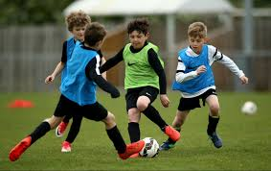
He was ill and he could not play
As he was ill, he could not play

Slide 5
Our Today’s topic is-----
Compound to Complex

Slide 6
Learning outcomes
The students will be able to
identify Complex and Compound Sentences,
make structures of each form of Sentences,
change the Compound into Complex Sentence.

Slide 7
Compound to Complex
Rule-1. And যুক্ত Compound Sentence এর উভয় Subject এক হলে এবং একটি Clause অন্যটির কারণ বুঝালে-
Structure: Since/as/when(সময় বুঝালে)+ প্রথম Sentence+ and এর স্থলে comma+ দ্বিতীয় Sentence.
Compound: The writer was poor and could not taste caviare.
Complex: As he writer was poor , he could not taste caviare.
Compound: Since he dog lay close to him , it found a comfort there.
Complex: The dog lay close to him and found a comfort there.
Compound: The thief saw the police and ran away.
Complex: When the thief saw the police , he ran away.

Slide 8
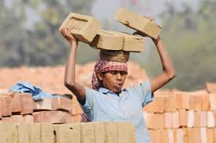
Rule-2. And যুক্ত Compound Sentence এর প্রথম Clause টি শর্ত বুঝালে- Structure: If+ 2nd Sentence এর Sub+1st clause+ and এর স্থলে comma+ 2nd clause.
Compound: Work hard and you will shine in life.
Complex: If you work hard, you will shine in life.
Compound : Read attentively and you will pass the examination.
Complex : If you read attentively , you will pass the examination

Slide 9
Rule-3. And যুক্ত Compound Sentence এর দ্বিতীয় Clause টিতে ব্যবহ্রত Pronoun(it/this) যদি প্রথম Clause টিকেই নির্দেশ করে –
Structure: দ্বিতীয় clause এর Sub+ verb+ otrers word + that + 1st clause.
Compound: He will succeed and I am sure of it.
Complex: I am sure that he will succeed.
Compound: He is innocent and I believe it.
Complex: I believe that he is innocent.

Slide 10
Rule-4. Or যুক্ত Compound Sentence কে Complex করার নিয়ম। Structure: If + Sub+do not+1st Clause+or এর স্থলে comma+ 2nd Clause.
Compound : Work hard or you can not prosper in life.
Complex: If you Work hard, you can not prosper in life.
Compound: Do or die.
Complex: If you do, you will die.
Compound: Walk fast or you can not get the job.
Complex: If you walk fast, you can not get the job.

Slide 11
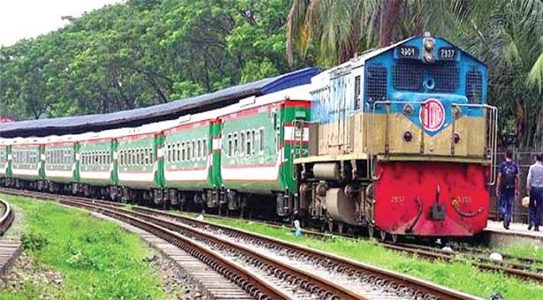
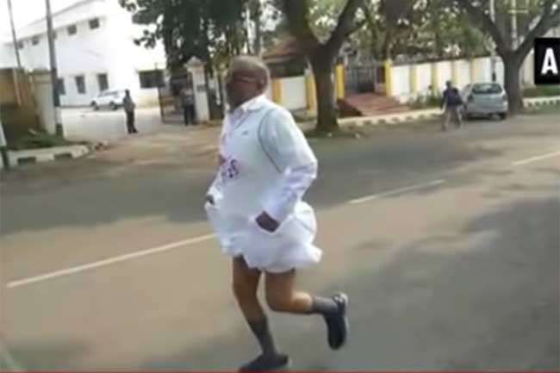
Rule-5. But/yet যুক্ত Compound Sentence কে Complex করার নিয়মঃ Structure: Though/although + 1st Clause+ but এর স্থলে comma+ 2nd Clause.
Compound: He ran fast but could not get the train.
Complex: Though he ran fast, could not get the train.
Compound: It disturb me but I did not know the reason.
Complex: Though It disturb me, I did not know the reason.

Slide 12
Rule-6. Very---and যুক্ত Compound Sentence কে Complex করার নিয়ম। Structure: Sub+ verb+ very এর স্থলে so + বাকী অংশ+ and এর স্থলে that+ 2nd clause.
Compound: The old sailor spoke very strangely and the guest stood still.
Complex: The old sailor spoke so strangely that the guest stood still.

Slide 13
Rule-7.So যুক্ত Compound Sentence কে Complex করার নিয়ম। Structure: 1st clause+ so এর স্থলে since/as/because+ 2nd clause
Compound: The boy read attentively , so he pass the examination.
Complex: The boy pass the examination because he read attentively .
Compound : Kamal stole a watch, so he was punished.
Complex: Sincs/as Kamal stole a watch, he was punished.

Slide 14
Their throats were very dry and they could not speak.
I paid the bill and I had no money in my pocket.
Rehena saw it and she knew that it must be for her husband.
Speak the truth and I will let you go.
Do or die.
Do and die.
Spare the rod and spoil the chold.
I did much for him, yet he was not pleased.
They gave it food and water and it became very tame.
Read or fail.

Slide 15
Thank for all

