Slide 1
Welcome everyone to my class…
Notes:
Dear teachers., I have used trigger application in most cases especially during the activities such as pair work…

Slide 2
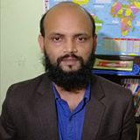
Nurul Aziz
Assistant Teacher (English)
Krishnakumari City Corp. Girls’ High School,
Nandankanan,Chittagong
E-mail : naziz13.na@gmail.com
Mobile : 01843773924
English For Today
Class : 9
Time : 45 Minutes
Date : 14/03/2020

Slide 3
Let’s watch a video

Slide 4
Our Today’s lesson is on……
Our food and shelter
Unit : 4, Lesson: 3
English For Today (Page: 43)

Slide 5
Learning outcomes
After the end of the lesson students will be able to
learn new words
comprehend the text after reading
talk about population problem
discuss the possible impacts of over population
write composition

Slide 6
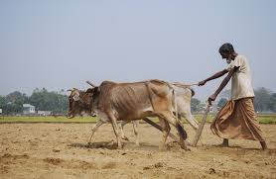
Vocabulary Presentation
Arable (adj.)
Syn. Cultivable
We need arable field to grow crops.

Slide 7
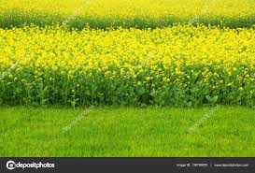
Vocabulary Presentation
Mustard (Noun)
Syn. rapeseed
Rapeseed is one of the most important cash crops in Bangladesh.

Slide 8
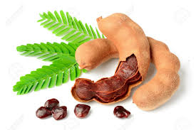
Vocabulary Presentation
A chocolate-colored fruit with acidic pulp.
Tamarind
(Noun)
There was a huge tamarind tree in our village.

Slide 9
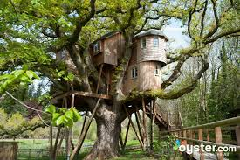
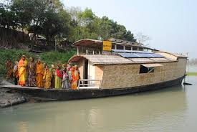
Group Work
Discuss what will be our problems if our population becomes double the number we have now.
Possible answers: Many of the people might live on trees or on the floating boats in the rivers.

Slide 10
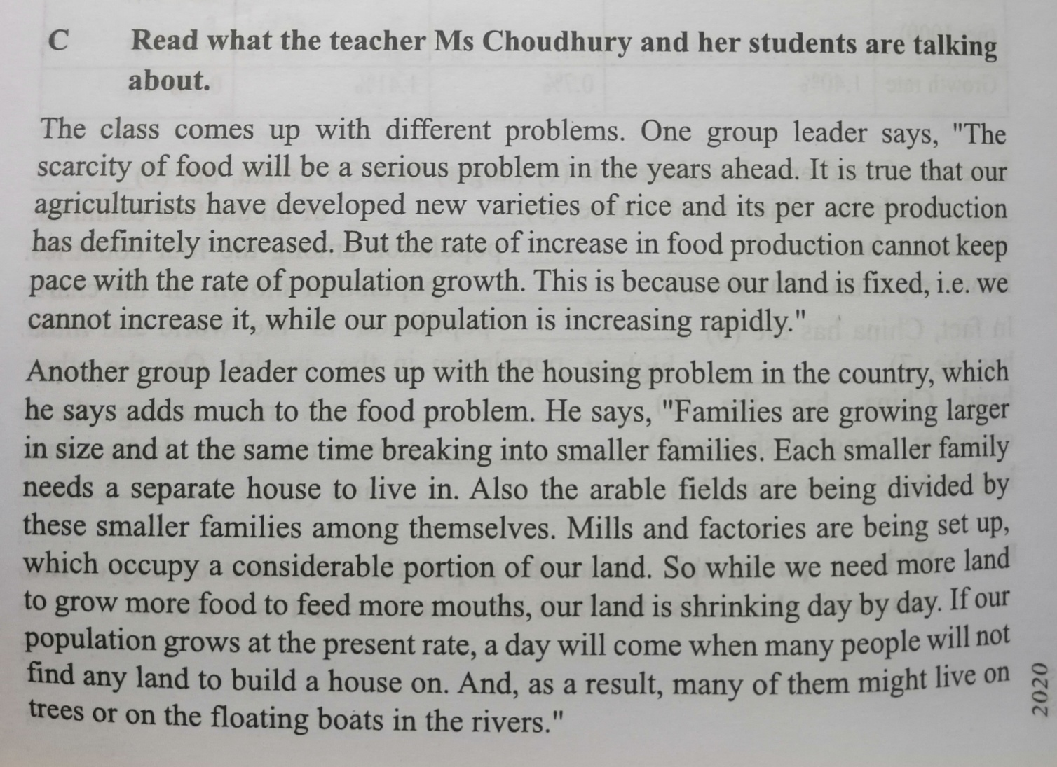
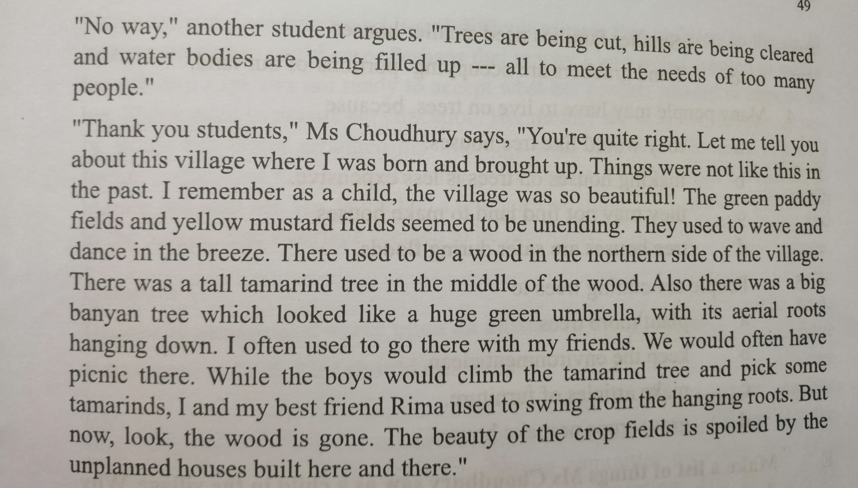
Reading passage

Slide 11
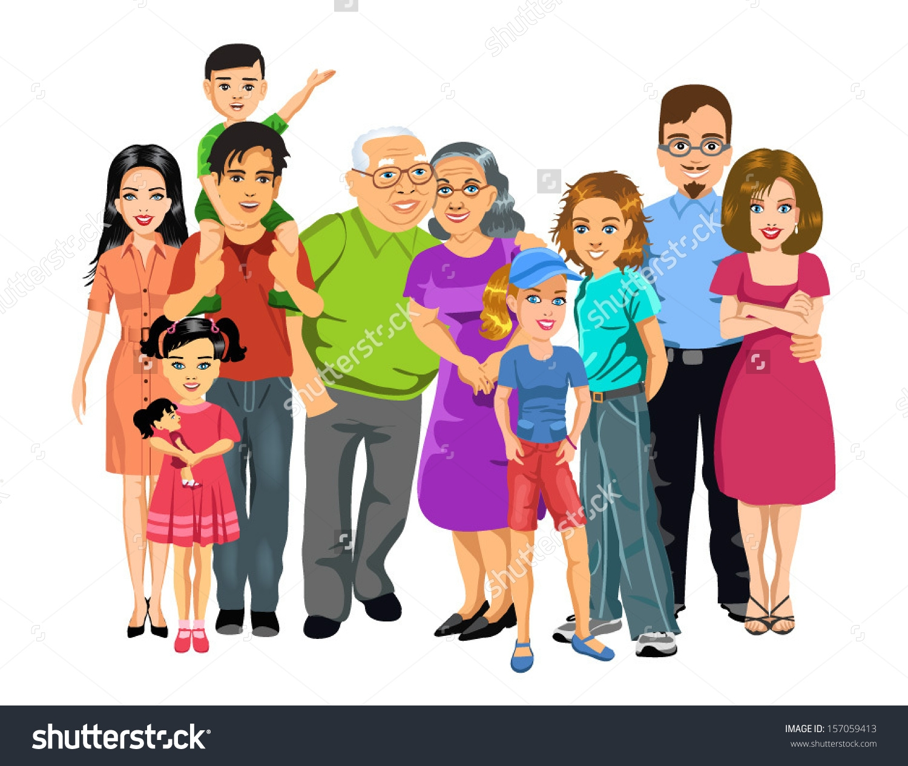
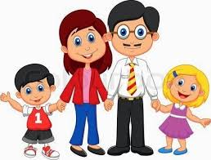
Reading text focus point
“Families are growing larger in size and breaking into smaller families.”
Larger family
Smaller family

Slide 12
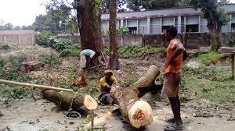
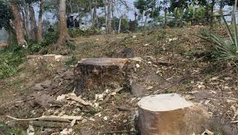
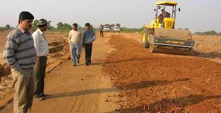
Reading text focus point
“Trees are being cut, hills are being cleared and water bodies are being dried up.

Slide 13
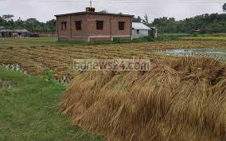
Reading text focus point
Mills and factories are being set up , which occupy a considerable portion of our land.

Slide 14
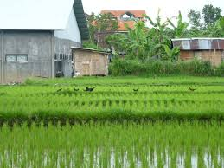
Reading text focus point
The beauty of the crop fields is spoiled by the unplanned houses built here and there.

Slide 15
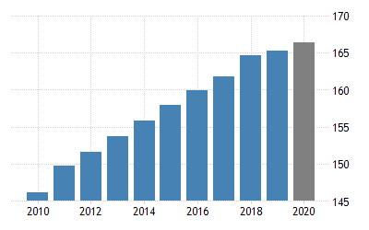
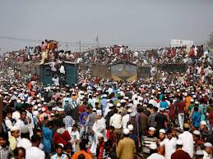
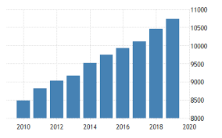
Reading text focus point
Increase in food production can not keep pace with the rate of population growth.
Population growth
Food production

Slide 16
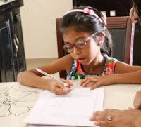
Individual work
The word ‘scarcity’ means?
shortage
People are cutting trees to ?
To grow crops
The second group leader talks about?
The housing problem
The first group leader talks about?
The scarcity of food
Tamarind is?
One kind of fruit.

Slide 17
The key sentences of the reading text.
C. Read what Ms. Choudhury and her students are talking about.
The class comes with different problems. One group leader says,” The scarcity of food will be a serious problem. (The full text is not given here but the keys sentences are mentioned below.)
Increase in food production can not keep pace with the rate of population growth.
Families are growing larger in size and breaking into smaller families.
The arable fields are being divided by these smaller families among themselves.
Mills and factories are being set up , which occupy a considerable portion of our land.
Trees are being cut, hills are being cleared and water bodies are being filled up.
The beauty of the crop fields is spoiled by the unplanned houses built here and there.

Slide 18
Pair Work
E. Make a list of things Ms. Choudhury saw as a child in the village. How do you know from the text that she liked them?
The things that Ms. Choudhury saw as a child in the village are….
Green paddy fields.
Yellow mustard fields.
A tall tamarind tree.
A big banyan tree.
A wood in the northern side of the village.

Slide 19
Evaluation
D. Tik the best answer.
2. How can our housing problem add to our food problem?
1. The rate of increase in food production cannot keep pace with the rate of population growth.
After making houses, farmers do not have enough time to work in the field.
After making houses, farmers do not have enough money to buy food.
If you do not have a home, you cannot store your food.
The sentence means that the food production
is as much as needed
is more than what is needed
d) is sufficient for the population
Is less than what is needed
d) For making too many houses, people are using the crop land.

Slide 20
Evaluation
3. What makes our land shrink day by day mentioned in line no. 13?
Families are growing larger in size.
Smaller families need smaller houses.
d) Land grabbers are occupying portions of our land.
b) Houses and factories are being built on it.

Slide 21
Evaluation
4. Many people may have to live on trees, because
5. People are cutting down trees to
They would like tree houses
Making houses on trees is less
Expensive
Tree houses are safer during floods
Plant more trees
Keep the environment clean
Make articles of furniture
They may not find land to make houses
d) Grow crops or make houses

Slide 22
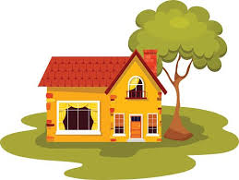
Home Work
Write a composition about your village or locality. Describe any change in the things you have noticed over the years, such as houses, fields, trees, plants etc.

Slide 23
Thank you and Good bye.
“Please stay home, stay safe.”

