Slide 2
Introduction
Hosne Ara Basry
(Lecturer in English)
Bhaktiarpara Charpir Aulia Alim
Madrasah, Anowara, Ctg.
Cell no: 01816001006
Email:
hosnearaamir94638@gmail.com

Slide 3
Lesson
Subject :
English first paper
English for Today
H.S.C/Alim
Duration:45m

Slide 4
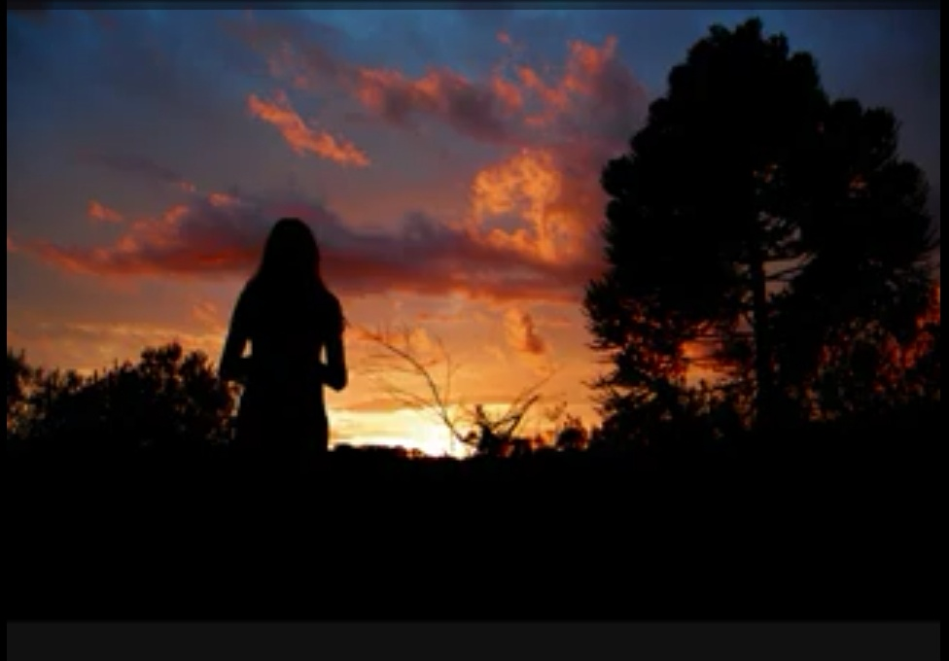

Slide 5
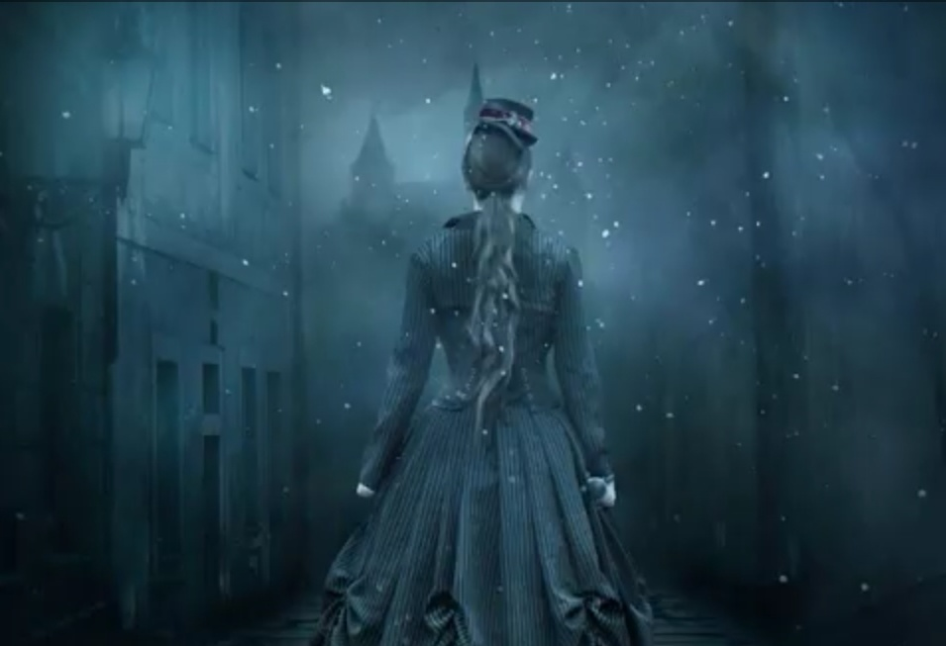
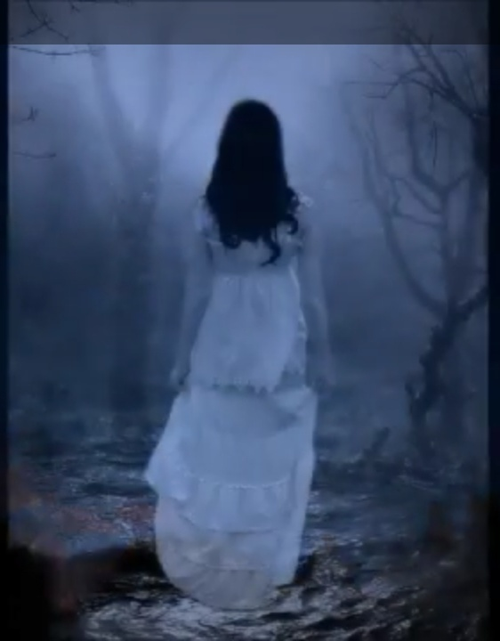

Slide 6
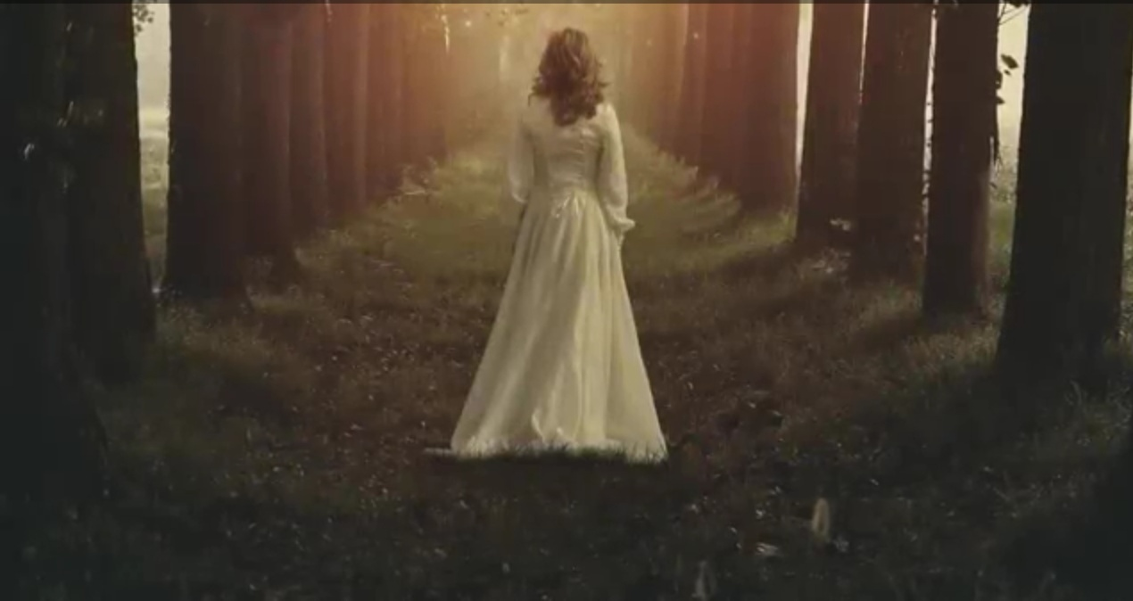

Slide 7
Today's Lesson :
Unit - 14
Lesson - 1

Slide 8
Learning Outcomes
After the end of the lesson the students will be learn
about -
★The poet
★The poem
★Poem analysis
★Interpretation

Slide 9
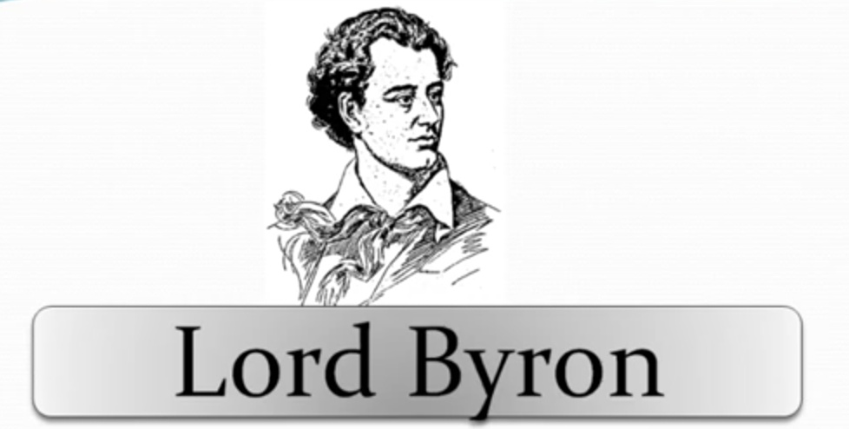
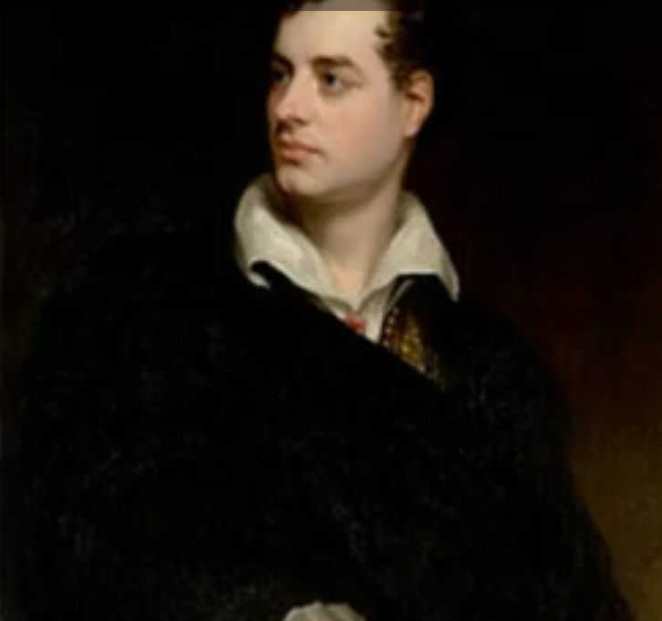

Slide 10
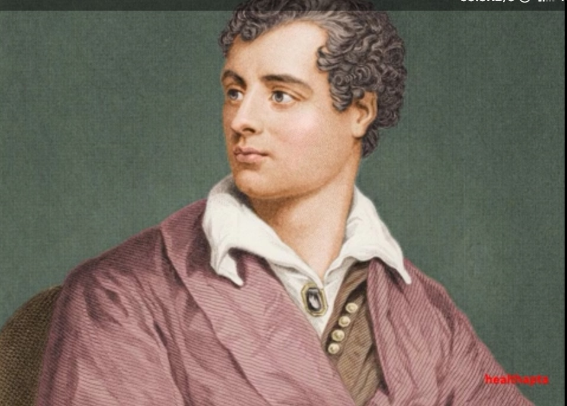

Slide 11
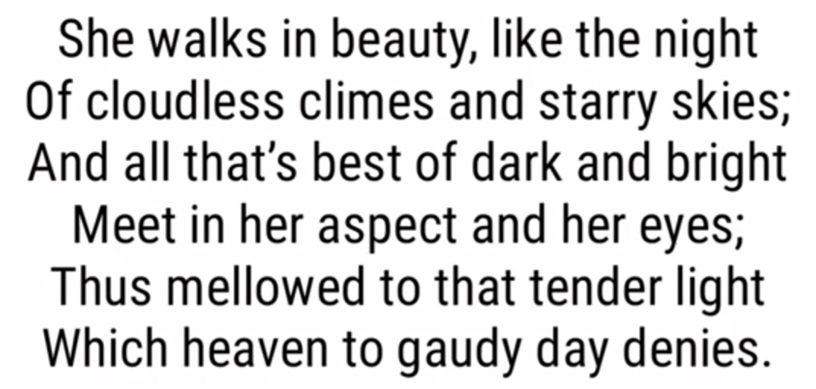

Slide 12
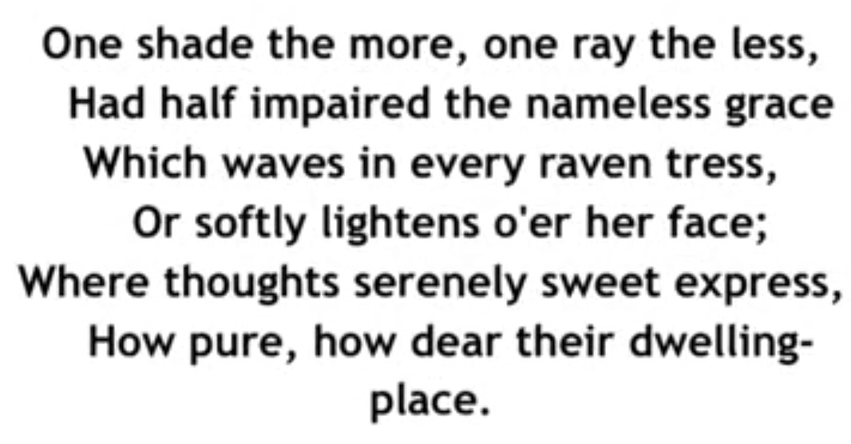

Slide 13
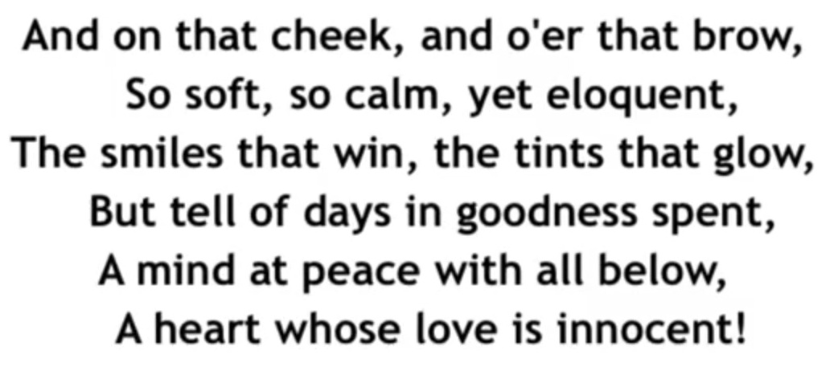

Slide 17
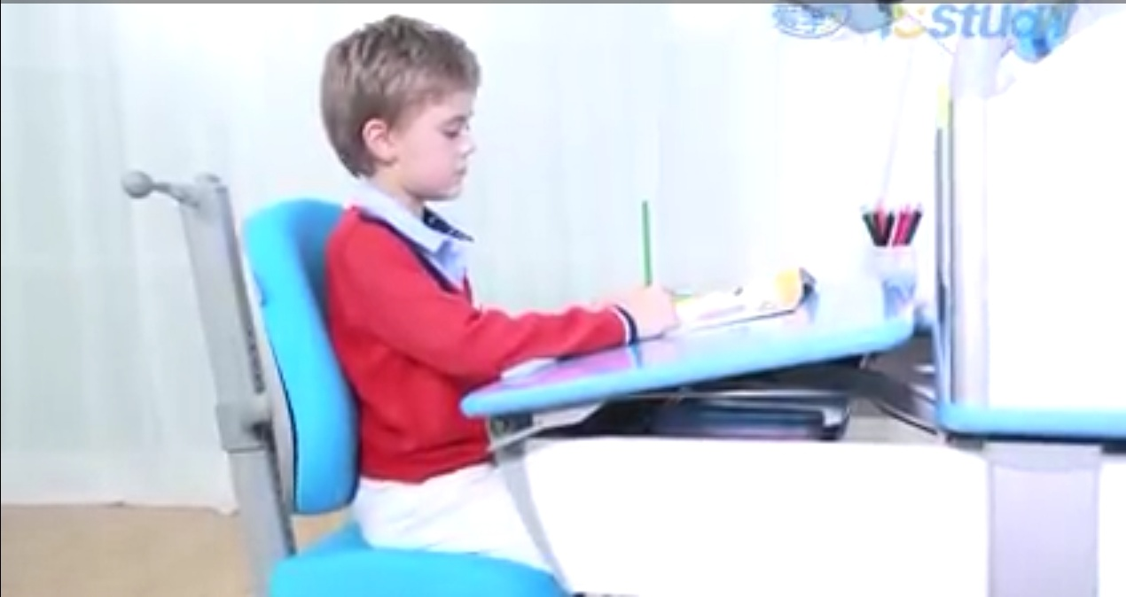
Individual work
Read the poem silently.

Slide 18
Group Work
Group Work
Discuss about the beauty of the lady and nature
according to this poem ?

Slide 19
Evaluation
★What is your view of beauty ?
★How does the poet describe about beauty ?

Slide 20
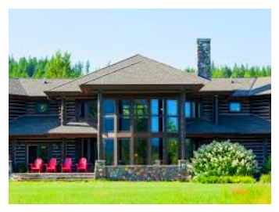
Home Work
★Learn appreciation of the poem.
★Write a theme of the poem in your own words.

Slide 21
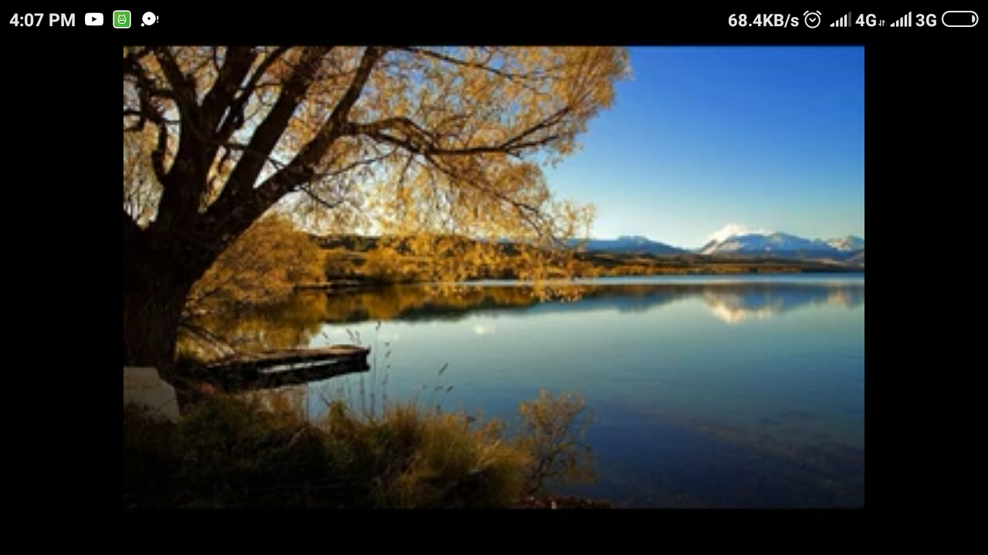
THANK YOU

