Slide 1
Welcome to All

Slide 2
Developed & Edited By
Ahmad Mahfuz Mahbub
Senior Lecturer
Department of Biology
Cambrian School & College
Dhaka
Class: IX-X
Subject: Biology
Chapter: Two
(Cells & Tissues of Organisms)
Class:05

Slide 3
Learning Outcomes
At the end of this lesson, student’s will be able to---
Write creative questions answer.

Slide 4
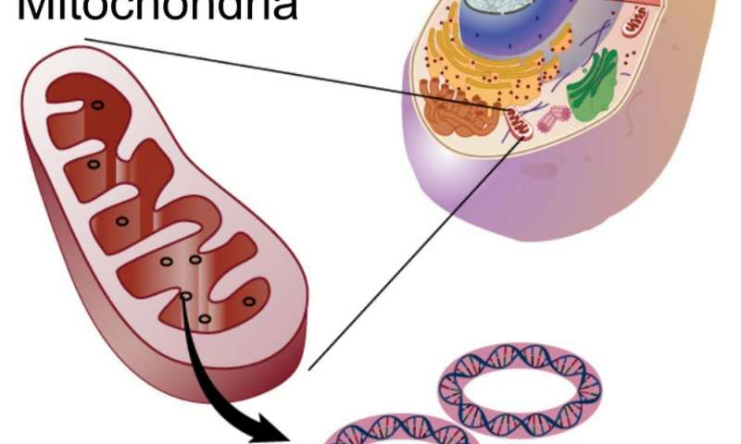
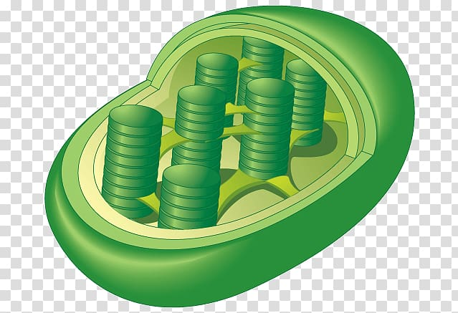
Chapter-2 (Cells and Tissues of organisms)

Slide 5
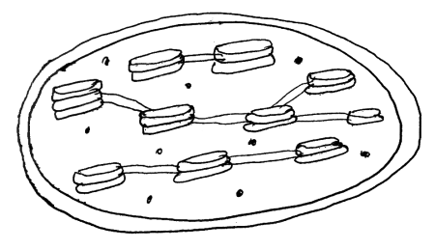
1. Look at the following stem and write answers the following questions.
a) What is Chromosome? 1
b) Why is mitochondria called the cell's powerhouse? 2
c) Draw the labelled diagram of above cell organelle. 3
d) Write the function of above cell organelle. 4

Slide 6
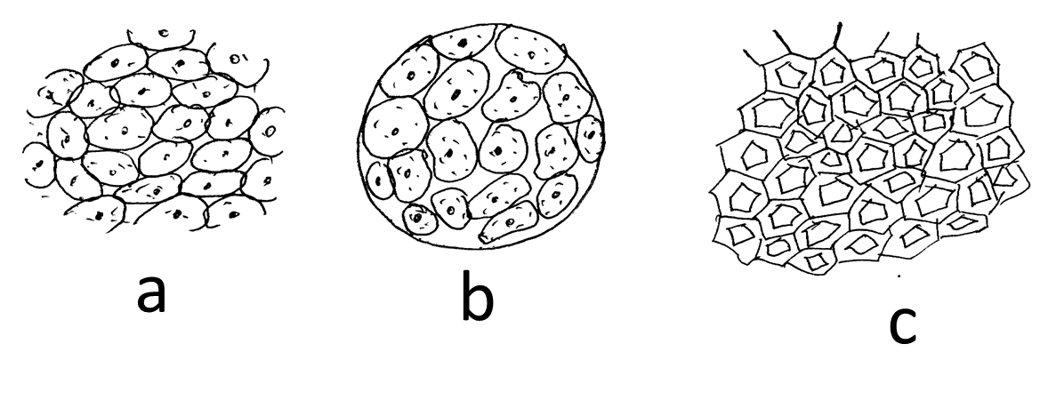
2. Look at the following stem and write answers the following questions.
a. Where can you find the tracheids? 1
b. Why is mitochondria called the powerhouse of cells? 2
c. Describe the structure of the image 'a'. 3
d. Mention the differences between 'b' and 'c'. 4

Slide 7
Thank you

