Slide 1
Welcome to All

Slide 2
Developed & Edited By
Ahmad Mahfuz Mahbub
Senior Lecturer
Department of Biology
Cambrian School & College
Dhaka
Class: IX-X
Subject: Biology
Chapter: Two
(Cells & Tissues of Organisms)
Class:13

Slide 3
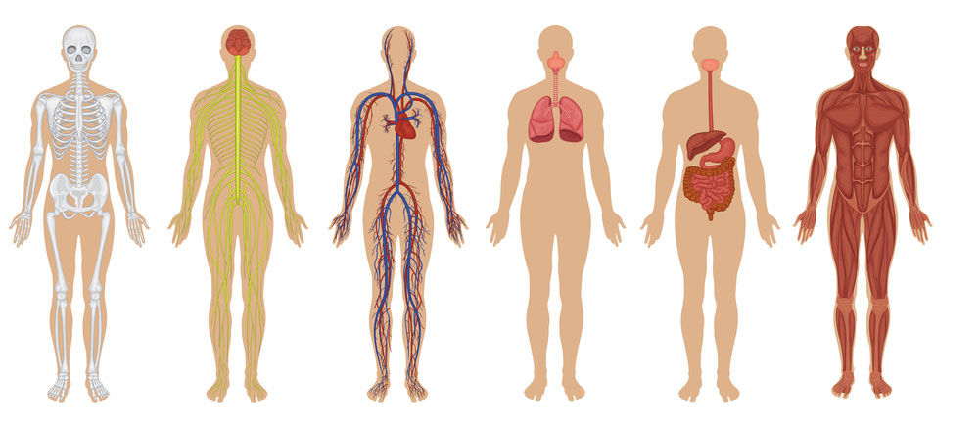
Can you tell what the pictures are?
Physiology

Slide 4
Lesson
Today
organ and system formation and function.

Slide 5
Learning Outcomes
End of the chapter, Student will able to…..
Explain the co-ordination of tissues,Organ and Organ
System.
can explain the function of Organ
and Organ System.

Slide 6
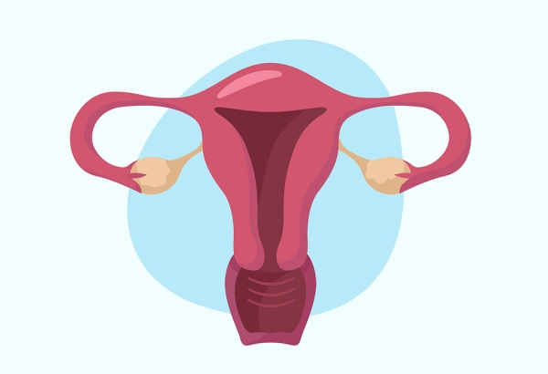
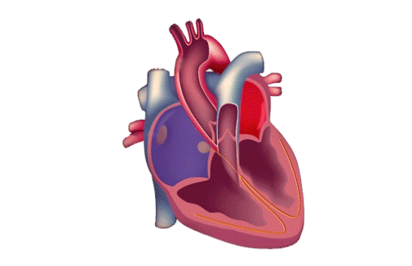
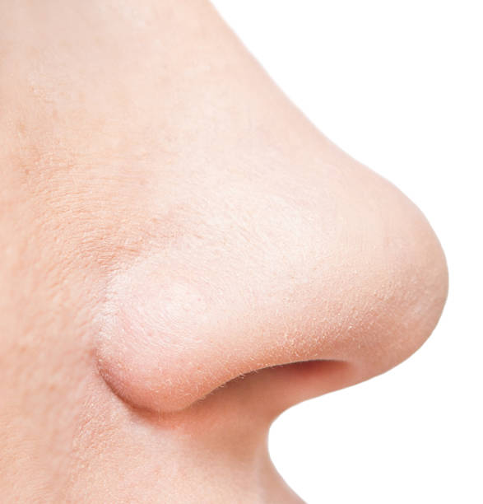
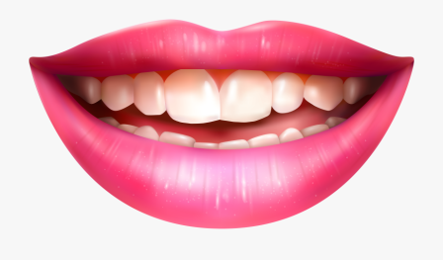
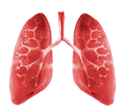
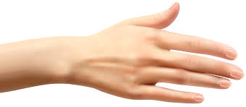
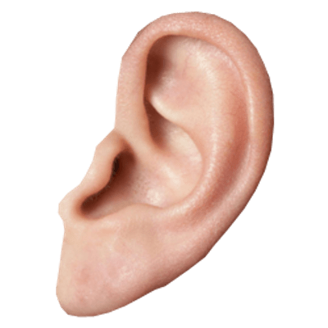
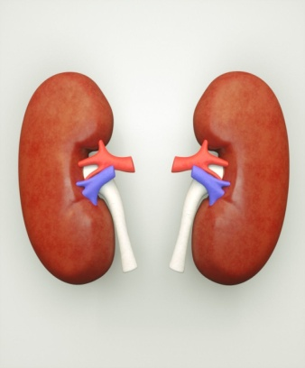
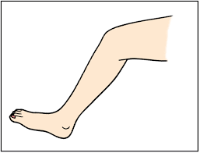
Example
Human body
Organ
System

Slide 7
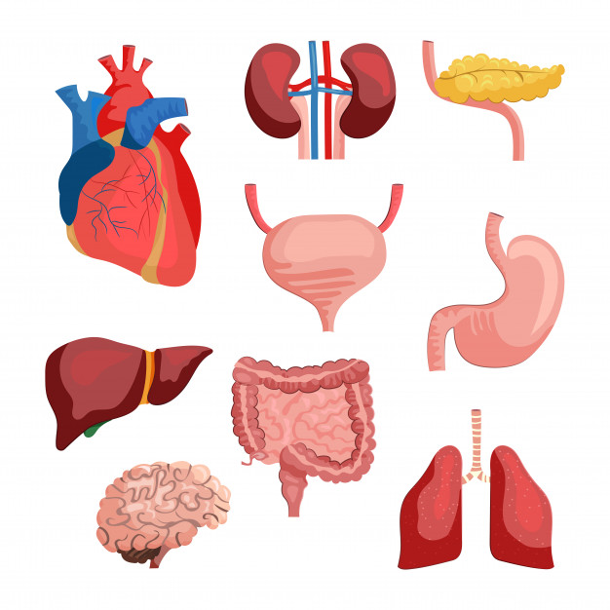
The number of organ is (2)
Example:
1.External Organ
2.Enternal Organ

Slide 8
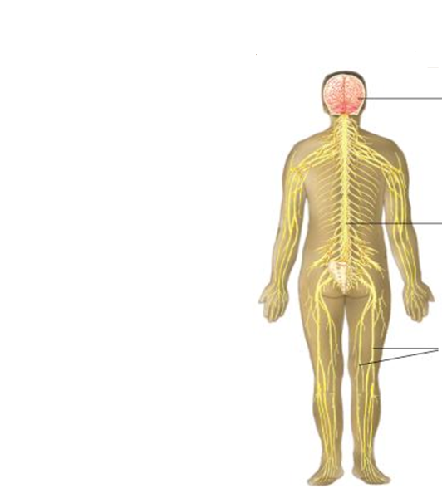
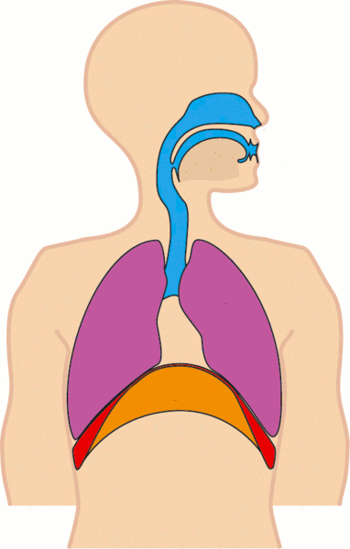
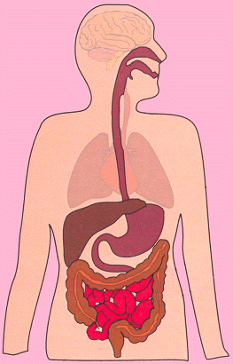
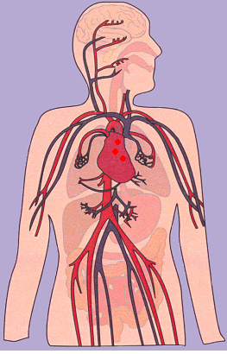
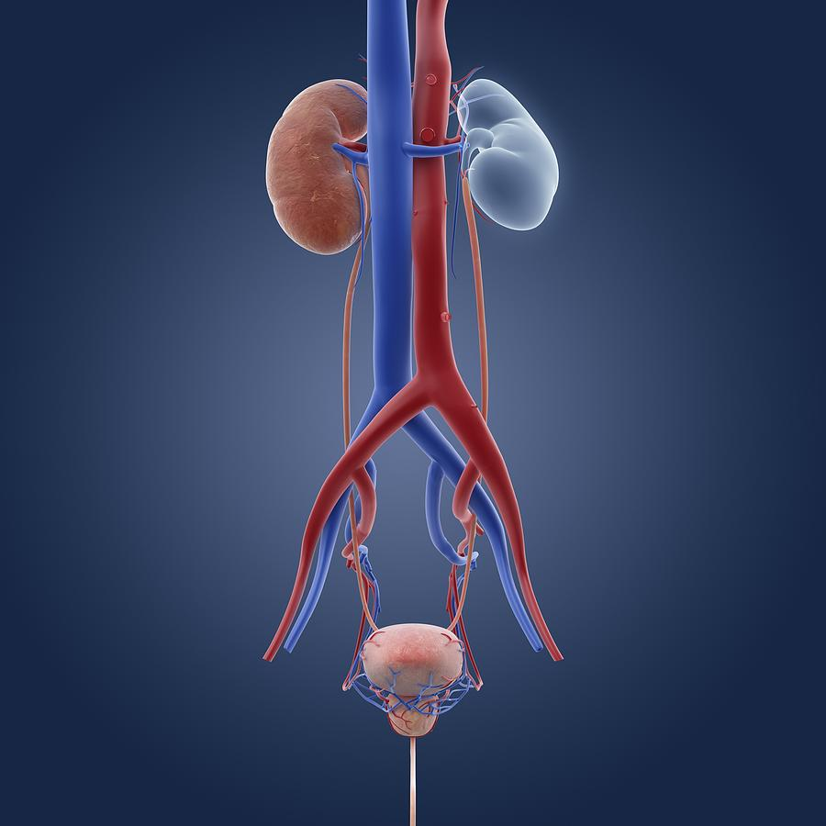
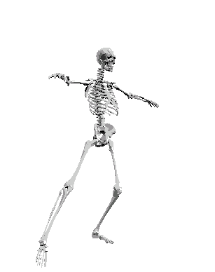
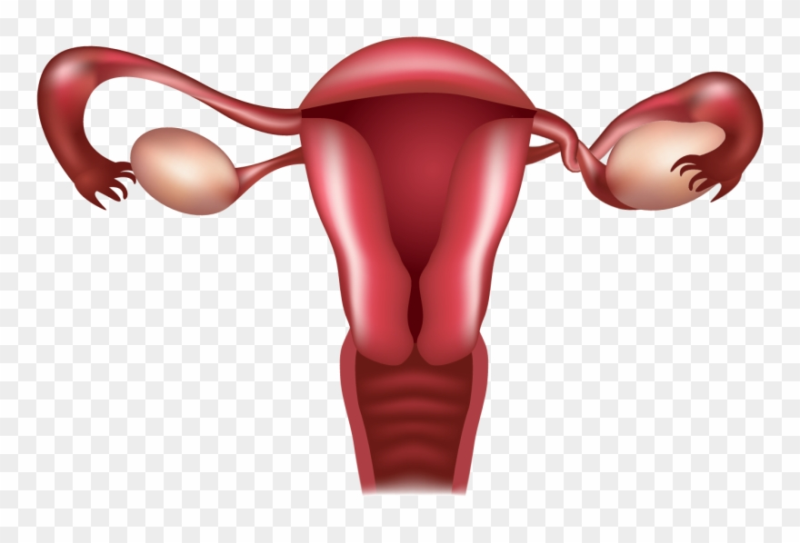
For physiological functions, a number of organs are formed in
the body.
Reproductive
system
Digestive system
Excretory
system
Nervous System
Blood
Circulatory
system
Skeleton System
Respira
tory system

Slide 9
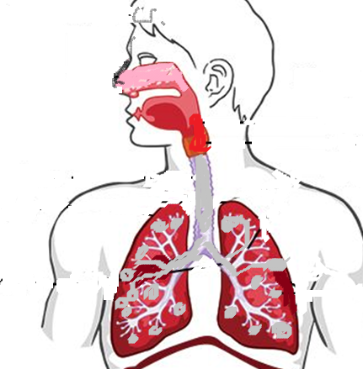
Respiratory
System
Nasal cavity
Nasal congestion
Trachea
Lung
Bronchus
Bronchial tubes
Alveoli
Diaphragm

Slide 10
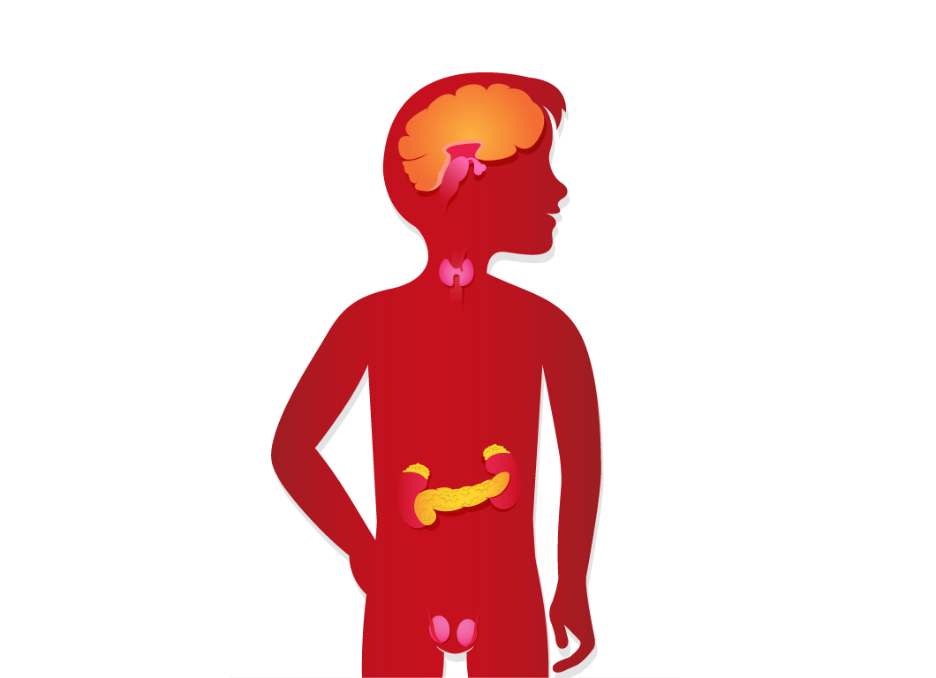
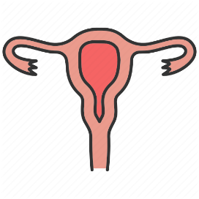
Human Hormone
gland
Pituitary gland
hypothalamus
Thyroid
Thymus
Pineal
islets of
Langerhans
estrosgen
Testosterone

Slide 11
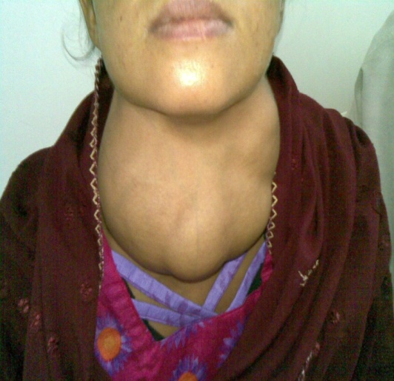
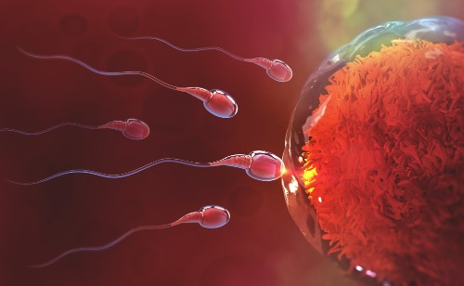
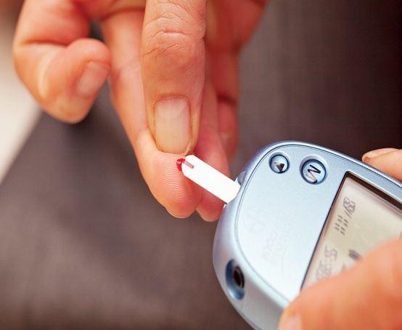
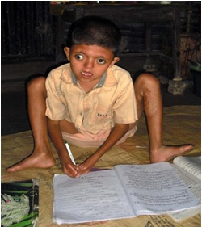
Folate in
the thyroid
gland
Helps prevent
disease
Helps in
breeding
Hormones
Function
Adrenaline
Hormones
are Protect
from stress
Insulin hormone
Controls sugar
Children are
physically
handicapped

Slide 12
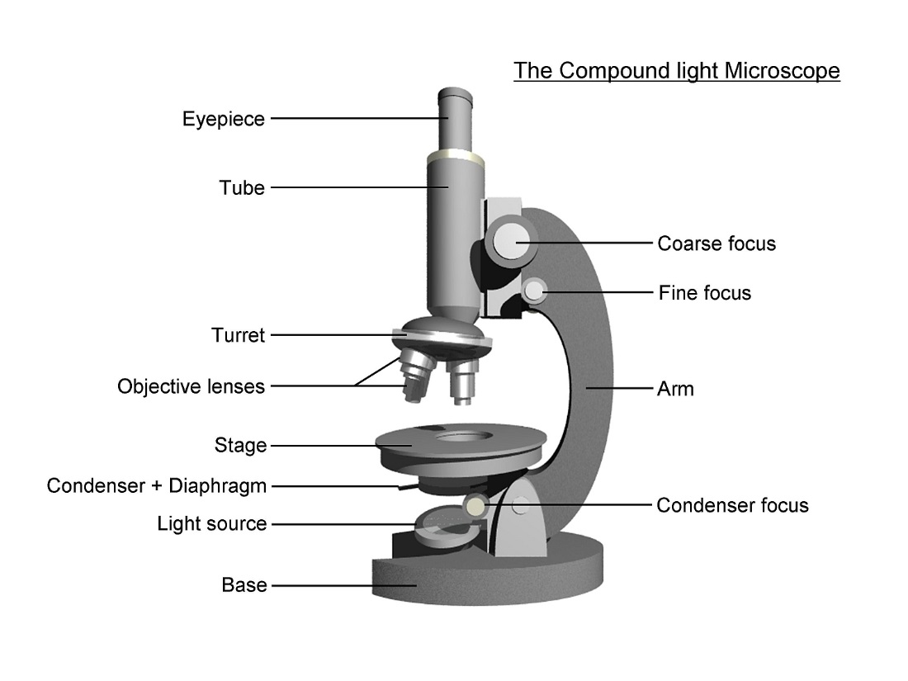

Slide 13
Evolution
1. Say what is Organ and System.
2. Describe digestive system, Excretory System, blood
circulation system function
3. Write down skin function.
4. What is the endrocrine gland?

Slide 14
Individual Work
Draw a simple microscope.

Slide 15
Home Work
You will be write various types of System and its function .

Slide 16
Thank You

