Slide 1
Welcome to All

Slide 2
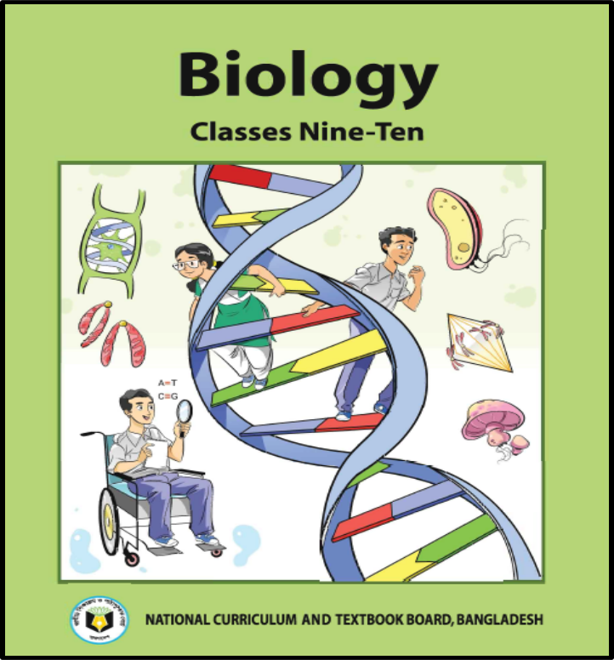
Prepared & Edited By
Ahmad Mahfuz Mahbub
Senior Lecturer
Department of Biology
Cambrian School & College
Dhaka
Class: IX-X
Subject: Biology
Chapter: Two
(Cells & Tissues of Organisms)
Class:14

Slide 3
Learning outcome
Students will be able to -
Write creative questions answer.

Slide 4
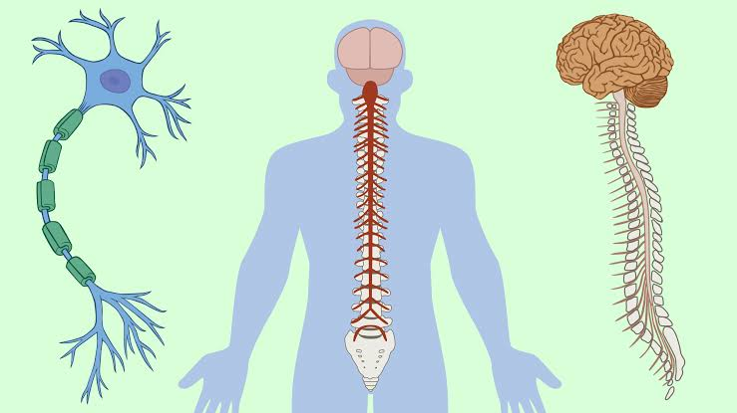
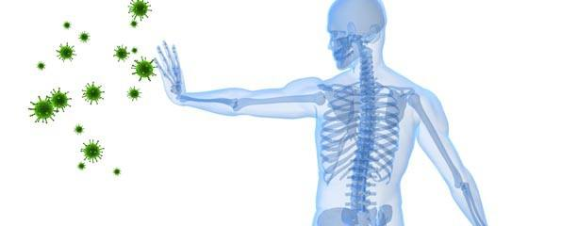
Chapter-2 (Cells and Tissues of Organisms)

Slide 5
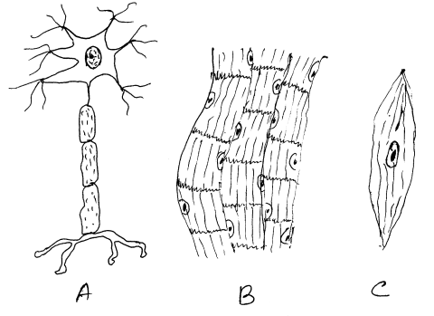
1.
a) What is Neuron? 1
b) Why don't neurons divide? 2
c) Describe the structure of figure A . 3
d) Write the differences between B and C. 4

Slide 6
Answer the following questions.
Where can you find the tracheid?
How many types of Plastids?
What is a cell?
What is an organ?
What is called the brain of a cell?
What is the function of the Chromosome?
What is the function of lysosomes?
How many cells are there in Xylem?
What is the function of Ribosome?

Slide 7
Thank you

