Slide 1


Well come to all in my class, English For Today.
WELL COME

Slide 2
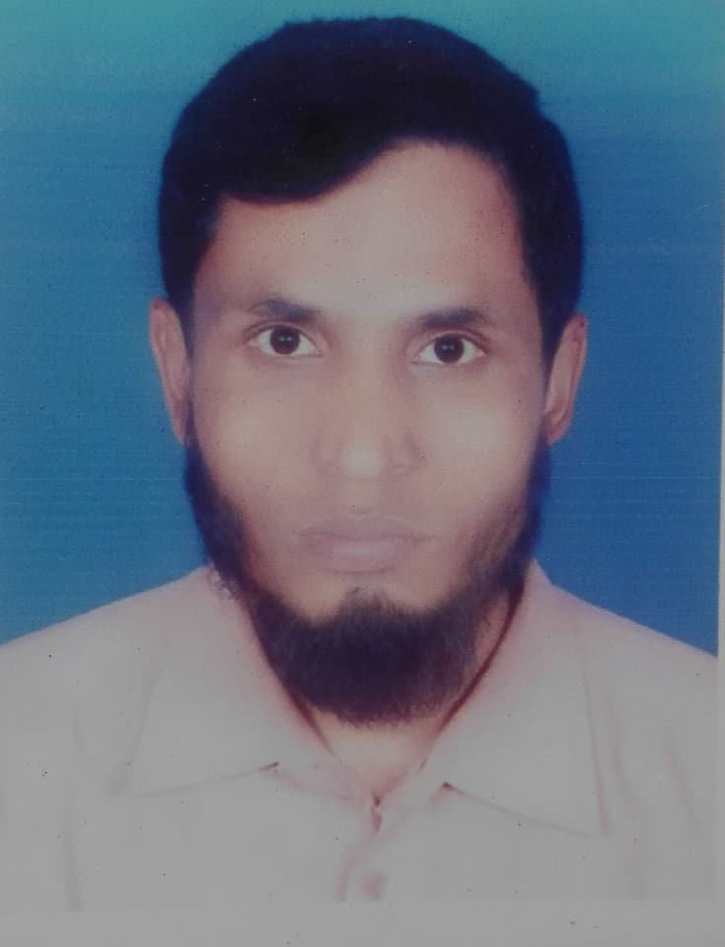
Introduction
Belayet Hossain
Assistant teacher
05 No South Jonardondi Govt. Primary School
Kalkini, Madaripur.
Gmail : belayet01715205765@gmail.com
Class: Five
Unit – 10, Lesson: 1-2, 3–5

Slide 3
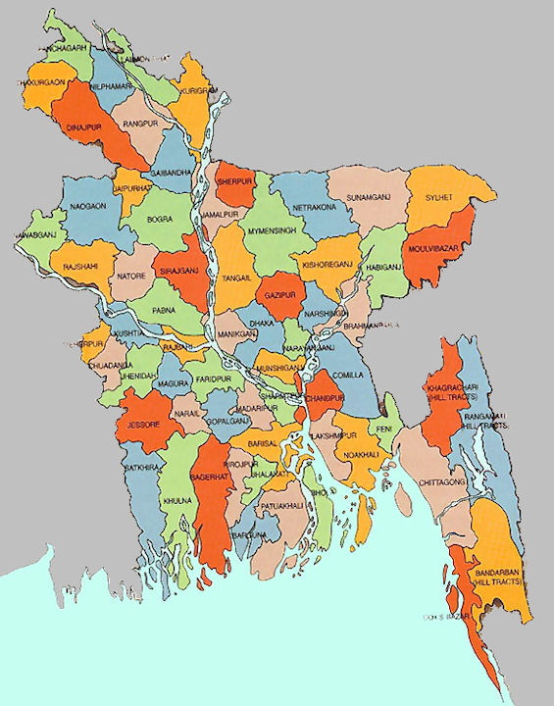
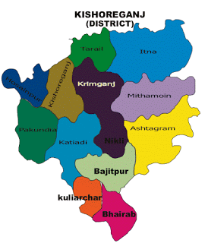
Dhaka
Kishoreganj
Bangladesh

Slide 4
Today's lesson is
My Home Town

Slide 5
Learning outcomes
Students will be able to…….
1.1.1 - Become familiar with English sounds by listening to common English words.
1.2.1 - Repeat after the teacher simple words and phrases with proper sounds and stress.
1.3.1 - Say simple words and phrases with proper sounds and stress.
3.3.1 - Say and answer the questions.

Slide 6
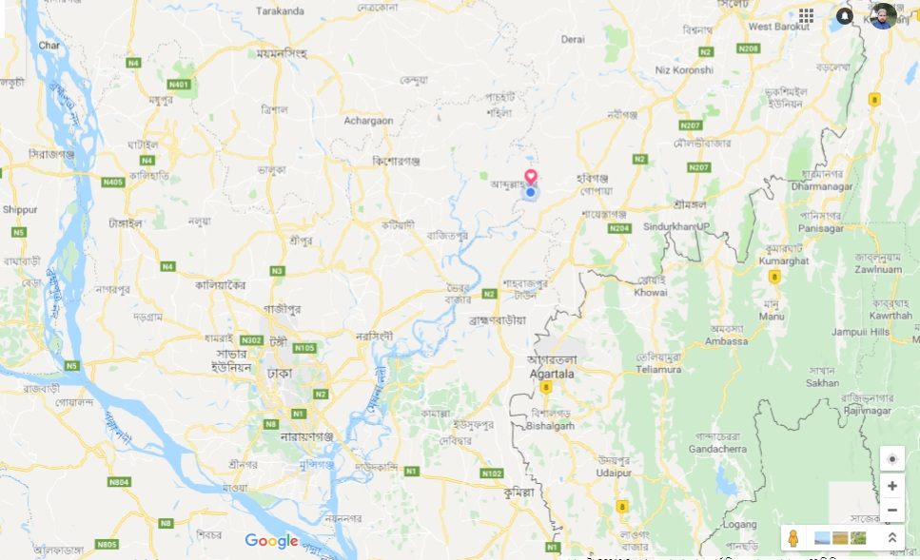
8 municipalities
My home district is Kishoreganj. It is about 145 kilometers from Dhaka. It is a district headquarter.
The district has 8 municipilities, 13 upazilas, 108 unions and 1745 villages.
13 upazilas
145 km
108 unions
1745 villages

Slide 7
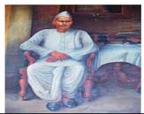
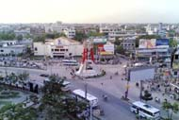
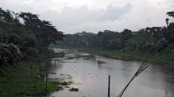
The name kishoreganj come from the name of an old landlord known as Brojakishore Pramanik or Nandakishore Pramanik.
The area of Kishoreganj municipality is about 10 square kilometers.
The river Narasunda flows through the town.

Slide 8
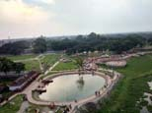
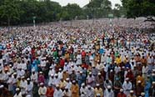
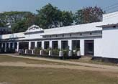
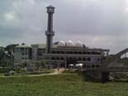
The largest Eid fairgrounds called Solakia Eid Ground and the well-known Government Gurudayal college are in the town.
Kishoreganj is a small town, but there are many important places in and around it.
People from many districts come to this place to celebrate Eid.
The Pagla Mosque is also in my home district.

Slide 9
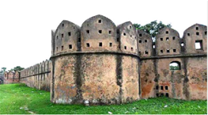
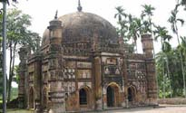
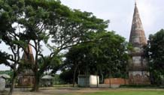
Near the Fuleshwari river you can see the Shiva Temple of Candrabati, the first woman poet of Bangla literature, was borne here.
You can also see thee Shah Mohammad Mosque at Egaroshindhur.
Out side the town, you can visit the fort of Isah Khan Jangal Bari.

Slide 10
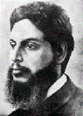
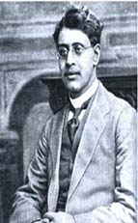
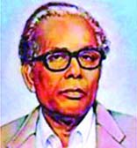
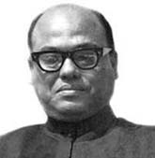
Syed Nazrul Islam, the first acting President of Bangladesh is also from here. I love my home district!
Two writers of children’s literature, Upendrakishore Roy Chowdhury and Sukumar Roy are also from here.
The great painter Zainul Abedin comes from Kishoreganj too.

Slide 11

Similar words
Headquarter
Central office.
Landlord
Owner of many land.
Important
Significant, Authentic
Municipalities
Fairground
Exibation
Well-known
Known to all
Celebrate
Dignify, Glorify
Famous
Eminent, Renowned
Literature
Creative writing
Painter
Arties

Slide 12
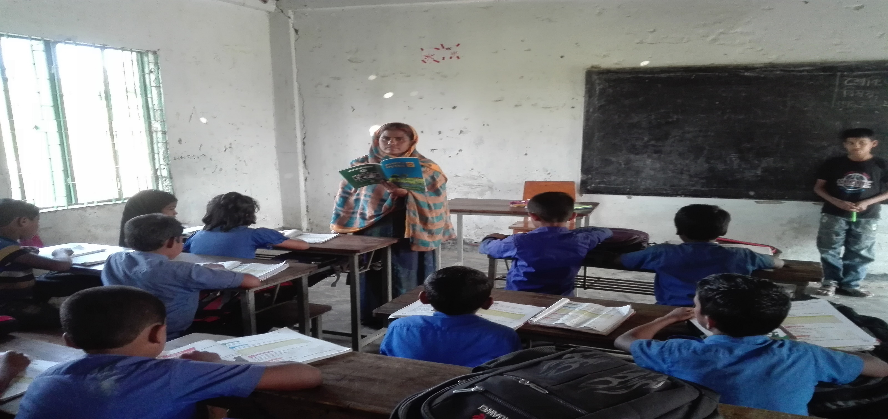
Teacher’s loud reading
Open your book page no. 38-39 (My home district is kishoreganj is ……………….love my home district.

Slide 13
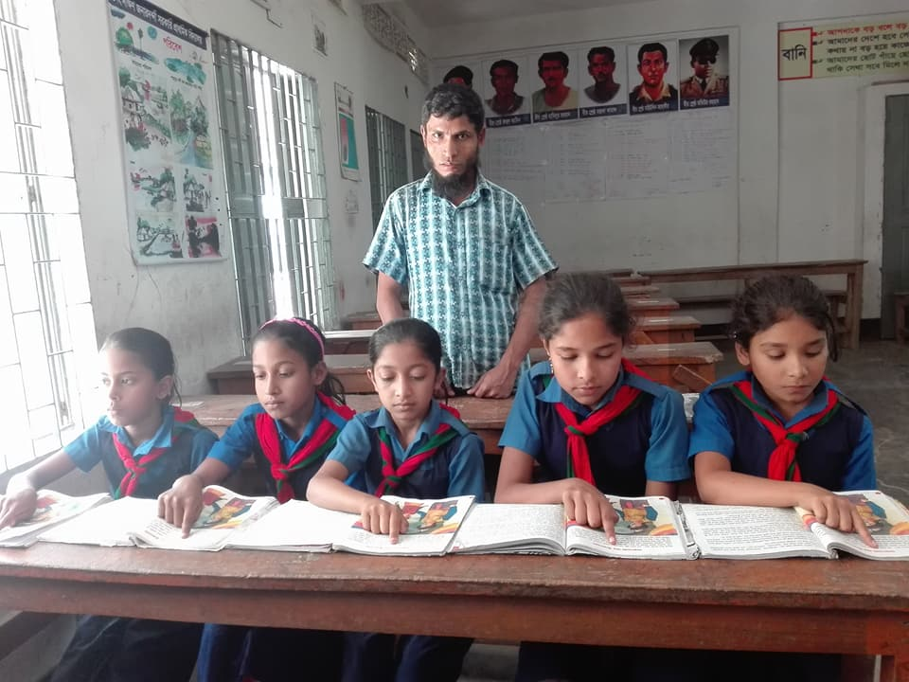
Student’s silent reading

Slide 14
Fill in the gap with suitable words given below.
Pair work
through
Solakia
district
upazila
Egaroshindhur
landlord
writer
municipality
a) The area of Kishoreganj …………………… is about 10 square kilometeres.
b) Nandakishore Pramanik is a ………….
c) Kishoreganj is a ……………….headquarter.
d) Many people come to ………………….. For Eid prayer.
e) The river Narasunda flows ………………the kishoreganj town.

Slide 15
Individual work
Write ‘True’ for correct statement or ‘False’ for incorrect statement.
a) Kishoreganj is about 108 kilometers from Dhaka.
False
b) There are 8 upazilas in Kishoreganj district.
False
c) Solakia is the largest Eid fairground.
True
d) Sukumar Roy wrote for the children.
True
e) Zainal abedin was a famous writer.
False
f) Chandrabati was the first woman poet of Bangla literature.
True

Slide 16
Pair work
Click me

Slide 17
Group Work
Answer the following questions in a sentence or sentences
a) How many villages are there in Kishoreganj district?
b) How does the name ‘Kishoreganj’ come from?
c) What can you see outside the Kishoreganj town? Write any two.
d) Write the name of the famous persons of Kishoreganj.
e) What is the name of the first acting President of Bangladesh.
f) Why do you love your home district? Write in three sentences.

Slide 18
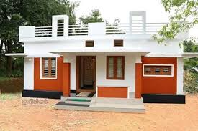
Home work
Write a short composition about your home district at least five sentences.

Slide 19
GOOD BYE. SEE AGAIN.THANKS TO EVERYBODY.

